Slide 1
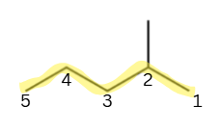
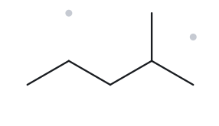



PART A · STRUCTURE → NAME · FOUNDATION
CARD A01
Molecular formula: C₆H₁₄
UPPER LEFT
UPPER RIGHT
1. Numbered parent
2. Naming trail
Parent: the longest chain is 5 C, so pentane.
Numbering: a methyl sits on the second carbon from one end (2), but on the fourth from the other (4). 2 is lower.
Substituents: methyl on C2.
LOWER LEFT
LOWER RIGHT
3. NAME
4. The Alkane check
2-methylpentane
VERIFICATION STRIP
☐ longest chain/ring ☐ lowest locants ☐ alphabetical order ☐ punctuation ☐ formula counted

Slide 2
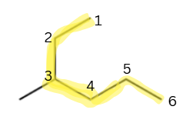
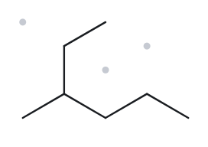

PART A · STRUCTURE → NAME · FOUNDATION
CARD A02
Molecular formula: C₇H₁₆
UPPER LEFT
UPPER RIGHT
1. Numbered parent
2. Naming trail
Parent: the longest chain bends through the branch point, going from the end of the ethyl arm to the end of the 3-carbon arm. That is 6 C, so hexane.
Numbering: from the ethyl end, the branch carbon is C3. From the other end, it is C4. 3 is lower.
Substituents: methyl on C3. (The one-carbon arm is the methyl.)
LOWER LEFT
LOWER RIGHT
3. NAME
4. The Alkane check
3-methylhexane
VERIFICATION STRIP
☐ longest chain/ring ☐ lowest locants ☐ alphabetical order ☐ punctuation ☐ formula counted

Slide 3
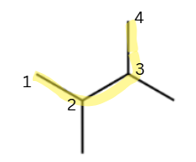
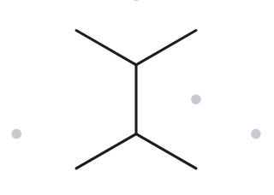

PART A · STRUCTURE → NAME · FOUNDATION
CARD A03
Molecular formula: C₆H₁₄
UPPER LEFT
UPPER RIGHT
1. Numbered parent
2. Naming trail
Parent: the longest chain is 4 C, so butane. The two adjacent branch carbons are C2 and C3.
Numbering: {2,3} from either end.
Substituents: methyl on C2 and methyl on C3, so use di-.
LOWER LEFT
LOWER RIGHT
3. NAME
4. The Alkane check
2,3-dimethylbutane
VERIFICATION STRIP
☐ longest chain/ring ☐ lowest locants ☐ alphabetical order ☐ punctuation ☐ formula counted

Slide 4
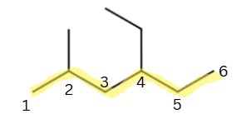
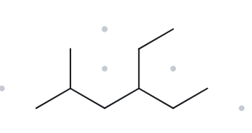

PART A · STRUCTURE → NAME · DEVELOPING
CARD A04
Molecular formula: C₉H₂₀
UPPER LEFT
UPPER RIGHT
1. Numbered parent
2. Naming trail
Parent: the longest chain is 6 C (several equal paths exist), so hexane. All of them carry one methyl and one ethyl.
Numbering: one direction gives {2,4}, the other gives {3,5}. 2 < 3, so use {2,4}.
Substituents: methyl on C2, ethyl on C4. Ethyl is cited first alphabetically.
LOWER LEFT
LOWER RIGHT
3. My name (written first)
4. The Alkane check
4-ethyl-2-methylhexane
VERIFICATION STRIP
☐ longest chain/ring ☐ lowest locants ☐ alphabetical order ☐ punctuation ☐ formula counted

Slide 5
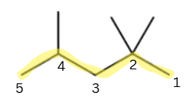
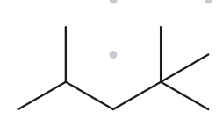

PART A · STRUCTURE → NAME · DEVELOPING
CARD A05
Molecular formula: C₈H₁₈
UPPER LEFT
UPPER RIGHT
1. Numbered parent
2. Naming trail
Parent: the longest chain is 5 C, so pentane.
Numbering: one direction gives {2,2,4}, the other gives {2,4,4}. At the second term, 2 < 4.
Substituents: two methyls on C2 and one methyl on C4, so use tri-.
LOWER LEFT
LOWER RIGHT
3. NAME
4. The Alkane check
2,2,4-trimethylpentane
VERIFICATION STRIP
☐ longest chain/ring ☐ lowest locants ☐ alphabetical order ☐ punctuation ☐ formula counted

Slide 6
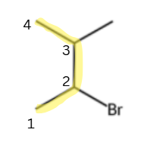
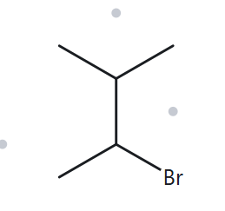

PART A · STRUCTURE → NAME · DEVELOPING
CARD A06
Molecular formula: C₅H₁₁Br
UPPER LEFT
UPPER RIGHT
1. Numbered parent
2. Naming trail
Parent: the longest chain is 4 C, so butane.
Numbering: {2,3} from either end, so it is a tie. Bromo comes before methyl alphabetically, so bromo gets C2.
Substituents: bromo on C2, methyl on C3.
LOWER LEFT
LOWER RIGHT
3. NAME
4. The Alkane check
2-bromo-3-methylbutane
VERIFICATION STRIP
☐ longest chain/ring ☐ lowest locants ☐ alphabetical order ☐ punctuation ☐ formula counted

Slide 7
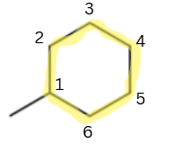
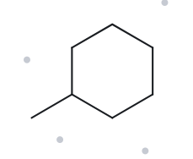
PART A · STRUCTURE → NAME · DEVELOPING
CARD A07
Molecular formula: C₇H₁₄
UPPER LEFT
UPPER RIGHT
1. Numbered parent
2. Naming trail
Parent: the ring is the parent, with 6 C, so cyclohexane.
Numbering: only one substituent, so no locant is needed.
Substituents: methyl.
LOWER LEFT
LOWER RIGHT
3. NAME
4. The Alkane check
methylcyclohexane
VERIFICATION STRIP
☐ longest chain/ring ☐ lowest locants ☐ alphabetical order ☐ punctuation ☐ formula counted

Slide 8
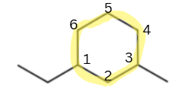
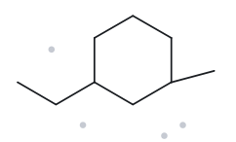

PART A · STRUCTURE → NAME · CHALLENGE
CARD A08
Molecular formula: C₉H₁₈
UPPER LEFT
UPPER RIGHT
1. Numbered parent
2. Naming trail
Parent: the ring, cyclohexane.
Numbering: the two substituents are separated by one ring carbon, so the locants are {1,3} either way round. Tie, so alphabetical order decides. Ethyl gets C1.
Substituents: ethyl on C1, methyl on C3.
LOWER LEFT
LOWER RIGHT
3. NAME
4. The Alkane check
1-ethyl-3-methylcyclohexane
VERIFICATION STRIP
☐ longest chain/ring ☐ lowest locants ☐ alphabetical order ☐ punctuation ☐ formula counted

Slide 9
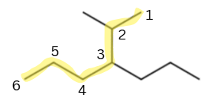
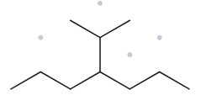

PART A · STRUCTURE → NAME · CHALLENGE
CARD A09
Molecular formula: C₁₀H₂₂
UPPER LEFT
UPPER RIGHT
1. Numbered parent
2. Naming trail
Parent: trace from one methyl of the isopropyl group, through its CH and the branch carbon, then down the right-hand side. That is 6 C, so hexane.
Substituents: the other methyl of the isopropyl group is on the second carbon of this chain. The left-hand arm of the original zigzag (3 carbons) is a propyl on the third carbon.
Numbering: from the isopropyl end the locants are {2,3}. From the other end they are {4,5}. {2,3} wins.
Alphabetical order: methyl before propyl.
LOWER LEFT
LOWER RIGHT
3. NAME
4. The Alkane check
2-methyl-3-propylhexane
VERIFICATION STRIP
☐ longest chain/ring ☐ lowest locants ☐ alphabetical order ☐ punctuation ☐ formula counted

Slide 10



PART A · STRUCTURE → NAME · CHALLENGE
CARD A10
Molecular formula: C₈H₁₆
UPPER LEFT
UPPER RIGHT
1. Numbered parent
2. Naming trail
Parent: the ring is the parent, with 3 C, so cyclopropane. The straight tail has 5 C, which is longer than the ring, but this activity always takes the ring as the parent.
Numbering: only one substituent, so no locant is needed.
Substituents: a 5-carbon straight chain, pentyl.
LOWER LEFT
LOWER RIGHT
3. NAME
4. The Alkane check
pentylcyclopropane
VERIFICATION STRIP
☐ longest chain/ring ☐ lowest locants ☐ alphabetical order ☐ punctuation ☐ formula counted

Slide 11
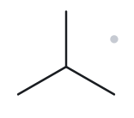

PART B · NAME → STRUCTURE · FOUNDATION
CARD B01
Given name: 2-methylpropane
UPPER LEFT
UPPER RIGHT
1. Name decoded
2. Bond-line structure (The Alkane)
Parent: propane → a 3-carbon chain.
Substituents: methyl on C2.
Expected formula: 3 + 1 = 4 C; open chain → C₄H₁₀
LOWER LEFT
LOWER RIGHT
3. Formula check
4. Back-check
Counted from the drawing: C₄H₁₀
Open chain: CₙH₂ₙ₊₂ = C₄H₁₀ ✓
Returned by The Alkane: 2-methylpropane. ✓ Same as the given name.
✓ parent length matches | ✓ substituent positions match | ✓ formula agrees | ✓ back-check recorded
VERIFICATION STRIP
☐ parent length ☐ substituent positions ☐ formula agrees ☐ back-check recorded

Slide 12
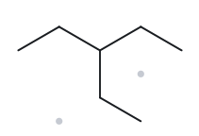

PART B · NAME → STRUCTURE · FOUNDATION
CARD B02
Given name: 3-ethylpentane
UPPER LEFT
UPPER RIGHT
1. Name decoded
2. Bond-line structure (The Alkane)
Parent: pentane → a 5-carbon chain.
Substituents: ethyl on C3.
Expected formula: 5 + 2 = 7 C; open chain → C₇H₁₆
LOWER LEFT
LOWER RIGHT
3. Formula check
4. Back-check
Counted from the drawing: C₇H₁₆
Open chain: CₙH₂ₙ₊₂ = C₇H₁₆ ✓
Returned by The Alkane: 3-ethylpentane. ✓ Same as the given name.
parent length matches | ✓ substituent positions match | ✓ formula agrees | ✓ back-check recorded
VERIFICATION STRIP
☐ parent length ☐ substituent positions ☐ formula agrees ☐ back-check recorded

Slide 13
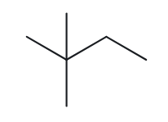
PART B · NAME → STRUCTURE · FOUNDATION
CARD B03
Given name: 2,2-dimethylbutane
UPPER LEFT
UPPER RIGHT
1. Name decoded
2. Bond-line structure (The Alkane)
Parent: butane → a 4-carbon chain.
Substituents: two methyls (dimethyl) on C2.
Expected formula: 4 + 2 = 6 C; open chain → C₆H₁₄
[cropped screenshot of your drawing]
LOWER LEFT
LOWER RIGHT
3. Formula check
4. Back-check
Counted from the drawing: C₆H₁₄
Open chain: CₙH₂ₙ₊₂ = C₆H₁₄ ✓
Returned by The Alkane: 2,2-dimethylbutane. ✓ Same as the given name.
✓ parent length matches | ✓ substituent positions match | ✓ formula agrees | ✓ back-check recorded
VERIFICATION STRIP
☐ parent length ☐ substituent positions ☐ formula agrees ☐ back-check recorded

Slide 14
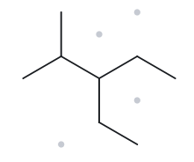

PART B · NAME → STRUCTURE · DEVELOPING
CARD B04
Given name: 3-ethyl-2-methylpentane
UPPER LEFT
UPPER RIGHT
1. Name decoded
2. Bond-line structure (The Alkane)
Parent: pentane → a 5-carbon chain.
Substituents: methyl on C2; ethyl on C3.
Expected formula: 5 + 1 + 2 = 8 C; open chain → C₈H₁₈
LOWER LEFT
LOWER RIGHT
3. Formula check
4. Back-check
Counted from the drawing: C₈H₁₈
Open chain: CₙH₂ₙ₊₂ = C₈H₁₈ ✓
Returned by The Alkane: 3-ethyl-2-methylpentane. ✓ Same as the given name.
✓ parent length matches | ✓ substituent positions match | ✓ formula agrees | ✓ back-check recorded
VERIFICATION STRIP
☐ parent length ☐ substituent positions ☐ formula agrees ☐ back-check recorded

Slide 15
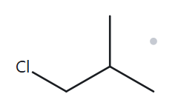
PART B · NAME → STRUCTURE · DEVELOPING
CARD B05
Given name: 1-chloro-2-methylpropane
UPPER LEFT
UPPER RIGHT
1. Name decoded
2. Bond-line structure (The Alkane)
Parent: propane → a 3-carbon chain.
Substituents: chloro on C1; methyl on C2.
Expected formula: 3 + 1 = 4 C; open chain → C₄H₁₀; Cl replaces one H → C₄H₉Cl
LOWER LEFT
LOWER RIGHT
3. Formula check
4. Back-check
Counted from the drawing: C₄H₉Cl
Open chain: CₙH₂ₙ₊₂ = C₄H₁₀; minus one H for Cl = C₄H₉Cl ✓
Returned by The Alkane; 1-chloro-2-methylpropane. ✓ Same as the given name.
✓ parent length matches | ✓ substituent positions match | ✓ formula agrees | ✓ back-check recorded
VERIFICATION STRIP
☐ parent length ☐ substituent positions ☐ formula agrees ☐ back-check recorded

Slide 16
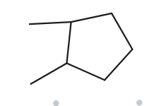

PART B · NAME → STRUCTURE · DEVELOPING
CARD B06
Given name: 1,2-dimethylcyclopentane
UPPER LEFT
UPPER RIGHT
1. Name decoded
2. Bond-line structure (The Alkane)
Parent: cyclopentane → a 5-carbon ring.
Substituents: methyl on C1; methyl on C2.
Expected formula: 5 + 2 = 7 C; one ring → C₇H₁₄
]
LOWER LEFT
LOWER RIGHT
3. Formula check
4. Back-check
Returned by The Alkane: 1,2-dimethylcyclopentane. ✓ Same as the given name.
✓ parent length matches | ✓ substituent positions match | ✓ formula agrees | ✓ back-check recorded
Counted from the drawing: C₇H₁₄
One ring: CₙH₂ₙ = C₇H₁₄ ✓
VERIFICATION STRIP
☐ parent length ☐ substituent positions ☐ formula agrees ☐ back-check recorded

Slide 17
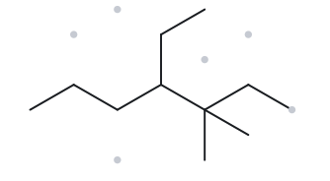

PART B · NAME → STRUCTURE · DEVELOPING
CARD B07
Given name: 4-ethyl-3,3-dimethylheptane
UPPER LEFT
UPPER RIGHT
1. Name decoded
2. Bond-line structure (The Alkane)
Parent: heptane → a 7-carbon chain.
Substituents: two methyls (dimethyl) on C3; ethyl on C4.
Expected formula: 7 + 2 + 2 = 11 C; open chain → C₁₁H₂₄
[cropped screenshot of your drawing]
LOWER LEFT
LOWER RIGHT
3. Formula check
4. Back-check
Counted from the drawing: C₁₁H₂₄
Open chain: CₙH₂ₙ₊₂ = C₁₁H₂₄ ✓
4-ethyl-3,3-dimethylheptane. ✓ Same as the given name.
✓ parent length matches | ✓ substituent positions match | ✓ formula agrees | ✓ back-check recorded
VERIFICATION STRIP
☐ parent length ☐ substituent positions ☐ formula agrees ☐ back-check recorded

Slide 18
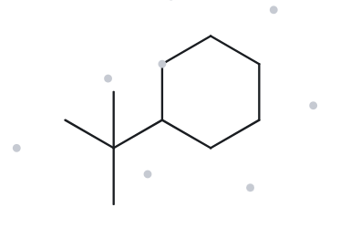

PART B · NAME → STRUCTURE · CHALLENGE
CARD B08
Given name: tert-butylcyclohexane
UPPER LEFT
UPPER RIGHT
1. Name decoded
2. Bond-line structure (The Alkane)
Parent: cyclohexane → a 6-carbon ring.
Substituents: tert-butyl on C1 (one carbon bearing three methyls = 4 C).
Expected formula: 6 + 4 = 10 C; one ring → C₁₀H₂₀
]
LOWER LEFT
LOWER RIGHT
3. Formula check
4. Back-check
Counted from the drawing: C₁₀H₂₀
One ring: CₙH₂ₙ = C₁₀H₂₀ ✓
The Alkane will likely return (1,1-dimethylethyl)cyclohexane. ✓ Same compound as the given name, written with a different accepted name for the group (Appendix B.3). Say this on the card.
✓ parent length matches | ✓ substituent positions match | ✓ formula agrees | ✓ back-check recorded
VERIFICATION STRIP
☐ parent length ☐ substituent positions ☐ formula agrees ☐ back-check recorded

Slide 19
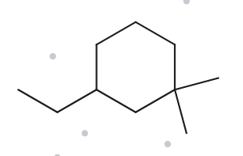

PART B · NAME → STRUCTURE · CHALLENGE
CARD B09
Given name: 3-ethyl-1,1-dimethylcyclohexane
UPPER LEFT
UPPER RIGHT
1. Name decoded
2. Bond-line structure (The Alkane)
Parent: cyclohexane → a 6-carbon ring.
Substituents: two methyls (dimethyl) on C1; ethyl on C3.
Expected formula: 6 + 2 + 2 = 10 C; one ring → C₁₀H₂₀
LOWER LEFT
LOWER RIGHT
3. Formula check
4. Back-check
Counted from the drawing: C₁₀H₂₀
One ring: CₙH₂ₙ = C₁₀H₂₀ ✓
3-ethyl-1,1-dimethylcyclohexane. ✓ Same as the given name. The locant set {1,1,3} beats {1,3,3}.
✓ parent length matches | ✓ substituent positions match | ✓ formula agrees | ✓ back-check recorded
VERIFICATION STRIP
☐ parent length ☐ substituent positions ☐ formula agrees ☐ back-check recorded

Slide 20
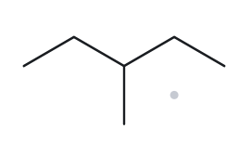

PART B · NAME → STRUCTURE · CHALLENGE
CARD B10
Given name: 2-ethylbutane (deliberately incorrect name)
UPPER LEFT
UPPER RIGHT
1. Name decoded
2. Bond-line structure (The Alkane)
Parent: butane → a 4-carbon chain.
Substituents: ethyl on C2.
Expected formula: 4 + 2 = 6 C; open chain → C₆H₁₄
LOWER LEFT
LOWER RIGHT
3. Formula check
4. Back-check
3-methylpentane, so this is ✗ against the given name.
Correct name: 3-methylpentane.
Rule broken: the parent must be the longest continuous chain. The ethyl branch extends the chain to 5 carbons, and the leftover carbon becomes a methyl on C3.
✓ parent length matches | ✓ substituent positions match | ✓ formula agrees | ✓ back-check recorded (record both names)
Counted from the drawing: C₆H₁₄
Open chain: CₙH₂ₙ₊₂ = C₆H₁₄ ✓
VERIFICATION STRIP
☐ parent length ☐ substituent positions ☐ formula agrees ☐ back-check recorded

