Slide 1

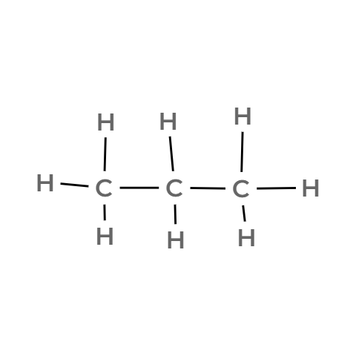


CARD 01 — PROPANE
Molecular Formula: C₃H₈
1. MOLECULAR FORMULA
2. LEWIS STRUCTURE
[place formula here]
[insert digital Lewis structure here]
3. CONDENSED STRUCTURAL FORMULA
4. BOND-LINE FORMULA (KETCHER)
[place condensed formula here]
[insert exported Ketcher structure here]
☐ atom count verified ☐ valence checked ☐ bond order checked ☐ same connectivity confirmed

Slide 2
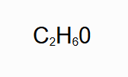
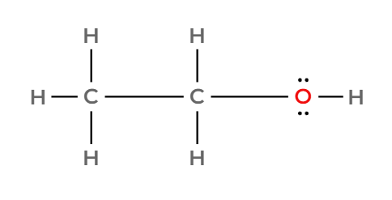
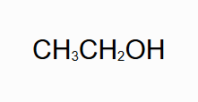
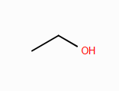
CARD 02 — ETHANOL
Molecular Formula: C₂H₆O
1. MOLECULAR FORMULA
2. LEWIS STRUCTURE
[place formula here]
[insert digital Lewis structure here]
3. CONDENSED STRUCTURAL FORMULA
4. BOND-LINE FORMULA (KETCHER)
[place condensed formula here]
[insert exported Ketcher structure here]
☐ atom count verified ☐ valence checked ☐ bond order checked ☐ same connectivity confirmed

Slide 3
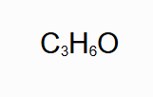
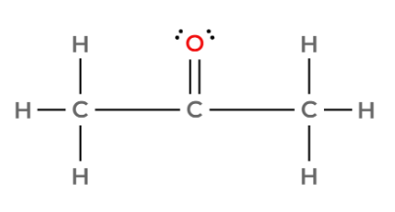
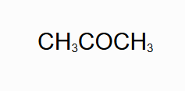
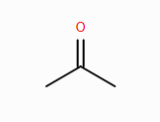
CARD 03 — ACETONE (PROPAN-2-ONE)
Molecular Formula: C₃H₆O
1. MOLECULAR FORMULA
2. LEWIS STRUCTURE
[place formula here]
[insert digital Lewis structure here]
3. CONDENSED STRUCTURAL FORMULA
4. BOND-LINE FORMULA (KETCHER)
[place condensed formula here]
[insert exported Ketcher structure here]
☐ atom count verified ☐ valence checked ☐ bond order checked ☐ same connectivity confirmed

Slide 4
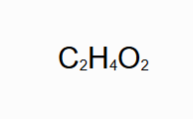
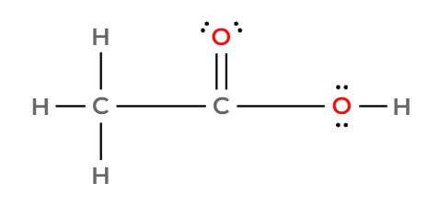
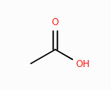
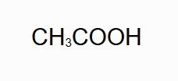
CARD 04 — ACETIC ACID (ETHANOIC ACID)
Molecular Formula: C₂H₄O₂
1. MOLECULAR FORMULA
2. LEWIS STRUCTURE
[place formula here]
[insert digital Lewis structure here]
3. CONDENSED STRUCTURAL FORMULA
4. BOND-LINE FORMULA (KETCHER)
[place condensed formula here]
[insert exported Ketcher structure here]
☐ atom count verified ☐ valence checked ☐ bond order checked ☐ same connectivity confirmed

Slide 5

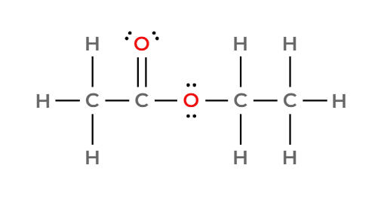
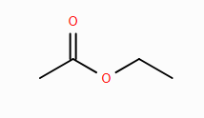

CARD 05 — ETHYL ACETATE (ETHYL ETHANOATE)
Molecular Formula: C₄H₈O₂
1. MOLECULAR FORMULA
2. LEWIS STRUCTURE
[place formula here]
[insert digital Lewis structure here]
3. CONDENSED STRUCTURAL FORMULA
4. BOND-LINE FORMULA (KETCHER)
[place condensed formula here]
[insert exported Ketcher structure here]
☐ atom count verified ☐ valence checked ☐ bond order checked ☐ same connectivity confirmed

Slide 6

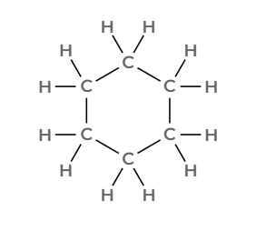
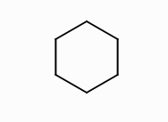
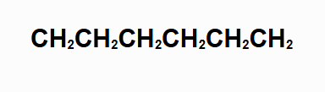
CARD 06 — CYCLOHEXANE
Molecular Formula: C₆H₁₂
1. MOLECULAR FORMULA
2. LEWIS STRUCTURE
[place formula here]
[insert digital Lewis structure here]
3. CONDENSED STRUCTURAL FORMULA
4. BOND-LINE FORMULA (KETCHER)
[place condensed formula here]
[insert exported Ketcher structure here]
☐ atom count verified ☐ valence checked ☐ bond order checked ☐ same connectivity confirmed

Slide 7

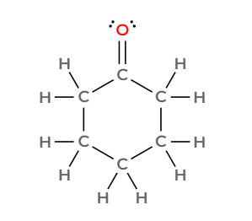

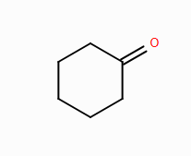
CARD 07 — CYCLOHEXANONE
Molecular Formula: C₆H₁₀O
1. MOLECULAR FORMULA
2. LEWIS STRUCTURE
[place formula here]
[insert digital Lewis structure here]
3. CONDENSED STRUCTURAL FORMULA
4. BOND-LINE FORMULA (KETCHER)
[place condensed formula here]
[insert exported Ketcher structure here]
☐ atom count verified ☐ valence checked ☐ bond order checked ☐ same connectivity confirmed

Slide 8

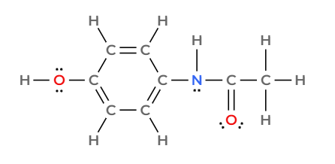
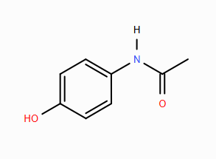

CARD 08 — ACETAMINOPHEN (PARACETAMOL)
Molecular Formula: C₈H₉NO₂
1. MOLECULAR FORMULA
2. LEWIS STRUCTURE
[place formula here]
[insert digital Lewis structure here]
3. CONDENSED STRUCTURAL FORMULA
4. BOND-LINE FORMULA (KETCHER)
[place condensed formula here]
[insert exported Ketcher structure here]
☐ atom count verified ☐ valence checked ☐ bond order checked ☐ same connectivity confirmed

Slide 9

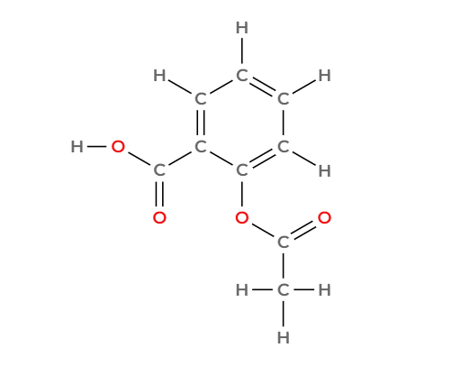
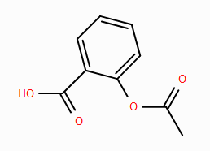
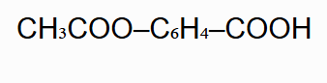
CARD 09 — ASPIRIN (ACETYLSALICYLIC ACID)
Molecular Formula: C₉H₈O₄
1. MOLECULAR FORMULA
2. LEWIS STRUCTURE
[place formula here]
[insert digital Lewis structure here]
3. CONDENSED STRUCTURAL FORMULA
4. BOND-LINE FORMULA (KETCHER)
[place condensed formula here]
[insert exported Ketcher structure here]
☐ atom count verified ☐ valence checked ☐ bond order checked ☐ same connectivity confirmed

Slide 10
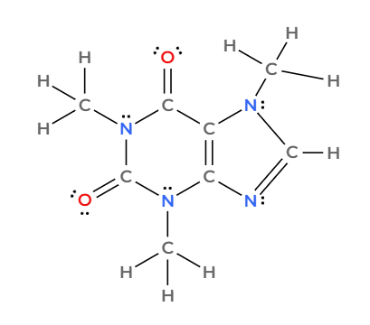
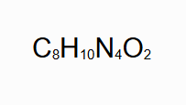
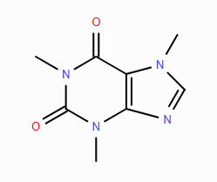
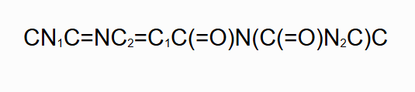
CARD 10 — CAFFEINE
Molecular Formula: C₈H₁₀N₄O₂
1. MOLECULAR FORMULA
2. LEWIS STRUCTURE
[place formula here]
[insert digital Lewis structure here]
3. CONDENSED STRUCTURAL FORMULA
4. BOND-LINE FORMULA (KETCHER)
[place condensed formula here]
[insert exported Ketcher structure here]
☐ atom count verified ☐ valence checked ☐ bond order checked ☐ same connectivity confirmed

