Slide 1
IndexedDB and Other Random…
Chad Michel

Slide 2
.NET Developer
Mostly a .NET guy
Most a relational DB guy
Nice to play with other technologies and ideas

Slide 3


Slide 4
Big changes in Web Development
Data on the client (local storage / IndexedDB)
Disconnected data (offline)
Pushing data to the client (web sockets)
Canvas
WebGL

Slide 5
JavaScript
Is JavaScript the current cool language?
C→C++→Java/C# → Ruby → JavaScript???
Really?

Slide 6
JavaScript
Crazy language to get your head around
Demo1 – Do something

Slide 7
IndexedDB
Very cool
Data at the client.
Why?
Performance
Offline
Offload work to client

Slide 8
IndexedDB
Demo2

Slide 9
IndexedDB
Not really here yet.
Still limited support
Probably still some bugs

Slide 10
What is IndexedDB?
Key / value store
Not relational
Transactional
Async (mostly)

Slide 11
Key Terms
Database – Contains many object stores. Has a version (int)
Object Store – Stores a bunch of link objects using a key
Request – a single read or write operation
Index – Way to look up objects in an object store

Slide 12
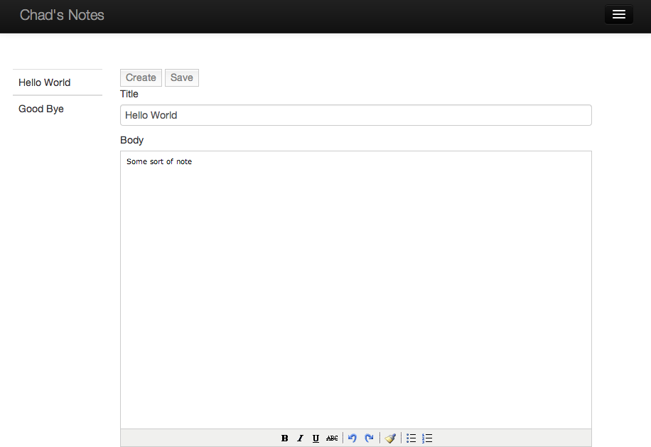
Some Stored Data

Slide 13
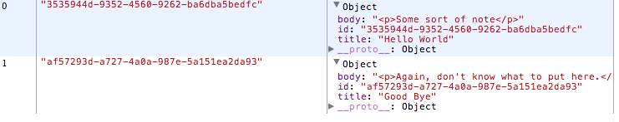
Some Stored Data

Slide 14
The SuperBasic Demo
Create a Database and an Object Store

Slide 15
Fail
Why were we not seeing anything?
File:// based paths are not supported ☹

Slide 16
We need a little hosting
Since we are going Full-JavaScript, lets go node.
Node allows for JavaScript on the server.

Slide 17
Node
Installing is easy
Nodejs.org
Use npm to install express and ejs
npm install express
npm install ejs
Use express to create a really basic site
express –e
Run the site
node app.js

Slide 18
IndexedDB + Node
Demo3working

Slide 19
Saving some stuff
Use put to save
Saving an object
Demo4

Slide 20
Getting some stuff
Use get to retrieve
More Demos…

Slide 21
Cleaning up a little
JQuery Deferred
Promises
Make async easier to read
Provides a consistent way to do async callbacks

Slide 22
Seque - rough
How about hosting node in Windows Azure?
Azure does this better than anything else ☺

Slide 23
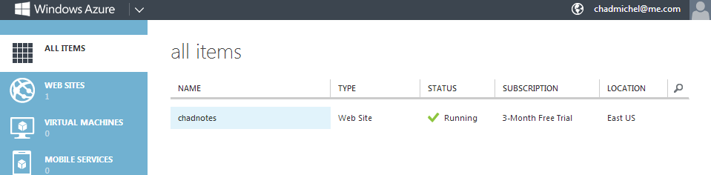
Azure Web Sites

Slide 24
Deploy straight from github
https://github.com/chadmichel/IndexedDBDemo.git
Runs at http://chadnotes.azurewebsites.net/

Slide 25
Disconnected?
Previous site works disconnected!
Disconnected Demo

Slide 26
Other cool things to explore

Slide 27
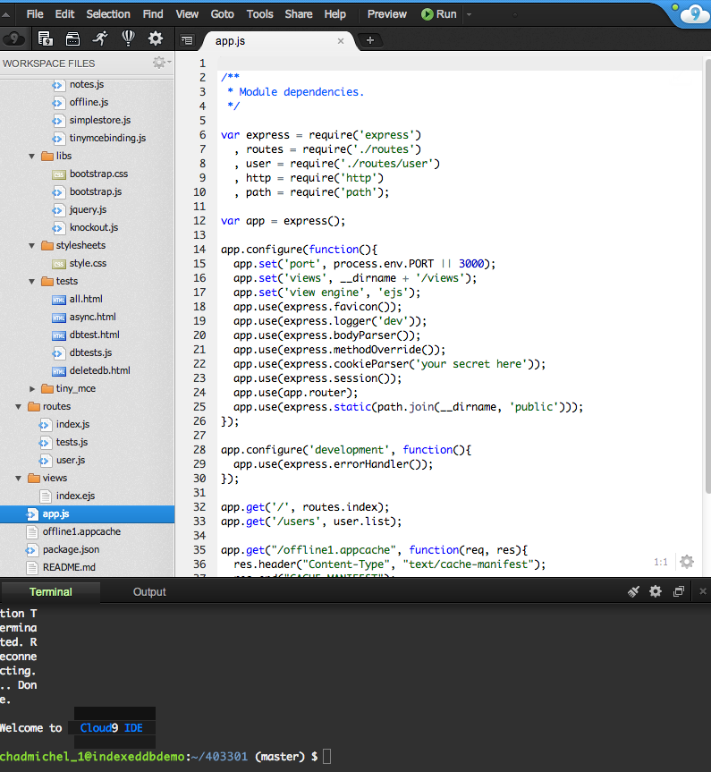
Cloud9

Slide 28
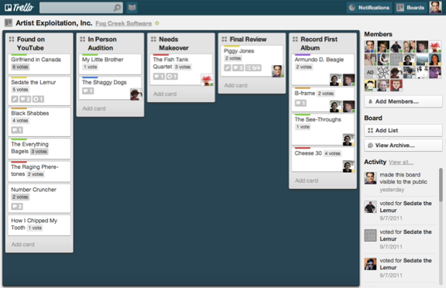
Trello

Slide 29
Push based architectures
Write now most sites pull for data
Github pulls about every 10 seconds
Ajax calls to retrieve data
Why not just push the changes to the active listeners?

