Slide 1
IndexedDB and Other Random…
Chad Michel

Slide 2
.NET Developer
Mostly a .NET guy
Most a relational DB guy
Nice to play with other technologies and ideas

Slide 3
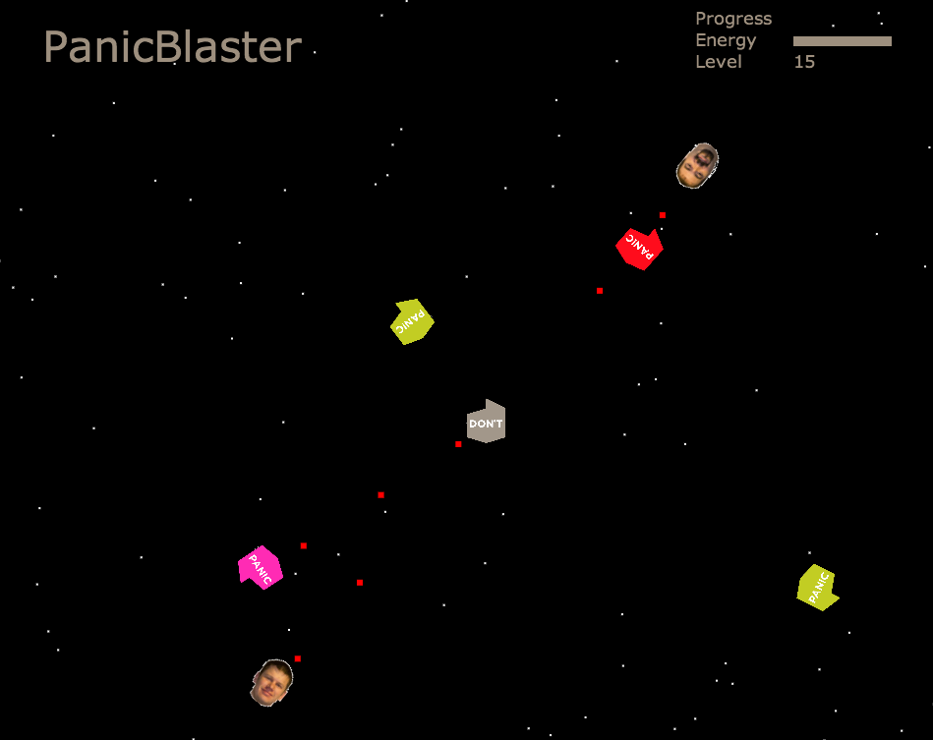

Slide 4
Big changes in Web Development
Data on the client
Disconnected data

Slide 5
JavaScript
Is JavaScript the current cool language?
C→C++→Java/C# → Ruby → JavaScript???
Really?

Slide 6
JavaScript
Crazy language to get your head around

