Slide 1
IndexedDB and Other Random…
Chad Michel

Slide 2
.NET Developer
Mostly a .NET guy
Most a relational DB guy
Nice to play with other technologies and ideas

Slide 3


Slide 4
Big changes in Web Development
Data on the client
Disconnected data
Pushing data to the client

Slide 5
JavaScript
Is JavaScript the current cool language?
C→C++→Java/C# → Ruby → JavaScript???
Really?

Slide 6
JavaScript
Crazy language to get your head around
Demo1 – Do something

Slide 7
IndexedDB
Very cool
Data at the client.
Why?
Performance
Offline
Offload work to client

Slide 8
IndexedDB
Demo2

Slide 9
IndexedDB
Not really here yet.
Still limited support
Probably still some bugs

Slide 10
What is IndexedDB?
Key / value store
Not relational
Transactional
Async (mostly)

Slide 11
Key Terms
Database – Contains many object stores. Has a version (int)
Object Store – Stores a bunch of link objects using a key
Request – a single read or write operation
Index – Way to look up objects in an object store

Slide 12
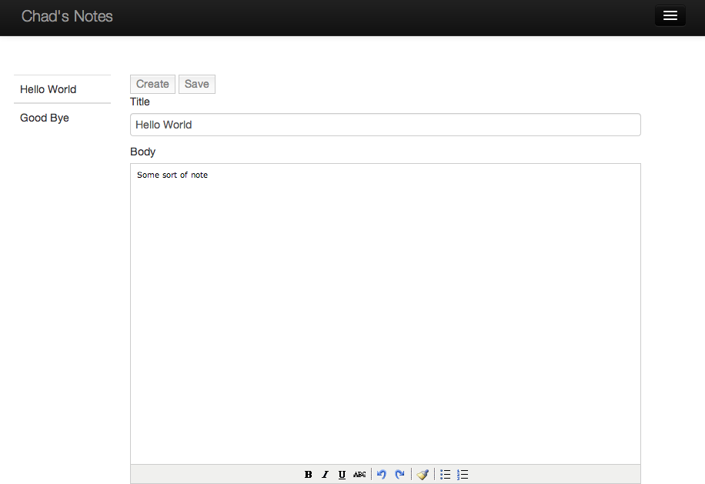
Some Stored Data

Slide 13
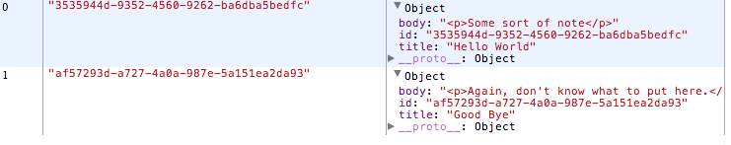
Some Stored Data

Slide 14
The SuperBasic Demo
Create a Database and an Object Store

