Slide 1
Debugging
Chad Michel
10/11/2016

Slide 2
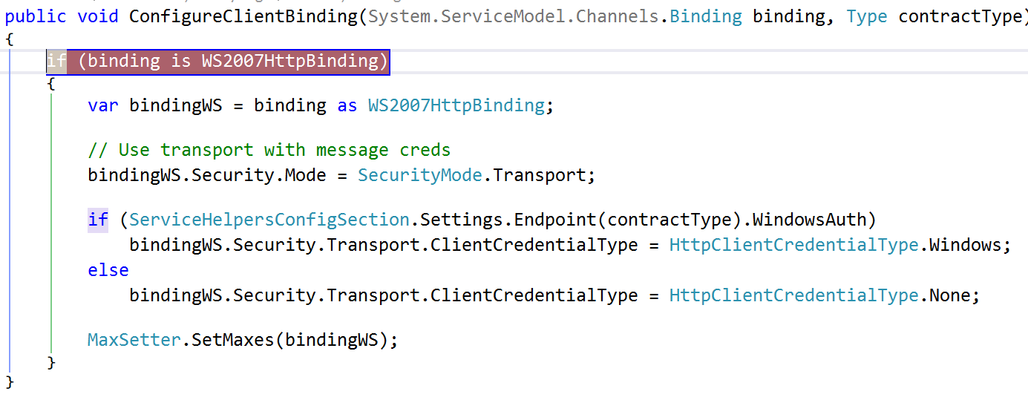

Slide 3
If debugging is the process of removing bugs, then programming must be the process of putting them in.
- Edsger W. Dijkstra

Slide 4
Debugging is twice as hard as writing the code in the first place. Therefore, if you write the code as cleverly as possible, you are, by definition, not smart enough to debug it.
- Brian Kernighan

Slide 5
Pillars of a happy developer
Great code
Great team
Great process
Great quality

Slide 6
Why do we want happy devs?
Happy Dev is Productive Dev

Slide 7
Pillars of a happy developer
Great code
Great team
Great process
Great quality

Slide 8
What makes Great Code?
Easy to navigate
Easy to run
Easy to test
Easy to change
Easy to debug

Slide 9
Why is debugging important for great code?
Devs need ability to step thru code
Devs need to be able to spelunk
Devs need to be able to find bugs

Slide 10
Debug
Almost all environments can be debugged
Windows
.NET
Java
Ruby
Python
JavaScript
Browser
node.js
Even DB

Slide 11
Pillars of a happy developer
Great code
Great team
Great process
Great quality

Slide 12
Desk checking
Walk thru all code before submitting it
Use the debugger
Steve McConnell – Code Complete

Slide 13
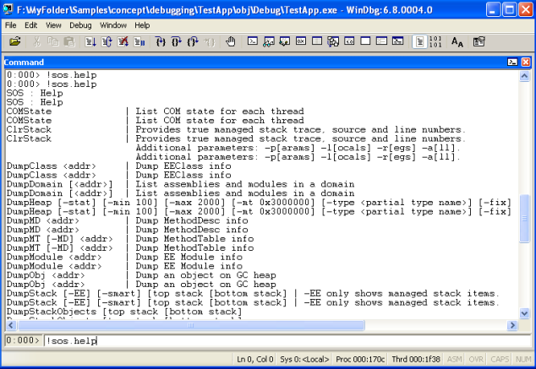
Examples - WinDbg
http://www.codeproject.com/Articles/23589/Get-Started-Debugging-Memory-Related-Issues-in-Net

Slide 14
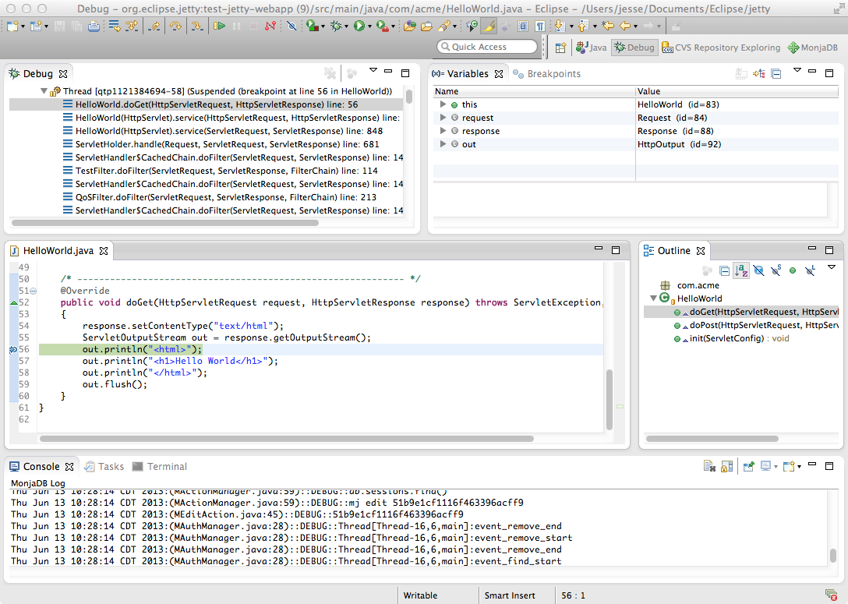
Examples - Eclipse
http://www.eclipse.org/jetty/documentation/9.4.x/debugging-with-eclipse.html

Slide 15
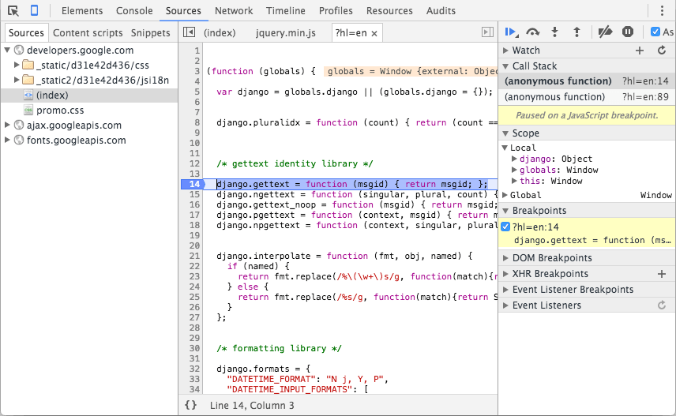
Examples – Chrome (JavaScript)
https://developers.google.com/web/tools/chrome-devtools/images/sources.png

Slide 16
Common Debugging Features
Breakpoints
Step into
Step over
Watch variables

Slide 17
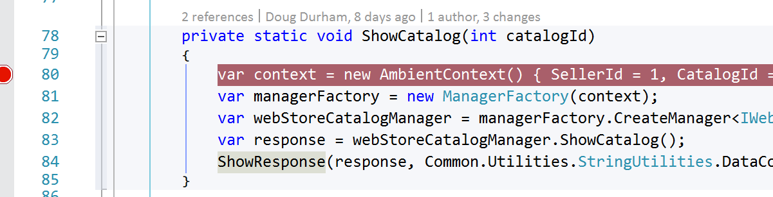
Breakpoints
F9 in VS

Slide 18
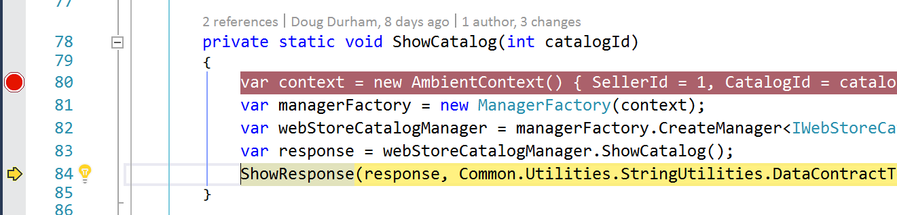
Step over
F10 in VS

Slide 19
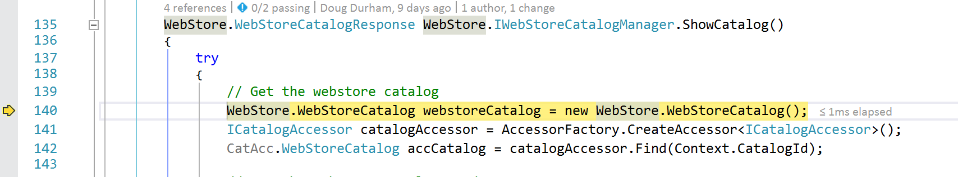
Step Into
F11 in VS

Slide 20
Step Out
Shift + F11

Slide 21
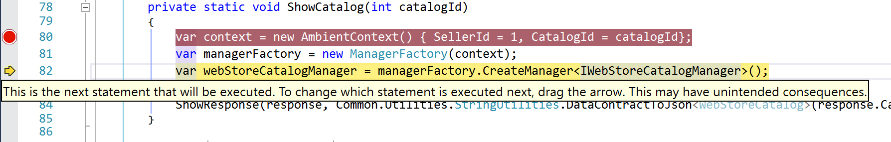
Move current executing line

Slide 22
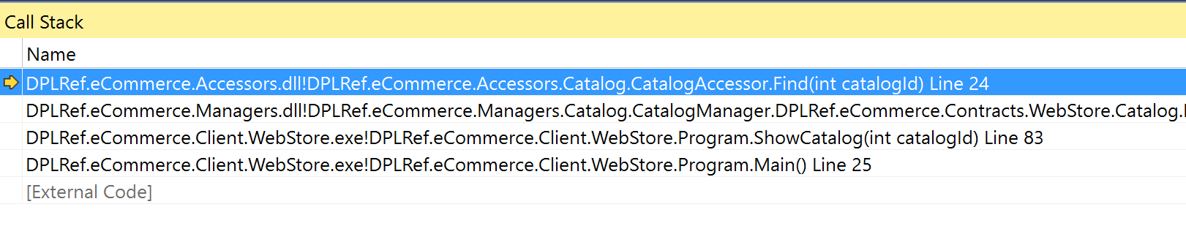
Call stacks

Slide 23
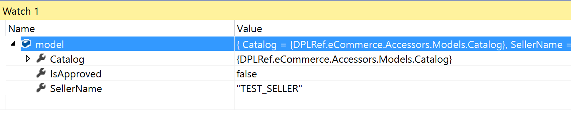
Watch

Slide 24
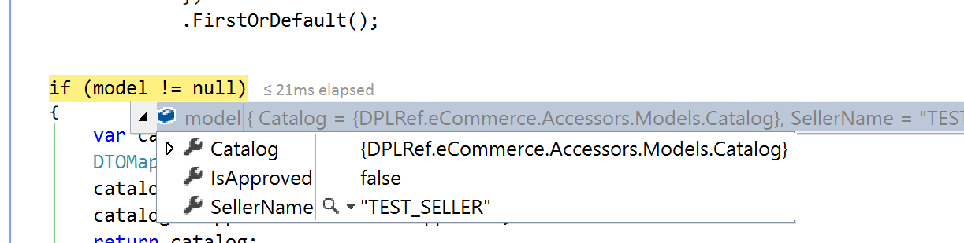
In line - Watch

Slide 25
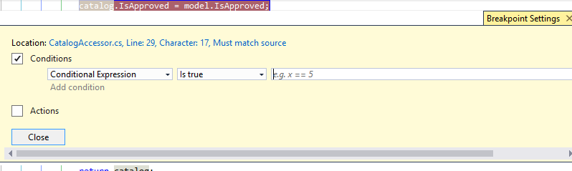
Conditional Breakpoints

Slide 26
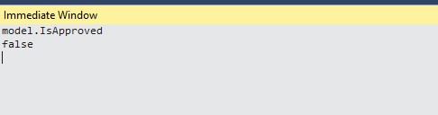
Immediate Window

Slide 27
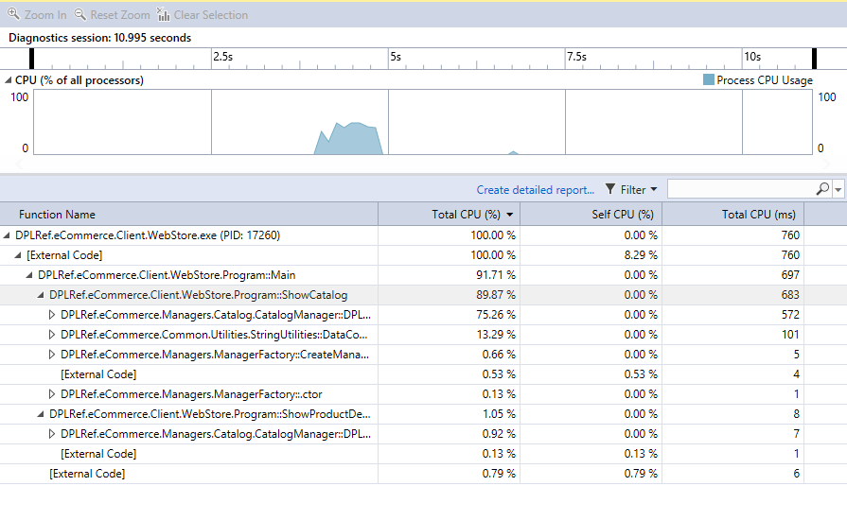
Performance Profiler

Slide 28
Uses for debugging
Find a bug
Desk checking
Spelunking…

Slide 29
https://github.com/chadmichel/Talks

