Slide 1
Debugging
Chad Michel
10/21/2016

Slide 2
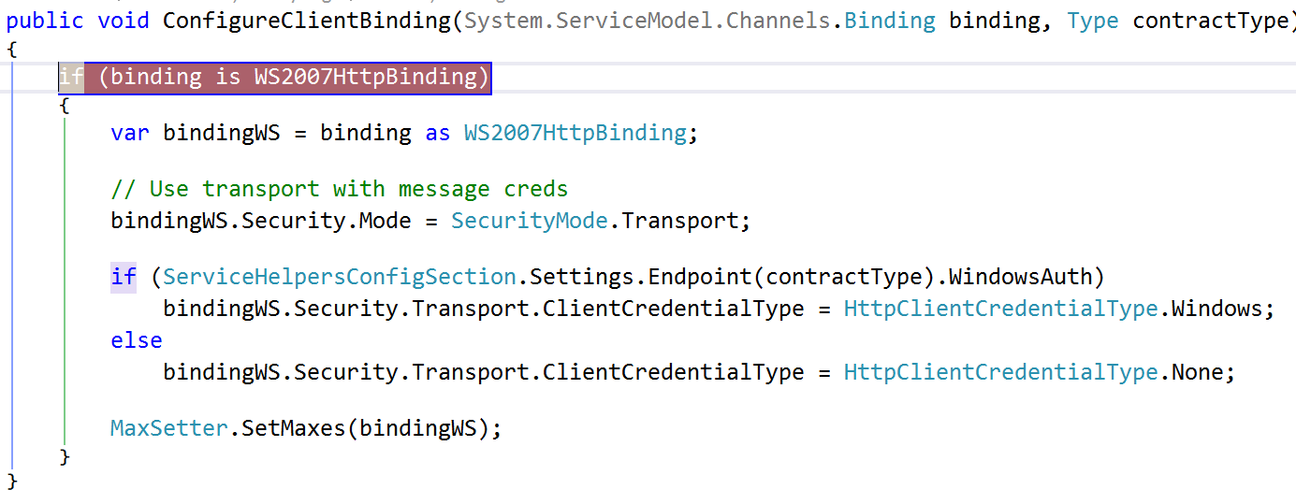

Slide 3
If debugging is the process of removing bugs, then programming must be the process of putting them in.
- Edsger W. Dijkstra

Slide 4
Debugging vs Using a Debugger
This talk will blur the lines…

Slide 5
Pillars of a happy developer
Great code
Great team
Great process
Great quality

Slide 6
Why do we want happy devs?
Happy Dev is Productive Dev

Slide 7
Pillars of a happy developer
Great code
Great team
Great process
Great quality

Slide 8
What makes Great Code?
Easy to navigate
Easy to run
Easy to test
Easy to change
Easy to debug

Slide 9
Why is debugging important for great code?
Devs need ability to step thru code
Devs need to be able to spelunk
Devs need to be able to find bugs

Slide 10
Debug
Almost all environments can be debugged
Windows
.NET
Java
Ruby
Python
JavaScript
Browser
node.js
Even DB

Slide 11
Pillars of a happy developer
Great code
Great team
Great process
Great quality

Slide 12
Desk checking
Walk thru all code before submitting it
Use the debugger
Steve McConnell – Code Complete

Slide 13
Finding bugs
Use debugger to reproduce bugs quickly

Slide 14
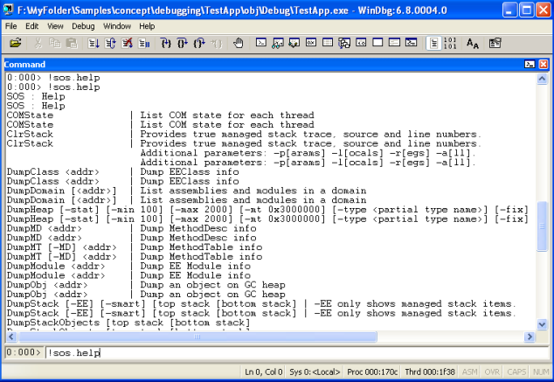
Examples - WinDbg
http://www.codeproject.com/Articles/23589/Get-Started-Debugging-Memory-Related-Issues-in-Net

Slide 15
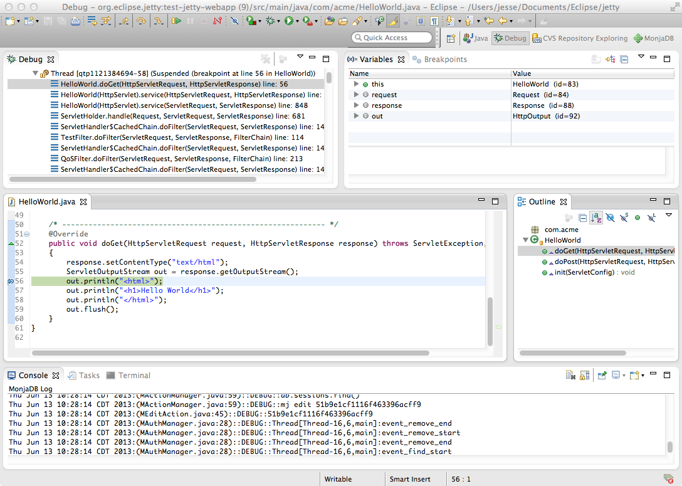
Examples - Eclipse
http://www.eclipse.org/jetty/documentation/9.4.x/debugging-with-eclipse.html

Slide 16
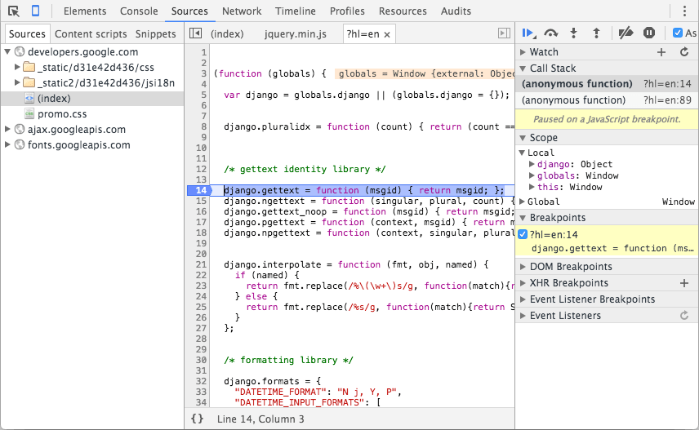
Examples – Chrome (JavaScript)
https://developers.google.com/web/tools/chrome-devtools/images/sources.png

Slide 17
Common Debugging Features
Breakpoints
Step into
Step over
Watch variables

Slide 18
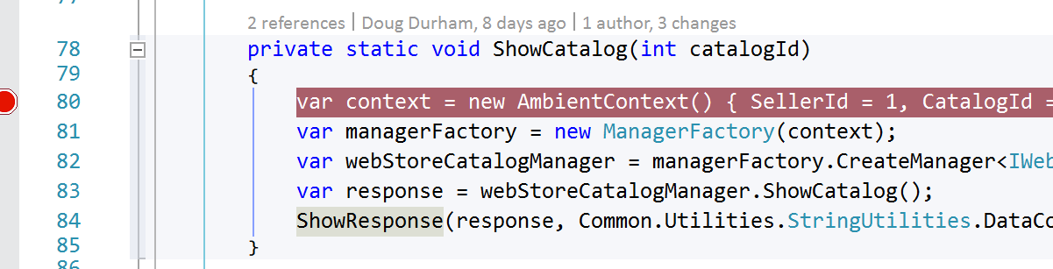
Breakpoints
F9 in VS

Slide 19
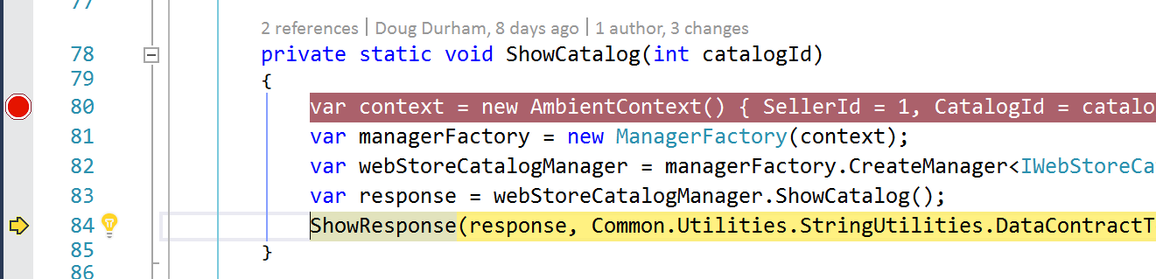
Step over
F10 in VS

Slide 20
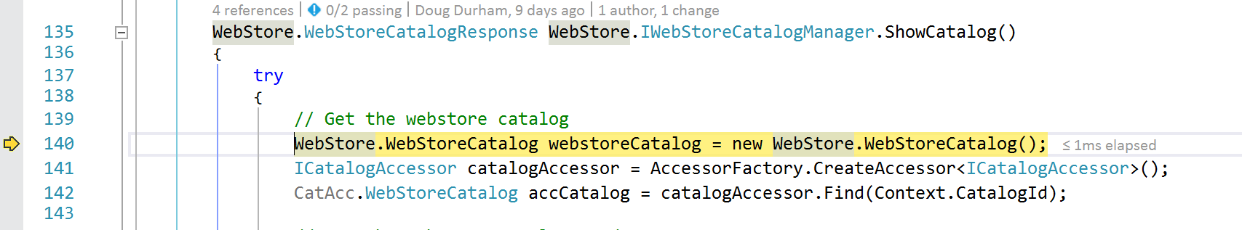
Step Into
F11 in VS

Slide 21
Step Out
Shift + F11

Slide 22
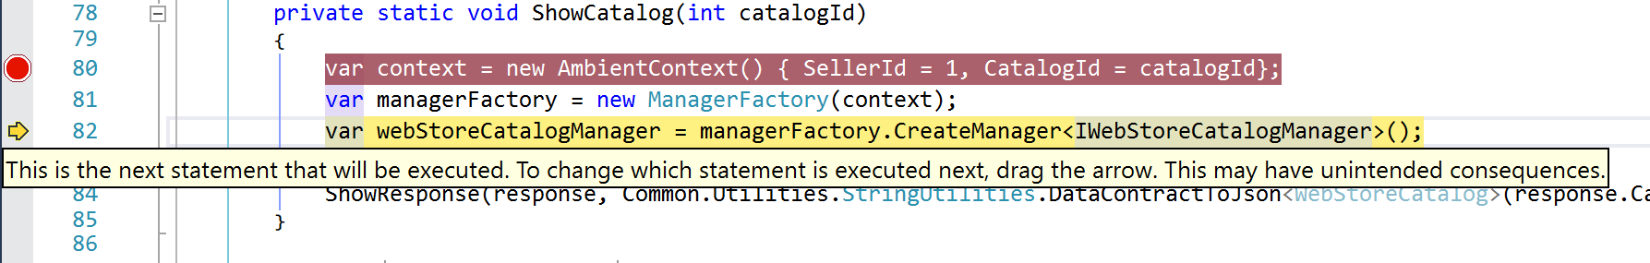
Move current executing line

Slide 23
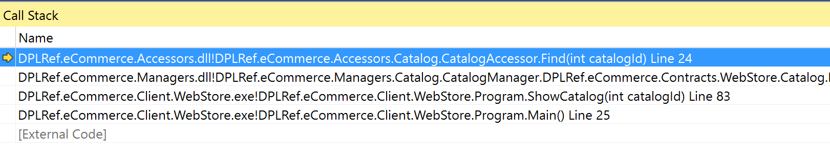
Call stacks

Slide 24
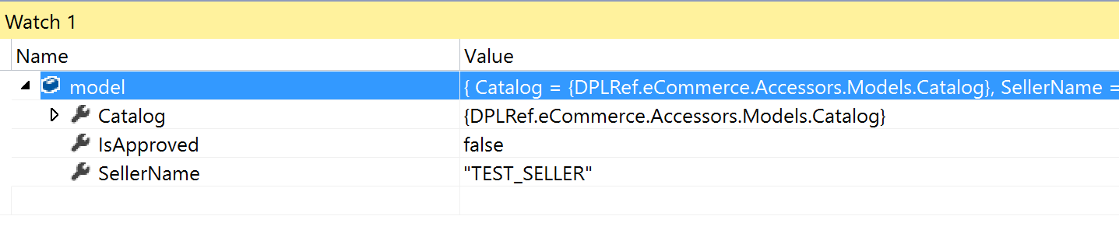
Watch

Slide 25
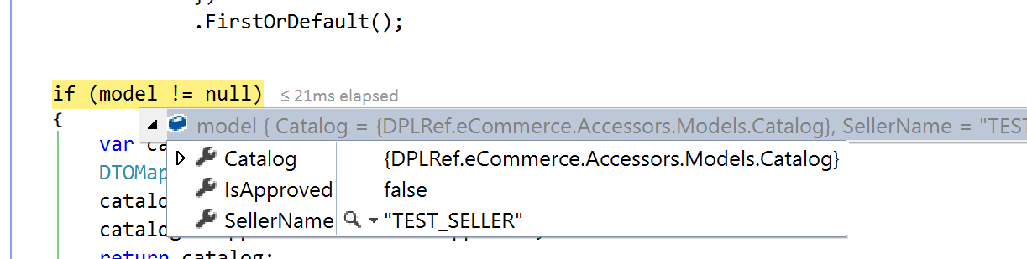
In line - Watch

Slide 26
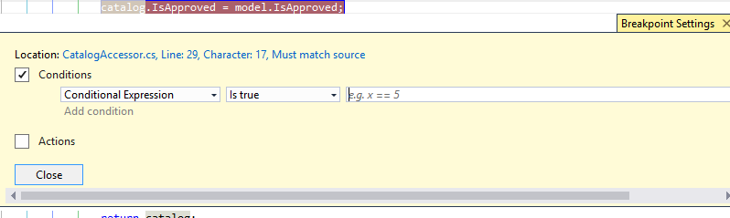
Conditional Breakpoints

Slide 27
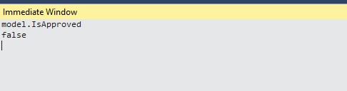
Immediate Window

Slide 28
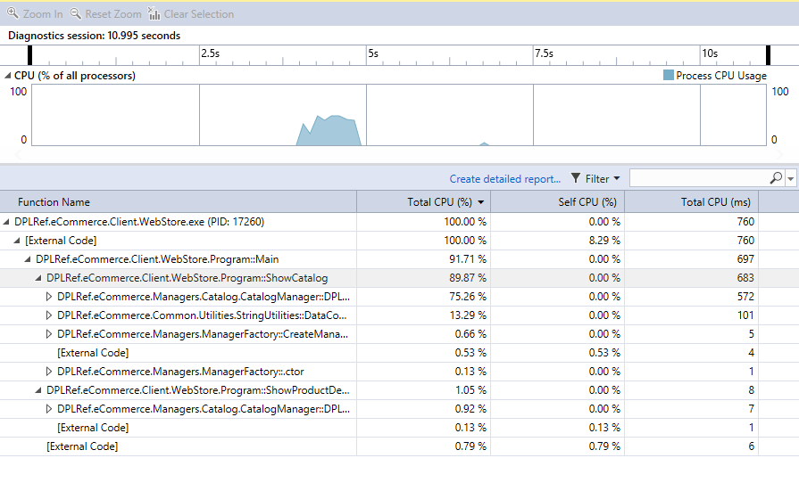
Performance Profiler

Slide 29
Uses for debugging
Find a bug
Desk checking
Spelunking…

Slide 30
Spelunking
UI Layer
Business
Logic
DB Layer

Slide 31
Demo…

Slide 32
Tips for Finding Bugs
Reproduce the bug with debugger enabled
Excellent logging
Step through all code before merging
Mock out parts of system
Unit test to reproduce the bug

Slide 33
Warning…
Don’t use debugger as an excuse not to think
Other ways to find bugs are better
Code Reviews / Design Reviews
Unit Tests
Integration Tests
Manual Tests

Slide 34
Debugging is twice as hard as writing the code in the first place. Therefore, if you write the code as cleverly as possible, you are, by definition, not smart enough to debug it.
- Brian Kernighan

Slide 35
https://github.com/chadmichel/Talks

