Slide 1
Funability
Doug Durham
Chad Michel

Slide 2
Why did we get into software development?
Rapid return on our effort
Work on tough problems
Build tools that people use
Enriching our lives
Building something innovative
Impacting people’s lives
Saving money / creating wealth
Automating complex activities

Slide 3
Problem is…
… the journey many of us are on to seek fulfillment of those goals has required enduring a lot of “pain” along the way.
Cool office spaces is not enough

Slide 4
The pain…
Swim through 5 layers of inheritance
12 hour product releases
6 weeks of stabilization
Estimates <> reality
Dreading project status reviews
Hours wading through code to determine how something works
Hope and prayers during releases
Edge of seat waiting for support calls about system down
Looking for new projects to avoid maintaining ugly code
Test environment cumbersome and shared
Estimates driven by deadlines vs reality
Silos of design philosophy throughout the system
…

Slide 5
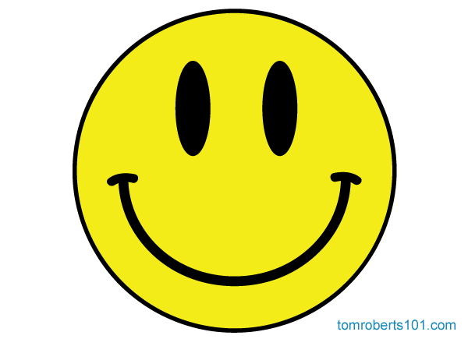
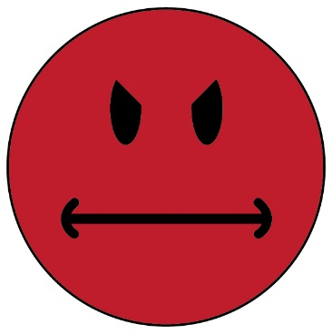
What we want…
What we enjoy
What we loathe

Slide 6
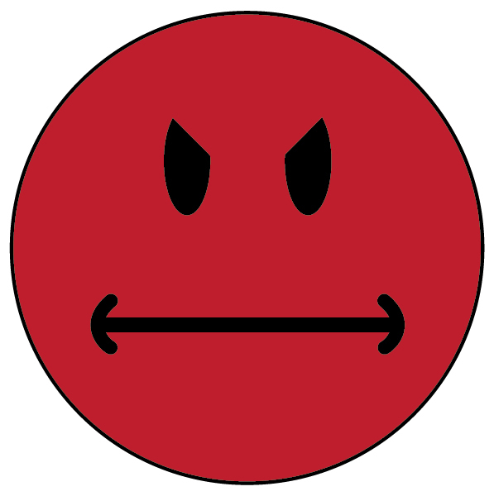
Reality for most of us…
What we enjoy
What we loathe

Slide 7
How can we turn this around?
We have put a lot of emphasis on the ability of our software teams and development culture to achieve fun and personal fulfillment in our work…
…helping to realize the things that got us into software while minimizing the pain…
… we call this Funability
… the measure of how well our culture and process enable us to realize the motivations that got us into this business in the first place

Slide 8
What contributes to Funability?
Frequent Delivery of Value to Customers
Being Part of a Team
Maintainability of the System
Effective Management of Technical Debt
Sound Software Design
Consistent Quality of Product Releases
Productivity and Efficiency of the Developers

Slide 9
What contributes to Funability?
Frequent Delivery of Value to Customers
Visibility of progress by internal stakeholders
Regular and frequent releases to external customers
Minimizing long, drawn-out development efforts

Slide 10
What contributes to Funability?
Being Part of a Team
Frequent interactions with teammates on project items
Ability to leverage pair programming when necessary
Esprit de Corps - a feeling of pride, fellowship, and common loyalty shared by the members of a particular group.
Mutual accountability amongst the team

Slide 11
What contributes to Funability?
Maintainability of the System
Ability to efficiently read and understand the code throughout the system
Ability to effectively debug the system
Ability to understand the impact of a change on the entire system
Ability to avoid unintended behavior changes
Maximizing the useful life of a software system
Avoidance of silos in the System

Slide 12
What contributes to Funability?
Effective Management of Technical Debt
Recognizing when choices will lead to technical debt
Ability to efficiently reduce technical debt as part of normal feature development
Leveraging tools to identify technical debt

Slide 13
What contributes to Funability?
Consistent Quality of Product Releases
Stress-free release days
Automation of processes
No stabilization phases
Hot fixes as the exception, not the rule

Slide 14
What contributes to Funability?
Productivity and Efficiency of the Developers
Creating a project management discipline that reduces the mental burden on developers and leads
Enabling designers and developers enough time to actually do some work

Slide 15
What contributes to Funability?
Sound Software Design
Consistency of the conceptual design of the software
Consistent adherence to common design principles and criteria
Simplicity over complexity and cleverness
Disciplined and consistent approach to decomposition and estimation
This is the “bedrock” of our culture

Slide 16
Can’t a lot of this be managed through office layout and agile processes?

Slide 17
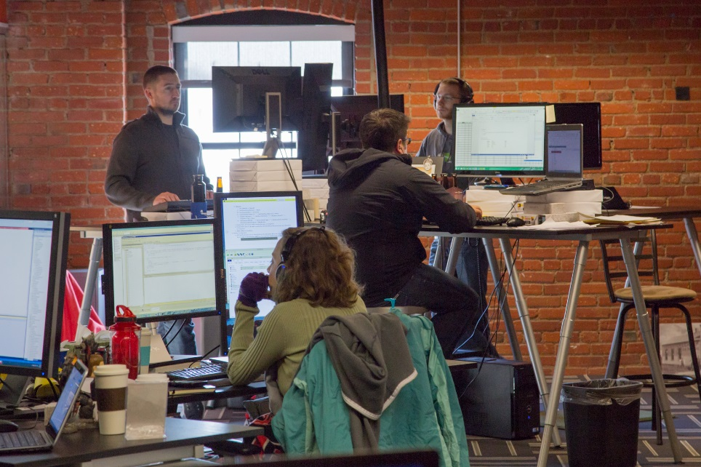
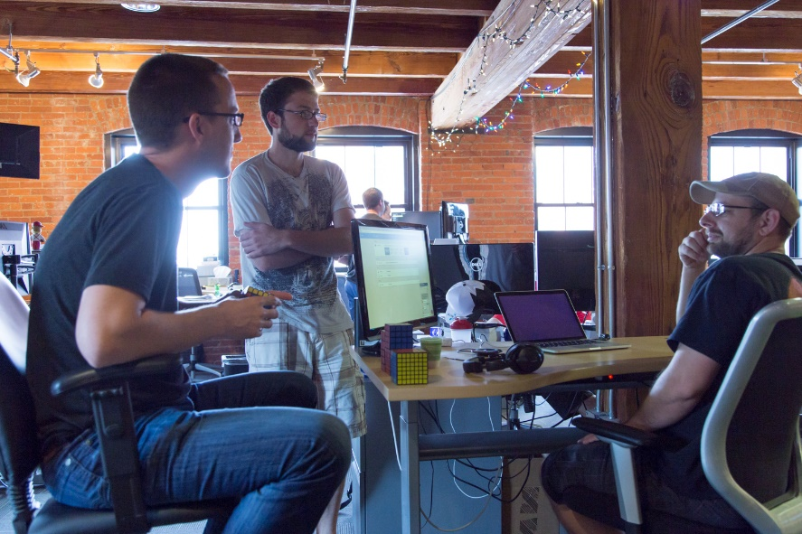
Cool spaces are important
Creates a relaxed and collegial environment
Enables collaboration
Helps with recruiting
Enables play
Increases socialization

Slide 18
… and Agile methods are essential, but…
… they are not enough to effectively address and manage the ever-increasing essential complexity of the problems we are trying to solve with software
Bottom line: Agile is not a silver bullet

Slide 19
 | Frequent Value Delivery | Part of a Team | Maintainability | Managing Technical Debt | Sound Software Design | Consistent Release Quality | Productivity & Efficiency
“Cool” Space |  | Ease of interaction and collaboration |  |  |  |  | A comfortable, exciting, relaxing environment
Agile Methods | Sprints and Kanban methods ensure value prioritization | Daily standups and mutual accountability |  |  | Estimation as part of the planning process | Reduced scope of short sprints reduces release risk | Rituals enable collaboration and early issue resolution

Slide 20
Strategies and techniques for increasing Funability

Slide 21
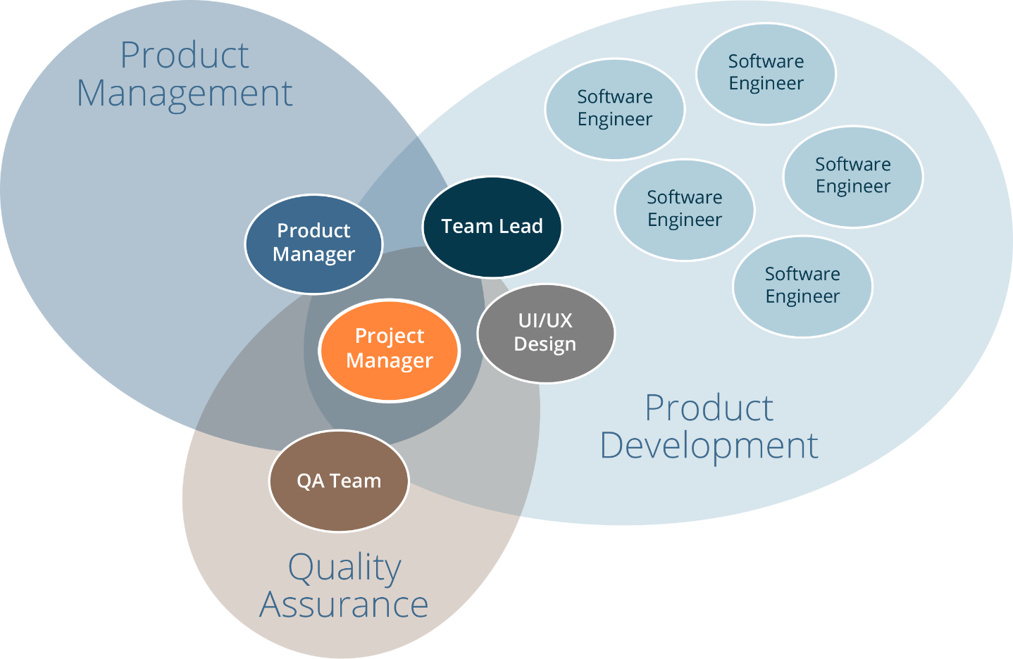
Key Team Roles

Slide 22
Establish a strong development lead role
Lead Developer
Qualities of good programmer +…
Coaches Jr programmers
Works with programmers to design new features
Lead Engineer
Qualities of good engineer +…
Coaches and mentors team on design principles and standards
Responsible for maintaining the conceptual design
Maintains big picture of product
Proactive communicator
Responsible for performance of product
Ensures engineers are testing their code
Performs code reviews

Slide 23
Establish a strong project management role
Primary responsibility: Process facilitator
Ensure steps are followed
Maintain consistency
Keep a productive rhythm
Schedule/facilitate meetings
Keep meetings productive
Ensure proper task prioritization
Central communication for project
Tight coordination with lead engineer, UI/UX, QA and product manager
Decision tracking and documentation
Release plan development
Task/action item tracking
Project status monitoring / reporting
Project health monitoring / reporting
Information/decision coordination
Retrospectives
Management of external communications
Lead daily standups
Keeps sprint planning < 1 hour

Slide 24
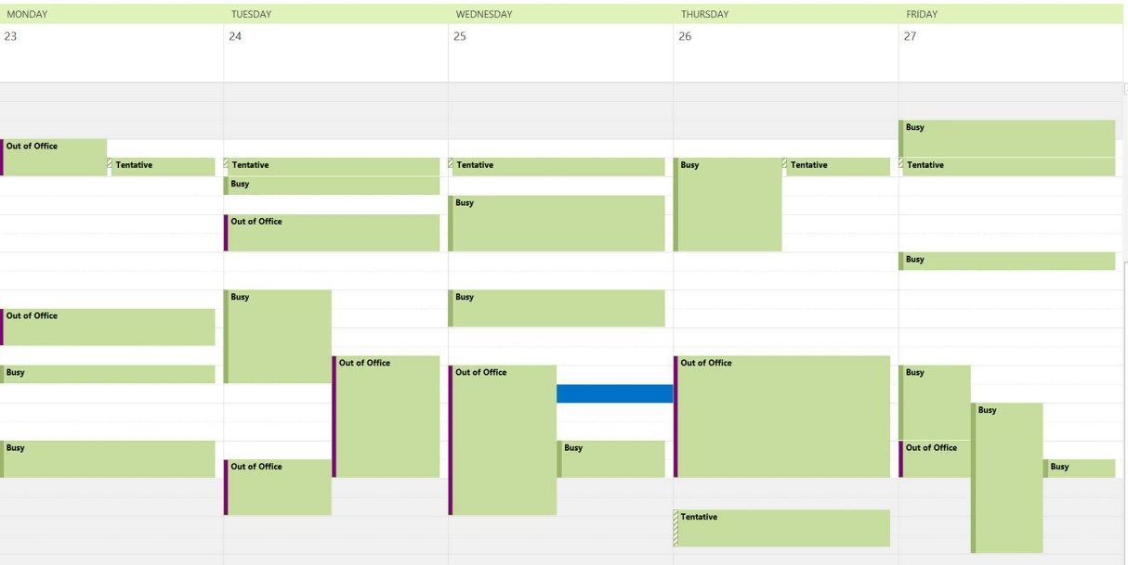
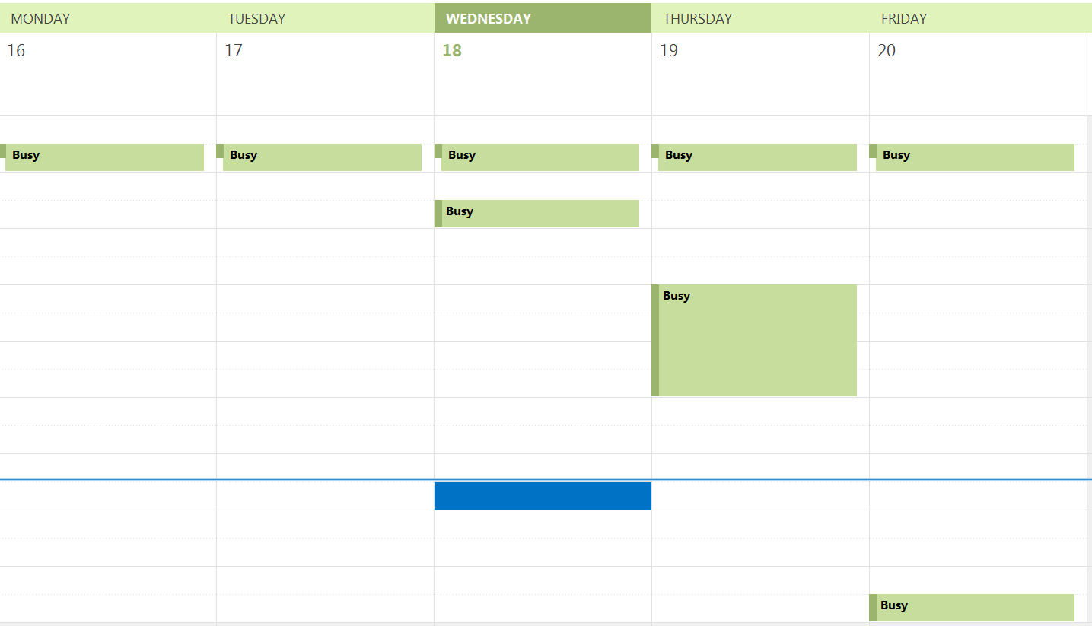
Protect the schedules of your “makers”
Manager vs Maker Schedule
Paul Graham (Y Combinator): http://www.paulgraham.com/makersschedule.html

Slide 25
Establish a consistent design identity
Avoid treating every new project as a unique design effort
When done right, the methodology for decomposing a system can (and should) be the same for every project
System feels created by a single mind
Ensures things such as testability remain high in all areas of system
Enables movement of developers from one area of the system to another, and from project to project
Examples: object-orientation, services, micro-services, IDesign

Slide 26
Establish a consistent design identity
“I will contend that Conceptual Integrity is the most important consideration in system design. It is better to have a system omit certain anomalous features and improvements, but to reflect one set of design ideas, than to have one that contains many good but independent and uncoordinated ideas.”
Fred Brooks (1975)

Slide 27
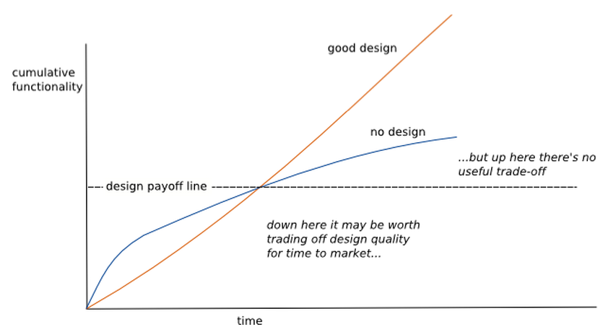
Design Stamina Hypothesis
Usually weeks, not months
http://www.martinfowler.com/bliki/DesignStaminaHypothesis.html

Slide 28
Practice test-driven design
Forces consumption awareness in your code because you create the first consumer
Gets you focused on the interface rather than the implementation
Tends to create interfaces that are conveniently callable
Forces the software to be more testable which usually requires more decoupling from its surroundings
Things that are difficult to test tend to be simplified in order to achieve testability
Tests allow you to play “what if” games with broad changes to assess the impact to the design
Makes the code more understandable/readable
Unit tests that describe how the developer intended the code to be consumed
Built in example code!

Slide 29
Require code review of every pull request
Code reviews single best way to improve quality
Reduces the stabilization cycle
Enables us to develop confidently
Provides mechanism for coaching and mentoring
Ensures the code is consistent with the software architecture/design

Slide 30
Use continuous integration with tests
We want confidence that our systems work
We don’t want that dreaded support call
Enables us to sleep at night
Avoids “broken window” syndrome

Slide 31
Require ability to do integration tests on the desktop
Enables a developer to build and run end-to-end tests and validation on their own machines
Includes hosting of databases locally
Avoids collisions with other developers
Enables development in isolation
Ability to do this must be a conscious design all along the way
Your system design choices can enable or prevent this

Slide 32
 | Frequent Value Delivery | Part of a Team | Maintainability | Managing Technical Debt | Sound Software Design | Consistent Release Quality | Productivity & Efficiency
“Cool” Space |  | Ease of interaction and collaboration |  |  |  |  | A comfortable, exciting, relaxing environment
Agile Methods | Sprints and Kanban methods ensure value prioritization | Daily standups and mutual accountability |  |  |  | Reduced scope of short sprints reduces release risk | Flexible processes Rituals enable collaboration and early issue resolution
Strong Lead Engineer |  | Mentoring junior developers | Ensure code standards met | Maintains “big picture” enabling proactive tradeoff evaluation and decisions | Maintains conceptual design integrity | Accountability for product releases | Maintains focus of the team and prevents thrashing
Strong Project Management | Ensures clear definition of done and use expectations |  |  |  |  | Manages expectations across all stakeholders through proactive communication | Mental burden of planning, decision, and stakeholder details lifted from dev team
Maker Schedules |  | Increased availability for spontaneous collaboration |  |  |  | Less disruptions can mean increased focus and better results | Large blocks of time to “get into” the problem at hand
Consistent Design Identity | More efficient estimation and planning of work | Increased collaboration efficiency as a result of reduced design silos | Software designed to encapsulate volatility making future changes easier | Enables explicit decision for design deviation | Consistent adherence to common design principles and criteria helps reduce entropy/software rot Consistent approach to system decomposition |  | Narrow developer FOV Increased shared understanding of the whole system
Test-Driven Design | Helps ensure main branch has releaseable code | Quality/design accountability increased and shared mutually amongst the team | Code-base is constantly under some for of test Reduces unintended changes in behavior | Helps identify areas of potential technical debt Enables refactoring | Enables adherence to best practices related to design | Defect detection prior to formal QA testing Reduces level of stress during releases | Narrow developer FOV
Pull Request Code Review | Helps ensure main branch has releaseable code | Shared responsibility for the entire code base and shared design | Can enable simplicity over cleverness | Helps identify areas of potential technical debt | Increased likelihood of design problems identified early | Defect detection prior to formal QA testing | Provides coaching and mentoring opportunities to improve skills of the team
Continuous Integration w/Tests | Provides option for continuous deployment | Accountability to the team for consistently successful builds |  | Can integrate code quality static analysis |  | QA can focus more on acceptance and regression testing vs defect detection | Broken builds encourage attention to detail and discipline
Desktop integration tests |  |  | Helps prevent failed builds |  |  | Defect detection prior to code review | Increases ease of testing Reduces need for stabilization

Slide 33
Summary
No silver bullet to creating a dev culture with high Funability
To truly change your development culture you need to go beyond cool spaces and agile/scrum and change the way the software is designed and constructed
Only an integrated view of these processes and best practices will get you where you want to be
Constantly review practices and push for higher Funability
Challenges remain
Still feeling a lot of pain in the web client tier and some mobile app development
How to actually measure funability in the workplace

Slide 34
Thanks!
“If builders built buildings the way programmers wrote programs, then the first woodpecker that came along would destroy civilization.”
Gerald Weinberg
ddurham@dontpaniclabs.com / @dnsdurham
cmichel@dontpaniclabs.com / @chadmichel
http://blog.dontpaniclabs.com / @dontpaniclabs

Slide 35
Help us answer the age-old question:
Dog or Cat or Robot?
And enter for a chance to win an Amazon Fire Stick
How it works:
Take the sticker of your choice.
Post a photo of it on Twitter and mention us (@dontpaniclabs).
Bonus: Follow us on Twitter for an additional entry.
We’ll draw the winner on Monday, May 23 and announce it on Twitter.

