Slide 1
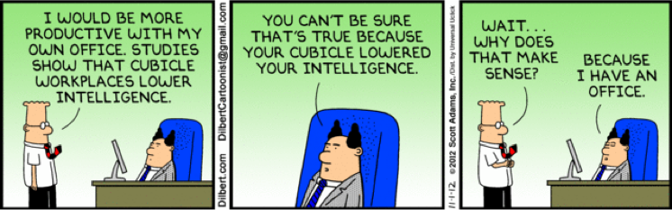
We like cool office spaces…

Slide 2
Funability
Doug Durham
Chad Michel

Slide 3
Why did we get into software development?
Rapid return on our effort
Work on tough problems
Build tools that people use
Enriching our lives
Creating efficiencies through automation
Saving lives / protecting our way of life
Saving money
[SEE STACK OVERFLOW REPORT]

Slide 4
Problem is…
… the journey many of us are on to seek fulfillment of those goals has required enduring a lot of “pain” along the way.
Cool office spaces is not enough

Slide 5
The pain…
Swim through 5 layers of inheritance
12 hour product releases
6 weeks of stabilization
Estimates <> reality
Dreading project status reviews
Hours wading through code to determine how something works
Hope and prayers during releases
Edge of seat waiting for support calls about system down
Looking for new projects to avoid maintaining ugly code
Test environment cumbersome and shared
Estimates driven by deadlines vs reality
Silos of design philosophy throughout the system

Slide 6
What we want…
What we enjoy
What we loathe

Slide 7
Reality for most of us…
What we enjoy
What we loathe

Slide 8
How can we turn this around?
We have put a lot of emphasis on the ability of our software teams and development culture to achieve fun and personal fulfillment in our work…
…helping to realize the things that got us into software in the first place while minimizing the pain…
… we call this Funability
… the measure of how well our culture and process enable us to realize the motivations that got us into this business in the first place

Slide 9
What contributes to Funability?
Frequent Delivery of Value to Customers
Visibility of progress by internal stakeholders
Regular and frequent releases to external customers
Being Part of a Team
Frequent interactions with teammates on project items
Ability to leverage pair programming when necessary
Esprit de Corps - a feeling of pride, fellowship, and common loyalty shared by the members of a particular group.
Mutual accountability amongst the team
Maintainability of the System
Ability to efficiently read and understand the code throughout the system
Ability to effectively debug the system
Ability to understand the impact of a change on the entire system
Ability to avoid unintended behavior changes
Maximizing the useful life of a software system
Avoidance of Silos in the System
Effective Management of Technical Debt
Recognizing when choices will lead to technical debt
Ability to efficiently reduce technical debt as part of normal feature development
Leveraging tools to identify
Sound Software Design
Consistency of the conceptual design of the software
Consistent adherence to common design principles and criteria
Simplicity over complexity and cleverness
Fred Brooks quote
Consistent Quality of Product Releases
Stress-free release days
Automation of processes
No stabilization phases
Hot Fixes as the exception, not the rule
Productivity and Efficiency of the Developers
Creating a project management discipline that reduces the mental burden on developers and leads
Enabling designers and developers enough time to actually do some work

Slide 10
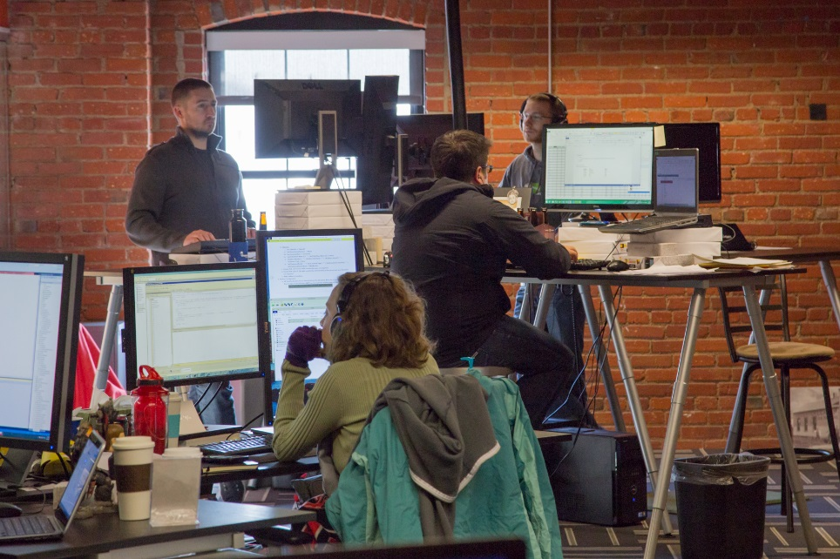
Cool spaces are important
Creates a relaxed and collegial environment
Enables collaboration
Helps with recruiting
Enables play
Increases socialization

Slide 11
… and Agile methods are essential, but…
… they are not enough to effectively address and manage the ever-increasing essential complexity of the problems we are trying to solve with software
Bottom line: Agile is not a silver bullet

Slide 12
 | Frequent Value Delivery | Part of a Team | Maintainability | Managing Technical debt | Sound Software Design | Consistent Release Quality | Productivity & Efficiency
“Cool” Space |  | Ease of interaction and collaboration |  |  |  |  | A comfortable, exciting, relaxing environment
Agile Methods | Sprints and Kanban methods ensure value prioritization | Daily standups and mutual accountability |  |  |  | Reduced scope of short sprints reduces release risk | Rituals enable collaboration and early issue resolution

Slide 13
Strategies and techniques for increasing Funability

Slide 14
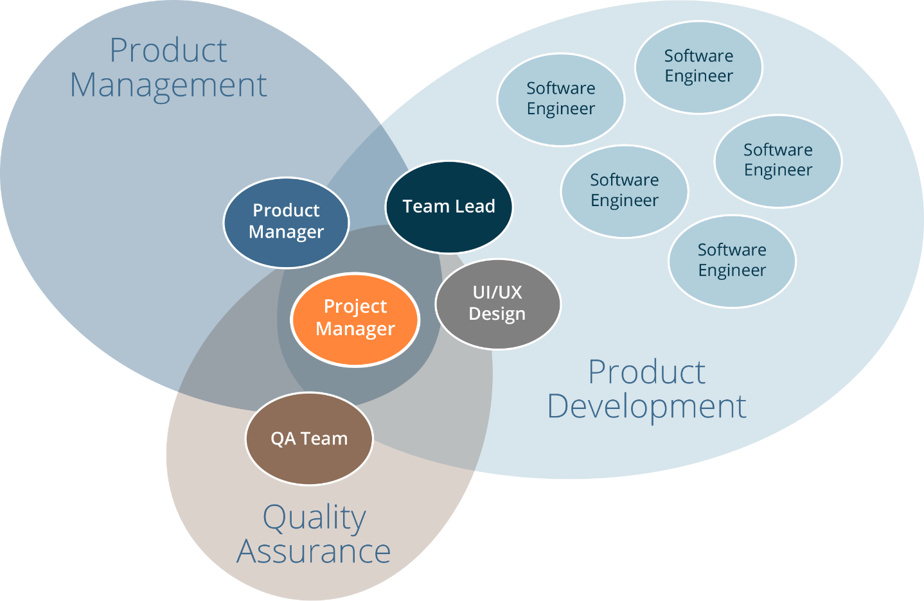
Key Team Roles

Slide 15
Establish a strong development lead role
Lead Developer
Qualities of good programmer+
Coaches JR programmers
Works with programmers to design new features
Lead Engineer
Qualities of good engineer+
Coaches and mentors team on design principles and standards
Responsible for maintaining the conceptual design
Maintains big picture of product
Proactive communicator
Responsible for performance of product
Ensures engineers are testing their code
Performs code reviews

Slide 16
Establish a strong project management role
Primary responsibility: Process facilitator
Ensure steps are followed
Maintain consistency
Keep a productive rhythm
Schedule/facilitate meetings
Keep meetings productive
Ensure proper task prioritization
Central communication for project
Tight coordination with lead engineer, UI/UX, QA and product manager
Decision tracking and documentation
Release plan development
Task/action item tracking
Project status monitoring / reporting
Project health monitoring / reporting
Information/decision coordination
Retrospectives
Management of external communications
Lead daily standups

Slide 17
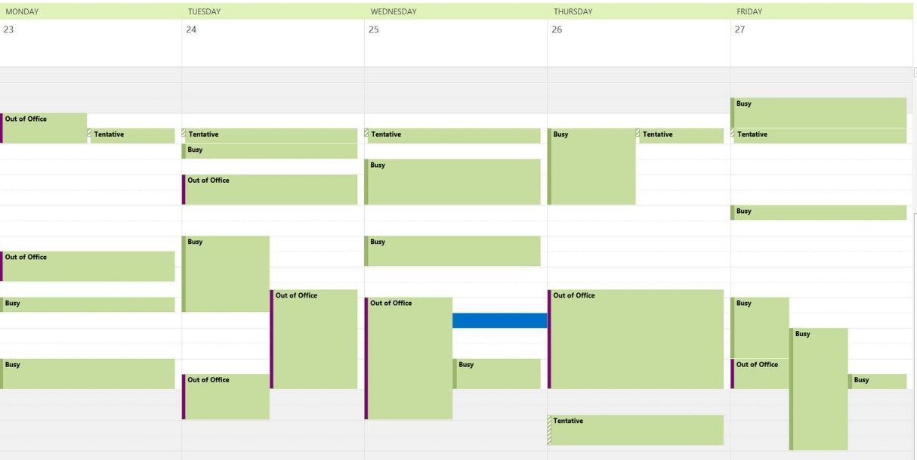
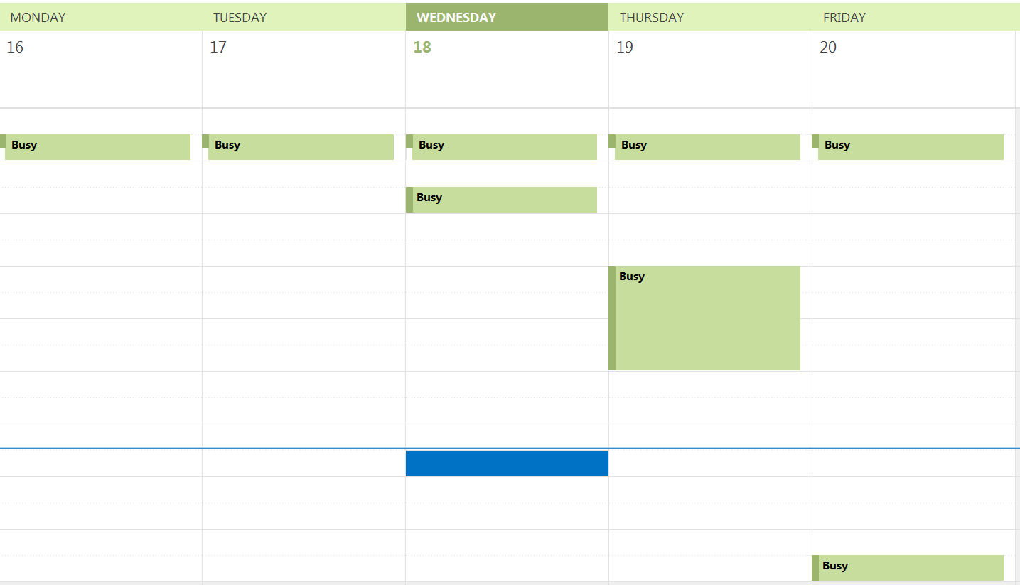
Protect the schedules of your “makers”
Manager vs Maker Schedule
Paul Graham (Y Combinator): http://www.paulgraham.com/makersschedule.html

Slide 18
Establish a consistent design identity
Avoid treating every new project as a unique design effort
When done right, the methodology for decomposing a system can (and should) be the same for every project
System feels created by a single mind
If you can work on one part, you should be able to work on another
Ensures things such as testability remain high in all areas of system
Enables movement of developers from one area of the system to another
Examples: Object Orientation, Service Orientation, Micro-Services

Slide 19
Practice test-driven design
Forces consumption awareness in your code because you create the first consumer
Gets you focused on the interface rather than the implementation
Tends to create interfaces that are conveniently callable
Forces the software to be more testable which usually requires more decoupling from its surroundings
Things that are difficult to test tend to be simplified in order to achieve testability
Tests allow you to play “what if” games with broad changes to assess the impact to the design
Makes the code more understandable/readable
Unit tests that describe how the developer intended the code to be consumed
Built in example code!

Slide 20
Require code review of every pull request
Code reviews single best way to improve quality
Steve McConnell, Code Complete [Find exact quote]
Reduces the stabilization cycle
Enables us to develop confidently
Provides mechanism for coaching and mentoring

Slide 21
Use continuous integration with tests
We want confidence that our systems work
We don’t want that dreaded support call
Enables us to sleep at night
Avoids “broken window” syndrome

Slide 22
Require ability to do integration tests on the desktop
Enables a developer to build and run end-to-end tests and validation on their own machines
Includes hosting of databases locally
Avoids collisions with other developers
Enables development in isolation
Ability to do this must be a conscious design all along the way
Your system design choices can enable or prevent this

Slide 23
 | Frequent Value Delivery | Part of a Team | Maintainability | Managing Technical Debt | Sound Software Design | Consistent Release Quality | Productivity & Efficiency
“Cool” Space |  | Ease of interaction and collaboration |  |  |  |  | A comfortable, exciting, relaxing environment
Agile Methods | Sprints and Kanban methods ensure value prioritization | Daily standups and mutual accountability |  |  |  | Reduced scope of short sprints reduces release risk | Rituals enable collaboration and early issue resolution
Strong Lead Engineer |  | Mentoring junior developers | Ensure code standards met |  | Maintains conceptual design integrity | Accountability for product releases | Maintains focus of the team and prevents thrashing
Strong Project Management
Maker Schedules |  |  |  |  |  | Less disruptions can mean increased focus and better results | Large blocks of time to “get into” the problem at hand
Consistent Design Identity |  |  | Reduces design silos Increased shared understanding of the whole system | Enables explicit decision for design deviation | Consistent adherence to common design principles and criteria |  | Narrow developer FOV
Test-Driven Design |  |  | Reduces unintended changes in behavior | Helps identify areas of potential technical debt Enables refactoring | Enables adherence to best practices related to design | Defect detection prior to formal QA testing | Narrow the developer FOV
Pull Request Code Review |  | Shared responsibility for the entire code base | Can enable simplicity over cleverness | Helps identify areas of potential technical debt | Increased likelihood of design problems identified early | Defect detection prior to formal QA testing
Continuous Integration w/Tests | Provides option for continuous deployment | Accountability to the team for consistently successful builds |  | Can integrate code quality static analysis |  | QA can focus more on acceptance and regression testing vs defect detection | Broken builds encourage attention to detail and discipline
Desktop integration tests |  |  | Helps prevent failed builds |  |  | Defect detection prior to code review | Increases ease of tesing Reduces need for stabilization
Combine with Keynote items

Slide 24
Summary
No silver bullet to creating a dev culture with high Funability
To truly change your development culture you need to go beyond cool spaces and agile/scrum and change the way the software is designed and constructed
Only an integrated view of these processes and best practices will get you where you want to be
Constantly review practices and pushing for higher Funability

Slide 25
Thanks!
“If builders built buildings the way programmers wrote programs, then the first woodpecker that came along would destroy civilization.”
Gerald Weinberg
ddurham@dontpaniclabs.com / @dnsdurham
cmichel@dontpaniclabs.com / @chadmichel
http://blog.dontpaniclabs.com / @dontpaniclabs

