Slide 1
A Sandwich SQL Project
THE GREAT CHICKEN SANDWICH SHOWDOWN OF 2022

Slide 2
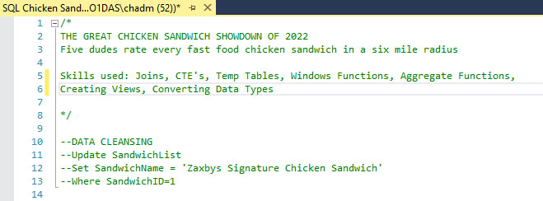
Finding the best Fast Food Chicken Sandwich

Slide 3

The Dudes and the Sandwiches.

Slide 4

Which sandwich is the best value?
The Popeye’s chicken sandwiches cost less than 7/10^{ths} of a penny per calorie. What a deal! The Chick Fil A Spicy Chicken Sandwich costs 1.1 pennies per calorie. That’s a spicy, pricey sandwich.

Slide 5
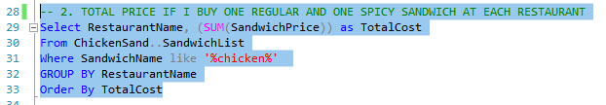
How much for one of each?
One regular sandwich and one spicy sandwich at Kentucky Fried Chicken is just $8.98! However, one of each at Zaxby’s is $16.98. That is so Zaxpensive!

Slide 6
What if we factor in travel costs?
It costs me $3.72 to drive out to Slim Chickens. Chances of me traveling that far? SLIM to none.
Luckily, McDonalds is less than a mile away.

Slide 7
Total money spent on this idiotic project?
$145.99. On chicken sandwiches. From fast food restaurants. I am an idiot.

Slide 8
Finally… the actual scores!
Which cuisine reigned supreme? Five dudes individually rated each sandwich in a blind taste test, assigning each one a score on a zero to 10 scale.

Slide 9
And the winning chicken sandwich is…
Based on our very limited sample size, the ZAXBY’S SPICY CHICKEN SANDWICH was voted Number 1 overall.
The Kentucky Fried Chicken Sandwiches were voted worst in the survey. Sorry, Colonel Sanders. It was definitely not finger lickin’ good.

Slide 10


Thanks for clicking through to the end!
- Chad Morelli

