Slide 1
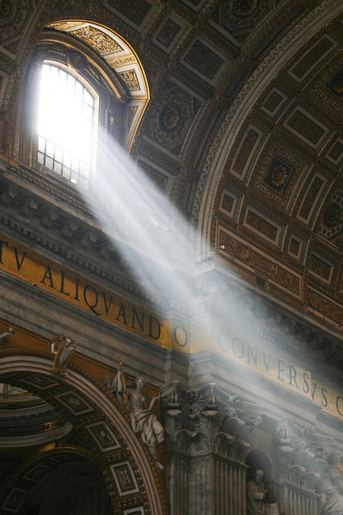
Theological Basics
God and Man,
Jesus and Church,
Tradition and Scripture

Slide 2
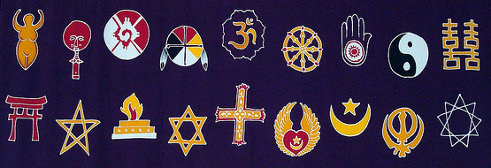
THE Unique Gospel of Jesus, The Christ
Notes:
Today in America, Catholics face a bewildering number of alternative views on faith and spirituality. On one hand, “secular humanism” and unvarnished atheism pervade in our academic institutions and our media -- confronting and confounding ill-equipped Catholics on fundamental issues. On the other hand, New Age paganism and Eastern spirituality gently ease their way into Christianity and specifically Catholicism, distorting the Gospel message of love through Christ. Even among Christian and pseudo-Christian groups, the understanding of God is contorted. For example, LDS (Mormon) and Jehovah’s Witness theology denies the Trinity including Christ’s divinity and resurrection. Fortunately for us, none of these philosophies are new and all have been dealt with at one time or another by the Church in the last 2,000 years. A well-equipped Catholic has everything he or she needs to navigate these murky waters. The reality of the Gospel -- God and His saving plan through Christ -- is a unique message in human history. Some say God doesn’t exist, but He does. Some say God is distant, but he is really present in the tabernacle and has given us the Eucharist so that we may commune with Him in the most intimate way. Some say God is a manipulative, angry, or vindictive, but He’s consistent, unconditional in His love, and always ready to forgive a repentant heart. Some say God asks too much and gives too little, but He asks no more than you would ask of your own spouse or child and He has given us everything we have and more than we could imagine in eternal life. Some say God is confusing or contradictory, but He has given us a Church and a Tradition in Word and Scripture so that we might understand His will for us. This week, we will cover the proper, Catholic understanding of God, His nature, His revelation of Himself to us, and the Church he established to guide us through the ages. We’ll equip you to understand how faith in God is not just reasonable, it’s the only reason and rationale that stands up to the test. We’ll also cover how God has revealed Himself in Jesus, through the Church, and through Scripture.

Slide 3
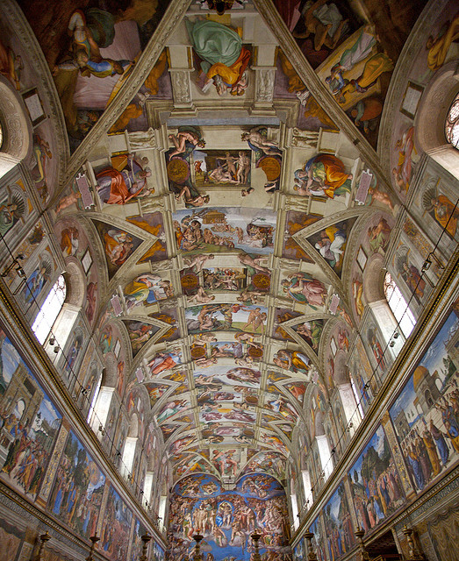
What IS GOD? Who is God?
Notes:
“In the beginning God” (Gen 1:1)
Doesn’t just exist, but is existence itself; substance itself, cannot be broken down
There never was a time when God wasn’t; he isn’t just eternal, but infinite
God is not a thing. He is the creator of all things
God is the simplest and most complete answer to the most foundational and pressing questions of every human: Where did I come from? What is my purpose? Where am I going? (God; to know love and serve Him; eternal life with Him in Heaven)
“If God does not exist, then everything is permissible.” - Dostoevsky (famous Russian Orthodox philosopher)
Evolution of denial of God: Village atheist “There is no God”, Enlightenment Deism “God exists, but has hit the road”, Modernist (Nietzsche) “God is dead”, post-Modernist “There is no God” village atheism now with books and “science” as an excuse not to have faith and use reason (e.g. “Scientism”).

Slide 4
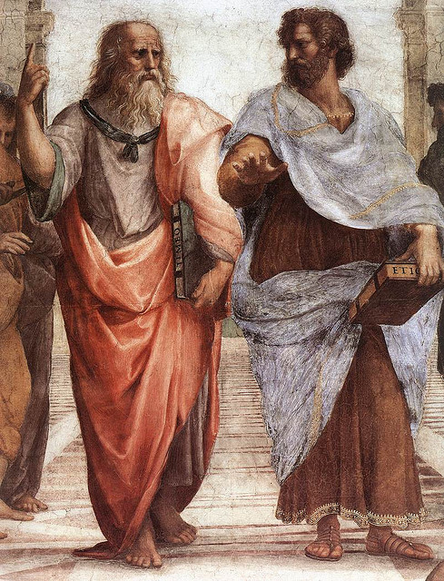
KNOWLEDGE OF THE EXISTENCE of God
8 Arguments for God’s Existence
Nature
“Perfection”
Change
Causation
Time and Contingency
Morality
Art & Beauty
Desire for Joy & Happiness
Notes:
Nature: “The survival of the fit presupposes the arrival of the fit” (Peter Kreeft)
“Goodness” and “Badness”, degrees of perfection implies an ultimate gauge by which we can judge “good” or “bad” He is infinite, perfect, and good which can all be deduced from his self-existence (Aristotle, Aquinas)
If everything is in motion and changes, there must have been a “prime mover”, an “unchanging cause of change” (Aristotle)
To exist implies a cause, the universe exists, therefore it must have a cause (Kalam).
Time and Contingency: Existence of anything implies the existence of its source material, everything ultimately depends on the existence of space and time, therefore there must be something upon which space and time rely for existence that exists and which is not contingent upon anything else (Argument from Contingency)
We have a sense of morality. Morality requires an objective basis and cannot be explained by pure physiology
Art and Beauty - that humans can conceive and perceive the artistic value and beauty in things (including nature) cannot adequately be accounted for by purely biological explanations
Desire of joy and happiness and “yearning” for something we haven’t experienced and can’t fully explain (i.e. God) cannot be explained physically

Slide 5
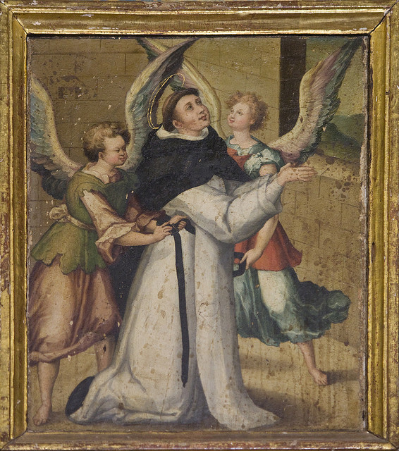
KNOWLEDGE OF ATTRIBUTES of God
8 Attributes of God Known by Reason
Unknowable in the true sense
Not a “thing”
Infinite
Singular (unique)
Simple
Perfect
Good
Intellect and Will (Personality)
Notes:
God is unknowable in the true sense, all our knowledge is merely based on analogies
He is not a creature, a “thing”, or a higher/glorified thing, He depends on no other things
He is infinite, singular (unique), simple (substance itself, not comprised of smaller parts), perfect, good, and has a personality (intellect and will)

Slide 6
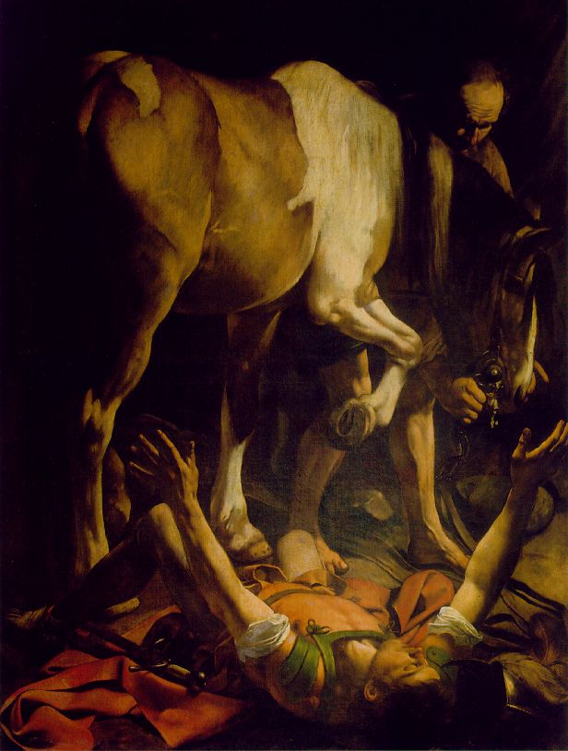
Revealed ATTRIBUTES of God
12 Revealed Attributes of God
Infinitely Eternal (“is, was, is to come”)
Omnipresent/Ubiquitous
Immutable
Simple (no parts; Shema)
Good
Holy
Both Just and Merciful
Love and loving
All-knowing (omniscient)
All-powerful (omnipotent)
Transcendent
Imminent (close, present, available)
Notes:
Infinitely eternal (John 8:58 - “Before Abraham was, I AM”, Revelation 1:4 “is, was, is to come”)
Immensity/ubiquity/omnipresence (Heb 1:3;4:12-13, Acts 17:24-28, Eph 1:12, Col 1:16-17, Ps 138:7-12, Job 12:10, etc)
Immutability ("there is no change, nor shadow of alteration" (James 1:17) and several others)
God is one. Simple, no parts. Three persons, distinct, but perfect unity. (Deut 6:4)
God is good (wills all to go to Heaven - 1 Tim 4:10; contrary to Calvinism, Islam, some Eastern religions;
God is Holy, (Lev 11:44); Gen 1:27 we made in the image and likeness of God
God is both just and merciful (Jesus got the justice, we got the mercy)
God is love (He loves all of us and desires our true happiness in Him, with Him, and through Him; 1 Jn 4:8)
God is omniscient (He knows all)
God is omnipotent (He is all-powerful, can do anything that is possible)
God is transcendent (not above, but more-than, everything that is good about us, God is that much better)
God is Imminent (not distant, in and among us, present and available)

Slide 7
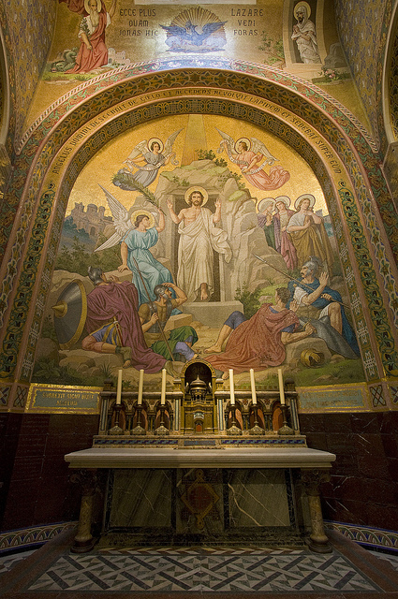
Other facts revealed to us
The name of God
Trinity
Gradual revelation

Slide 8
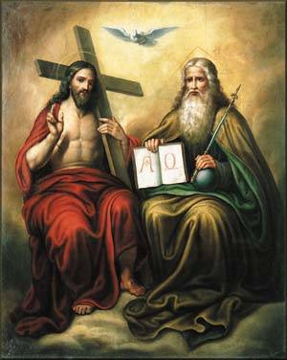
Trinity
One God (Deut 6:4)
Father is God (Jn 5:18)
Son is God (Jn 8:58)
Holy Spirit is God (Mt 28:19)
Distinct persons
Not just names
Or our perspective
Nicene Creed

Slide 9
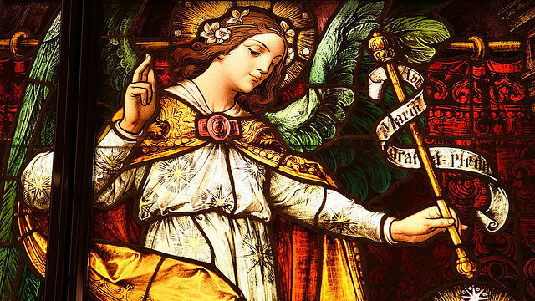
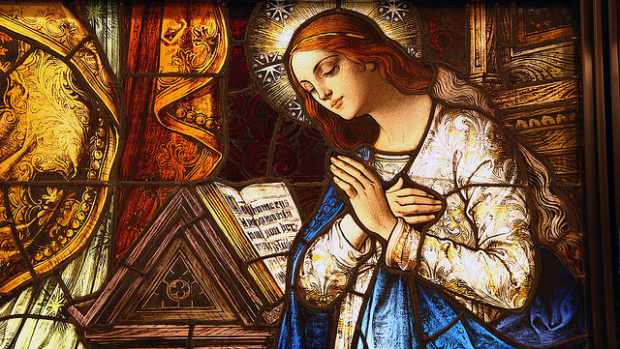
Incarnation
God becomes man
Distinctly Christian doctrine
Not just a ghost
Homoousius / Consubstantial
One spirit, one body, two natures
Hypostatic union
Notes:
Distinctly Christian doctrine, no other religion has a “God-man” doctrine quite like it
Separates Christians and non-Christians (i.e. “just a good man”, “just a prophet”, etc)
Not a ghost or apparition (Gnostic Docetism, originated outside of Church)
Of the same substance of God (homoousius; Not Arian homoiousius “similar sub.”)
Not God and part Man separate in the same body (Nestorian [dyophysite] heresy, rejected in Council of Ephesus in A.D. 431)
Not God and Man fused into a single nature (Monophysite heresy, rejected in Council of Chalcedon A.D. 451)
100% God, 100% Man, one person, two natures in a mystical “hypostatic union” his divinity felt his humanity and his humanity felt his divinity (finally defined in Council of Constantinople II A.D. 553)

Slide 10
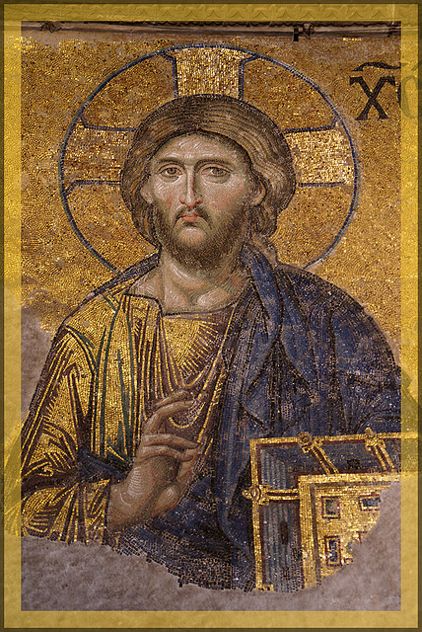
Jesus, the Christ
Jesus: “God Saves”
Christ, Messiah: “Anointed One”
Only person ever pre-announced
Actual historical person
Born around 4 B.C.
Fulfilled all the prophecies
Psalm 22 (Suffering Servant)
Isaiah 7:14
Hosea 11:1
Jeremiah 31:15
Isaiah 9:1-2
Notes:
“Jesus” means “God Saves”
“Christ/Messiah” means “Annointed One”
Only person ever pre-announced, OT and even pagan prophecies (note the pagan kings of the east came to adore Christ at the Nativity)
Real historical figure, archaeological and documentary evidence
More documentary and archaeological evidence for Jesus than for Alexander the Great
Born around 4 BC in Bethlehem just south of Jerusalem
Fulfilled all the prophecies (Psalm 22, Isaiah 7:14, Hosea 11:1, Jeremiah 31:15, Isaiah 9:1-2)

Slide 11
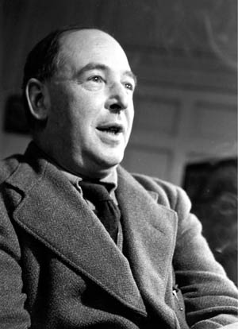
“Either this man was, and is, the Son of God, or else a madman or something worse. You can shut him up for a fool, you can spit at him and kill him as a demon or you can fall at his feet and call him Lord and God, but let us not come with any patronising nonsense about his being a great human teacher. He has not left that open to us. He did not intend to. ... Now it seems to me obvious that He was neither a lunatic nor a fiend: and consequently, however strange or terrifying or unlikely it may seem, I have to accept the view that He was and is God.”
– C.S. Lewis

Slide 12
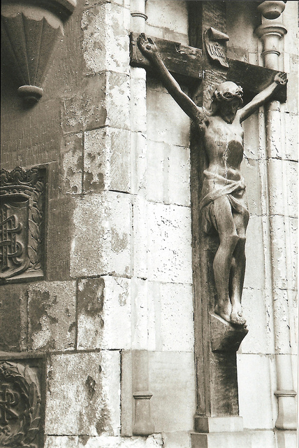
Lord, LIAR, LUNATIC, LEGEND, or GURU?
Trustworthiness
Lord?
Liar?
Lunatic?
Legend?
Guru?
The Resurrection

Slide 13
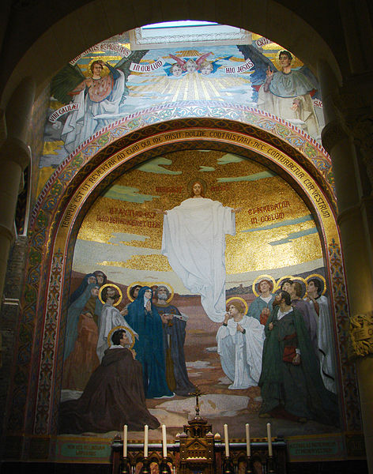
What REMAINS
The Church
The Body of Christ
The Kingdom of God

Slide 14
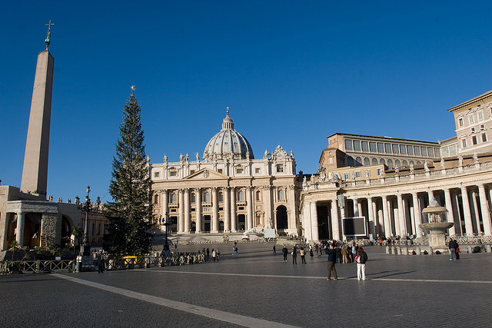
The Church
Continuation of Authority
Mission
One
Holy
Universal
Apostolic

Slide 15
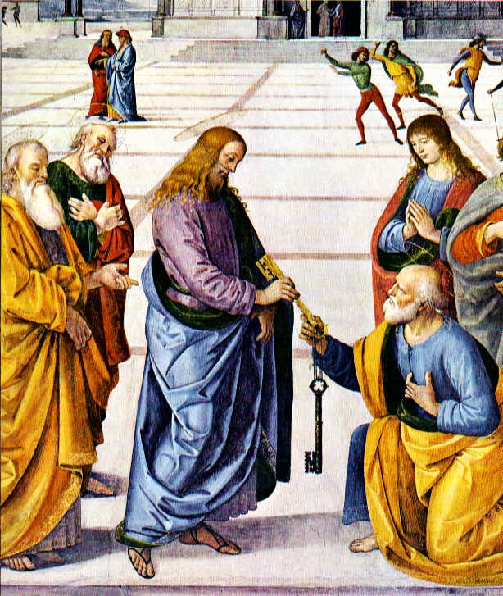
The KINGDOM OF GOD
The Keys
Signs and Wonders
Holy Spirit – Paraclete

Slide 16
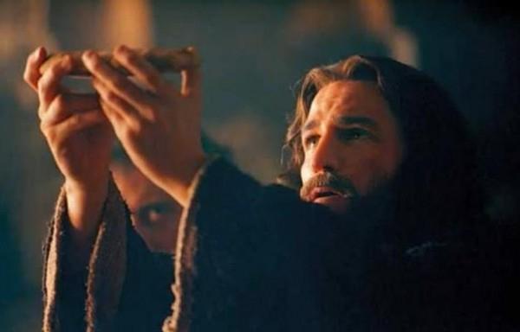
The Body of CHRIST
Communion with Jesus
One Body
Christ as the Head
Bride of Christ
The New Temple

Slide 17
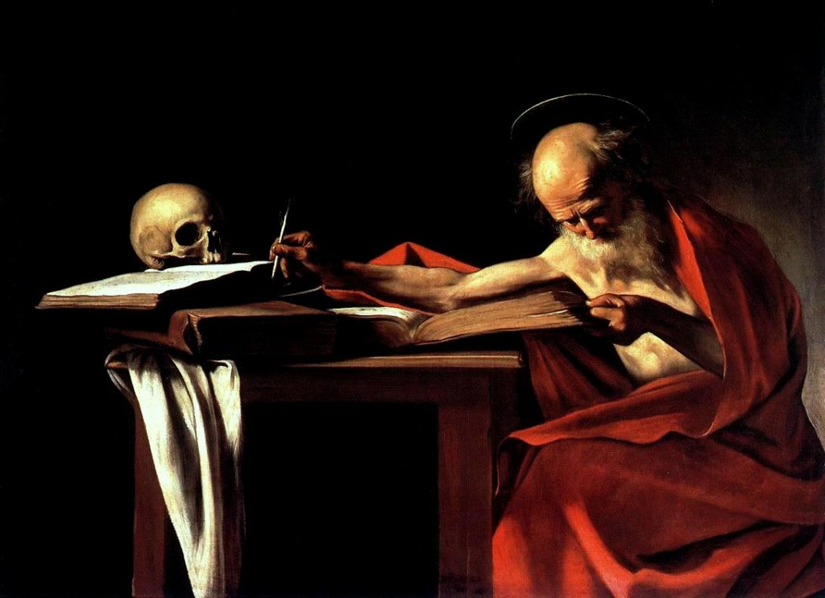
The Word of God

Slide 18
“Go into the whole world and proclaim the gospel to every creature. Whoever believes and is baptized will be saved; whoever does not believe will be condemned.”
- Mark 16:15-16
“Whoever listens to you listens to me. Whoever rejects you rejects me. And whoever rejects me rejects the one who sent me.”
- Luke 10:16
“Therefore, brothers, stand firm and hold fast to the traditions that you were taught, either by an oral statement or by a letter of ours.”
- 2 Thessalonians 2:15

Slide 19
ἀπόστολος (Apostle)
Transliteration: apostolos
English: Apostle
Definition:
A messenger, envoy, delegate, one commissioned by another to represent him in some way

Slide 20
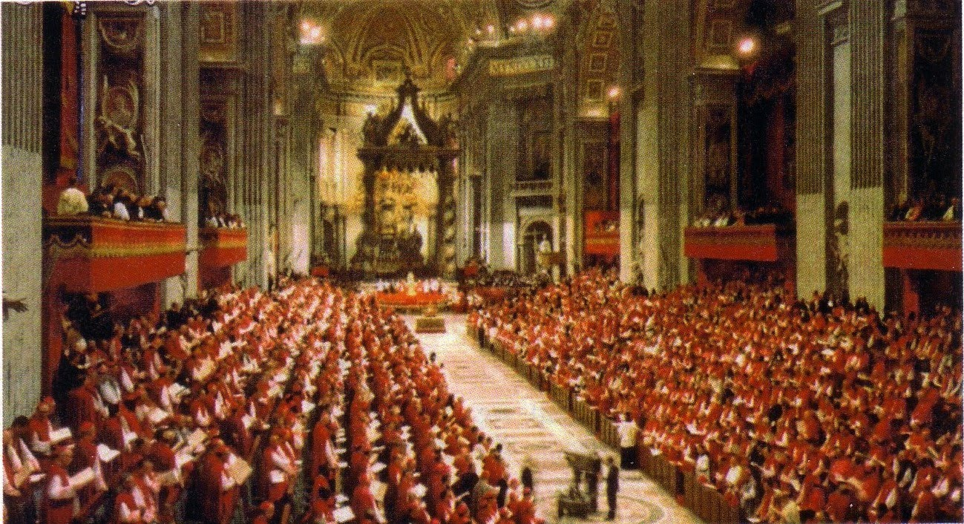
Apostolic Authority
Seat of Moses
Keys to Loose and Bind
Infallibility
Magisterium
Dogma, Doctrine, and Discipline

Slide 21
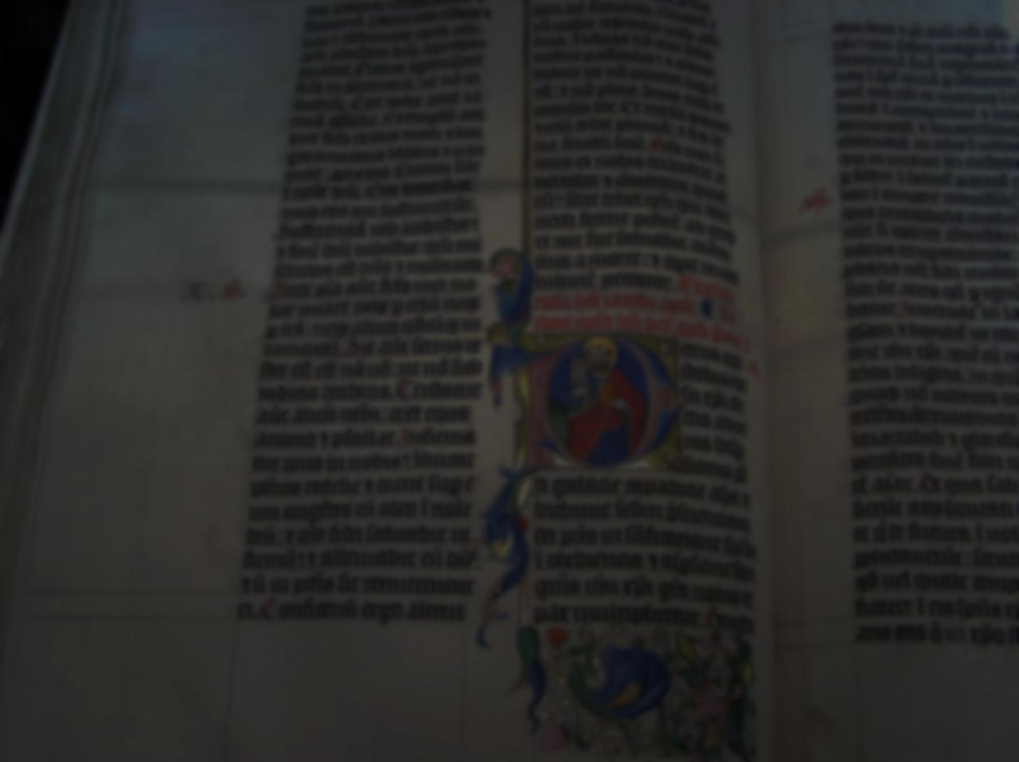
Sacred SCRIPTURE
Super brief history of the Bible
Forming the faith
Senses of Scripture

