Slide 1

Talent Management
Presented by Chad Reo
August 15, 2020

Slide 2
Project Objectives
Identify overall attrition trends
Name top three factors that contribute to turnover
Create a model to predict Attrition
Create a model to predict Income

Slide 3
Description of Data
ID | MaritalStatus
Age | MonthlyIncome
Attrition | MonthlyRate
BusinessTravel | NumCompaniesWorked
DailyRate | Over18
Department | OverTime
DistanceFromHome | PercentSalaryHike
Education | PerformanceRating
EducationField | RelationshipSatisfaction
EmployeeCount | StandardHours
EmployeeNumber | StockOptionLevel
EnvironmentSatisfaction | TotalWorkingYears
Gender | TrainingTimesLastYear
HourlyRate | WorkLifeBalance
JobInvolvement | YearsAtCompany
JobLevel | YearsInCurrentRole
JobRole | YearsSinceLastPromotion
JobSatisfaction | YearsWithCurrManager
Data Set contains 36 fields
1 ID field
2 Fields we are trying to predict.
870 distinct records

Slide 4
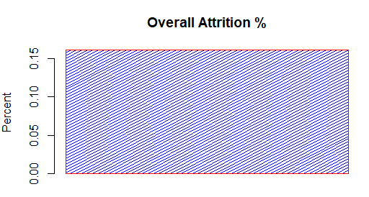
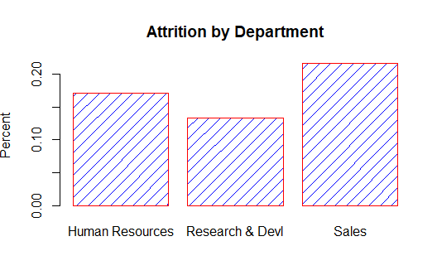
Overview of Attrition
EmplCnt | AttritionCnt | AttritionPrcnt
870 | 140 | 16%
Department | EmplCnt | AttritionCnt | AttritionPrcnt
HR | 35 | 6 | 17%
R&D | 562 | 75 | 13%
Sales | 273 | 59 | 22%

Slide 5
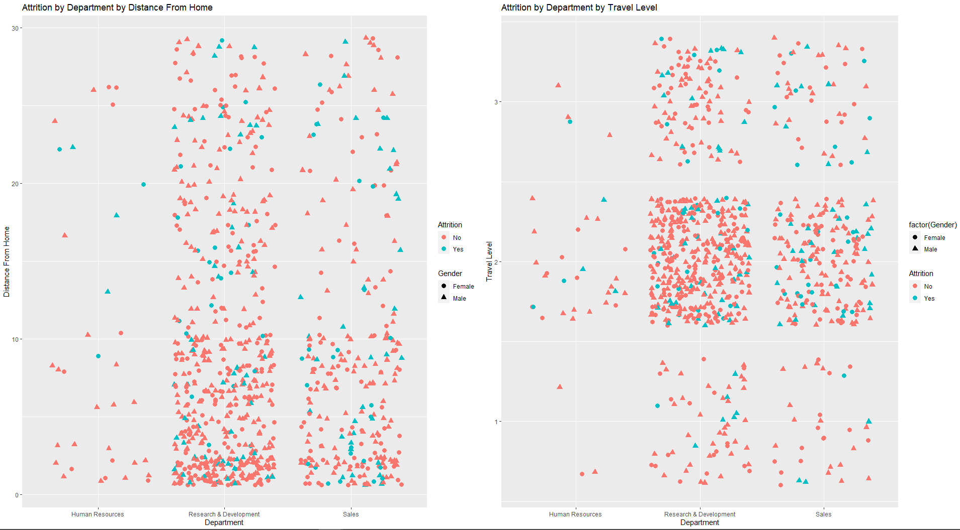
Attrition by Distance & Travel
Attrition Appears to increase as both Distance and Travel increase

Slide 6
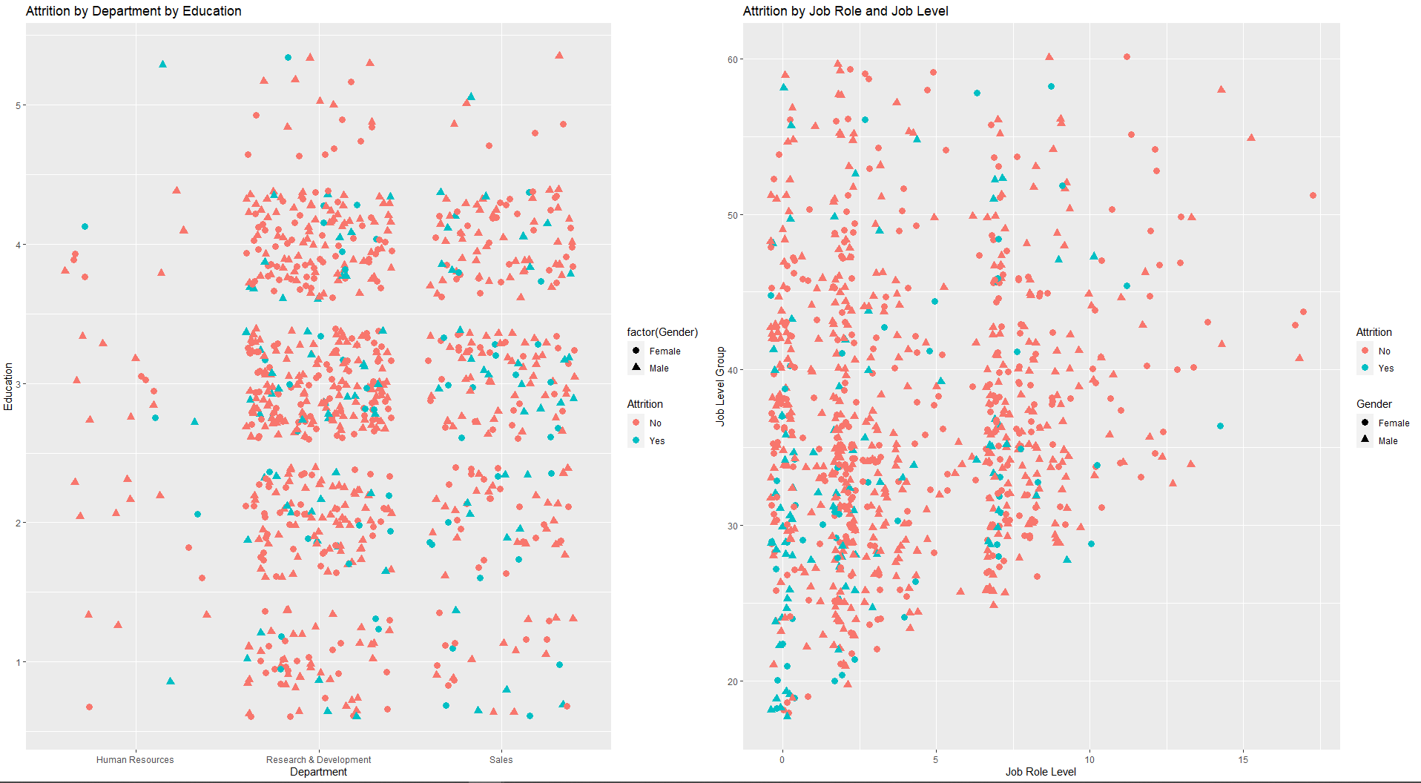
Attrition by Distance & Travel
Attrition Appears to decrease as Education and Job Level Increase

Slide 7
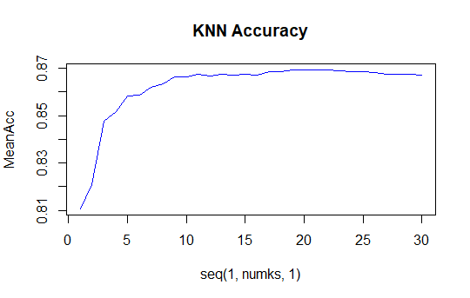
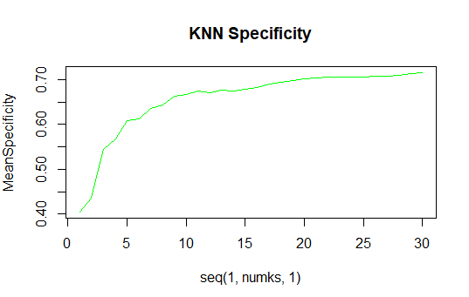
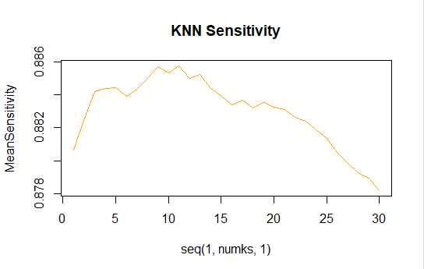
KNN Model to Predict Attrition
Choosing K= 12 appears to provide the best mix of Accuracy, Specificity, and Sensitivity

Slide 8
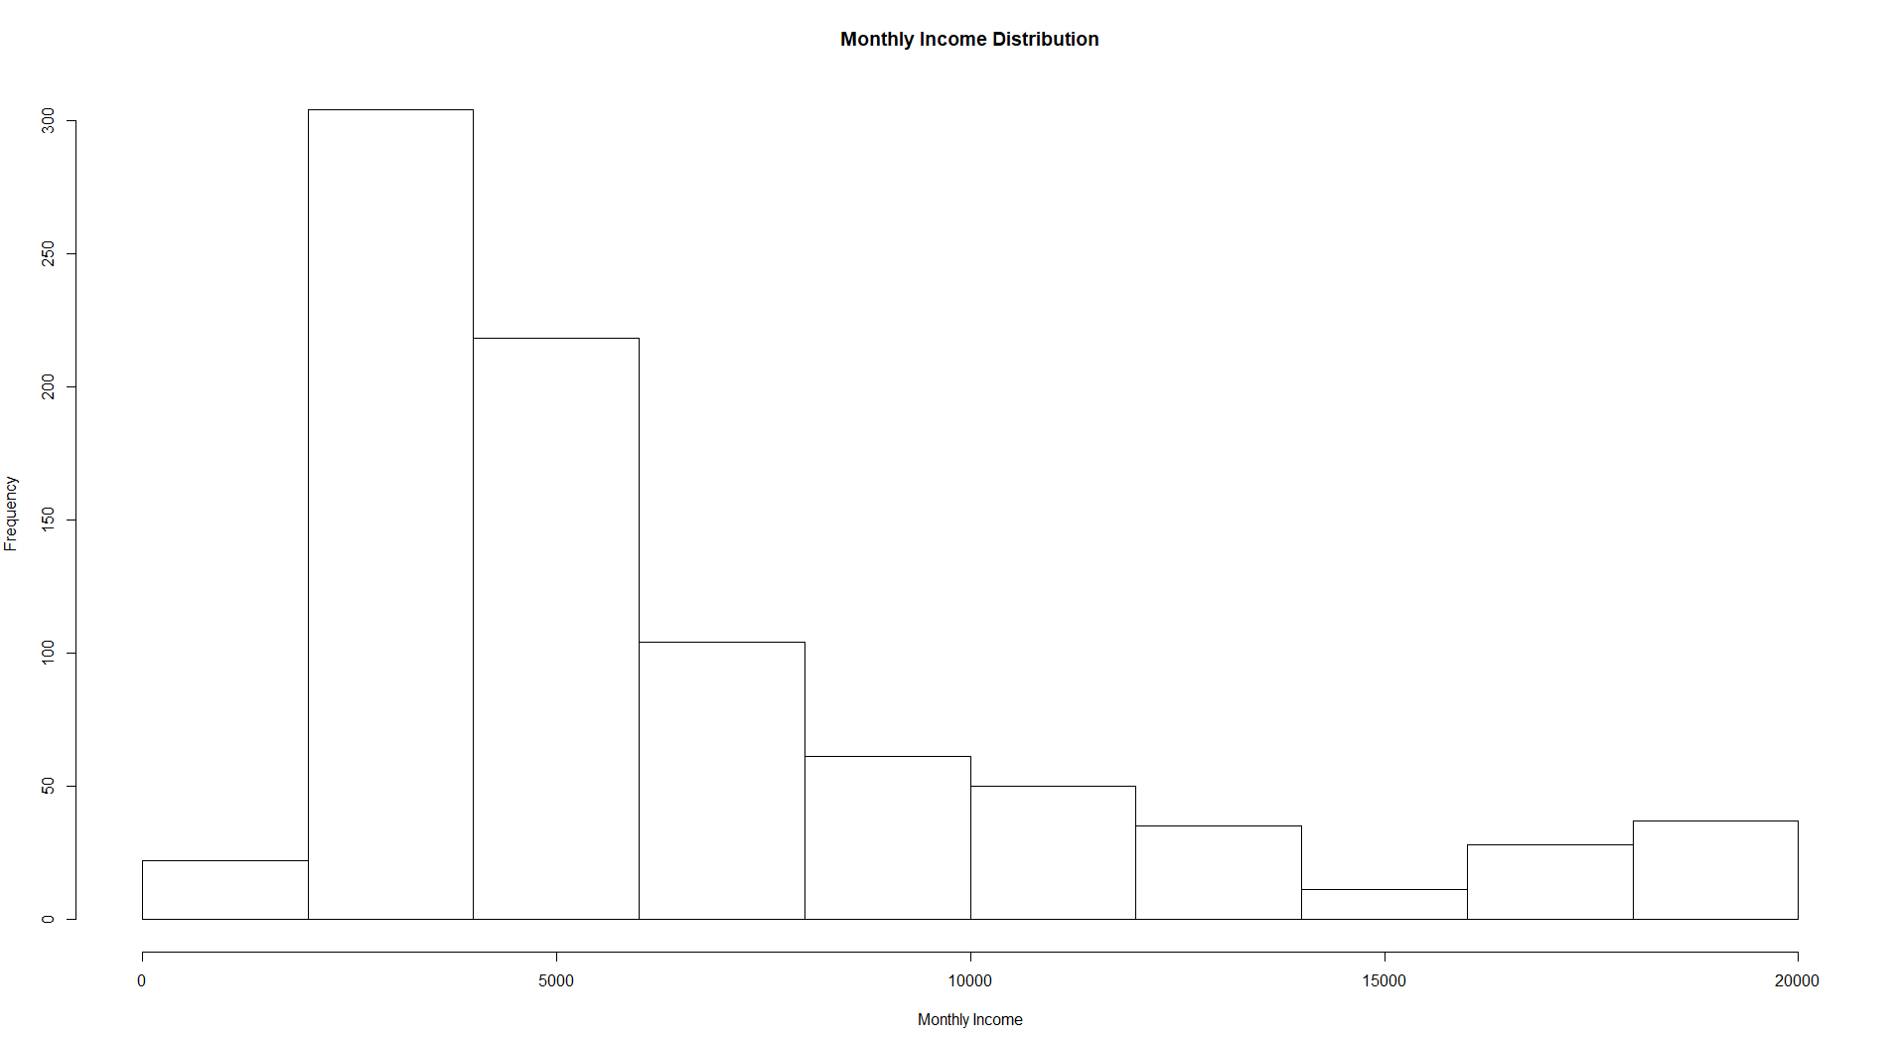
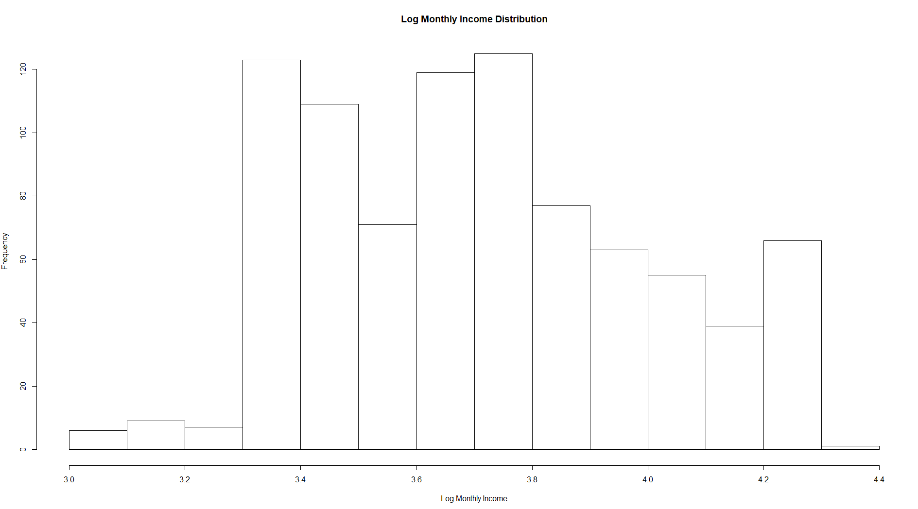
Overview of Income
Higher Incomes are skewing the number to the right
To Make the distribution more normal, we Log Transform Income

Slide 9
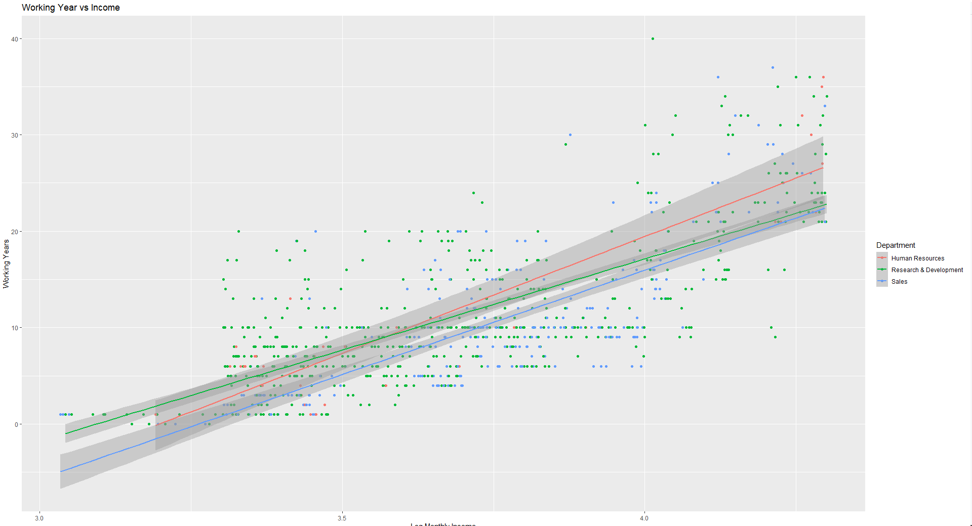
Comparing Working Years to Income

Slide 10
Creating Regression Model
Using our transformed fields we create a regression model using the following fields: LogMonthlyIncome ~ DeptTurnoverLvl + JobLevelGrp + JobRoleLvl + TotalWorkingYears
As can seen by the table below, this model produces an R squared value of 0.8, which explains about 80% of the variability of the in the Log Income Variable.
 | Estimate | Std. Error | t value | Pr(>|t|)
(Intercept) | 4.162 | 0.039 | 106.636 | <2e-16 | ***
DeptTurnoverLvl | 0.071 | 0.008 | 9.238 | <2e-16 | ***
JobLevelGrp | -0.175 | 0.015 | -11.955 | <2e-16 | ***
JobRoleLvl | -0.121 | 0.010 | -12.065 | <2e-16 | ***
TotalWorkingYears | 0.013 | 0.001 | 14.814 | <2e-16 | ***
Multiple R-squared | 0.7965 | Adj. R-squared | 0.7952

Slide 11
Next steps in Engagement
Target Turnover
What areas do we need to focus on?
What tactics can we use to reduce or keep low?
Review Salaries
Are salaries fairly distributed across the company?
Is there equal pay for equal work?

