Slide 1

Jellyfish
Ultimate
Status
Tool

Slide 2
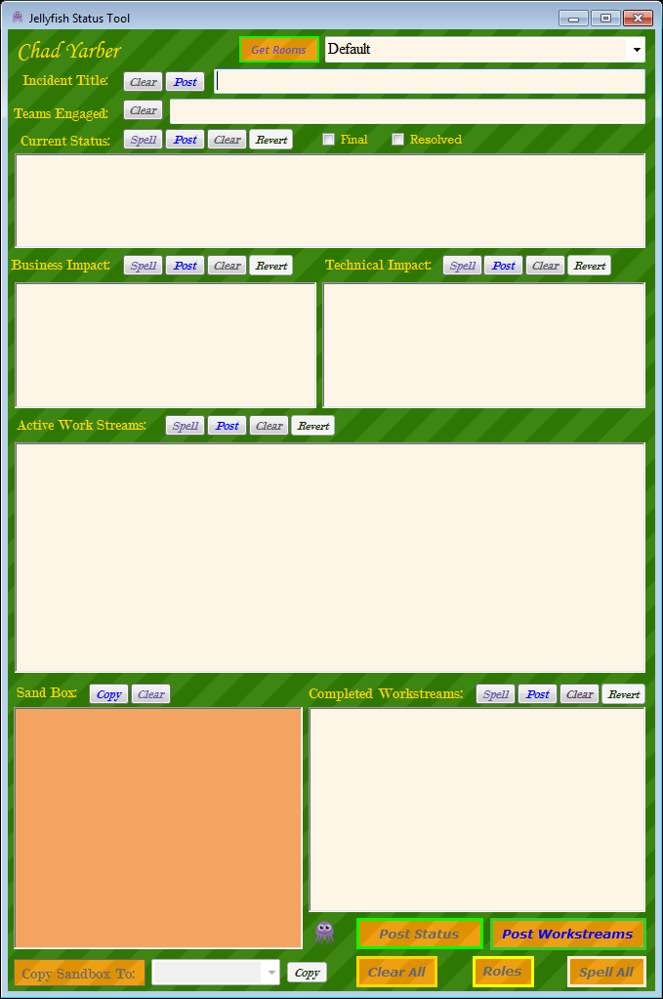
Jellyfish (Deprecated)
Original Jellyfish
Allowed Analysts to create a pre-formatted status update
Status update is copied to the users clipboard to paste into Campfire.
Individual sections can be copied and pasted into Campfire as well.
Users can perform a spell check on individual sections or the full status update.
Problems
To many issues with HipChat
Complicated UX

Slide 3
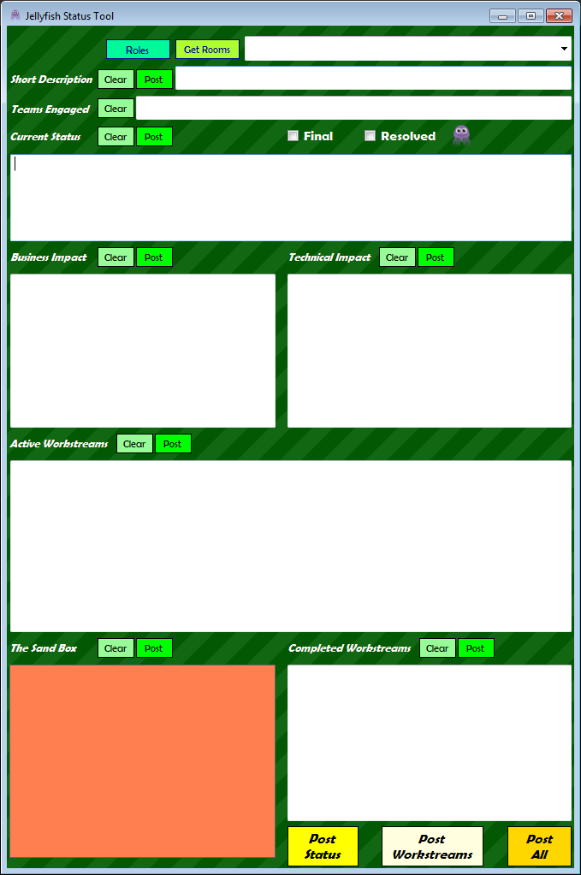
Jellyfish (New!)
Changes to the functionality
Allows direct posting into HipChat Rooms
Individual POST buttons allow users to post that section directly into the chosen HipChat Room.
Simplified UX

Slide 4


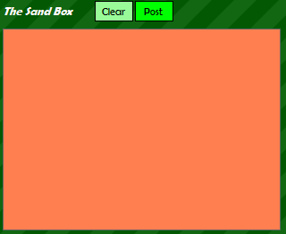

Component:
overview
Get Rooms:
Refreshes room dropdown list
Individual Controls:
Post, Clear
Status Update:
Post Status, Post Workstreams, Post All
The Sand Box:
Post, Clear
Jellyfish Icon:
Allows for background color change

Slide 5
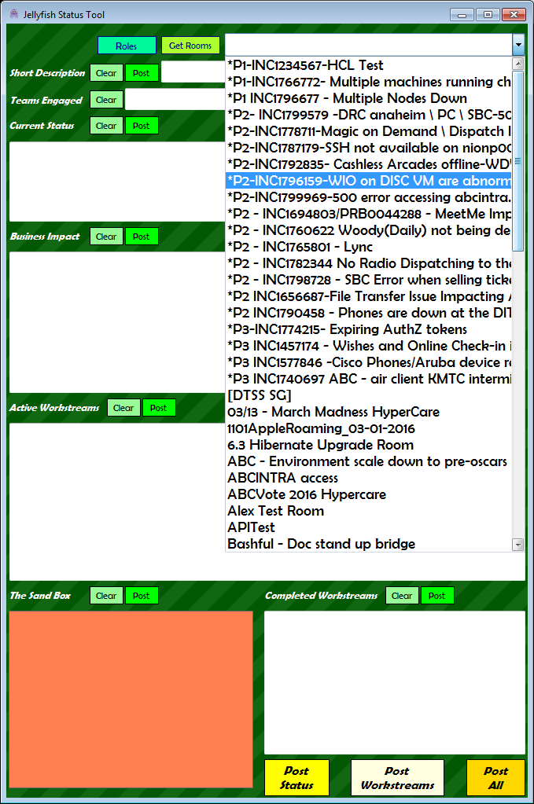
Component
Get Rooms
Get Rooms:
Dropdown list will load the HipChat Rooms when Jellyfish is opened for the first time.
Open the dropdown list to select the room you want to post to.
After you select the room, the Dropdown list will be disabled to prevent room changes.
If you need to Change the room click the Get Rooms button to the left of the dropdown.
Get Rooms allows you to update the tool without closing it.
When you select the room the Short Description will automatically update with the room title

Slide 6

Component Individual Controls
Individual controls:
Post: Post the section directly into the chosen HipChat Room.
Clear: Clears the text in the field, press Crtl+Z to undo a mistake.
*:Explained in Sandbox section

Slide 7
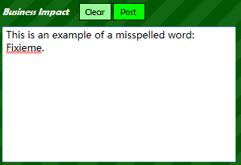
Automatic Spell Check
All Text boxes now come with automatic spell checking
Misspelled words are underlined as shown in the example.
Right-Click on the misspelled word and select from the choices in the dropdown menu to fix the spelling

Slide 8
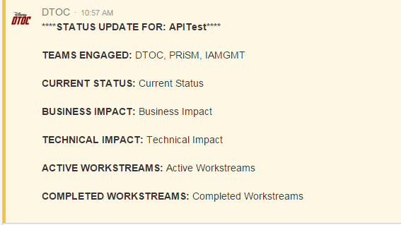
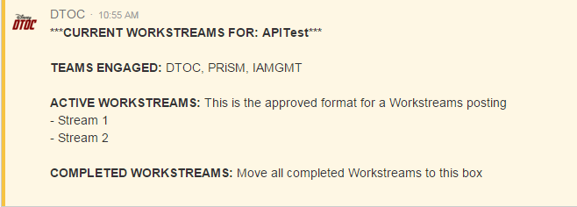
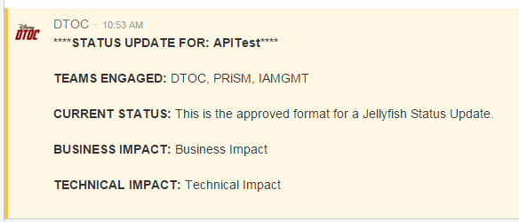
Component
Status Update
All
Status Update:
The Post Status button will send a Status Update to HipChat
Title, Current Status, Business/Technical Impact, Teams Engaged
The Post Workstreams button will post:
Active and Completed Workstreams
Post All:
This will post both the Status and the Workstreams as one post.
Workstreams
Status

Slide 9
Component
Final/Resolved
Final and Resolved:
Selecting either box will add a Final or Resolved tag in front of the title in HipChat.
Uses:
Final:
If the incident is not resolved but a workaround is in place.
Teams will be dropping to reconvene at a later time
The Incident impact has been mitigated but there are lingering issues
Resolved:
The incident is completely resolved with no lingering workstreams

Slide 10
Component
The Sand Box
The Sand Box:
Used to take notes or store important information such as:
Resource phone number
Server names
Important information
The Sand Box can now post into HipChat. Important tips:
The Sand Box does NOT have active spell check
If you are posting from The Sand Box, be warned EVERYTHING will be posted.

Slide 11
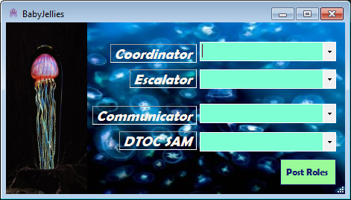
Component
Roles
Roles a.k.a. Baby Jellies:
As before you can identify the currently active DTOC Roles using the Baby Jellies window.
Select the name of the user from the dropdown and click Post Roles.
The list will automatically be sent to the selected HipChat room and the BabyJellyies window will close.

Slide 12

Any Questions?

Slide 13
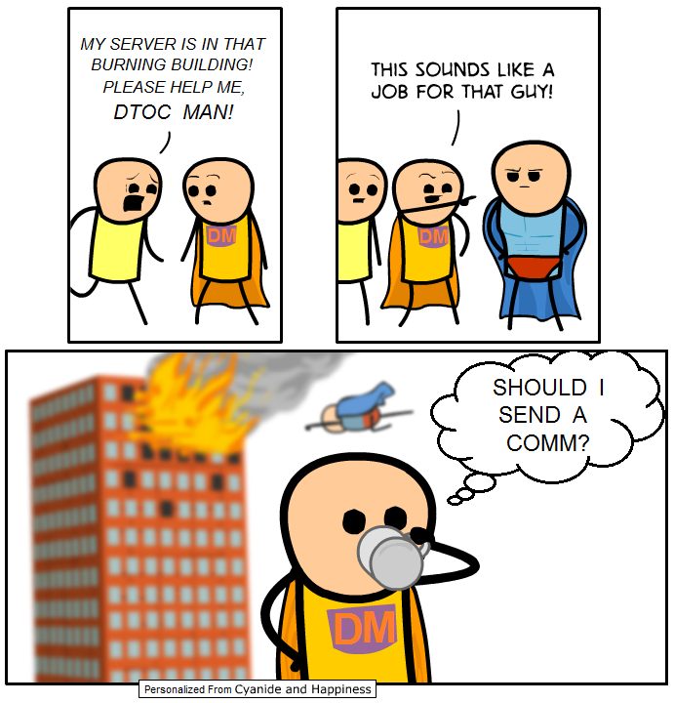
The End
Jellyfish
Ultimate
Status
Tool

