Slide 1
RELATIONAL DATABASES
CHAPTER 2 OF DATA-ORIENTED DESIGN BY RICHARD FABIAN

Slide 2
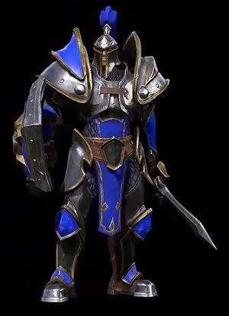
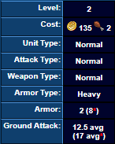
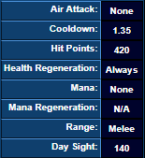
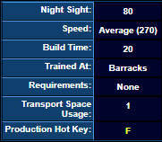
How to OOD to DOD?

Slide 3
NORMALIZING YOUR DATA
Level | EXP | Feats | Ability Score

Slide 4
NORMALIZING YOUR DATA
Level | EXP | Feats | Ability Score
1
2
3
4
5
6
7
8

Slide 5
NORMALIZING YOUR DATA
Level | EXP | Feats | Ability Score
1 | -
2 | 2000
3 | 5000
4 | 9000
5 | 15000
6 | 23000
7 | 35000
8 | 51000

Slide 6
NORMALIZING YOUR DATA
Level | EXP | Feats | Ability Score
1 | - | 1st
2 | 2000 | -
3 | 5000 | 2nd
4 | 9000 | -
5 | 15000 | 3rd
6 | 23000 | -
7 | 35000 | 4th
8 | 51000 | -

Slide 7
NORMALIZING YOUR DATA
Level | EXP | Feats | Ability Score
1 | - | 1st | -
2 | 2000 | - | -
3 | 5000 | 2nd | -
4 | 9000 | - | 1st
5 | 15000 | 3rd | -
6 | 23000 | - | -
7 | 35000 | 4th | -
8 | 51000 | - | 2nd

Slide 8
NORMALIZING YOUR DATA
Level | EXP | Feats | Ability Score
1 | - | 1st | -
2 | 2000 | - | -
3 | 5000 | 2nd | -
4 | 9000 | - | 1st
5 | 15000 | 3rd | -
6 | 23000 | - | -
7 | 35000 | 4th | -
8 | 51000 | - | 2nd

Slide 9
NORMALIZING YOUR DATA
Level | EXP | Feats | Ability Score
1 | NULL | 1st | NULL
2 | 2000 | NULL | NULL
3 | 5000 | 2nd | NULL
4 | 9000 | NULL | 1st
5 | 15000 | 3rd | NULL
6 | 23000 | NULL | NULL
7 | 35000 | 4th | NULL
8 | 51000 | NULL | 2nd

Slide 10
FIRST NORMAL FORM
Level | Feats
1 | 1st
3 | 2nd
5 | 3rd
7 | 4th
Level | Ability Score
4 | 1st
8 | 2nd
Level | EXP
2 | 2000
3 | 5000
4 | 9000
5 | 15000
6 | 23000
7 | 35000
8 | 51000

Slide 11
FIRST NORMAL FORM
Level | Feats
1 | 1st
3 | 2nd
5 | 3rd
7 | 4th
Level | Ability Score
4 | 1st
8 | 2nd
Level | EXP
2 | 2000
3 | 5000
4 | 9000
5 | 15000
6 | 23000
7 | 35000
8 | 51000

Slide 12
FIRST NORMAL FORM
Level | Feats
1 | 1st
3 | 2nd
5 | 3rd
7 | 4th
Level | Ability Score
4 | 1st
8 | 2nd
Level | EXP
2 | 2000
3 | 5000
4 | 9000
5 | 15000
6 | 23000
7 | 35000
8 | 51000

Slide 13
REMOVES CLUTTER EASIER TO READ LESS STATES TO CONSIDER

Slide 14
SECOND NORMAL FORM
Weapon Type | Quality | Damage | Damage Type

Slide 15
SECOND NORMAL FORM
Weapon Type | Quality | Damage | Damage Type
Sword
Sword
Sword
Lance
Lance
Hammer
Hammer

Slide 16
SECOND NORMAL FORM
Weapon Type | Quality | Damage | Damage Type
Sword | Rusty
Sword | Average
Sword | Masterwork
Lance | Average
Lance | Masterwork
Hammer | Rusty
Hammer | Average

Slide 17
SECOND NORMAL FORM
Weapon Type | Quality | Damage | Damage Type
Sword | Rusty | 2d4
Sword | Average | 2d6
Sword | Masterwork | 2d8
Lance | Average | 2d6
Lance | Masterwork | 3d6
Hammer | Rusty | 2d4
Hammer | Average | 2d4+4

Slide 18
SECOND NORMAL FORM
Weapon Type | Quality | Damage | Damage Type
Sword | Rusty | 2d4 | Slashing
Sword | Average | 2d6 | Slashing
Sword | Masterwork | 2d8 | Slashing
Lance | Average | 2d6 | Piercing
Lance | Masterwork | 3d6 | Piercing
Hammer | Rusty | 2d4 | Crushing
Hammer | Average | 2d4+4 | Crushing

Slide 19
SECOND NORMAL FORM
Weapon Type | Quality | Damage | Damage Type
Sword | Rusty | 2d4 | Slashing
Sword | Average | 2d6 | Slashing
Sword | Masterwork | 2d8 | Slashing
Lance | Average | 2d6 | Piercing
Lance | Masterwork | 3d6 | Piercing
Hammer | Rusty | 2d4 | Crushing
Hammer | Average | 2d4+4 | Crushing

Slide 20
SECOND NORMAL FORM
Weapon Type | Quality | Damage | Damage Type
Sword | Rusty | 2d4 | Slashing
Sword | Average | 2d6 | Slashing
Sword | Masterwork | 2d8 | Slashing
Lance | Average | 2d6 | Piercing
Lance | Masterwork | 3d6 | Piercing
Hammer | Rusty | 2d4 | Crushing
Hammer | Average | 2d4+4 | Crushing

Slide 21
SECOND NORMAL FORM
Weapon Type | Quality | Damage
Sword | Rusty | 2d4
Sword | Average | 2d6
Sword | Masterwork | 2d8
Lance | Average | 2d6
Lance | Masterwork | 3d6
Hammer | Rusty | 2d4
Hammer | Average | 2d4+4
Weapon Type | Damage Type
Sword | Slashing
Lance | Piercing
Hammer | Crushing

Slide 22
SECOND NORMAL FORM
Weapon Type | Quality | Damage
Sword | Rusty | 2d4
Sword | Average | 2d6
Sword | Masterwork | 2d8
Lance | Average | 2d6
Lance | Masterwork | 3d6
Hammer | Rusty | 2d4
Hammer | Average | 2d4+4
Weapon Type | Damage Type
Sword | Slashing
Lance | Piercing
Hammer | Crushing

Slide 23
REMOVES REDUNDANCY GRANULARITY FLEXIBLE BEHAVIORS

Slide 24
THIRD NORMAL FORM BOYCE-CODD DOMAIN KEY / KNOWLEDGE

Slide 25
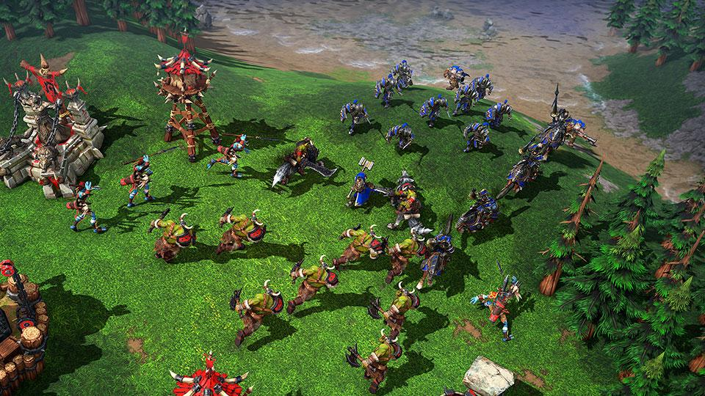
HOW DO ENTITIES INTERACT?

Slide 26
INSERTIONS DELETIONS UPDATES

Slide 27


Slide 28
INSERTION
Entity | Speed | Damage | Health
0 | 25.0f | 35 50 | 100

Slide 29
INSERTION
Entity | Speed | Damage | Health | Selected
0 | 25.0f | 35 50 | 100

Slide 30
DELETION
Entity | Speed | Damage | Health | Selected
0 | 25.0f | 35 50 | 100

Slide 31
DELETION
Entity | Speed | Damage | Health
0 | 25.0f | 35 50 | 100

Slide 32
UPDATE
Entity | Speed | Damage | Health
0 | 25.0f | 35 50 | 100

Slide 33
UPDATE
Entity | Speed | Damage | Health
0 | 25.0f | 35 50 | 50

Slide 34
UPDATE
Entity | Speed | Damage | Health
0 | 12.5f | 20 35 | 50

Slide 35
ANY QUESTIONS?

