Slide 1

Team GVSU Milestone #1
Members: Chris Schaefer, Laura Young and Chad Mersino

Slide 2
Introduction to FFPAC
Faculty Facilities Planning Advising Committee
Committee of GVSU Faculty that overviews classrooms on campus
Conduct yearly walkaround of the campuses and visit each classroom
Note any needed renovations of all aspects for a classroom
Information can be used not only to make immediate changes, but can change the way classrooms are delegated for the next school year
In need of application to centralize information along with collecting information in a user friendly format

Slide 3
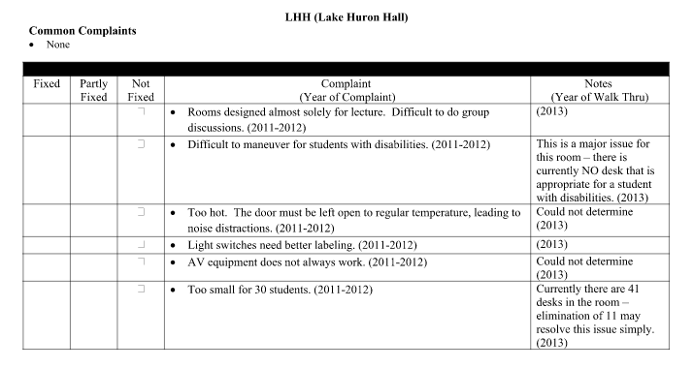
Old System Consisted of 41 Pages of...
Notes:
Here's the old system… Lot of useless information that is unorganized and is not shared amongst multiple users. This layout is troublesome in many ways:
Unorganized and hard to read
Not able to be updated by multiple users efficiently
Hard to tell what is fixed and what is broken
Information can easily be lost if only connected to this one file
Not user friendly to enter information
No verification that someone fixed the problem itself
No room for improvement, more entries = more complexity

Slide 4
Desired Application
Front end website application linked to a database
Have two main pieces for this project to work
Front end website with forms to fill out per complaint
Link front end to database to save entries and can be referenced at any time
The front end must apply to multiple mediums since this will be on the fly complaint registering (mobile friendly)
Give the application a GVSU theme
If time allows, involve more complex solutions (room selection by map, keyword search, etc.)

Slide 5
Frameworks/Languages
AMP Stack [Apache, MySQL, PHP, Perl]
PHP
Wordpress PHP Framework
Template hack
Custom database class to build SQL

Slide 6
Development Process
Agile style of development
Hold sprints for the week and accomplish a task, build up to main picture
Check project specifications to ensure integrity of what is built to what is desired
Once main application was working, contact representatives about progress and showcase prototype of full application

