Slide 1
Development of a personal color analysis and customized style recommendation algorithm using deep learning analysis of face images
20191131 Chanwoo Park
20191146 Seunghyeon Seo
20221422 Chaerin Hwang
20221038 Dahyun Kim

Slide 2
Outline
Introduction
Description
Contributions

Slide 3
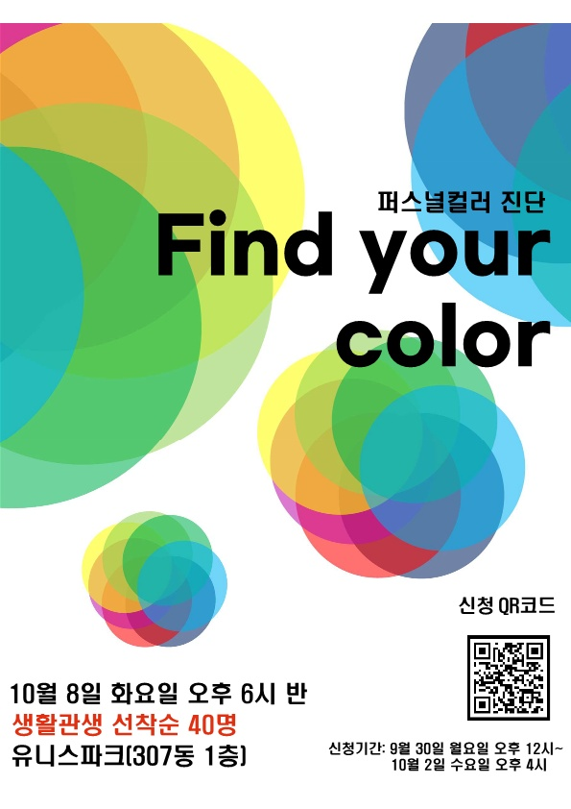

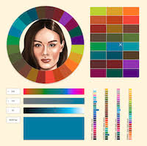
Introduction

Slide 4

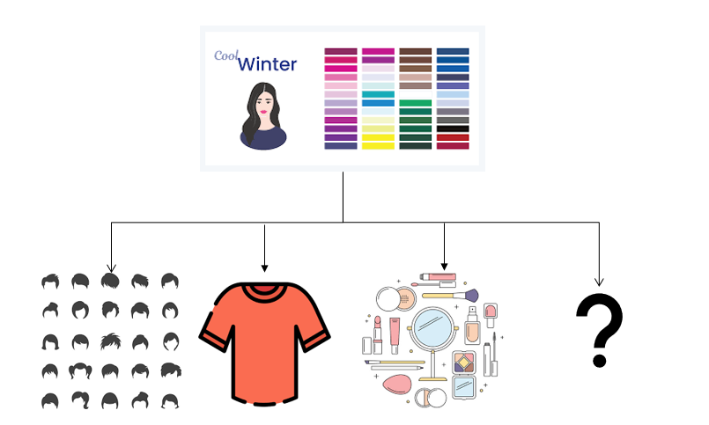
Description

