Slide 1
YouTube View Count Prediction Train with small data
Team 6
Suho Park
Chaejin Lim
Jaejoon Yoo
Jeongyeop Seo
Jihyun Lee

Slide 2
01
Our model
02
Cross validation
Contents
03
Overfitting with train data
04
Visualize trainable variables
05
Result

Slide 3
01
Our Model
Our novelty
YouTube View Count Prediction Model
Predicting YouTube Food Casting(먹방 유튜브) view counts by using thumbnail, title, number of subscribers and period
It may be useful for the people who want to measure the quality of their thumbnails
Thumbnail encoder
Thumbnail
Predictor
Title encoder
Title
Number of views
Number of Subscribers
Period

Slide 4
01
Our Model
Thumbnail Encoder
Output: Feature Map
Extract the feature map using EfficientNet B1 Pruned (light version)
Thumbnail(320 * 180 * 3) -> feature map (10 * 6 * 320)
Thumbnail encoder
Thumbnail
Feature Map

Slide 5
01
Our Model
Title Encoder
Output: Doc2Vec
Make it an embedding vector and match the lengths.
Make the paragrams with high similarity have similar vectors.
Title encoder
Title
Doc2Vec

Slide 6
01
Our Model
Predictor - Part 1
Extract Thumbnails & Title features
Conv
+ ReLU
Max
Pool
10
FC
+ReLU
FC
+ReLU
Feature Map
Dense
Feature Map
10
Thumbnails
&Title feature
Input
10
Doc2Vec

Slide 7
01
Our Model
Predictor - Part 2
Predict views
We compress the size of Thumbnails&Title feature parameter to 10 because we thought that Number of Subscribers and Period (Day) were powerful parameters.
10
FC
+ReLU
FC
+ReLU
FC
Thumbnails
&Title feature
Number of Subscribers
1
1
log10(views)
1
Period (day)
Input

Slide 8
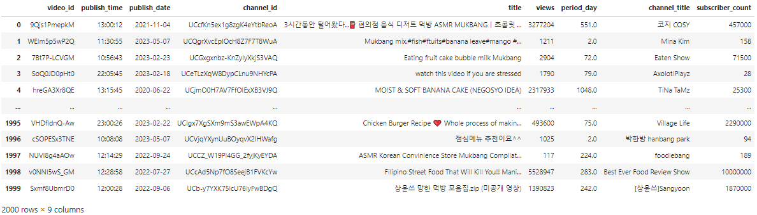
02
Cross validation set
Dataset
2000 rows were extracted from data of about 15000 lines and made a small dataset.
Thumbnail image data is stored as a file and read as a video_id value and used.

Slide 9
02
Cross validation set
Cross validation
Make 10 Cross validation datasets
Validation
Train
Test
Case1
random
0~199
Case2
random
200
~
399
. . .
Case10
random
1800
~
1999

Slide 10
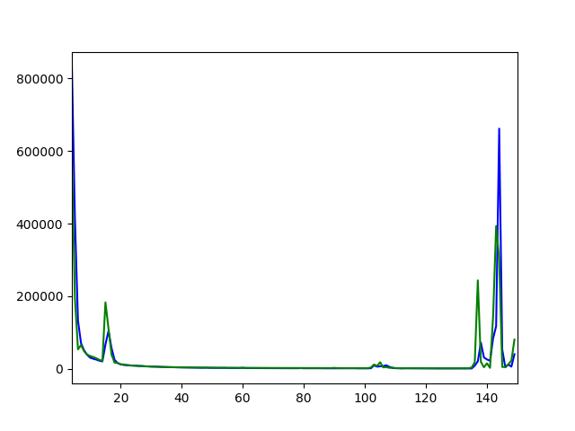
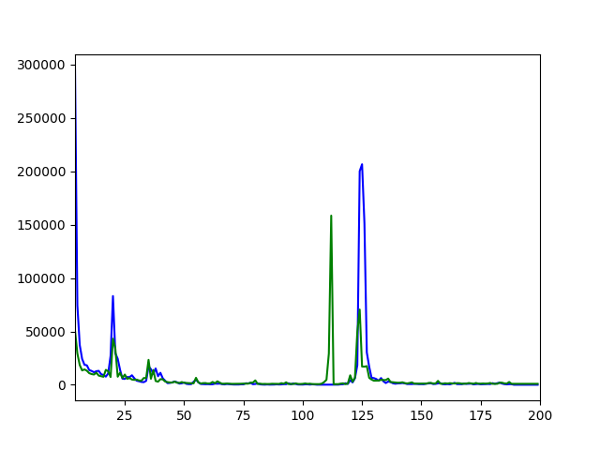
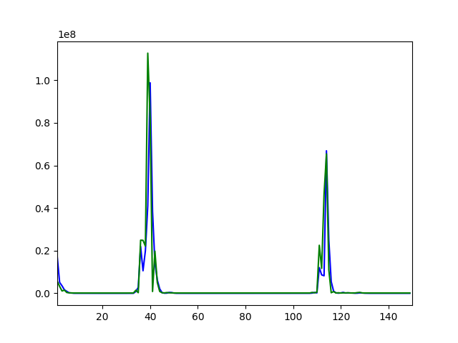
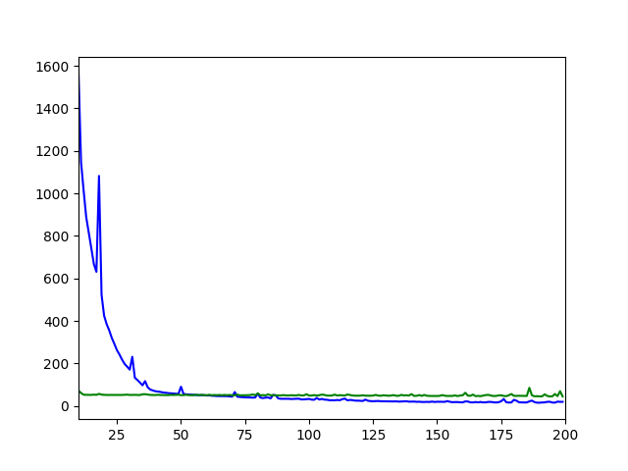
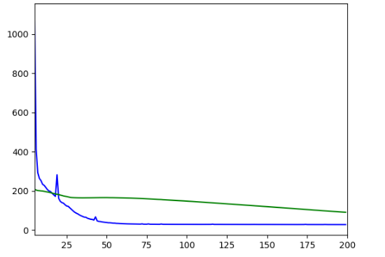
02
Cross validation set
Train with cross validation set
We tried from case 1 to case 5.
Hyper Parameters:
- batch_size = 128
- epochs = 200 (some are 150)
- learning rate = 0.005
Case4
Test MSE
1096.45
🤔
Case5
Test MSE
3449.11
train
valid
Case1
Test MSE
31.76
Case2
Test MSE
17.27
Case3
Test MSE
17.21

Slide 11
03
Overfitting with train data
Observe Overfitting
losses does not converge to zero
It was difficult to confirm the overfitting due to the time of the trainning and unstable loss.

Slide 12
03
Overfitting with train data
Fail to converge to zero-like values
There was an intermittent increase in loss.
There seems to be a problem with training
- Lack of data - Learning rate - Model Complexity - Input data nomalization

Slide 13
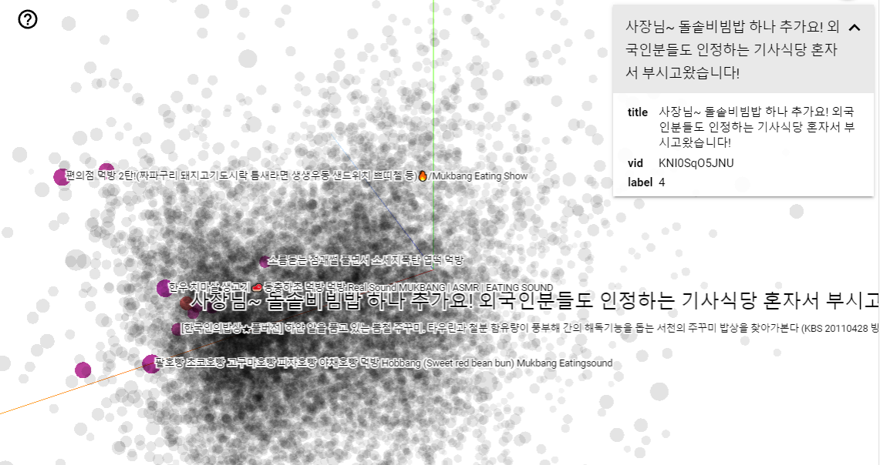
04
Visualize trainable variables
Doc2Vec Visualization
사장님~ 돌솥비빔밥 하나 추가요! 외국인분들도 인정하는 기사식당 혼자서 부시고왔습니다!
Using Embedding Projector (Google)
https://projector.tensorflow.org/
similar
한우 치마살 생고기🥩동충하초 먹방 먹방 Real Sound MUKBANG | ASMR | EATING
SOUNDSPICY SRI LANKAN FOOD IS SO FLAVOURFUL
팥호빵 초코호빵 고구마호빵 피자호빵 야채호빵 먹방 Hobbang (Sweet red bean bun) Mukbang Eatingsound
소름돋는 점괘썰 풀면서 소세지폭탄 엽떡 먹방
5시간 걸렸네요. 우족찜은 사드세요.. SPICY

Slide 14
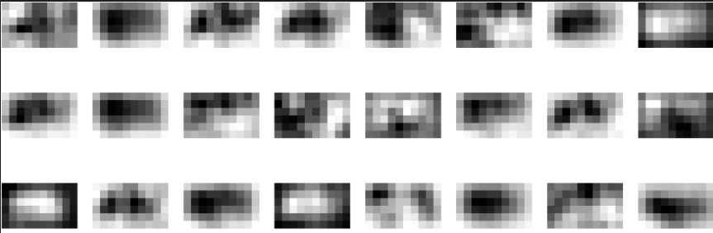

04
Visualize trainable variables
CNN Filter Visualization
Feature Map
Sample
Conv Filter
Sample

Slide 15
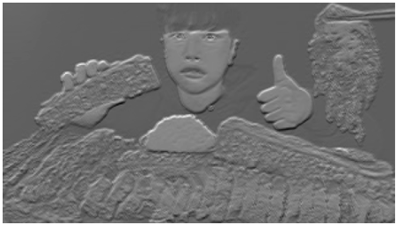

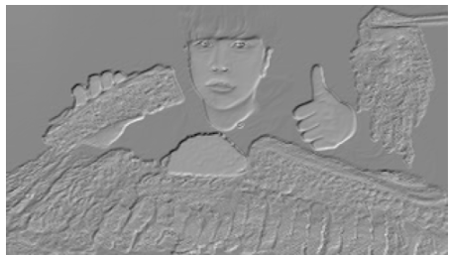
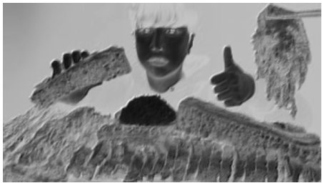
04
Visualize trainable variables
CNN Filter Visualization

Slide 16
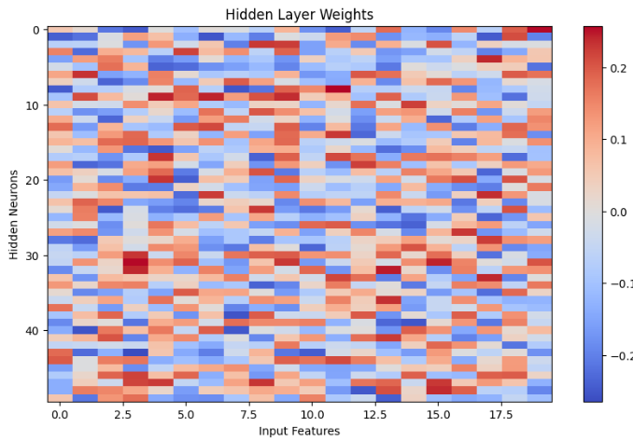
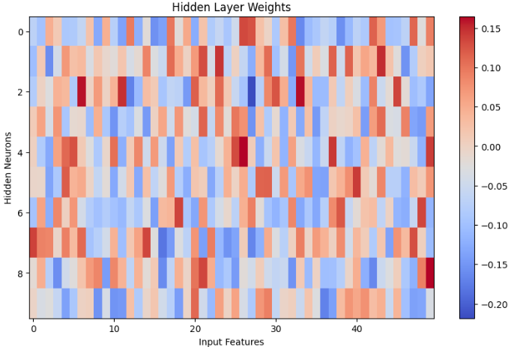
04
Visualize trainable variables
Hidden node Visualization
Conv
+ ReLU
Max
Pool
FC
+ReLU
FC
+ReLU
Feature Map
Dense
Feature Map
Thumbnails
&Title feature
Input
Doc2Vec

Slide 17
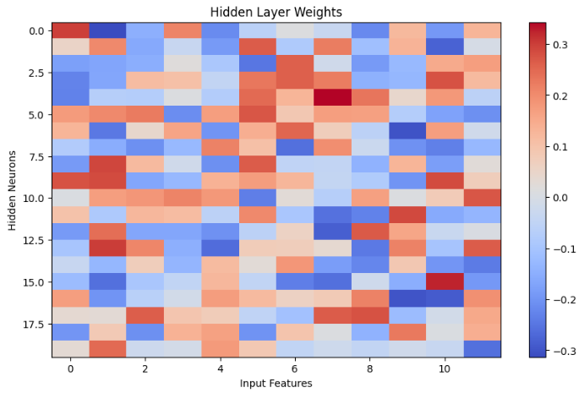
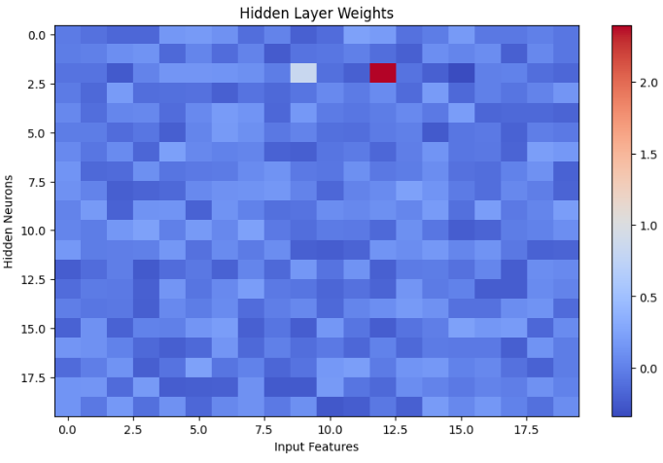
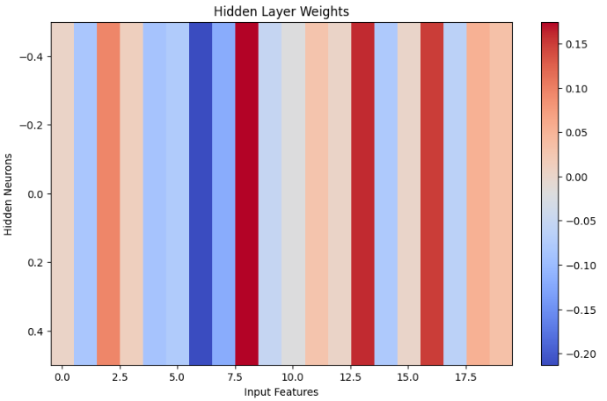
04
Visualize trainable variables
Hidden node Visualization
There are many values with a weight close to zero.
- Only the sparse features affect the output value.
- The output value is too small for the input value
Thumbnails
&Title feature
10
FC
+ReLU
FC
+ReLU
FC
Number of Subscribers
1
1
log10(views)
1
Period (day)

Slide 18
05
Result
Experiment Result (not cross evaluation)
Train : Valid : Test = 1600 : 200 : 200
MSE (Train) : 19.11
MSE (Valid) : 44.61
MSE (Test) : 17.21
Thumbnail encoder
Thumbnail
Predictor
Title encoder
Title
Number of views
Number of Subscribers
Period

Slide 19
05
Result
Experiment Result of Baseline
Train : Test = 1042 : 116
MSE (Train) : 1.19e-22
MSE (Test) : 0.61
Greyscale
+ Flatten
Thumbnail
(120,90,3)
Linear
Regression
Number of views
Number of Subscribers
Period

Slide 20
05
Result
Todo
Find Best Hyper-parameter
Train with Full data
Normalize Input data
Consider other loss function (RMSE, RMSLE, R Square)
Find a way to limit the output to between 0 and 10

