Slide 1
PVDF TOP K012
20

Slide 2
THIS WARRANTY IS VALIDATED FOR STEEL & ALUMINUM COATED BY PVDF COIL COATING SYSTEM FOR 20YEARS AND ALSO THIS WARRANTY APPLIES ONLY TO BELOW WARRANTY ITEMS.
WARRANTY ITEMS
This warranty becomes effective when the paint film under the hereinafter stated condition is found to;
Perforation
Prepainted PVDF TOP Is warranted against perforation by corrosion 20years after installation.
Peel, crack on the surface of coil coated sheet
Any defect must be recognized by naked eye investigation vertically from a distance of 2 meters. Defects for crazing or cracking that may occur from roll forming or sheet forming are not covered under this warranty.
Fade or change in color
Fading or changing is not excess as determined in accordance with the procedures outlined in ASTM D2244-93 measured on the exposed pained surfaces which have been cleaned of external deposits(dirt, oil, grease, foreign material, oxidized film, etc.) and chalk per ASTM D 3964. It is understood that fading or color changes may not be uniform if the surfaces are not equally exposed to the sun and elements.
Chalk
Chalk will not exceed numerical ratings when measured in accordance with the standard procedure specified in ASTM D 4214-89 on clean surface after removing dirt, other surface deposit per ASTM D 3964.
Warranty terms
Installed Area | Use of panel | Warranted terms
 |  | Perforation | Peel & flake | Color change | Chalk
Residential, Commercial, Light industrial | Roof (>500m from marine & Industrial environment) | 20 Y | 20 Y | ≤ΔE5 (20Y) | ≥#8 (20Y)
 | Wall (>500m from marine & Industrial environment) | 20 Y | 20 Y | ≤ΔE5 (20Y) | ≥#8 (20Y)

Slide 3
THIS WARRANTY SHALL BE SUBJECT TO STIPULATIONS AND CONDITIONS HEREINAFTER SET FORTH;
This warranty applies to goods used on metal building installed in Vietnam.
This warranty is a 2COAT and 2BAKE coating method, and the TOP surface (PRIMER+BASE) thickness is 25(±2)㎛. The primer coating thickness is 5(±1)㎛.
The PVDF top steel & aluminum paint finish as supplied must not be scratched, abraded, or damaged in any way, or coated with an incompatible material.
Sheltered areas or areas unwashed by rain exposure must be washed down on a regular 6 monthly basis. Corrosion arising in unwashed areas will not be covered by the warranty.
The warranty term regarding the fading and chalk of the paint is not applied to fundamental pigmentation colors.
The product, as supplied, must not at any time come into contact with an incompatible material.
The application of post paint treatment or system to the product will invalidate this warranty.
All flashings, fasteners or components fixed to or used with the product must be installed with PVDF TOP on galvanized steel, galvalume, aluminum substrates or materials approved by SeAH Coated Metal.
Installed pitch of the roof is equal to greater than 5 degrees above the horizontal.
The roof is fully lined and does not contain exposed eaves or other areas sheltered or unwashed by natural rainfall.
Wall sheeting must not be used as concrete formwork or be immersed during construction or immersed during general exposure.
The walling must not be protected from washing by natural rainfall due to structures including, without limitation, canopies, patios, carports or verandas, other than by eaves which extend no greater than 600mm out from the wall.
This warranty will not cover the defect due to the following causes:
Damage to the coating due to the improper processing, transportation, handling or installation.
Defects attributed to faulty design, method of manufacture or installation of the product.
Exposure in abnormal conditions: excessively polluted areas, excessively humid areas, tropical areas, in the vicinity of chemical or iron industry.
Contact with concrete, mortar, soil, ash, fertilizer, moisture retaining substances, lead or copper and other dissimilar metals, chemical agents, liquid from copper flashings or copper pipes, green or wet timber or treated timber.

Slide 4
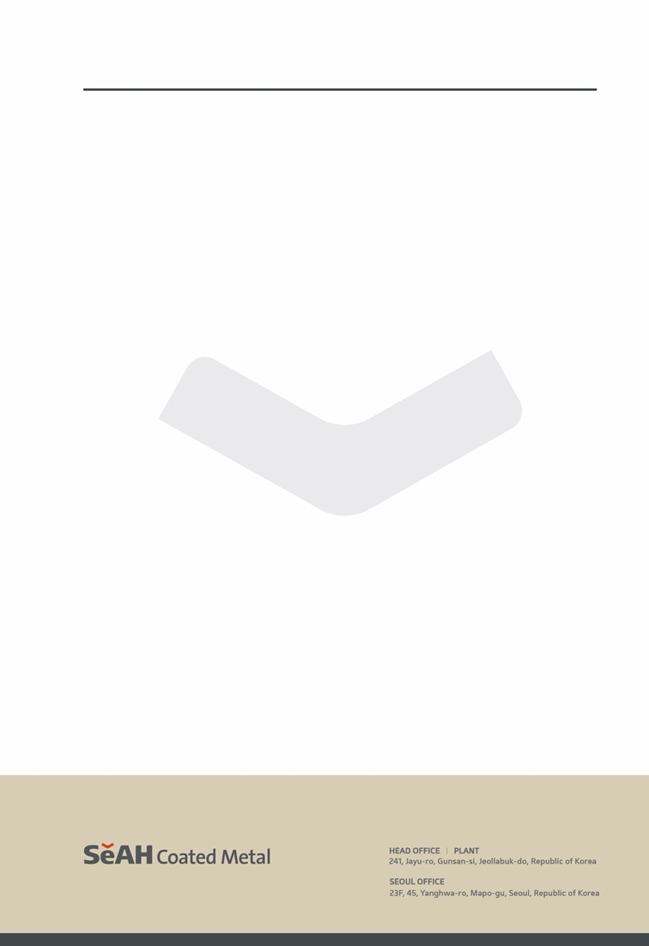
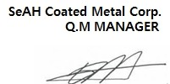
Attack from chemical or other agents, fumes, liquids or solids other than direct rain or run-off falling
onto the product.
6) Failure to remove debris and/or failure to provide free drainage of water including internal
condensation from all surfaces of the product.
Installations subject to salt marine, severe industry or unusually corrosive environments at any time in the future.
Corrosion arising within lapped areas of end-lapped sheets. Corrosion at cut edges.
Failure to replace corroded fasteners.
With regard to paint delamination (peel or flake), the internal facing surface of the product.
Damage or failure which is occurring from natural disaster, fire, flood, explosion, falling stone, acts of war, riots, vandalism, salt spray, atomic radiation, typhoons, other similarly extreme ‘acts of God’.
Damage resulting from exposure to extreme or abnormal environments characterized by high corrosion and pollution, including but not limited to: humid or tropical climates, coastal areas within a 500m radius, elevations exceeding 900m, and vicinities of chemical or steel industrial plants with significant chemical contamination.
Claims must be submitted within the guarantee period and within thirty (30) days after discovering the defect. Purchaser must notify the defect contents to SeAH Coated Metal in writing and give Union a reasonable opportunity to inspect the material. And If possible, Purchaser must provide SeAH Coated Metal 3 samples of defect mentioning coil No., product name and lot No., shipping date and end user. If not, It has to be investigated by SeAH Coated Metal or third parties.
End user must also maintain records for 21years that will identify the master coil number for each building erected in the field, which shall be available to SeAH Coated Metal on request.
This warranty becomes effective when all of above conditions are done.
2026.04.27

