Slide 1

Hospital Accessiblity
Geog 458 - Group AA1
Abi Chinn, Chaeri Hong, Yezhen Chen, Wyatt Stanley, Elijah Price

Slide 2
Project Description
The Geonarrative project maps hospital accessibility from a nationwide overview to detailed analyses in Washington State and Seattle. It showcases disparities in access and its impact on health outcomes through maps of hospital locations, population densities, and minority distributions.

Slide 3
Project Description
This project developed with VSCode, Mapbox for GitHub Pages, QGIS, QMetaTiles and Github.

Slide 4
Functions
The project features maps illustrating hospital availability in the U.S., Washington, and Seattle, using datasets to show access patterns. Users can scroll to see maps transitioning from national to local levels and click on red points for hospital details, revealing disparities in access from country to city.

Slide 5

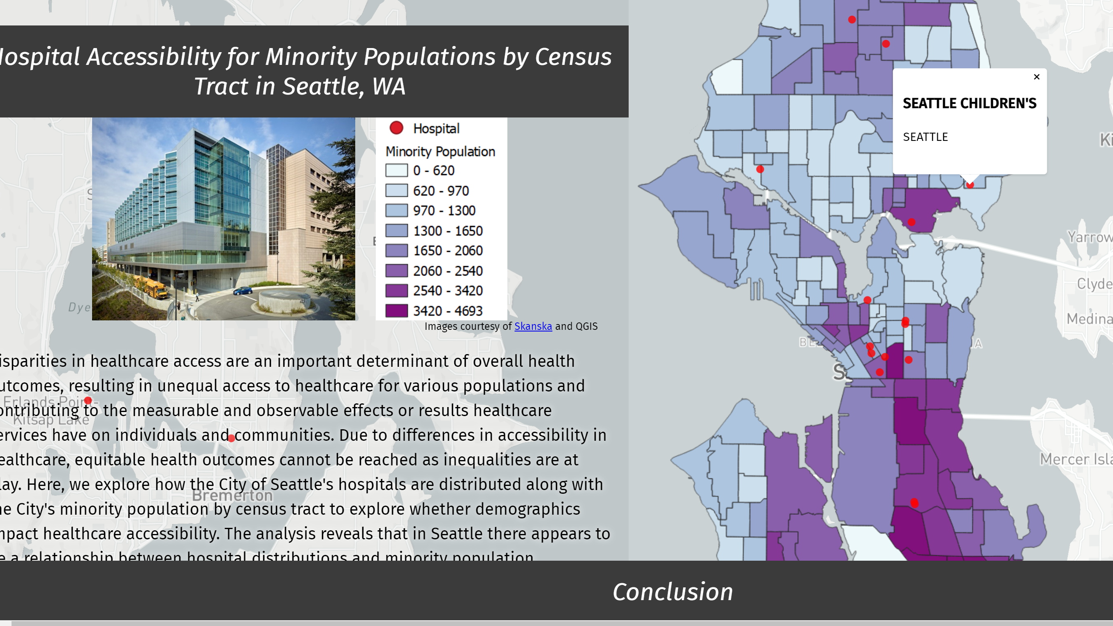
Example

Slide 6
Project goal
The project focuses on highlighting disparities in hospital access across the U.S., particularly in Washington and Seattle, and how these disparities affect health outcomes by increasing travel times for care.

Slide 7
Target Audience
The project aims to mobilize community members and inform government officials to advocate for better hospital accessibility in underserved areas, leveraging grassroots support to address potential healthcare disparities.

Slide 8
Data Sources
American Hospital Directory. (2023). Hospital Statistics by State. American Hospital Directory [Data Table]. Retrieved from https://www.ahd.com/state_statistics.html.
Erica Gardner. (2023). WAOFM - Census - Population Density by County by Decade, 1900 to 2020. Data.wa.gove [CSV]. Retrieved from https://data.wa.gov/demographics/WAOFM-Census-Population-Density-by-County-by-Decad/e6ip-wkqq/about_data.
Private Member (City of Seattle ArcGIS Online). (2023). 2020 Census Tracts - Seattle. Seattle GeoData [Shapefile]. Retrieved from https://data-seattlecitygis.opendata.arcgis.com/datasets/9075e8c912a24c4b9458af8866c72ae7/explore?location=59.801857%2C-99.687557%2C3.71.
Private Member (GeoPlatform ArcGIS Online). (2023). Hospitals. Homeland Infrastructure Foundation-Level Data [Shapefile]. Retrieved from https://hub.arcgis.com/datasets/geoplatform::hospitals/explore?location=47.635176%2C-122.255440%2C11.41.
Census Geographic Files. (2010): https://ofm.wa.gov/washington-data-research/population-demographics/gis-data/census-geographic-files
Department of Health (2023). Hospitals. Washington State Department of Health [Shapefile]. Retrieved from https://data-f2977-wa-geoservices.opendata.arcgis.com/datasets/626cb2ca35c64ea1a2ac502c573e3ec9/explore?showTable=true

Slide 9

County Population

Slide 10
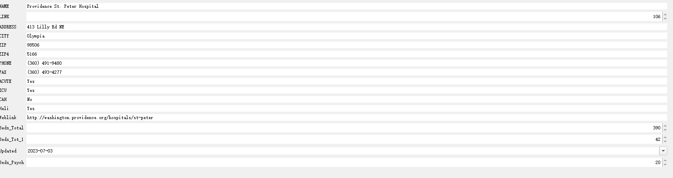
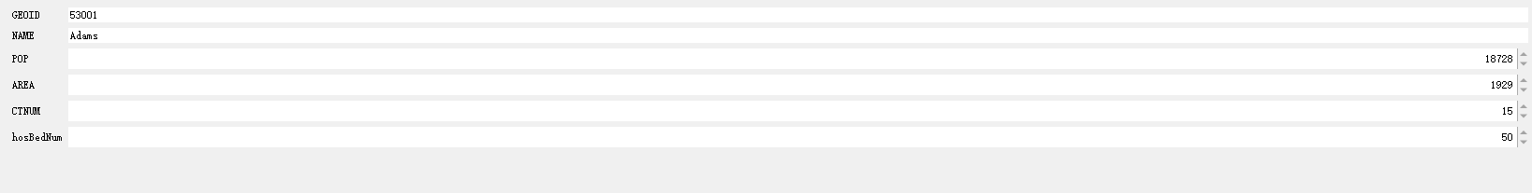
Hospital Location and Bed data

Slide 11
Our GeoNarrative
https://chaerihong.github.io/geog458_aa1_finalproject/

Slide 12
Thank you for listening

