Slide 1

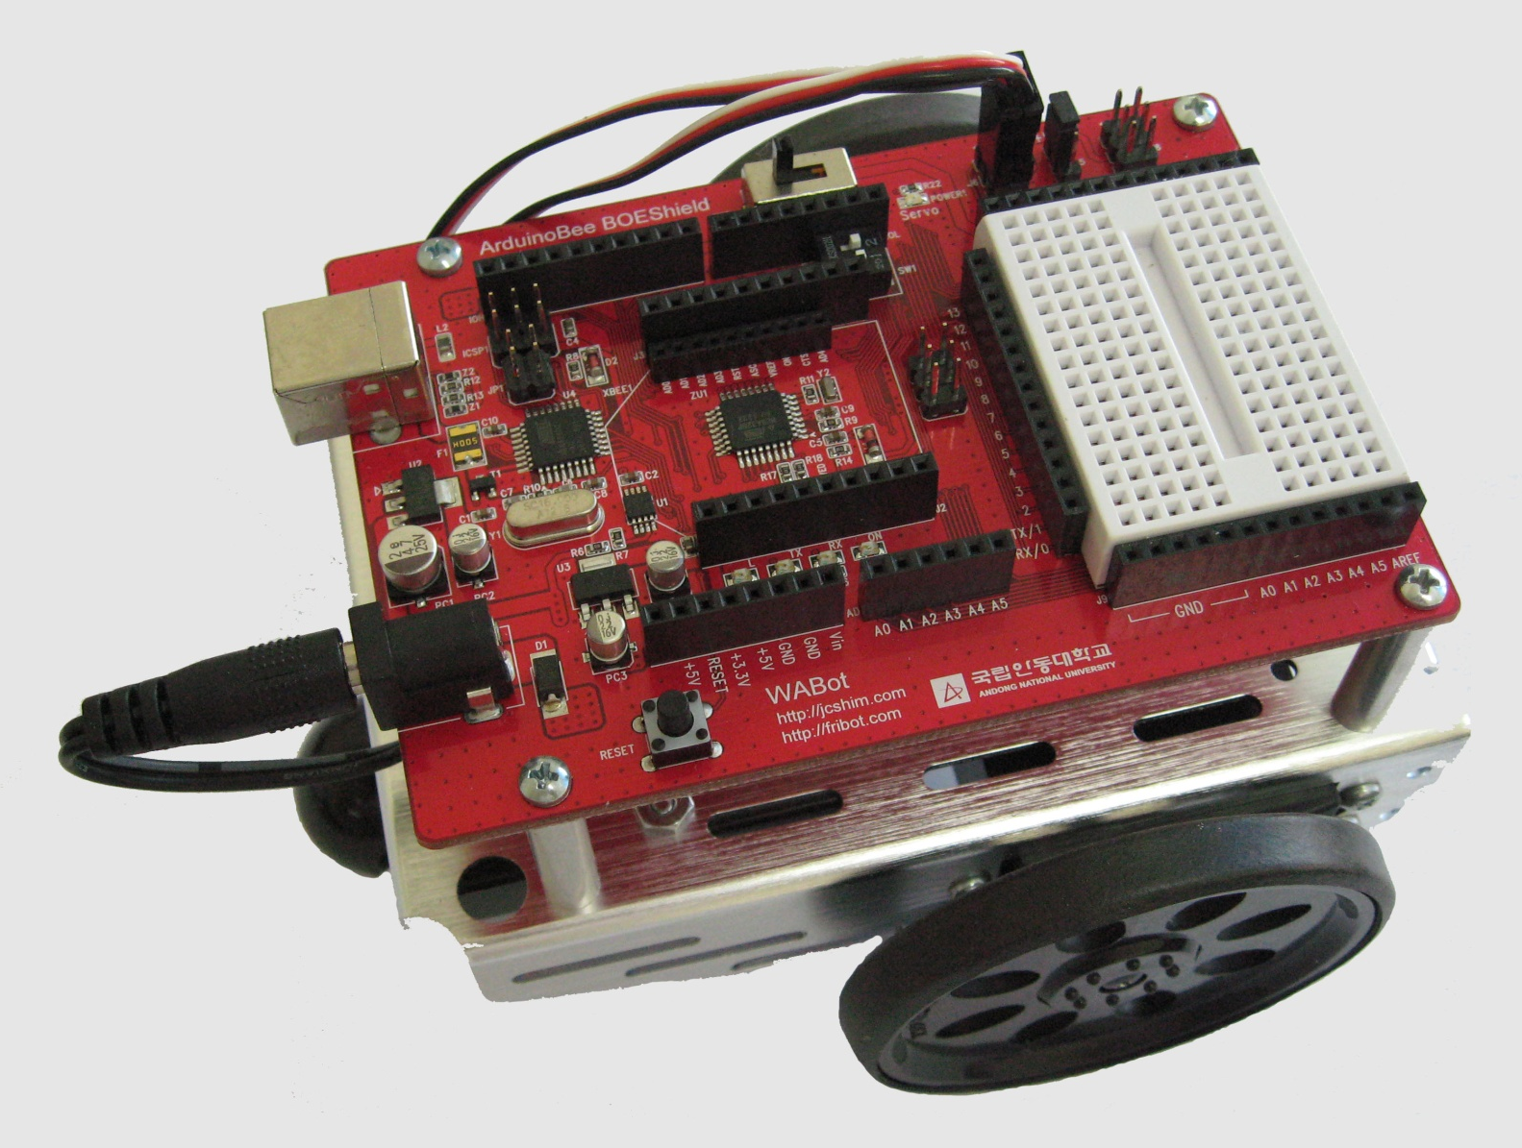
ABOT 조립 / 주행
컴퓨터소프트웨어공학과
IoT프로그래밍

Slide 2
목 차
1. ABOT 조립하기
2. ABOT 기본 동작

Slide 3
2.2.5 점진적으로 변속 주행하기
#include <Servo.h> // Include servo library
Servo servoLeft; // Declare left and right servos
Servo servoRight;
void setup() // Built-in initialization block
{
tone(4, 3000, 1000); // Play tone for 1 second
delay(1000); // Delay to finish tone
servoLeft.attach(13); // Attach left signal to pin 13
servoRight.attach(12); // Attach right signal to pin 12
for(int speed=0; speed<=100; speed+=2) //Ramp up to full speed.
{ servoLeft.writeMicroseconds(1500+speed);
// us = 1500,1502,...1598,1600
servoRight.writeMicroseconds(1500-speed);
// us = 1500,1498,...1402,1400
delay(100); // 100 ms at each speed
}

Slide 4
delay(500); // Full speed for 0.5 seconds
for(int speed=100;speed>=0;speed-=2)//Ramp from full speed to stop
{ servoLeft.writeMicroseconds(1500+speed);
// us = 1600,1598,...1502,1500
servoRight.writeMicroseconds(1500-speed);
// us = 1400,1402,...1498,1500
delay(100); // 100 ms at each speed
}
servoLeft.detach(); // Stop sending servo signals
servoRight.detach();
}
void loop() // Main loop auto-repeats
{ // Empty, nothing to repeat
}

Slide 5
2.2.6 전진/좌회전/우회전/후진
#include <Servo.h> // Include servo library
Servo servoLeft; // Declare left and right servos
Servo servoRight;
void setup() // Built-in initialization block
{
tone(4, 3000, 1000); // Play tone for 1 second
delay(1000); // Delay to finish tone
servoLeft.attach(13); // Attach left signal to pin 13
servoRight.attach(12); // Attach right signal to pin 12
// Full speed forward
servoLeft.writeMicroseconds(1700); // Left wheel counterclockwise
servoRight.writeMicroseconds(1300); // Right wheel clockwise
delay(2000); // ...for 2 seconds
// Turn left in place
servoLeft.writeMicroseconds(1300); // Left wheel clockwise
servoRight.writeMicroseconds(1300); // Right wheel clockwise
delay(600); // ...for 0.6 seconds

Slide 6
// Turn right in place
servoLeft.writeMicroseconds(1700); // Left wheel counterclockwise
servoRight.writeMicroseconds(1700); // Right wheel counterclockwise
delay(600); // ...for 0.6 seconds
// Full speed backward
servoLeft.writeMicroseconds(1300); // Left wheel clockwise
servoRight.writeMicroseconds(1700); // Right wheel counterclockwise
delay(2000); // ...for 2 seconds
servoLeft.detach(); // Stop sending servo signals
servoRight.detach();
}
void loop() // Main loop auto-repeats
{ // Empty, nothing needs repeating
}
자료출처: Parallax.com

Slide 7
2.2.7 사용자 함수로 주행하기
#include <Servo.h> // Include servo library
Servo servoLeft; // Declare left and right servos
Servo servoRight;
void setup() // Built-in initialization block
{
tone(4, 3000, 1000); // Play tone for 1 second
delay(1000); // Delay to finish tone
servoLeft.attach(13); // Attach left signal to pin 13
servoRight.attach(12); // Attach right signal to pin 12
maneuver(200, 200, 2000); // Forward 2 seconds
maneuver(-200, 200, 600); // Left 0.6 seconds
maneuver(200, -200, 600); // Right 0.6 seconds
maneuver(-200, -200, 2000); // Backward 2 seconds
maneuver(0, 0, -1); // Disable servos
}

Slide 8
void loop() // Main loop auto-repeats
{ // Empty, nothing needs repeating
}
void maneuver(int speedLeft, int speedRight, int msTime)
{ // speedLeft, speedRight ranges: Backward Linear Stop Linear Forward
// -200 -100......0......100 200
servoLeft.writeMicroseconds(1500+speedLeft); // Set Left servo speed
servoRight.writeMicroseconds(1500-speedRight);//Set right servo speed
if(msTime==-1) // if msTime = -1
{
servoLeft.detach(); // Stop servo signals
servoRight.detach();
}
delay(msTime); // Delay for msTime
}
자료출처: Parallax.com

Slide 9
2.2.7 사용자 함수로 주행하기
30Cm 전진, 30Cm 후진
30Cm 전진, 180도 회전, 30Cm 전진
30Cm 전진, 90도 우회전 반복하여 제자리로 돌아오기(과제1. 제자리로 돌아오는 동영상과 스케치 제출)
2
3
1
4

