Slide 1

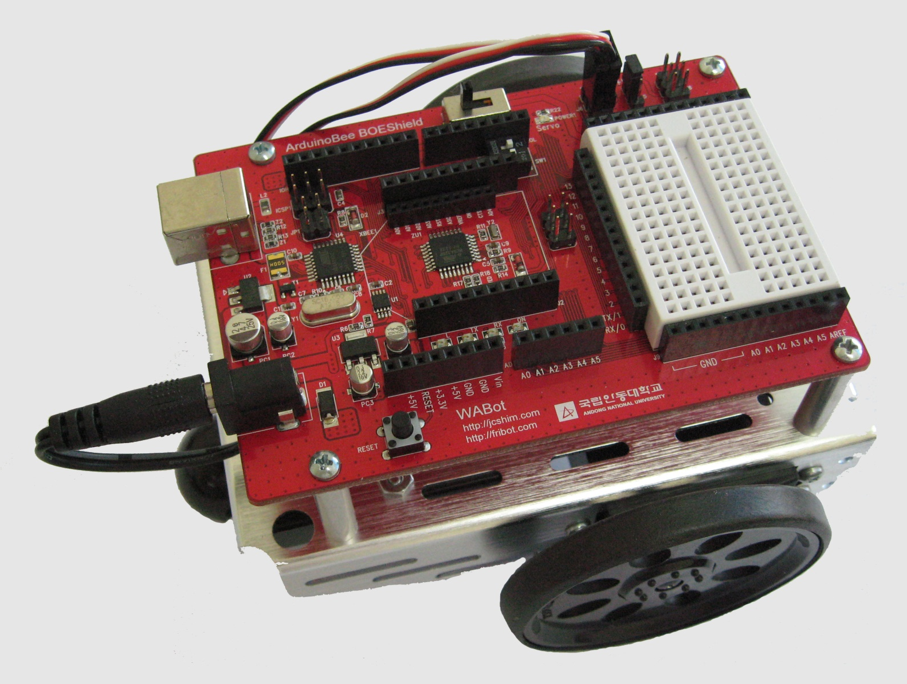
ABOT 적외선 사용 2
컴퓨터소프트웨어공학과
IoT프로그래밍

Slide 2
LED로 물체감지 표시하기
Infrared Receiver
5V
Infrared LED
P10
LED
P9
P8
LED
P7
P4
P3
P2
7, 8번 핀에 LED 출력 회로를 추가
GND
Infrared LED
Infrared Receiver

Slide 3
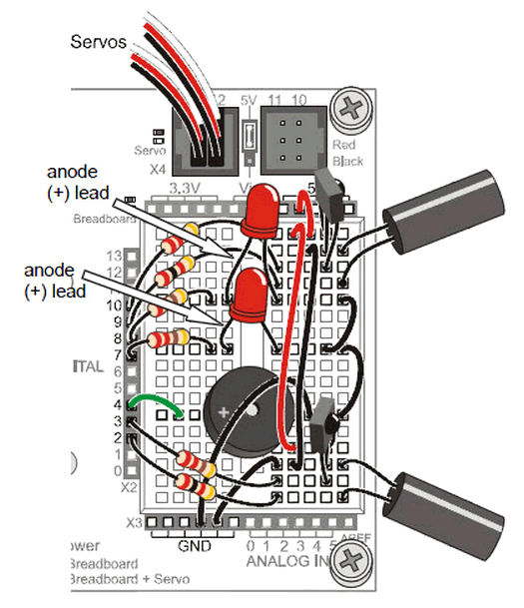
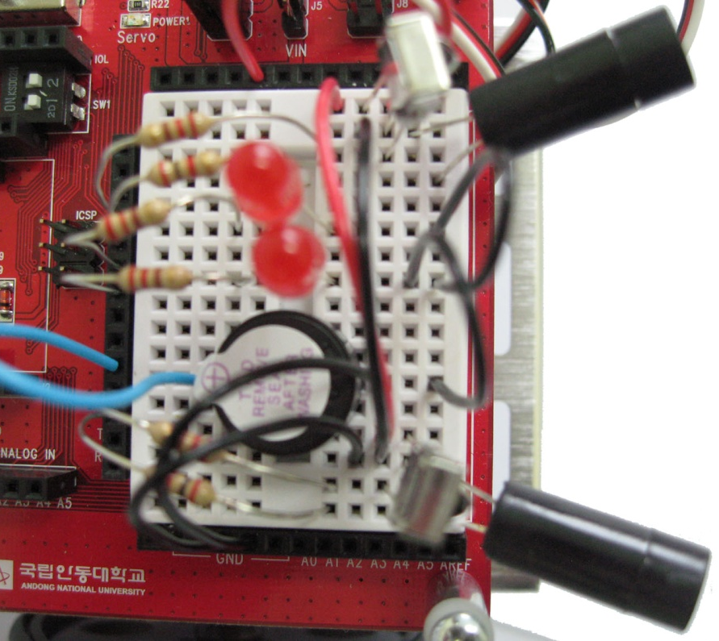
LED로 물체감지 표시하기
Infrared Receiver
5V
Infrared LED
P10
LED
P9
P8
LED
P7
P4
P3
P2
GND
Infrared LED
Infrared Receiver

Slide 4
ABOT 적외선 주행 테스트
#include <Servo.h> // Include servo library
Servo servoLeft; // Declare left and right servos
Servo servoRight;
void setup() // Built-in initialization block
{ pinMode(10, INPUT); pinMode(9, OUTPUT);//Left IR LED & Receiver
pinMode(3, INPUT); pinMode(2, OUTPUT);//Right IR LED & Receiver
pinMode(8, OUTPUT); pinMode(7, OUTPUT);// Indicator LEDs
tone(4, 3000, 1000); // Play tone for 1 second
delay(1000); // Delay to finish tone
servoLeft.attach(13); // Attach left signal to pin 13
servoRight.attach(12); } // Attach right signal to pin 12
void loop() // Main loop auto-repeats
{ int irLeft = irDetect(9, 10, 38000); // Check for object on left
int irRight = irDetect(2, 3, 38000);// Check for object on right
digitalWrite(8, !irLeft); // LED states opposite of IR
digitalWrite(7, !irRight);
자료출처: Parallax.com

Slide 5
if((irLeft == 0) && (irRight == 0)) // If both sides detect
{ backward(1000); // Back up 1 second
turnLeft(800); } // Turn left about 120 degrees
else if(irLeft == 0) // If only left side detects
{ backward(1000); // Back up 1 second
turnRight(400); } // Turn right about 60 degrees
else if(irRight == 0) // If only right side detects
{ backward(1000); // Back up 1 second
turnLeft(400); } // Turn left about 60 degrees
else // Otherwise, no whisker contact
{ forward(20); } // Forward 1/50 of a second
}
int irDetect(int irLedPin, int irReceiverPin, long frequency)
{ tone(irLedPin, frequency, 8); // IRLED 38 kHz for at least 1 ms
delay(1); // Wait 1 ms
int ir = digitalRead(irReceiverPin); // IR receiver -> ir variable
delay(1); // Down time before recheck
return ir; } // Return 1 no detect, 0 detect

Slide 6
void forward(int time) // Forward function
{ servoLeft.writeMicroseconds(1700); // Left wheel counterclockwise
servoRight.writeMicroseconds(1300); // Right wheel clockwise
delay(time); } // Maneuver for time ms
void turnLeft(int time) // Left turn function
{ servoLeft.writeMicroseconds(1300); // Left wheel clockwise
servoRight.writeMicroseconds(1300); // Right wheel clockwise
delay(time); } // Maneuver for time ms
void turnRight(int time) // Right turn function
{ servoLeft.writeMicroseconds(1700); // Left wheel counterclockwise
servoRight.writeMicroseconds(1700); // Right wheel counterclockwise
delay(time); } // Maneuver for time ms
void backward(int time) // Backward function
{ servoLeft.writeMicroseconds(1300); // Left wheel clockwise
servoRight.writeMicroseconds(1700); // Right wheel counterclockwise
delay(time); } // Maneuver for time ms
자료출처: Parallax.com

Slide 7
ABOT이 주행할 때 개선점은?
좌/우 센서의 감도가 비슷한가?
센서의 감도가 다르면 어떤 현상이 발생하는가?
장애물의 색상과 표면에 따른 감지 차이는?
송신/수신 센서의 감지방향 변화에는 어떤 차이가 있는가?

Slide 8
센서 감지횟수 증가시키기
#include <Servo.h> // Include servo library
Servo servoLeft; // Declare left and right servos
Servo servoRight;
void setup() // Built-in initialization block
{ pinMode(10, INPUT); pinMode(9, OUTPUT); //Left IR LED & Receiver
pinMode(3, INPUT); pinMode(2, OUTPUT); // Right IR LED & Receiver
pinMode(8, OUTPUT); pinMode(7, OUTPUT);// Indicator LEDs
tone(4, 3000, 1000); // Play tone for 1 second
delay(1000); // Delay to finish tone
servoLeft.attach(13); // Attach left signal to pin 13
servoRight.attach(12); } // Attach right signal to pin 12
void loop() // Main loop auto-repeats
{ int irLeft = irDetect(9, 10, 38000); // Check for object on left
int irRight = irDetect(2, 3, 38000);// Check for object on right
digitalWrite(8, !irLeft); // LED states opposite of IR
digitalWrite(7, !irRight);

Slide 9
if((irLeft == 0) && (irRight == 0)) // If both sides detect
{maneuver(-200, -200, 20); } // Backward 20 milliseconds
else if(irLeft == 0) // If only left side detects
{maneuver(200, -200, 20); } // Right for 20 ms
else if(irRight == 0) // If only right side detects
{maneuver(-200, 200, 20); } // Left for 20 ms
else // Otherwise, no IR detects
{maneuver(200, 200, 20); } // Forward 20 ms
}
int irDetect(int irLedPin, int irReceiverPin, long frequency)
{ tone(irLedPin, frequency, 8); // IRLED 38 kHz for at least 1 ms
delay(1); // Wait 1 ms
int ir = digitalRead(irReceiverPin);// IR receiver -> ir variable
delay(1); // Down time before recheck
return ir; } // Return 1 no detect, 0 detect
void maneuver(int speedLeft, int speedRight, int msTime)
{ // speedLeft, speedRight ranges: Backward Linear
// Stop Linear Forward
// -200 -100......0......100 200
// Set Left servo speed
servoLeft.writeMicroseconds(1500 + speedLeft);
// Set right servo speed
servoRight.writeMicroseconds(1500 - speedRight);
if(msTime==-1) // if msTime = -1
{ servoLeft.detach(); // Stop servo signals
servoRight.detach(); }
delay(msTime); // Delay for msTime
}
자료출처: Parallax.com

Slide 10
실습 과제
ABOT의 속도를 반으로 줄이도록 speedLeft와 speedRight를 수정
(과제2. 동영상과 스케치 제출)

