Slide 1

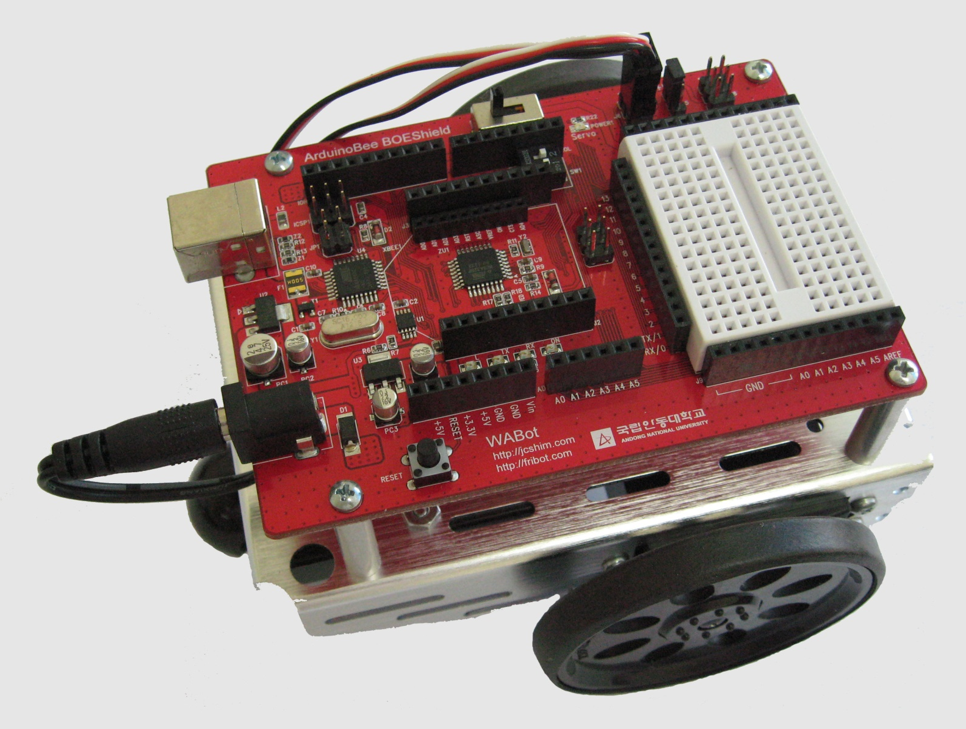
ABOT 적외선 사용 4
컴퓨터소프트웨어공학과
IoT프로그래밍

Slide 2
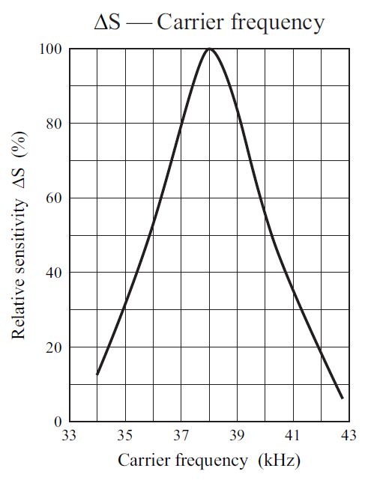
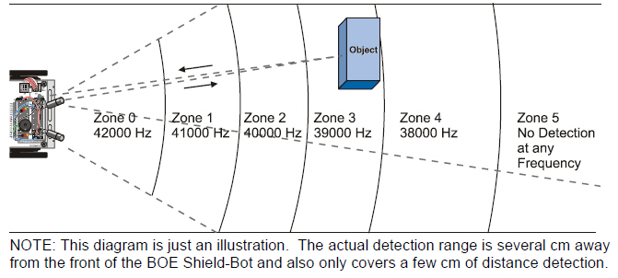
주파수로 거리 탐지하기
IR 검출기 최대 감도는 38.5kHz
40kHz에서는 감도가 ½로 감소
자료출처: Parallax.com

Slide 3
주파수 변화로 거리탐지 스케치
void setup(){ // Built-in initialization block
tone(4, 3000, 1000); // Play tone for 1 second
delay(1000); // Delay to finish tone
pinMode(10, INPUT); pinMode(9, OUTPUT); // Left IR LED & Receiver
pinMode(3, INPUT); pinMode(2, OUTPUT); // Right IR LED & Receiver
Serial.begin(9600); // Set data rate to 9600 bps
}
void loop(){ // Main loop auto-repeats
int irLeft = irDistance(9, 10); // Measure left distance
int irRight = irDistance(2, 3); // Measure right distance
Serial.print(irLeft); // Display left distance
Serial.print(" "); // Display spaces
Serial.println(irRight); // Display right distance
delay(100); // 0.1 second delay
}
자료출처: Parallax.com

Slide 4
주파수 변화로 거리탐지 스케치
int irDistance(int irLedPin, int irReceivePin)
{ int distance = 0;
for(long f = 38000; f <= 42000; f += 1000) {
distance += irDetect(irLedPin, irReceivePin, f);
}
return distance;
}
// IR Detection function
int irDetect(int irLedPin, int irReceiverPin, long frequency){
tone(irLedPin, frequency, 8); // IRLED 38 kHz for at least 1 ms
delay(1); // Wait 1 ms
int ir = digitalRead(irReceiverPin); // IR receiver -> ir variable
delay(1); // Down time before recheck
return ir; // Return 1 no detect, 0 detect
}
자료출처: Parallax.com

Slide 5

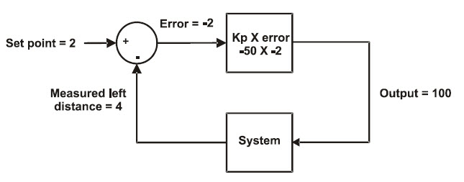
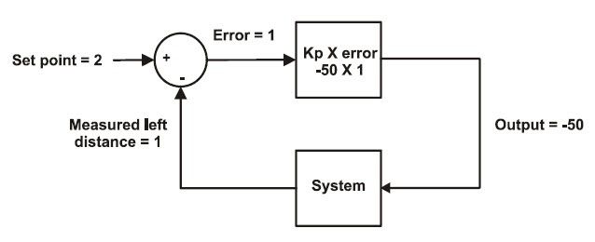
전방ABOT 추종 주행
설정거리 2영역보다 더 멀어질 때,
출력을 증가시킴
설정거리 2영역보다 더 가까워질 때,
출력을 감소시킴

Slide 6
추종주행 스케치
#include <Servo.h> // Include servo library
Servo servoLeft; // Declare left and right servos
Servo servoRight;
const int setpoint = 2; // Target distances
const int kpl = -50; // Proportional control constants
const int kpr = -50;
void setup() // Built-in initialization block
{ pinMode(10, INPUT); pinMode(9, OUTPUT); // Left IR LED & Receiver
pinMode(3, INPUT); pinMode(2, OUTPUT); // Right IR LED & Receiver
pinMode(8, OUTPUT); pinMode(7, OUTPUT);// Indicator LEDs
tone(4, 3000, 1000); // Play tone for 1 second
delay(1000); // Delay to finish tone
servoLeft.attach(13); // Attach left signal to pin 13
servoRight.attach(12); // Attach right signal to pin 12
}
자료출처: Parallax.com

Slide 7
void loop() // Main loop auto-repeats
{ int irLeft = irDistance(9, 10); // Measure left distance
int irRight = irDistance(2, 3); // Measure right distance
digitalWrite(8, !irLeft); // LED states opposite of IR
digitalWrite(7, !irRight);
// Left and right proportional control calculations
int driveLeft = (setpoint - irLeft) * kpl;
int driveRight = (setpoint - irRight) * kpr;
maneuver(driveLeft, driveRight, 20); // drive levels set speeds
}
int irDistance(int irLedPin, int irReceivePin) // IR distance measurement function
{ int distance = 0;
for(long f = 38000; f <= 42000; f += 1000) {
distance += irDetect(irLedPin, irReceivePin, f);
}
return distance;
}

Slide 8
// IR Detection function
int irDetect(int irLedPin, int irReceiverPin, long frequency)
{tone(irLedPin, frequency, 8); // IRLED 38 kHz for at least 1 ms
delay(1); // Wait 1 ms
int ir = digitalRead(irReceiverPin); // IR receiver -> ir variable
delay(1); // Down time before recheck
return ir; // Return 1 no detect, 0 detect
}
void maneuver(int speedLeft, int speedRight, int msTime)
{ // speedLeft, speedRight ranges: Backward Linear Stop Linear Forward
// -200 -100......0......100 200
servoLeft.writeMicroseconds(1500 + speedLeft); // Set Left servo speed
servoRight.writeMicroseconds(1500 - speedRight); // Set right servo speed
if(msTime==-1) // if msTime = -1
{ servoLeft.detach(); // Stop servo signals
servoRight.detach();
}
delay(msTime); // Delay for msTime
}

Slide 9
실습과제
setpoint 값을 0~5까지 변화시키며 동작을 비교
setpoint 값을 2로 바꾸고, kpl / kpr 값을 변화시키며 동작을 비교

