Slide 1


Slide 2
D E S T
Digital Envelope
Simulation Tool
20200941 곽채원

Slide 3
DEST : Class Design
Manager Package
CipherManage.java
KeyManage.java
SigManage.java
StrangeFileException.java
StrangeObjectException.java
Main Package
dest.java
sign_verify.java
throw
throw
catch!
throw

Slide 4
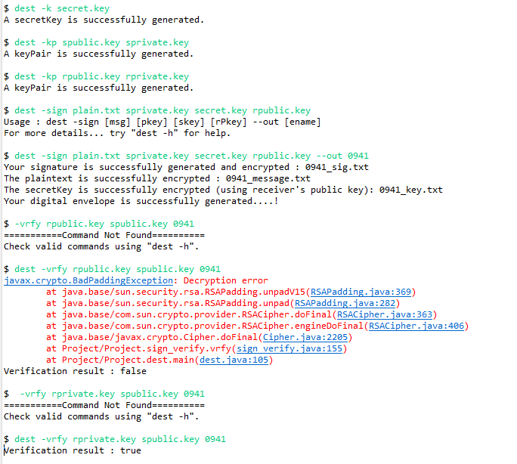
User-Interface
Console with an excellent readability
- implemented in command-line style..
- use options to explicitly separate its functions..

Slide 5
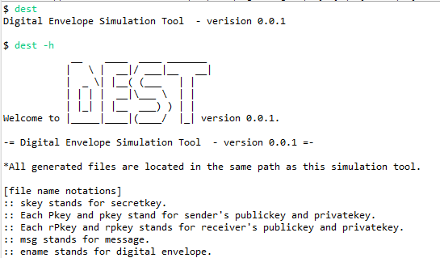
User-Interface
Console with an excellent readability
- implemented in command-line style..
- use options to explicitly separate its functions..

Slide 6
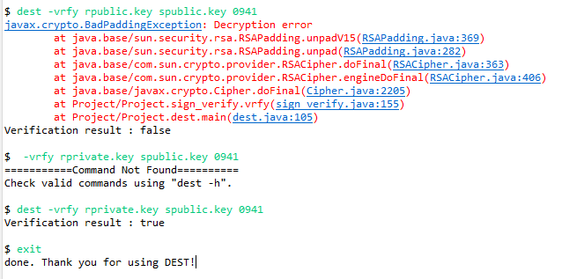
User-Interface
Console with an excellent readability
- implemented in command-line style..
- use options to explicitly separate its functions..
- user can continue the program whether exceptions occur or not..
※ The program will only be done with the “exit” command.

Slide 7
Applying Secure Coding Rules

Slide 8
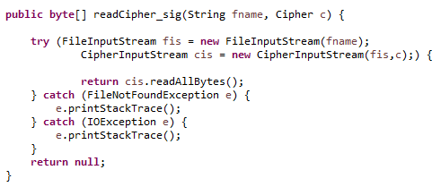
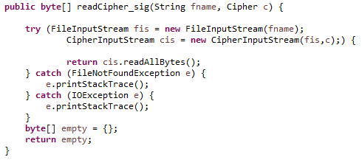
Applying Rule #41
Return an empty array of collection instead of a null value for methods that return an array or collection.
Before:
After:

Slide 9



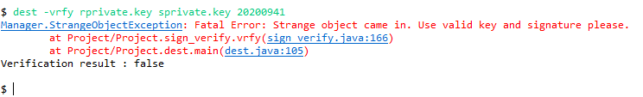
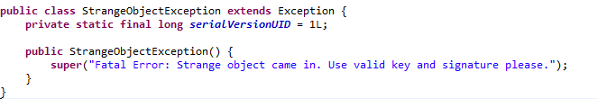
Applying Rule #33
Prefer user-defined exception over more general exception types.
Q. What if I want the program to continue even if user puts invalid (i.e. strange objects) input?
A. Define an exception for that and handle it.
This also can be very explicit way to show user what the problem is.
Before:
After:

Slide 10
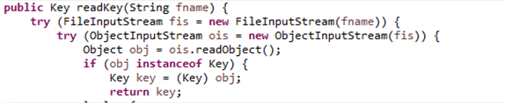
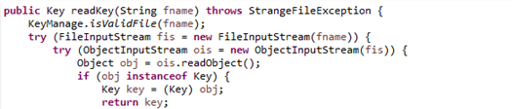
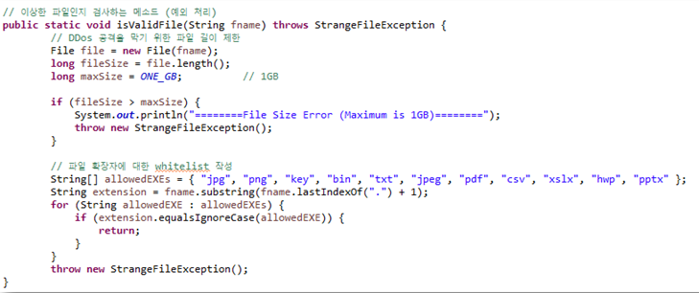

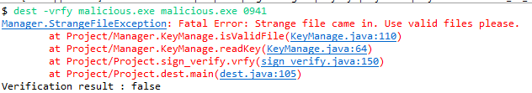

Applying Rule #7
Before:
Prevent code injection.
1. Limit the maximum file size to 1GB.
2. Whitelist valid file extensions.
After:
<< 39. Use meaningful symbolic constants to represent
literal values in program logic.

