Slide 1
Numerical programs

Slide 2
목차
개념어 정리
예상 문제

Slide 3
개념어 정리
Computing system
hardware
software
CPU : Central Processing Unit
ALU : Arithmetic Logic Unit
ROM : Read Only Memory
RAM : Random Access Memory
Variable : Symbolic Address Names
Debugging : Detecting, location, correcting “bugs” by running the program

Slide 4
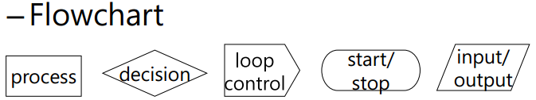
개념어 정리
Programming Language
Low level : Machine Language, Assembly Language
High level : Python, Java, C, Ruby, Basic, C++
Algorithm
Pseudocode
Flowchart

Slide 5
개념어 정리
Knowledge
Declarative Knowledge is composed of statements of fact.
Imperative Knowledge is about “how to” to accomplish something
Algorithm
Note that the description of the method is a sequence of simple steps, together with a low of control that specifies when each step is to be executed.
Fixed-program computer
Designed to do Specific things
Ex) 계산기 등등
Stored-program computer
Stores a sequence of instructions
Executes any instruction in that sequence

Slide 6
개념어 정리
Python
A general-purpose language that can be used effectively to build any kind of program
Do not need to access computer’s hardware
Weak static semantic checking
Simple to use and easy to learn
Freely available libraries
Program(script)
A sequence of definitions & commands
Evaluated & executed
By the shell (Python interpreter)
Command(statement)
instructs the interpreter to do something

Slide 7
개념어 정리
Objects
4 types of scalar objects
int , float, bool, None
indentation
is semantically meaningful in Python
Iteration(repetition)
When we want a program to do the same thing many times
Exhaustive enumeration
Enumerate all possibilities until we get the right answer or exhaust the space of possibilities.

Slide 8
개념어 정리
Binary search(Bisection search)
Numbers(data) are totally ordered

Slide 9
예상 문제
x = “z” x *= 3 print(x)
print(1 + 1*3 == 6)
x , y = 4, 2 print( not 1 + 1 == y or x == 4 and 7 == 8)
print( 5 + 3 // 4 – 7 ** 2 + 6 * 8 )
a = “adbec” a[-5] = a[3] =
print( True or not True and False or False )

Slide 10
예상 문제(중간고사 기출)
다음은 11과 12의 배수를 출력시키는 프로그램입니다.
괄호 안에 들어갈 적절한 명령어를 작성하시오.
x =1
While True:
if :
break
x = x+1
print(x, ‘is divisible by 11 and 12’)

Slide 11
예상 문제
#Nested for loops
x = 6
for j in range(x) :
for i in range(x) :
print(j,i)
x = 3
코드의 출력값을 적으시오.
#Nested for loops
* 같은 결과물이 나오도록 코드를 작성하시오.
**
***
****
*
**
***
*
**
*

Slide 12
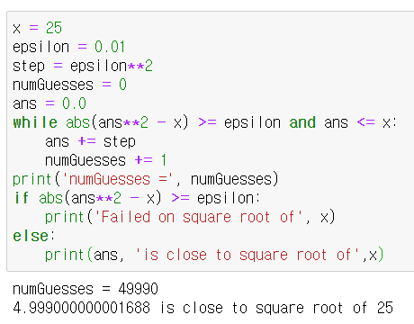
Approximate Solutions (근사 알고리즘)
X 의 제곱근의 근사값을
구하는 알고리즘

Slide 13
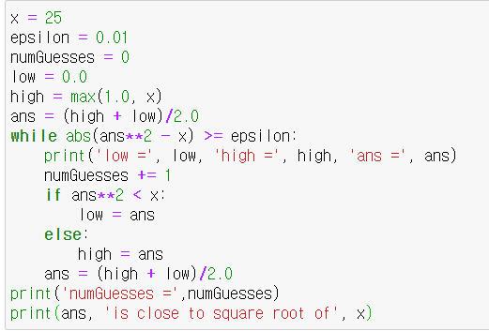
Bisection Search (이진탐색)

Slide 14
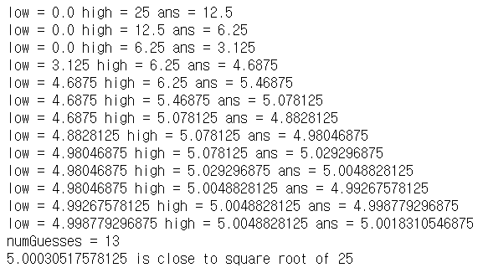

Slide 15
이진탐색 : 원하는 값에 도달할때까지
탐색범위를 ½ 씩 점차 좁혀나가는 탐색방법
정답
low
high
high
high
high

Slide 16
If ans **2 < x:
low = ans
else:
high = ans
numGuess = 1
ans**2=156.25 > x(25)
high = ans
numGuess = 2
ans**2=39.0625 > x(25)
high = ans
epsilon = 0.01 (오차범위)
ans (12.5)
ans (6.25)
high
x (25)
low
0.0
low
0.0
high
(12.5)

Slide 17
numGuess = 3
ans**2=9.765625 < x(25)
low = ans
numGuess = 4
ans**2=21.97.. < x(25)
low= ans
ans (3.125)
low
0.0
ans (4.6875)
high
(6.25)
low
(3.125)
high
(6.25)

Slide 18
…
numGuess = 13
ans = (low+high)/2.0
= 5.003051758125
오차범위가 0.01 미만이므로
abs(ans**2-x<epsilon) 이 되어 반복문을 빠져나와 결과를 출력한다.
ans (5.001831546875)
ㅇ
Low
(4.998779296875)
high
(5.0048828125)
numGuesses = 13
5.003051758125 is close to square root of 25

Slide 19
예상 문제
#Approximating the square root
x = 25
epsilon = 0.01 1. 에 알맞은 것을 입력하시오.
step = epsilon**2
numGuesses = 0
ans = 0.0
while abs(ans**2 – x) >= epsilon and :
ans += step
numGuesses += 1
print(‘numGuesses =‘ , numGuesses)
if abs(ans**2 – x) >= epsilon : 2. 어떤 방식으로 자료를 탐색했습니까?
print(‘Failed on square root of’, x)
else:
print(ans, ‘is close to square root of’, x)

Slide 20
예상 문제
#Approximating the square root
x = 25
epsilon = 0.01 1. 에 알맞은 것을 입력하시오.
numGuesses = 0
low = 0.0
high = max(1.0, x)
ans = (high + low) / 2.0
while abs(ans**2 – x) >= epsilon :
numGuesses += 1
if ans**2 < x :
else: 2. 어떤 방식으로 자료를 탐색했습니까?
print(‘numGuesses =‘ , numGuesses)
print(ans, ‘is close to square root of’, x)

Slide 21
예상 문제
#Approximating the square root
x = 25 을 채워 넣으시오.
epsilon = 0.01
step = epsilon**2
numGuesses = 0
ans = 0.0
print(‘numGuesses =‘ , numGuesses)
print(‘Failed on square root of’, x)
print(ans, ‘is close to square root of’, x)

Slide 22
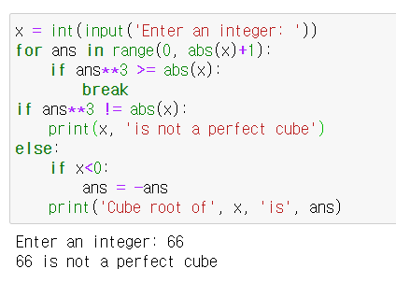

3제곱근 구하기

Slide 23
예상 문제
#find the cube root of a perfect cube
x = int(input(‘Enter an integer: ‘))
ans = 0
while ans**3 < abs(x) :
ans = ans + 1
if ans**3 != abs(x) :
print(x, ‘is not a perfect cube’)
else :
if x < 0 :
ans = -ans
print(‘Cube root of’, x, ‘is’, ans)
어떤 목적의 코드입니까?
어떠한 방식 사용하여 자료 탐색을 하였습니까?
Decrementing function은 무엇입니까?

Slide 24
예상 문제
#find the cube root of a perfect cube
x = int(input(‘Enter an integer: ‘))
ans = 0
print(x, ‘is not a perfect cube’)
else :
print(‘Cube root of’, x, ‘is’, ans)
에 알맞은 것은 입력하시오

Slide 25
예상 문제
#Find the cube root of a perfect cube
x = int(input(‘Enter an integer: ‘))
for ans in range(0, abs(x)+1) : 에 알맞은 것을 입력하시오.
if ans**3 >= ans(x) :
if :
print(x, ‘is not a perfect cube’)
else :
if x < 0 :
ans = -ans
print(‘Cube root of’, x, ‘is’, ans)

