Slide 1


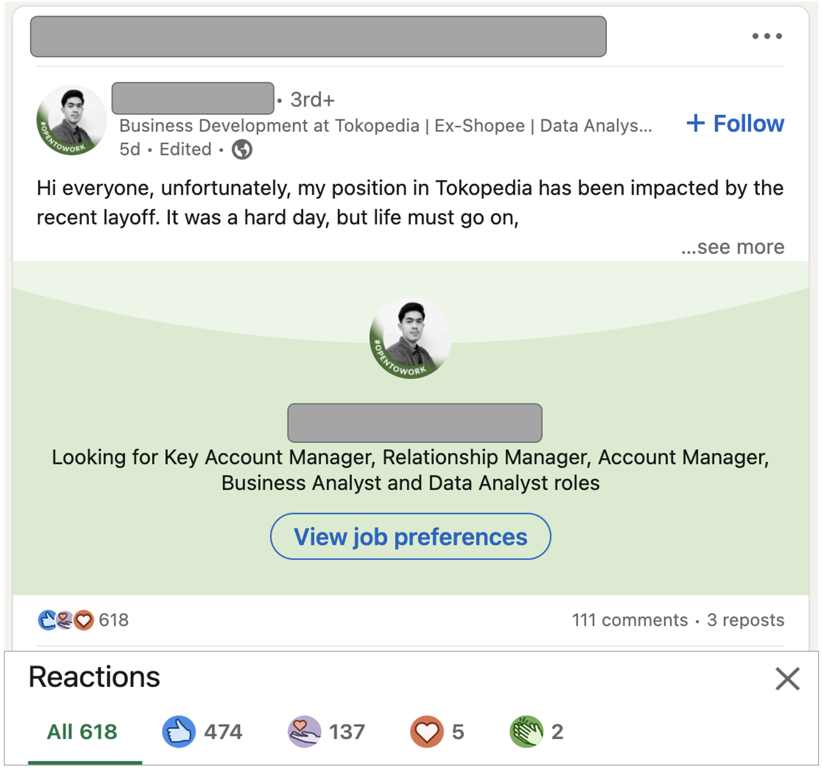
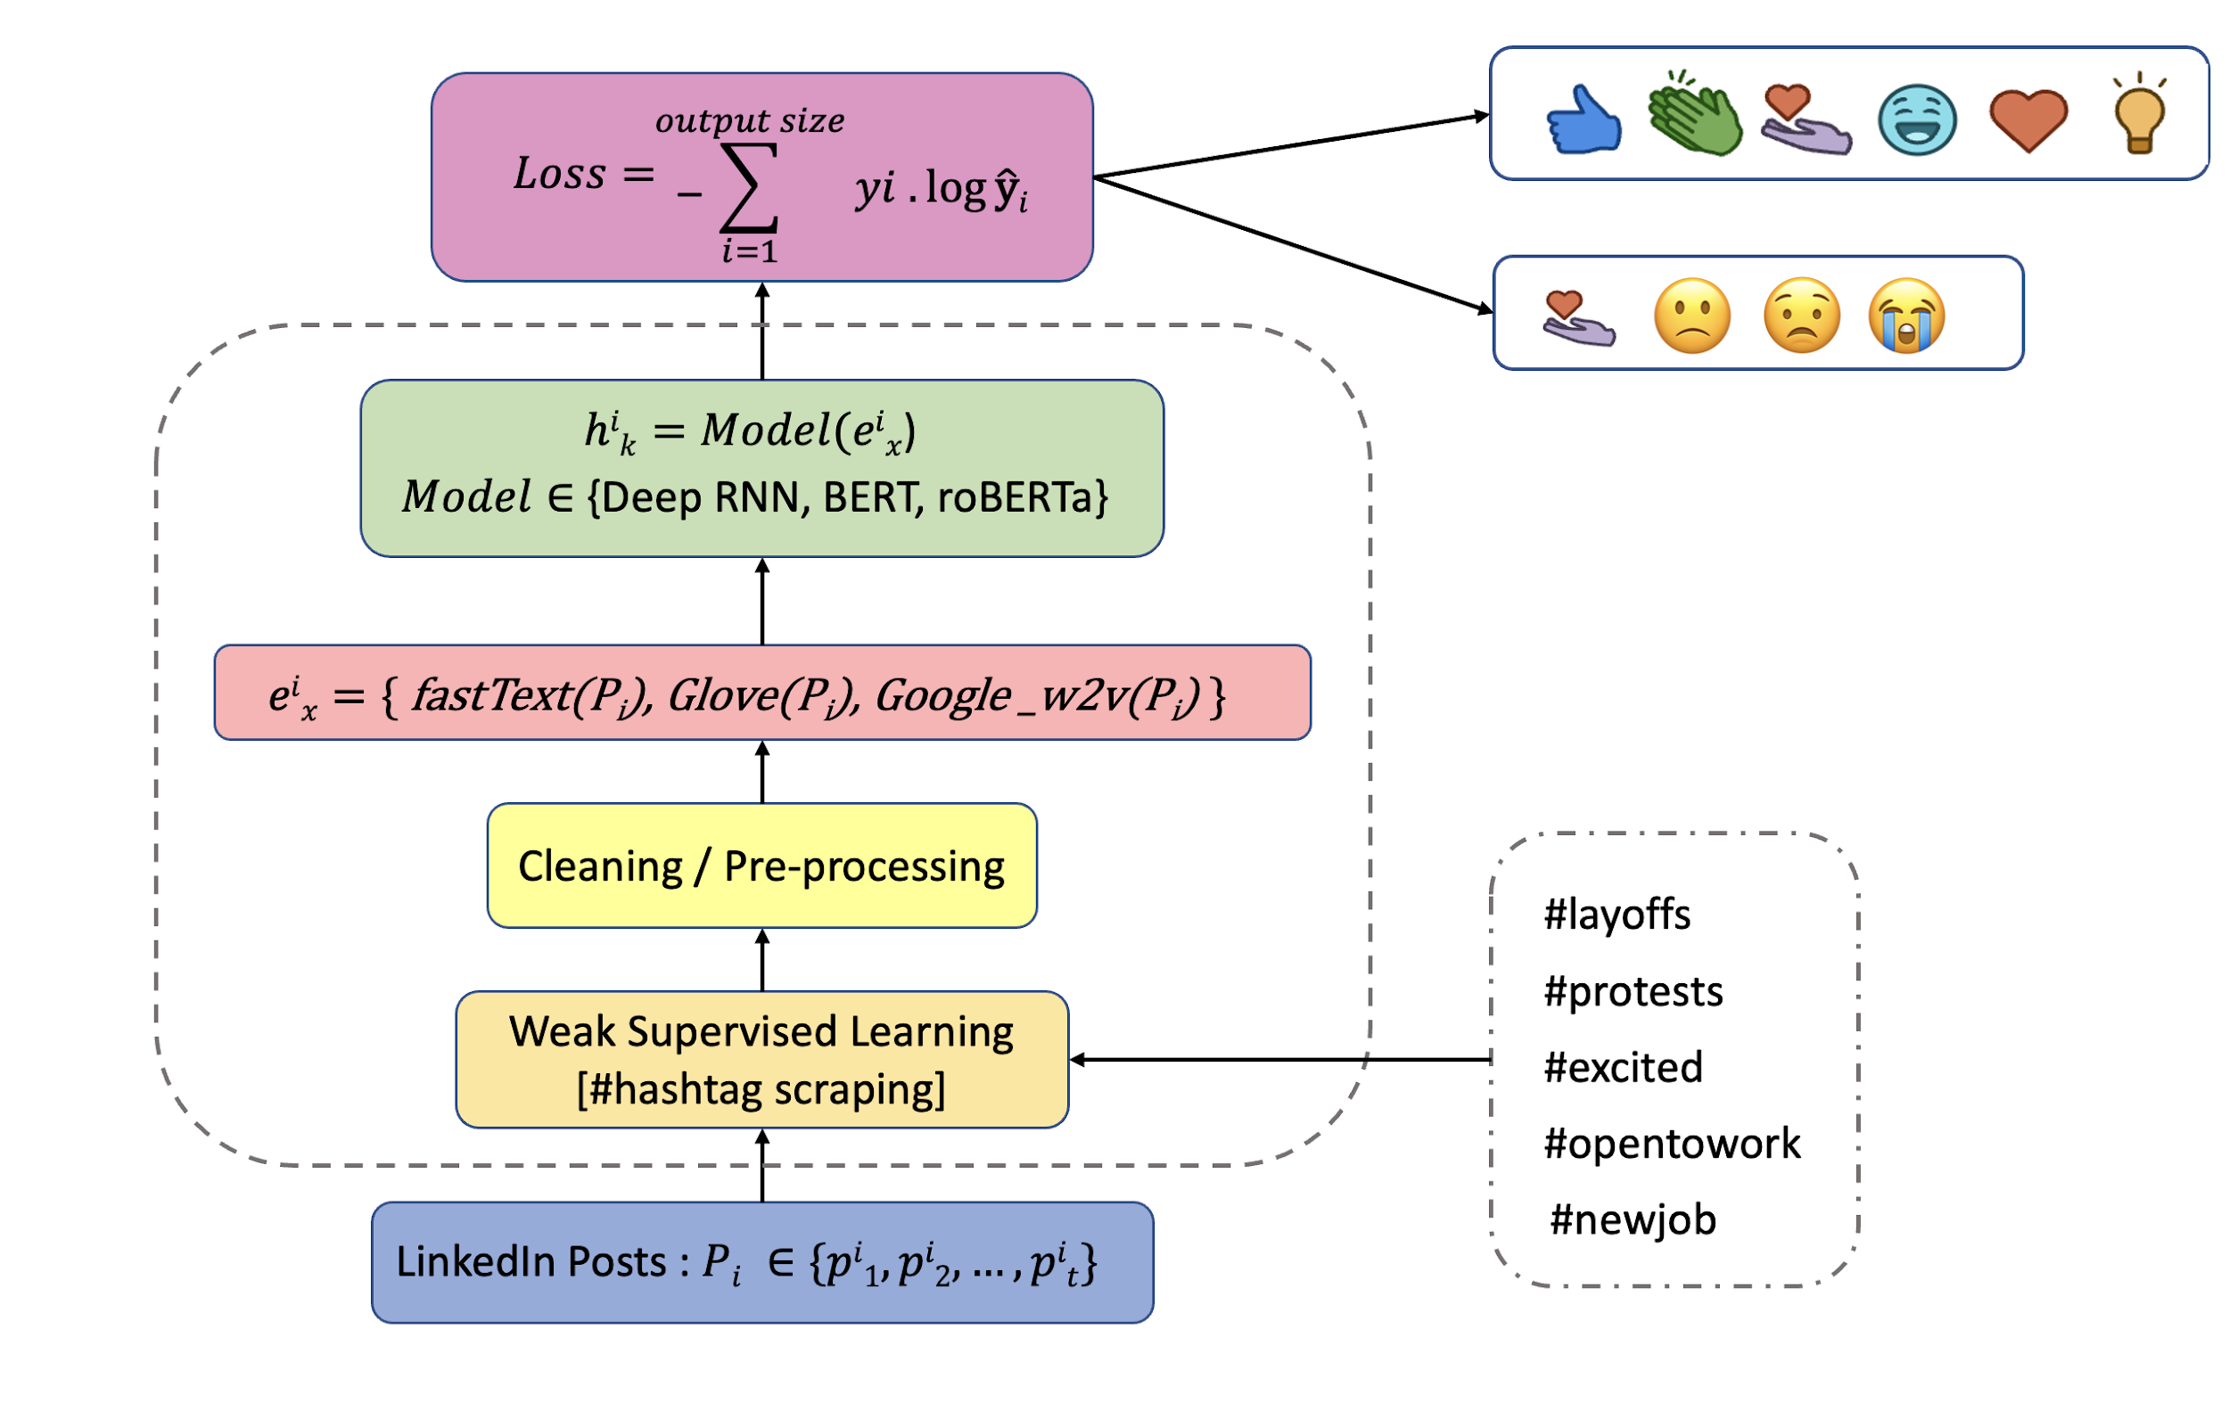
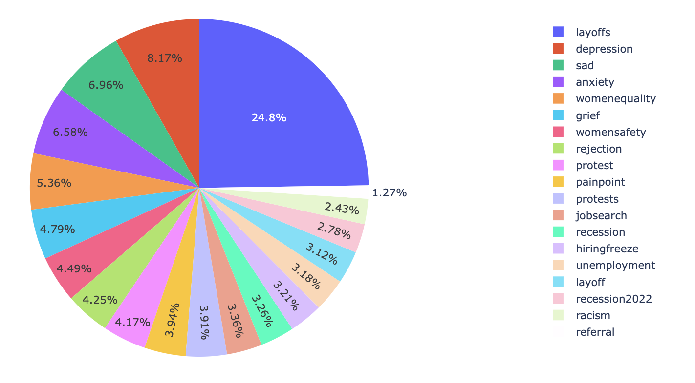
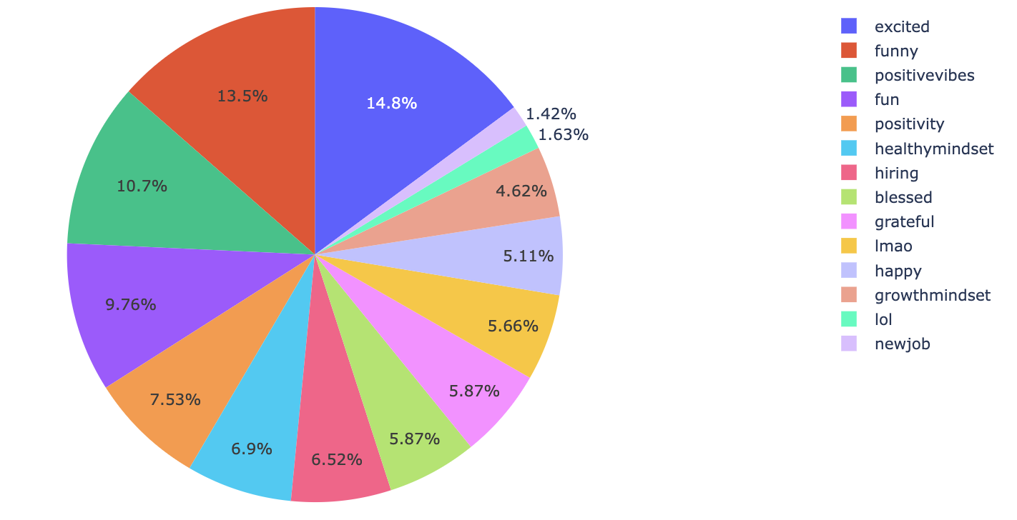
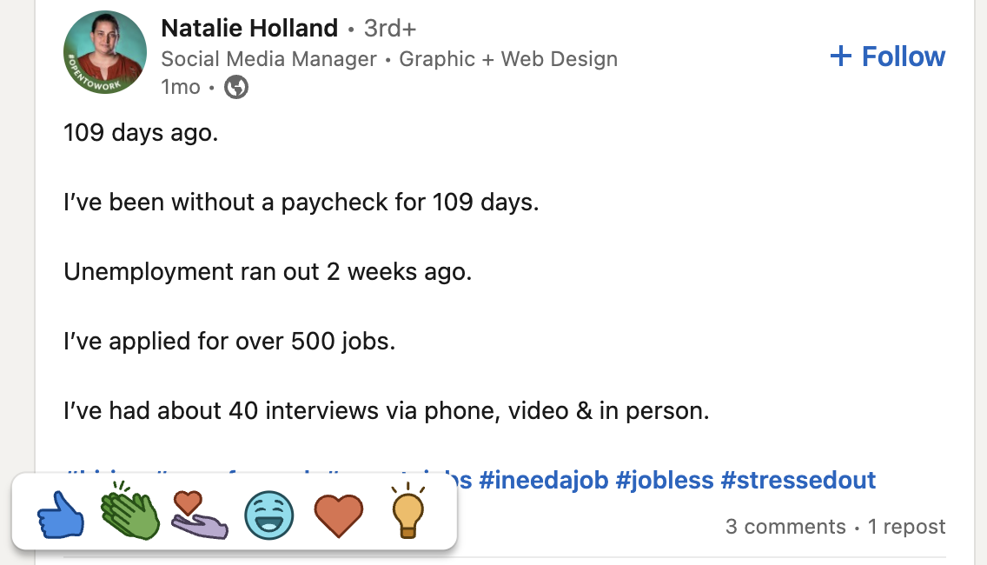
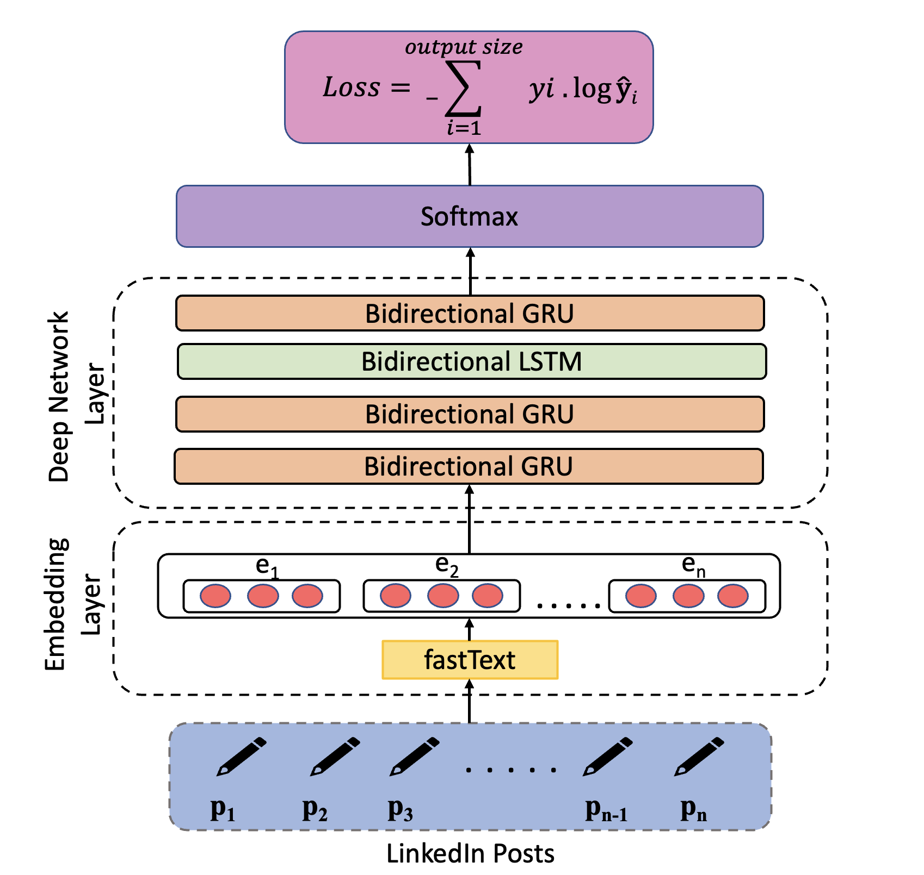
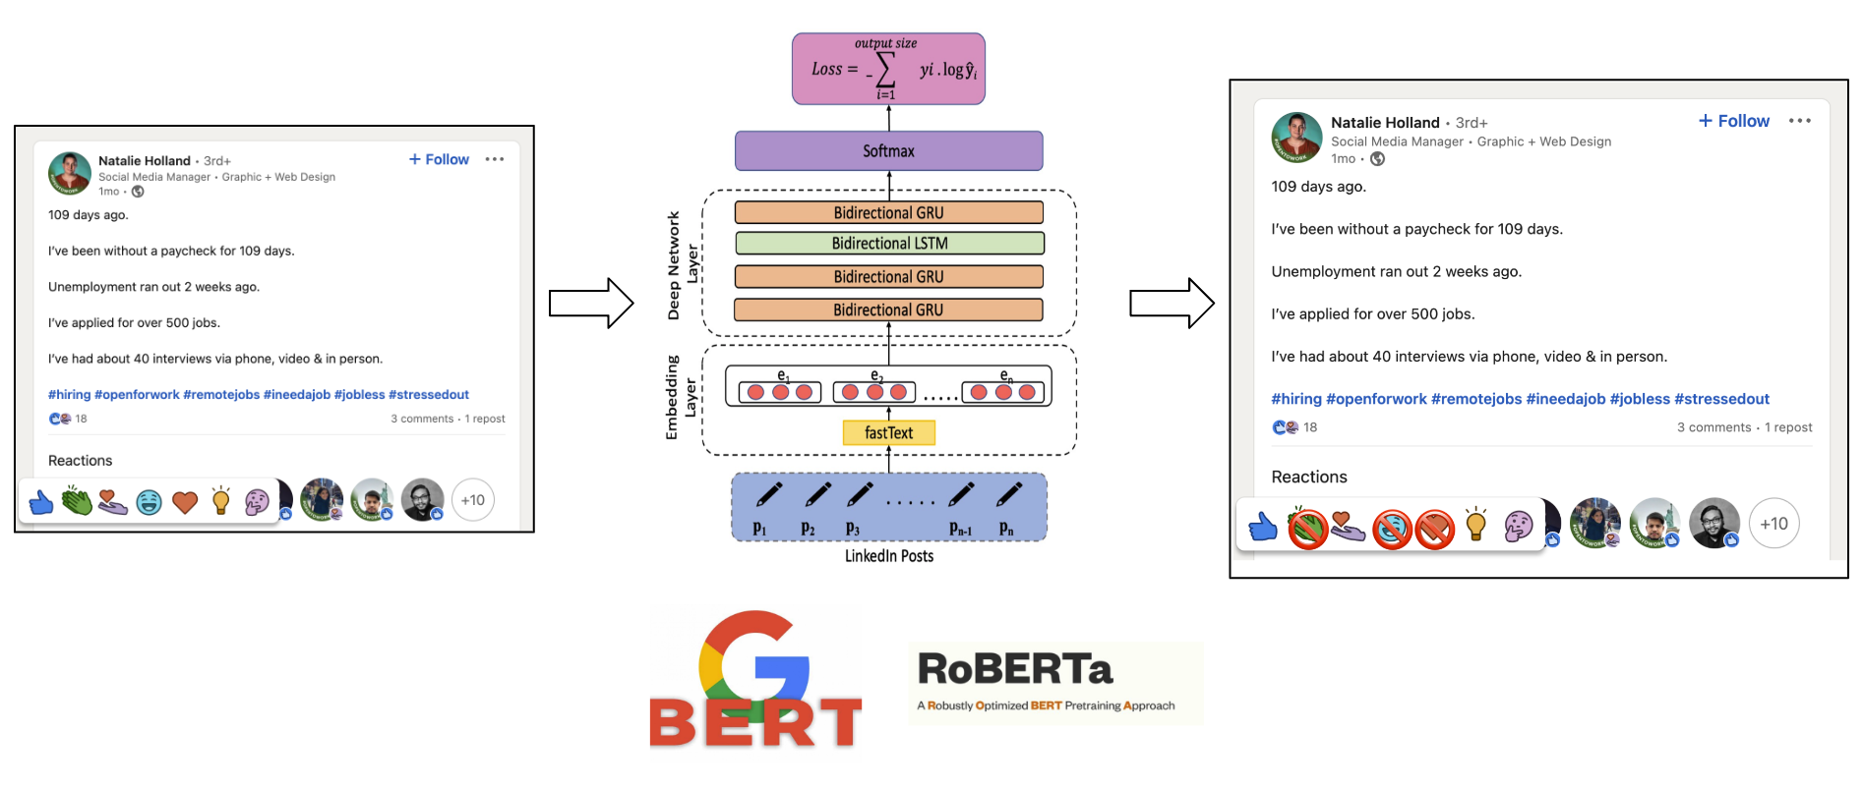
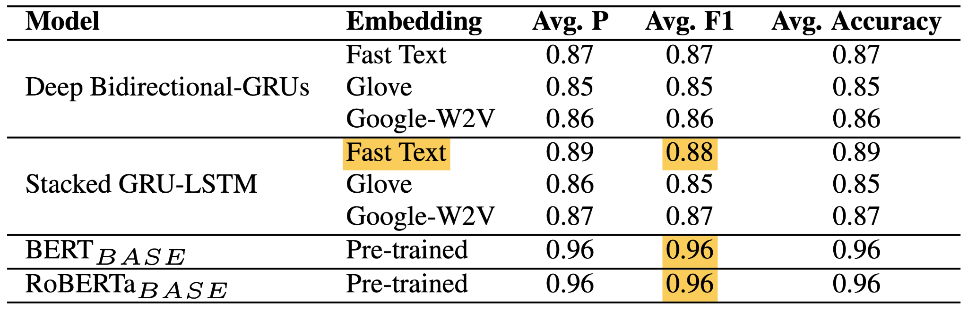
Are we spreading Hate or Reach? Towards Generating Contextually Relevant Reactions for LinkedIn Data
Group 17
Ajinkya Nagare, Amit Singh, Anay Dhombe, Ashwin Chafale, Sanket Bhilare
Motivation
LinkedIn gets flooded with 1000s of posts, and there are multiple reactions to react to a post
Most of the time, such reactions often tend to be against the sentiment of the post
This spreads negative sentiments amongst the users creating a negative psychological impact on the user. (E.g., like/celebrate/funny reaction to a post related to unemployment/protests)
Novelty: We propose a system that generates only contextually relevant reactions based on the sentiment.
Our system aims to answer the following research questions:
How many people react with a reaction opposite to the LinkedIn post sentiment?
How can we generate contextually relevant reactions to restrict the negative hate spread?
Design
Custom model architectures such as Deep Bidirectional- LSTMs, GRUs and Stacked LSTM-GRUs were trained on 20K posts.
FastText, Google pre-trained w2v, and GloVe were used to obtain vector representation for words.
Pre-trained BERT_{BASE} and RoBERTa_{BASE} models were fine-tuned on our training data.
Dataset
Used Weak Supervised Learning approach to generate and annotate data from raw LinkedIn posts
Around 20K posts were scraped using a scraping script and 30 different hashtags
Posts were further classified into respective sentiments based on the hashtags (E.g., Neg sentiment for #layoffs, #protests, etc.)
Model Architecture & Pipeline
Non-English English
NEURAL MACHINE TRANSLATION
CONTEXTUALLY RELEVANT REACTIONS
Analysis and Results
Models were evaluated on ~3K test data posts.
False positives are of higher concern to us. Hence, we want precision to be high.
Stacked GRU-LSTM performed better as compared to other custom models.
Fine-tuned BERT_{BASE} and RoBERTa_{BASE} models were the top performers.
CSCI 544 - Poster Presentation
GROUP - 17

Slide 2
Are we spreading Hate or Reach? Towards Generating Contextually Relevant Reactions for LinkedIn Data
Group 17
Ajinkya Nagare, Amit Singh, Anay Dhombe, Ashwin Chafale, Sanket Bhilare
Motivation
LinkedIn gets flooded with 1000s of posts, and there are multiple reactions to react to a post
Most of the time, such reactions often tend to be against the sentiment of the post
This spreads negative sentiments amongst the users creating a negative psychological impact on the user. (E.g., like/celebrate/funny reaction to a post related to unemployment/protests)
Novelty: We propose a system that generates only contextually relevant reactions based on the sentiment.
Our system aims to answer the following research questions:
How many people react with a reaction opposite to the LinkedIn post sentiment?
How can we generate contextually relevant reactions to restrict the negative hate spread?
Design
Custom model architectures such as Deep Bidirectional- LSTMs, GRUs and Stacked LSTM-GRUs were trained on 20K posts.
FastText, Google pre-trained w2v, and GloVe were used to obtain vector representation for words.
Pre-trained BERT_{BASE} and RoBERTa_{BASE} models were fine-tuned on our training data.
Dataset
Used Weak Supervised Learning approach to generate and annotate data from raw LinkedIn posts
Around 20K posts were scraped using a scraping script and 30 different hashtags
Posts were further classified into respective sentiments based on the hashtags (E.g., Neg sentiment for #layoffs, #protests, etc.)
Model Architecture & Pipeline
Non-English English
NEURAL MACHINE TRANSLATION
CONTEXTUALLY RELEVANT REACTIONS
Analysis and Results
Models were evaluated on ~3K test data posts.
False positives are of higher concern to us. Hence, we want precision to be high.
Stacked GRU-LSTM performed better as compared to other custom models.
Fine-tuned BERT_{BASE} and RoBERTa_{BASE} models were the top performers.
CSCI 544 - Poster Presentation
GROUP - 17

