Slide 1
Bank Telemarketing Prediction
GROUP 5
Charlotte Gallet - Hina Hussain - Elina Kelly

Slide 2
01
Table of Contents
02
03
04
05
Problem Definition
What do we want to predict and why?
Data
Exploration of the data set and data pre-processing steps.
Experimental Setup
What was the process and how did we arrive to the results?
Modeling
Which models have we used, with which parameters?
Results
The model we have chosen and its performance.

Slide 3
Problem Definition
Notes:
Charlotte

Slide 4
Business Problem Definition
The Company
Telemarketing
Subscription
Clients
Data of Portuguese Bank for campaign success
Phone calls to clients to offer subscriptions
The objective is to engage subscription to term deposits
Help the telemarketers focus on potential clients
Notes:
Charlotte

Slide 5
Data Science Problem Definition
Classification
Target Variable
Features
Binary classification of a categorical target variable
Target variable is whether the client will potentially subscribe or not
Categorical features about demographics and numerical features about financial situation
Notes:
Charlotte

Slide 6
Data
20,000 profiles
88.6%
11.4%
NON-
SUBSCRIBERS
SUBSCRIBERS
Notes:
Hina

Slide 7
Data preprocessing steps
01
01
02
03
04
05
Train, Validation & Test
Splitting the train into train and validation
Error, data correction
Missing values, outliers, encoding
Feature engineering
Polynomial terms
Value transformation
Categorical variables: decision tree-based remapping
Numerical variables: decision tree-based discretization
Value representation
Categorical variables: dummy encoding
Notes:
Hina

Slide 8
Experimental Setup
Notes:
Elina

Slide 9
Experimental Setup
Feature
Selection
Model
Benchmark
Model
Selection
Hyper-parameter
Tuning
Interpretation
Selecting the best 50 features with Fisher’s Score
Selecting the 2 models with the highest AUC on validation set
Interpreting the final model
Fitting 7 different classification algorithms on the train set
GridSearch and Cross-Validation on selected models to obtain optimal parameters
Notes:
Elina

Slide 10
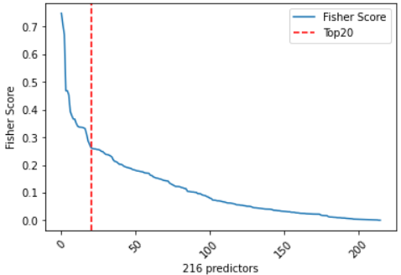
Feature Selection
Using Fisher’s Score to select number of features to have.
Fisher’s score finds variables which
assign similar values to instances in the same class and different values to instances from different classes.
Fisher’s score is calculated by taking the absolute difference between mean value of subscribers and non-subscribers for each independent variable divided by the square root of their variance.
Notes:
Elina

Slide 11
Modelling
Notes:
Charlotte

Slide 12
Used Models
KNN
Logistic Regression
Random Forest
Gradient Boosting
SVM
Neural Networks
Decision Tree
Notes:
Charlotte

Slide 13
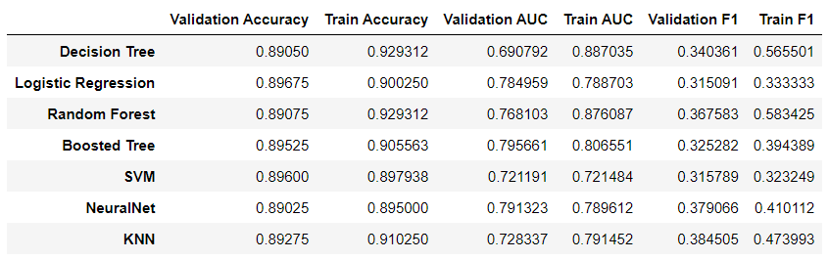
Model Benchmarking
overfitting
overfitting
overfitting
Notes:
Charlotte

Slide 14


Logistic Regression
Classification into 2 or more classes based on Sigmoid Function
Logs Odd transformation
Maximizing the likelihood function (loss function)
We derivate it to zero by using the Gradient Descent algorithm
Notes:
Charlotte

Slide 15
Gradient Boosting
Combine trees one by one using information from the previous tree.
Trees are grown sequentially by using information from previously grown trees
Making predictions through weak learners (trees)
Additive model that adds trees to minimize the loss function
In general, gradient boosting may be better than random forest but is more prone to overfitting.
Notes:
Charlotte

Slide 16
Hyper-Parameter Tuning
Logistic Regression
Gradient Boosting Tree
Solver
[‘newton-cg’, ‘liblinear’, ‘lbfgs’]
Used algorithm
Penalty
[‘none’, ‘l1’, ‘l2’]
The norm of the penalty
C
[1 and above]
Regularization strength
Learning Rate
[0.001 to 1]
Contribution of each tree
Number of estimators
[10 to 1000]
Number of Boosting to perform
Maximum Depth
[2 to 8]
Number of branches per tree
Notes:
Hina

Slide 17
Results & Interpretation
Notes:
Hina

Slide 18
Train & Test AUC
Model | Parameters | Validation AUC | Kaggle AUC
Gradient Boosting | max_depth=7 min_samples_leaf = 100 n_estimators = 250 learning_rate = 0.09 min_samples_split=750 | 0.7967 | 0.8003
Notes:
Hina

Slide 19
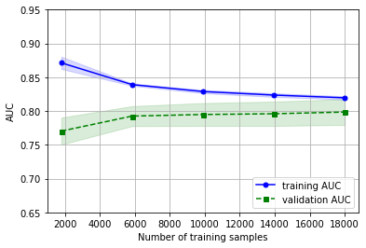
Learning Curve
Visualisation of the learning performance as the size of the training set increases
Translucent area represents the uncertainty/ standard deviation of the learning curve
Observation: good fit of the model
Notes:
Elina

Slide 20
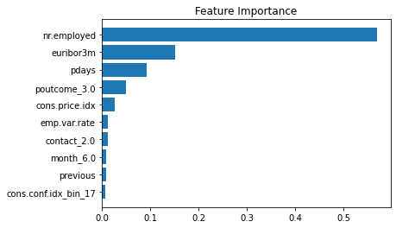
Feature Importance
Representation of the most
important features for our final model
1. Number of employees
2. Euribor 3 month rate
3. Days since last campaign contact
4. Outcome of the previous campaign
5. Consumer price index
Notes:
Elina
https://towardsdatascience.com/understanding-feature-importance-and-how-to-implement-it-in-python-ff0287b20285
“Feature Importance refers to techniques that calculate a score for all the input features for a given model — the scores simply represent the “importance” of each feature. A higher score means that the specific feature will have a larger effect on the model that is being used to predict a certain variable.”

Slide 21
Thank you for listening!

