Slide 1
ABHIRAM CHAGANTI
Finance & Strategy Portfolio
Rutgers Business School | Finance, PPE Concentration
Valuation • M&A • Equity Research • LBO • Software

Slide 2





PORTFOLIO OVERVIEW
This deck presents a cross-section of financial modeling and analysis work spanning valuation, M&A, equity research, and leveraged buyouts. Projects cover defense (Boeing, ISSC, Ducommun) and technology (Snowflake) I hope to reflect my focus on sectors where capital allocation, government policy, and innovation intersect.
ISSC Valuation
Boeing–ISSC M&A
Snowflake Research
Ducommun LBO
Dynamic Comps
DCF & Trading Comps
Implied 24–27% upside
Full merger model
2.9% immediate accretion
Equity research, SELL
57% downside via DCF
Entry / debt structure
Cash sweep & returns
Real-time fair value engine
Python + Streamlit MVP

Slide 3
ISSC VALUATION — DCF & TRADING COMPS
Discounted Cash Flow
Trading Comparables
Metric | Value
WACC | 10.96%
Terminal Growth Rate | 2.5%
PV of FCFs | $86M
PV of Terminal Value | $413M
Enterprise Value | $499M
Equity Value | $477M
Implied Share Price | $26.90 (24% upside)
Multiple | Implied EV | Price | Premium
EV/Revenue | $429M | $22.32 | 3%
EV/Gross | $423M | $22.65 | 5%
EV/Backlog | $839M | $45.43 | 110%
EV/R&D | $370M | $19.35 | -11%
Average | $515M | $27.44 | 27%
Selected Peer Group
AerSale (ASLE)
— Aftermarket & MRO services
Astronics (ATRO)
— Avionics & lighting systems
Intuitive Machines (LUNR)
— Space systems, similar revenue model
Spire Global (SPIR)
— Satellite analytics, gov't contracts
Sensitivity: WACC vs Terminal Growth
WACC \ TGR | 1.90% | 2.00% | 2.10%
10.91% | $656 | $663 | $671
11.46% | $618 | $625 | $632
12.03% | $583 | $589 | $596

Slide 4
BOEING–ISSC MERGER MODEL
Transaction Overview
Accretion / Dilution Analysis
Parameter | Detail
Acquirer | Boeing Co. (NYSE: BA)
Target | Innovative Aerosystems (ISSC)
Deal Type | Strategic tuck-in acquisition
Purchase Price | $510M (30% premium)
Consideration | 67% Cash / 33% Stock
Total Synergies | $200M (5-year)
2.9%
$200M
$1.80
Immediate Accretion
(2026E)
Total Synergies
Through 2030
Pro Forma EPS
vs $1.75 Standalone
Synergy Composition
Category | Amount | Type
Overhead Elimination | $110M | Cost
Procurement Savings | $40M | Cost
R&D Savings | $40M | Cost
Cross-Sell Revenue | $10M | Revenue
Total | $200M
Strategic Rationale
In-house ISSC's retrofitting and avionics R&D to support KC-46A, T-7A Red Hawk, and B-47 programs. Vertically integrate fuel optimization (ThrustSense) and cockpit systems (COCKPIT/IP). Drive down long-run manufacturing costs while strengthening fleet lifetimes.
RECOMMENDATION: BUY — Immediately accretive under all scenarios

Slide 5
SNOWFLAKE (SNOW) — EQUITY RESEARCH
SELL
Bear Thesis
Valuation Summary
1. Competitive Pressure
Databricks ($134B valuation) gaining AI/ML momentum. SNOW must sustain elevated R&D (42%) and S&M (43%) spend.
2. Structural Margin Ceiling
Cloud-agnostic model forces infrastructure payments to hyperscalers. Gross margin (67%) trails peer median (74%). SBC runs 32-40% of revenue.
3. Slowing Growth Engine
NRR declining: 178% → 158% → 131% → 127%. Customer optimization, mix dilution, and workload migration driving compression.
DCF
Comps (Bear)
$94
$155
-57.5%
-30.2%
DCF Metric | Value
WACC | 12.0%
Terminal Growth | 2.5%
Enterprise Value | $26.3B
Equity Value | $34.1B
Current Price | $222
SNOW trades at 17.2x NTM revenue vs peer median 14.2x — 21% premium despite worst-in-class gross margin. Even at 10% WACC / 3% TGR, implied price of $152 still represents 32% downside.

Slide 6
DUCOMMUN (DCO) — LEVERAGED BUYOUT
IN PROGRESS
Entry & Capital Structure
Projected Cash Flow & Debt Paydown (Optimistic)
Metric | Value
Share Price | $125.19
Entry EV | $1,937M
EV / LTM EBITDA | 15.5x (Bear)
Senior Debt (4.5x) | $569M @ 7.0%
Sub Debt (1.8x) | $227M @ 12.0%
Total Leverage | 6.4x EBITDA
Equity Contribution | $1,435M (65%)
 | 2026E | 2027E | 2028E | 2029E
EBITDA | $147M | $168M | $189M | $220M
Levered FCF | $53M | $69M | $84M | $108M
Cash Sweep | $50M | $66M | $80M | $103M
Sr. Debt (Net) | $502M | $478M | $456M | $425M
DCO is an A&D structures manufacturer. Model explores a sponsor-backed take-private with 95% cash sweep and senior + sub debt layers.

Slide 7
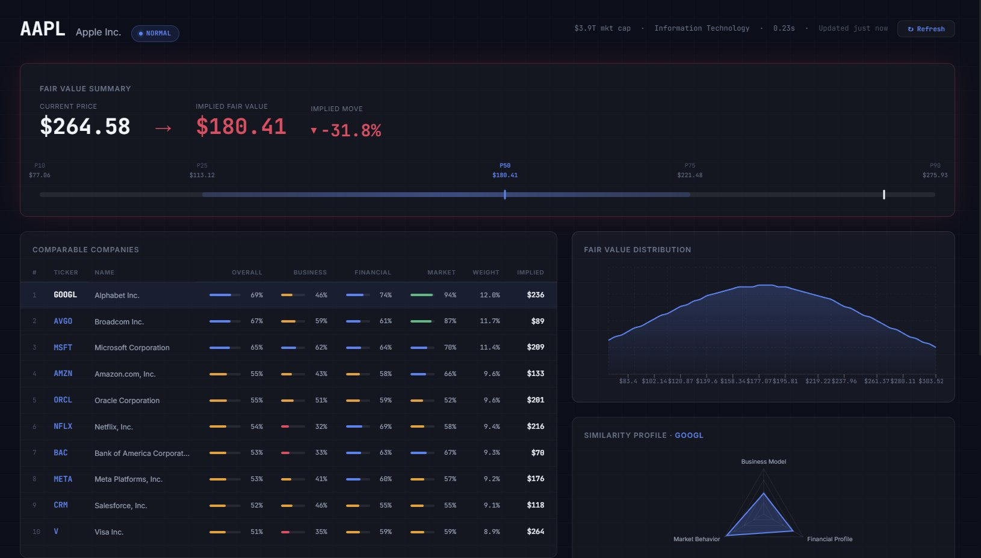
DYNAMIC COMPS ENGINE
Real-time comparable company analysis powered by multi-factor similarity scoring and macro-regime awareness
Multi-Factor Similarity
Scores peers across business model, financial profile, and market behavior dimensions
Sector-Aware Valuation
Growth-adjusted models with weighted EV/Revenue, EV/Gross, P/E, and EV/EBITDA
Watchlist Signals
Scan portfolios for mispricings with buy/sell alerts based on fair value divergence
VIX-Regime Detection
Adjusts analysis context based on current market regime (Normal, Elevated, Crisis)
TECH STACK: Python • Streamlit • Yahoo Finance API • FRED • Pandas • NumPy
STATUS: MVP Complete • v0.1.0 • Open Source

Slide 8

WHERE I'M FOCUSED NEXT
Perspectives at the intersection of capital markets, policy, and technology
Defense Industrial Base
Prime contractors face pressure to innovate faster while managing cost overruns. Prime contractors will look to vertically integrate where it makes sense, while "neo-Primes" (i.e Anduril, Palantir) will be in demand for cutting-edge military solutions.
Agentic Applications, Robotics
App development barriers have come down to virtually 0. I am eager about being very hands-on with the latest capabilities. Specifically, I am currently exploring how real-time data APIs could be coupled with video and audio generation models.
Unprecedented Competition in the Private Sector
There has been tremendous growth in the private sector and contrary to the developmental barriers in tech, the IPO market is wildly competitive. I am interested in public acquisitions in the private sector. Particularly newfound industrials venture capital.

Slide 9

Thank You
ABHIRAM CHAGANTI
I am open to opportunities!
chaganti.abhi@gmail.com | 331-218-8108
Rutgers Business School | Finance, PPE Concentration | Class of 2027
linkedin • ramchaganti.com

