Slide 1


Project
Group 11
Lecturer: Võ Thị Ngọc Châu
Team members:
Nguyễn Ngọc Thắng - 2270194

Slide 2
Contents
1. Introduction
2. Architecture
3. Frontend
4. Backend
5. System sequence
6. Demo

Slide 3

What is the Purchasing?
1. Introduction
- is one work to ensure enough raw materials to serve to maintain production and business company's business

Slide 4
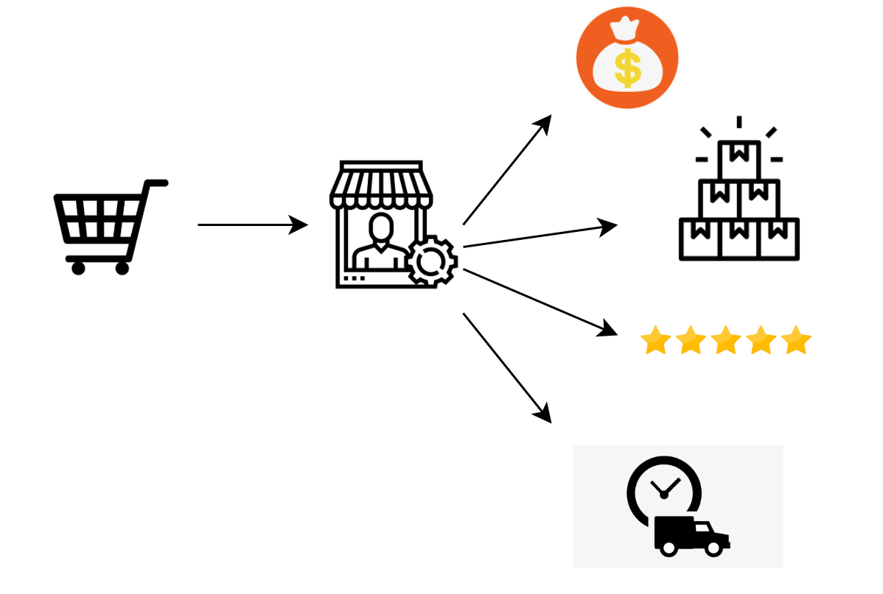
1. Introduction
Purchasing requirement

Slide 5

1. Introduction
supplier selection: Inventor Information
+ price
+ quantity
+ quality
+ lead time
+ Preferred
purchase contract management
Application Description

Slide 6
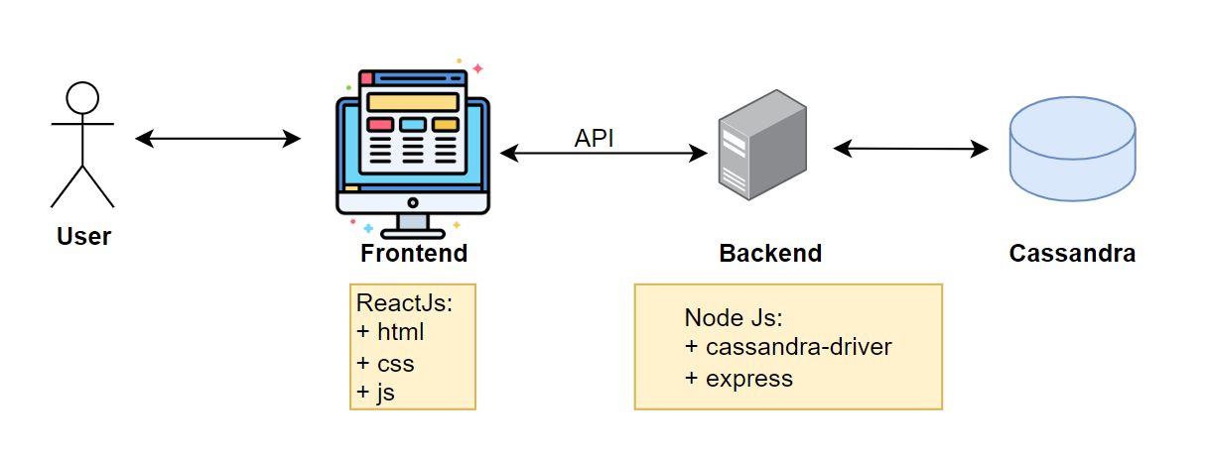
2. Architecture
Application Architecture

Slide 7
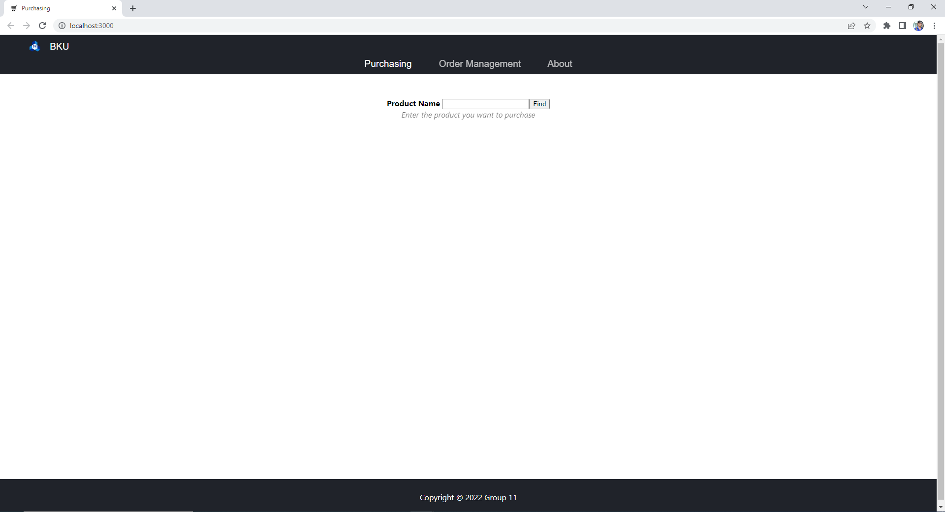
3. Frontend
Application UI

Slide 8

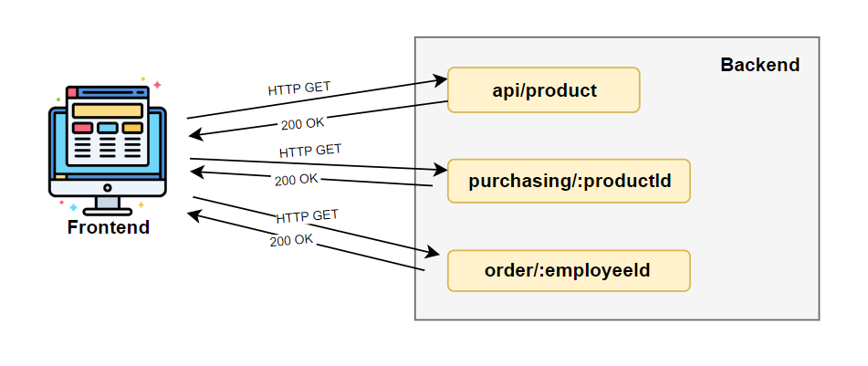
4. Backend
API

Slide 9
4. Backend
Connect database
Query example

Slide 10
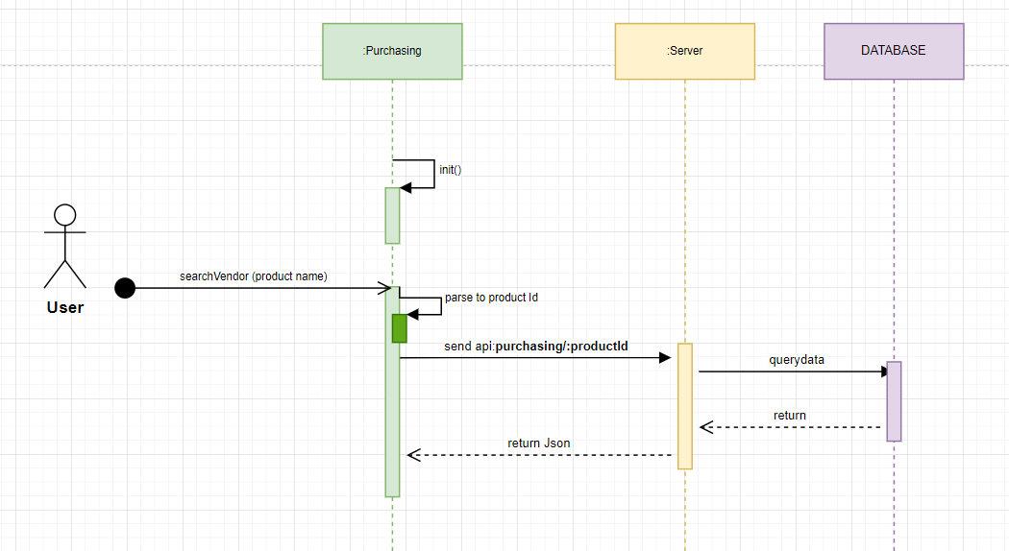
5. System sequence
Purchasing sequence diagram

Slide 11
6. Demo

Slide 12
Reference
https://cassandra.apache.org/doc/latest/
https://en.wikipedia.org/wiki/Apache_Cassandra
https://docs.datastax.com/en/cassandra-oss/3.x/index.html
https://data-flair.training/blogs/apache-cassandra-tutorial/
https://www.geeksforgeeks.org/architecture-of-apache-cassandra
https://reactjs.org/
https://nodejs.org/en/

Slide 13

Thank you

