Slide 1


Cassandra Database
Group 11
Lecturer: Võ Thị Ngọc Châu
Team members:
Nguyễn Ngọc Thắng - 2270194

Slide 2
Contents
I. Cassandra DB
II. Project

Slide 3
I. Cassandra
1. Introduction
2. Architecture
3. Data model
4. Data Types
5. Tool

Slide 4
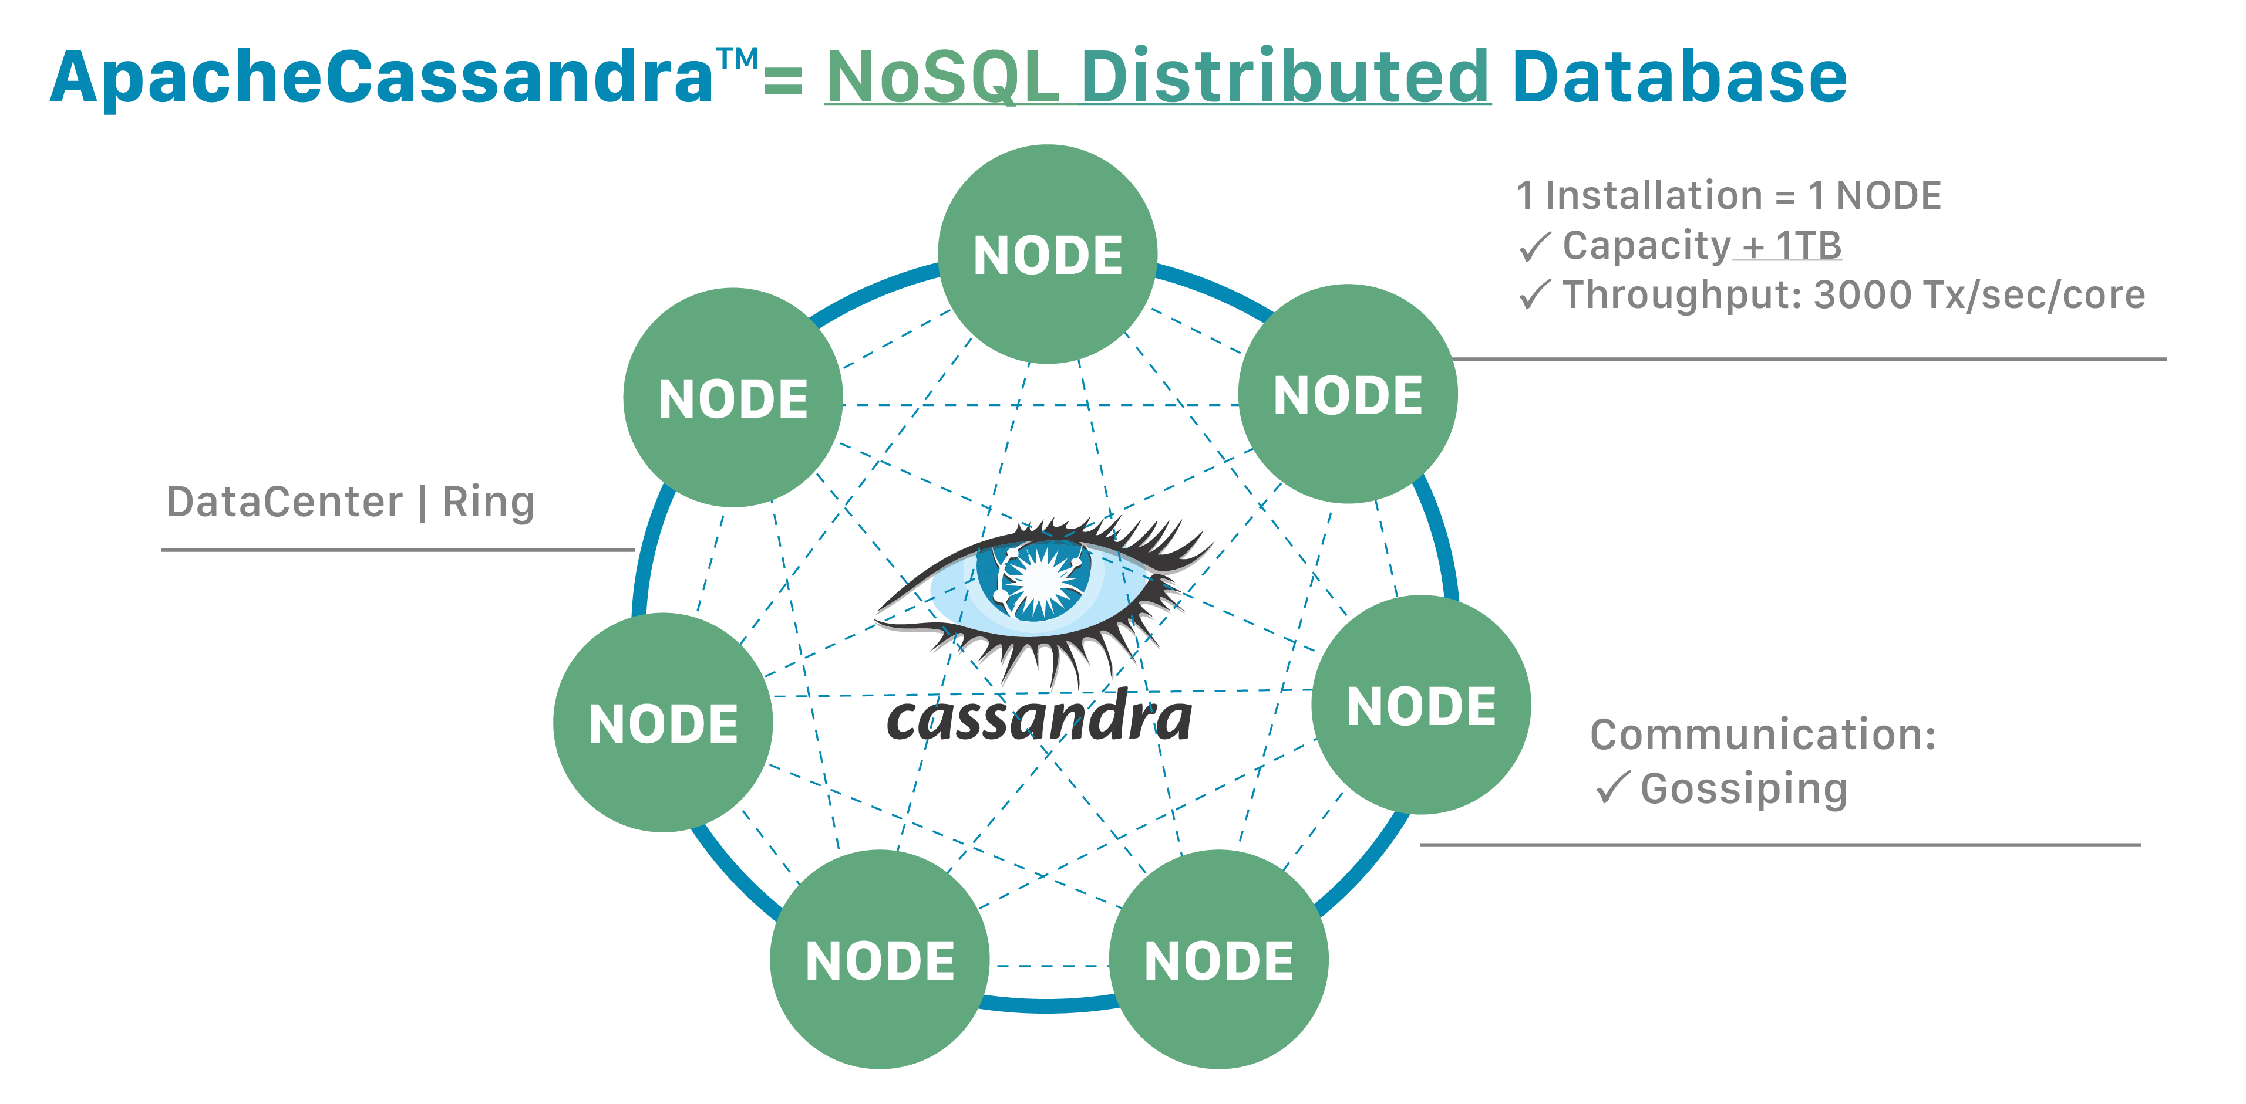
What is Cassandra?
1. Introduction
- Is an open source and distributed NoSQL database.
- It was developed by Facebook in 2007. It continues to be developed by Apache today
- Google's Bigtable + Amazon’s Dynamo
- Cassandra has multiple nodes on multiple clusters with P2P.
- Data is stored in tables and queried by Cassandra Query Language (CQL).

Slide 5
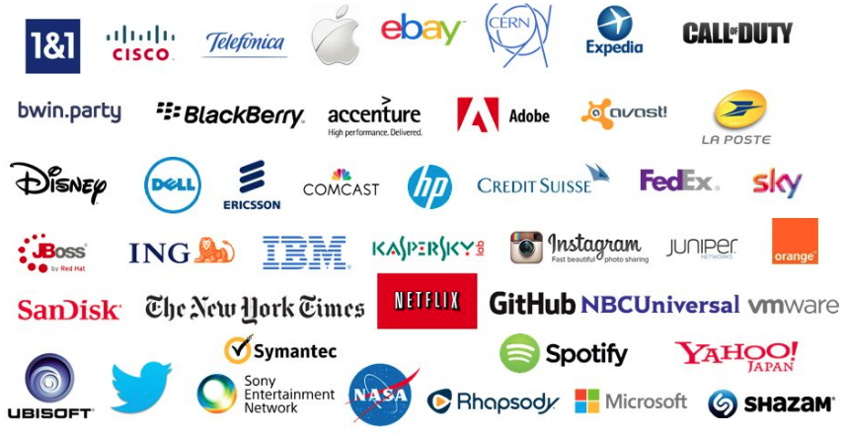
Companies using Cassandra
1. Introduction

Slide 6
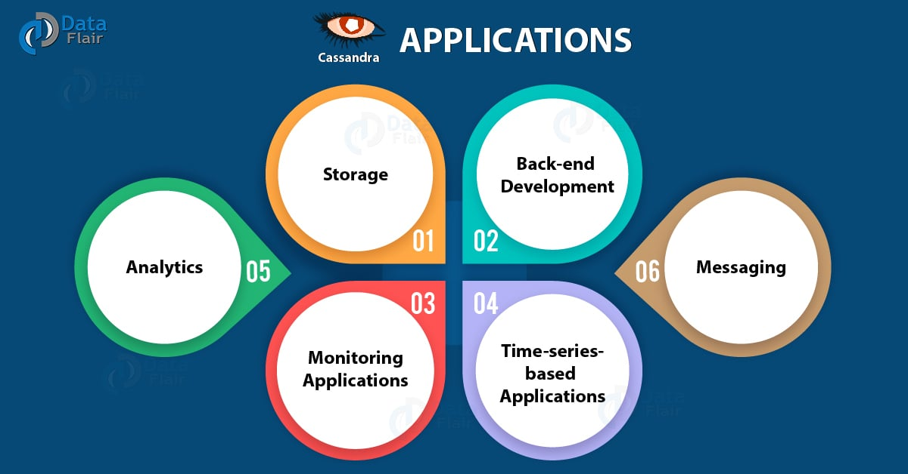
Use Case?
1. Introduction

Slide 7
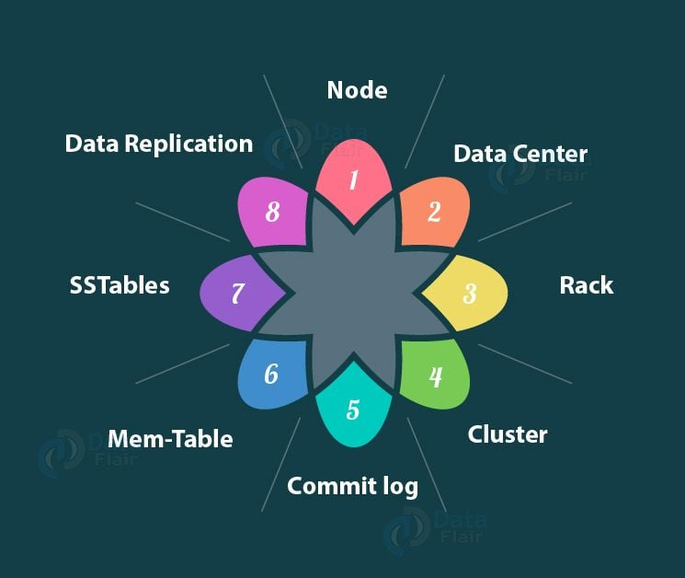
2. Architecture
Key Terms Of Cassandra Architecture

Slide 8
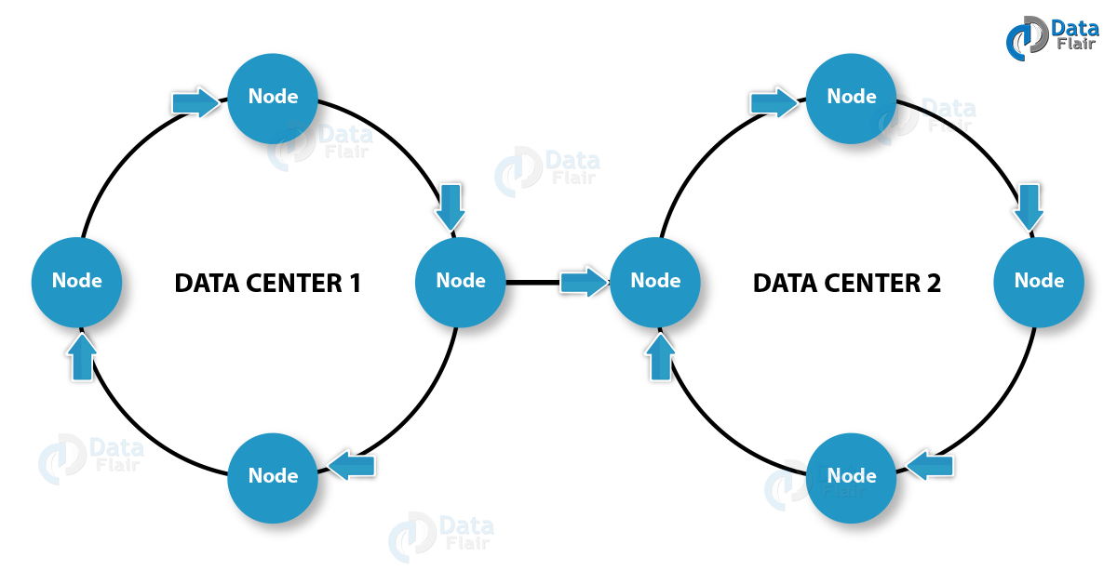
2. Architecture
Cluster

Slide 9
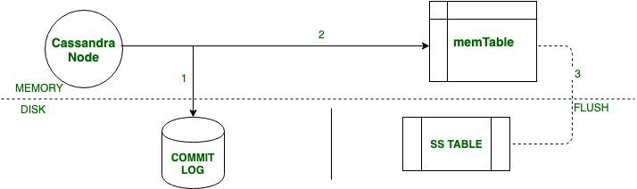
Storage Engine
2. Architecture

Slide 10
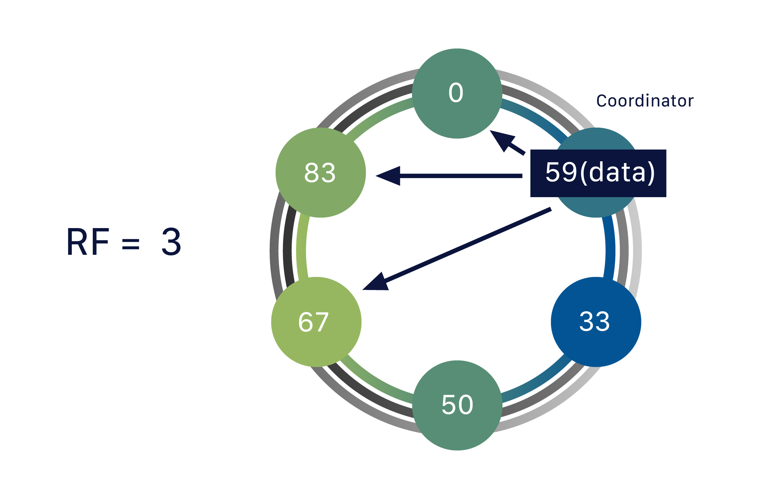
2. Architecture
Data Replication

Slide 11
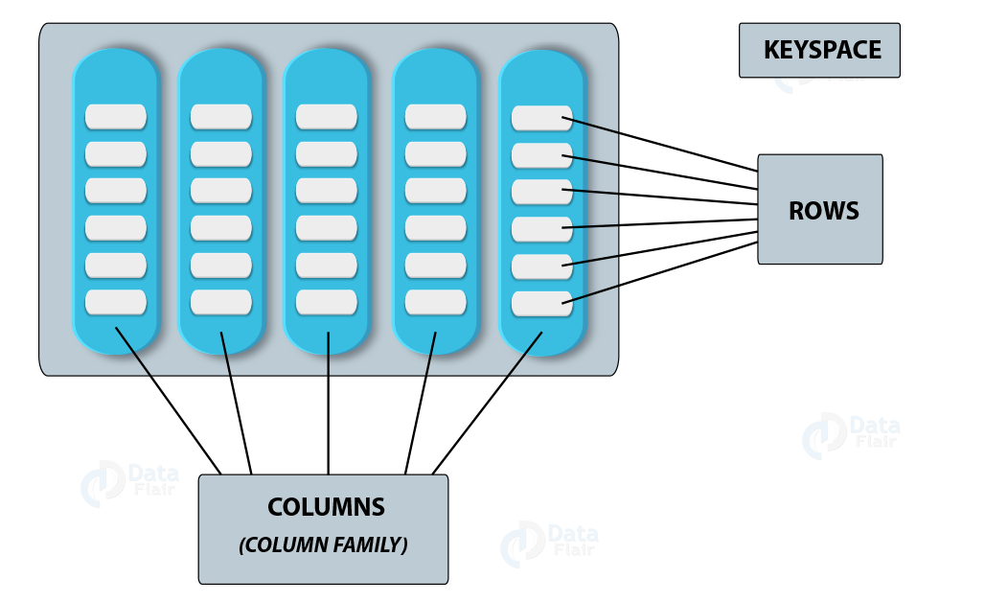
3. Data Model
Cassandra Data Model- Column Family in Cassandra

Slide 12
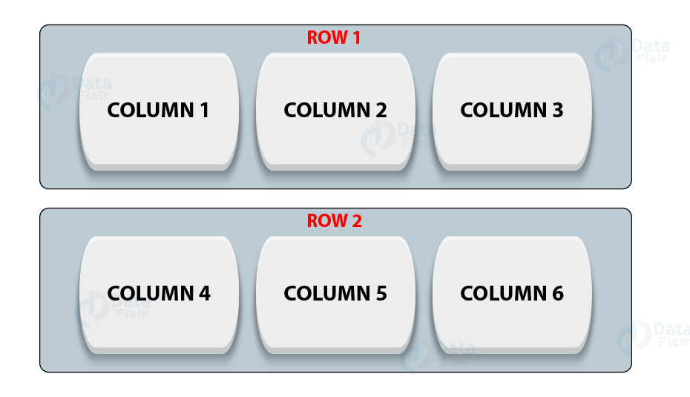
3. Data Model
Cassandra Data Model- Rows in Cassandra Column Family

Slide 13
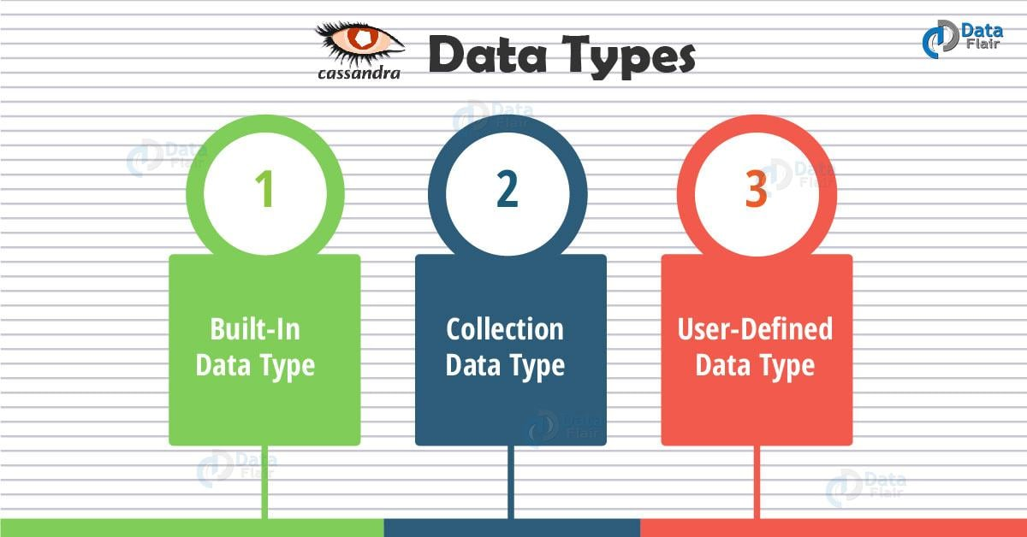
4. Data Types

Slide 14
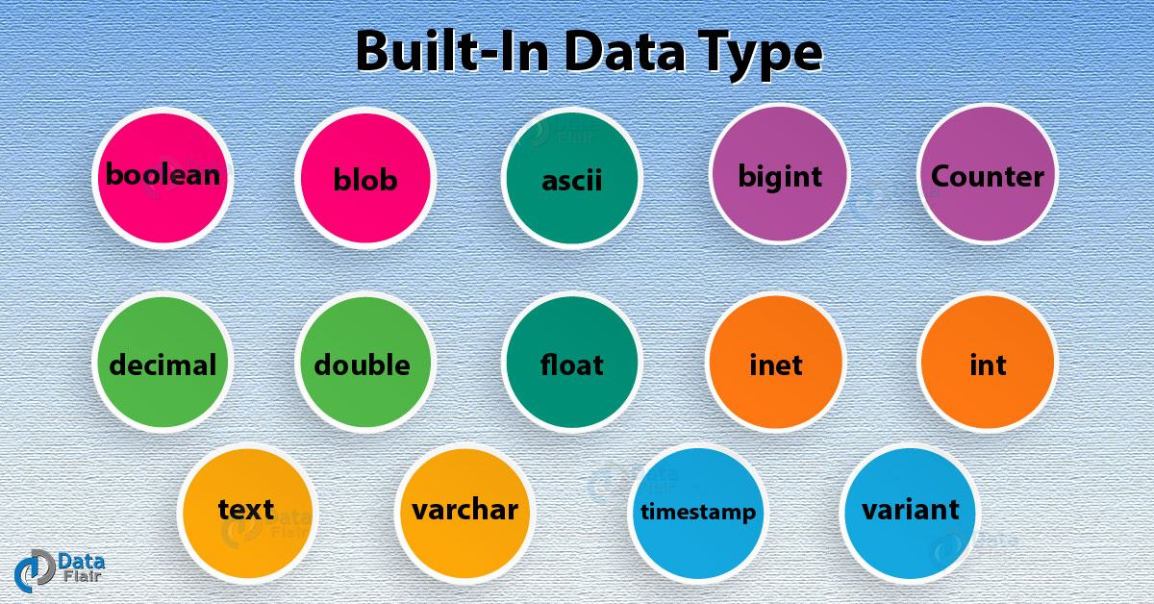
4. Data Types

Slide 15
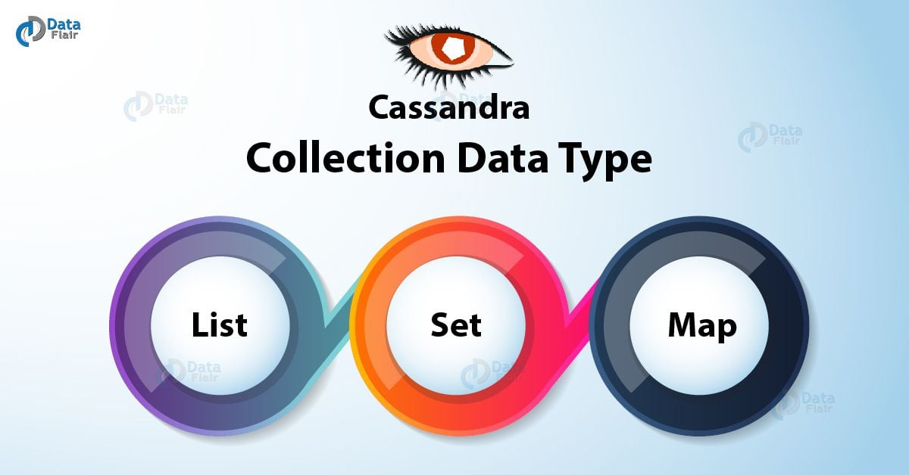
4. Data Types

Slide 16
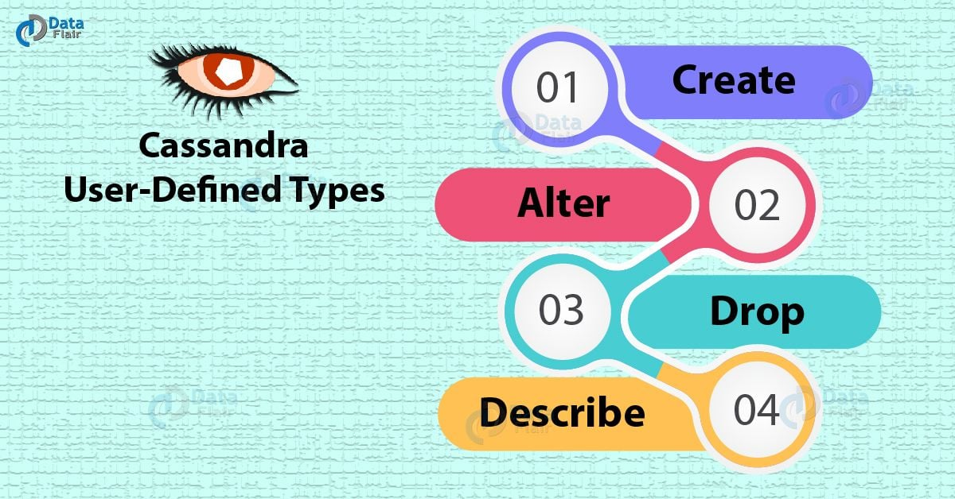
4. Data Types

Slide 17
5. Tool
- Cqlsh: is a command-line interface for interacting with Cassandra using CQL
Nodetool: allows you to narrow problems from the cluster down to a particular node and gives a lot of insight into the state of the Cassandra process itself
SSTable Tools: A toolkit for parsing, creating and doing other fun stuff with Cassandra 3.x SSTables. (under development && not yet stable)
Cassandra Stress: is used to benchmark and load-test a Cassandra cluster

Slide 18
Cassandra Application
AppScale: Back-end for Google App Engine applications.
Cisco‘s WebEx: storage for user feed and activity in near real time.
Globo.com: Back-end database for their streaming services.
Mahalo.com: Record user activity logs and topics for their Q&A website.
Netflix: Back-end database for their streaming services.
Nutanix: Store metadata and stats.

Slide 19
II. Project

Slide 20
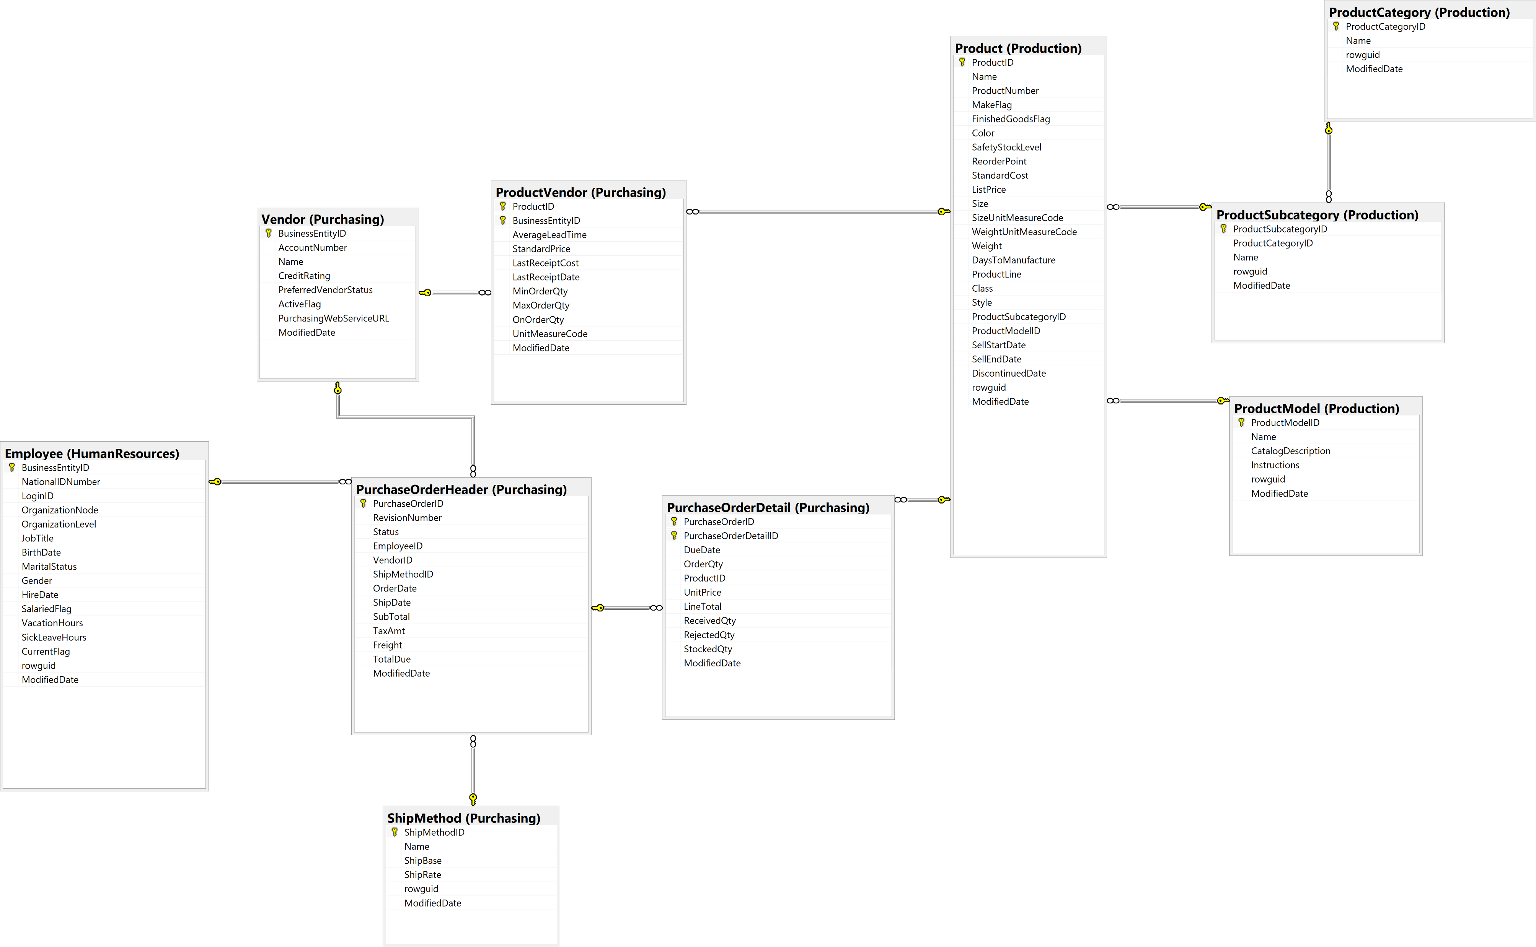
Reverse DB

Slide 21
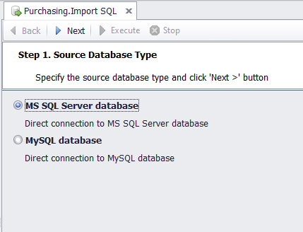
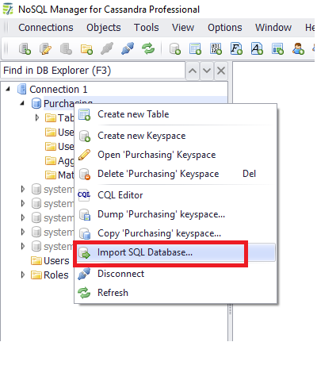
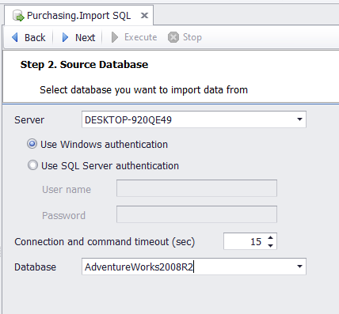
Migrate data
- sử dụng tool: NoSql Manager for Cassandra

Slide 22
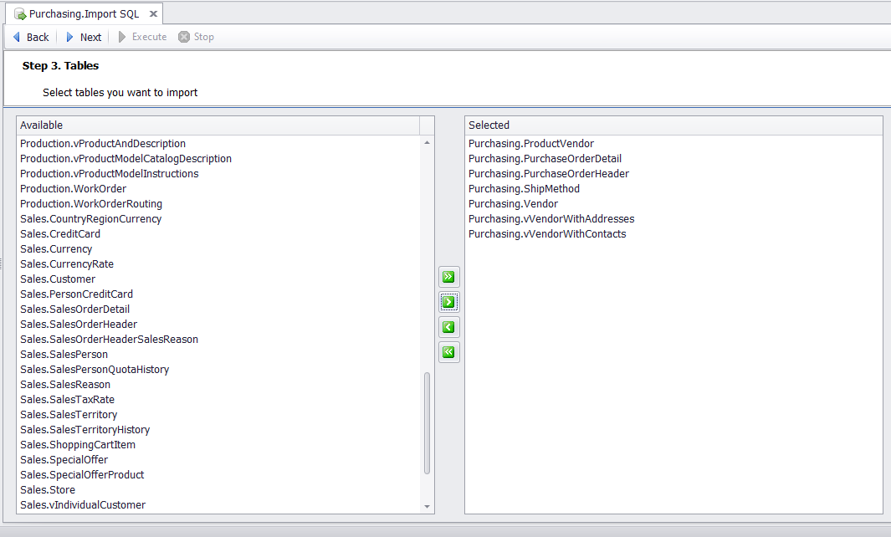
Migrate data

Slide 23
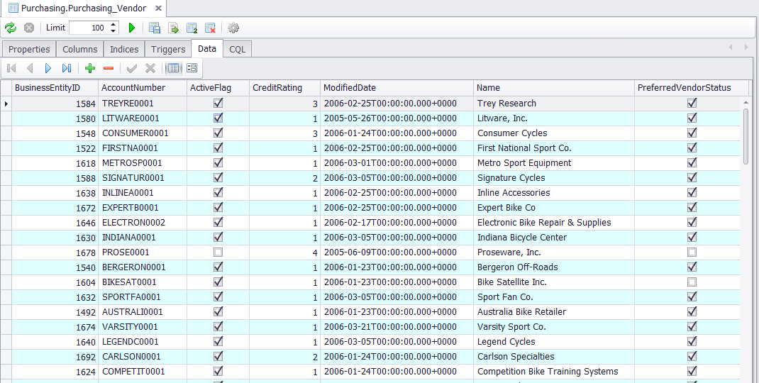
Migrate data

Slide 24
Application
Description: The Application to support purchasing:
supplier selection
purchase contract management
UI: https://drive.google.com/file/d/1J-t2CM8iUkfcEFRqw43vcpoHt8W8I-Lc/view?usp=sharing

Slide 25
Reference
https://cassandra.apache.org/doc/latest/
https://en.wikipedia.org/wiki/Apache_Cassandra
https://docs.datastax.com/en/cassandra-oss/3.x/index.html
https://data-flair.training/blogs/apache-cassandra-tutorial/
https://www.geeksforgeeks.org/architecture-of-apache-cassandra

Slide 26

Thank you

