Slide 1
Music Recommendation System
Using spotify’s data

Slide 2
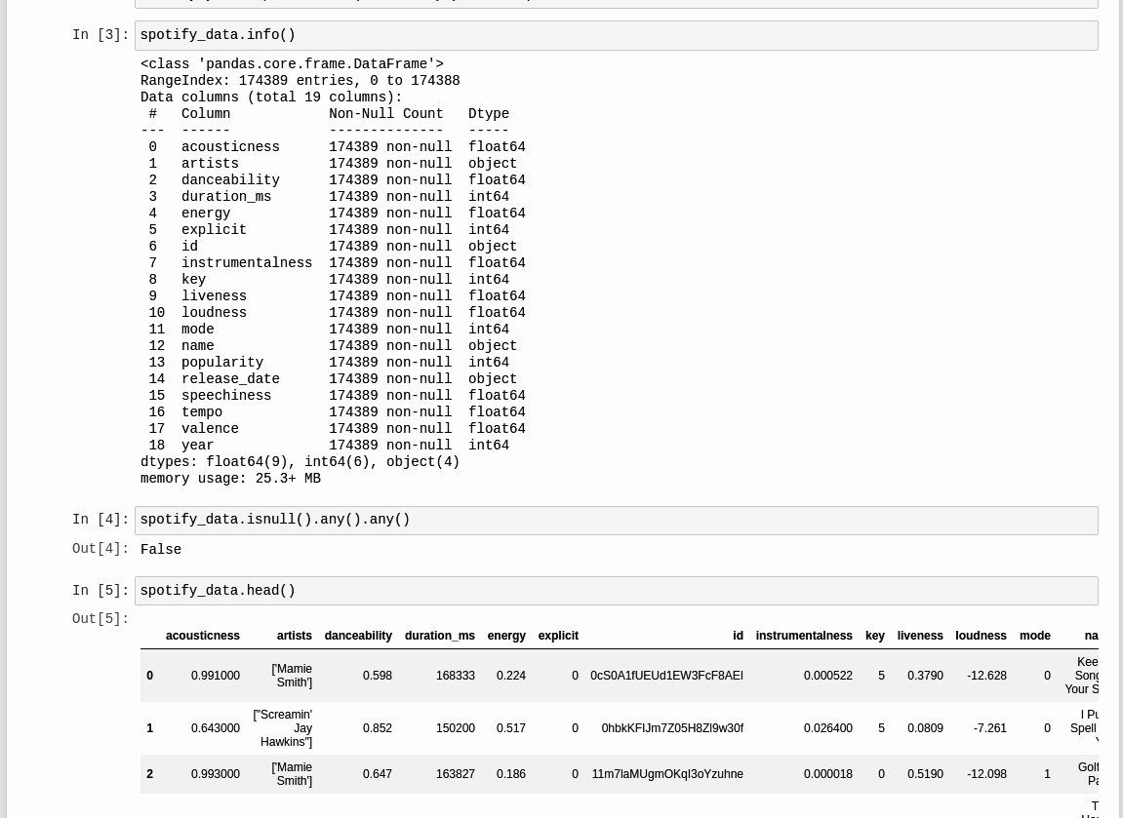
Know your Dataset
The dataset used for this notebook is publicly available on Kaggle.
It contains metadata and audio features for over 170,000 different songs.
Using “dataset.info()” we can see that the dataset contains 19 columns with 174389 rows. None of the row contains any null value.
“Spotipy” (a python client for the Spotify Web API) is used to fetch data for songs that does not exist in the original Spotify Song Dataset.

Slide 3
Libraries used
The libraries used are as follows:
numpy : fundamental package for scientific computing in Python.
pandas : We used the pandas library to import the dataset in our data frame and the same was used in all the further steps.
seaborn : Seaborn is a Python data visualization library based on matplotlib. It provides a high-level interface for drawing attractive and informative statistical graphics
Plotly.express: The plotly.express module (usually imported as px) contains functions that can create entire figures at once
spotipy : Spotipy is a lightweight Python library for the Spotify Web API. With Spotipy we get full access to all of the music data provided by the Spotify platform.

Slide 4

Exploratory Data Analysis

Slide 5
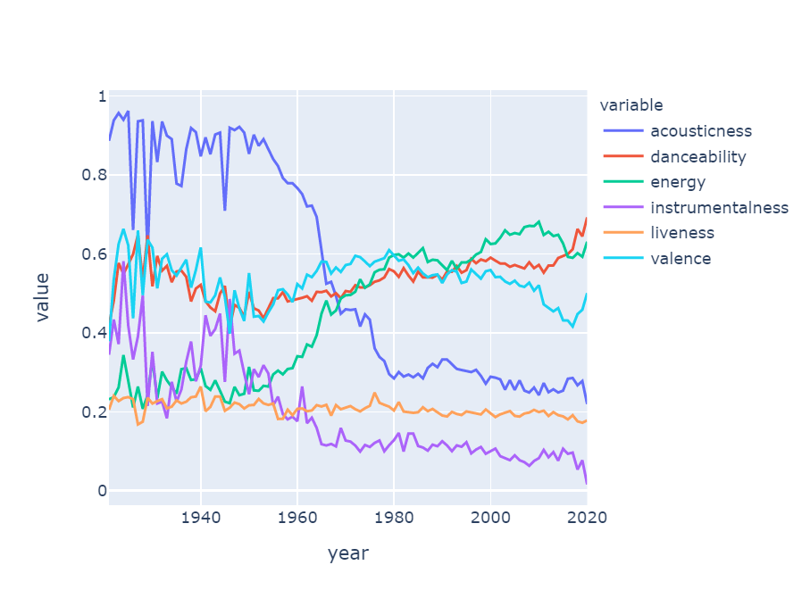
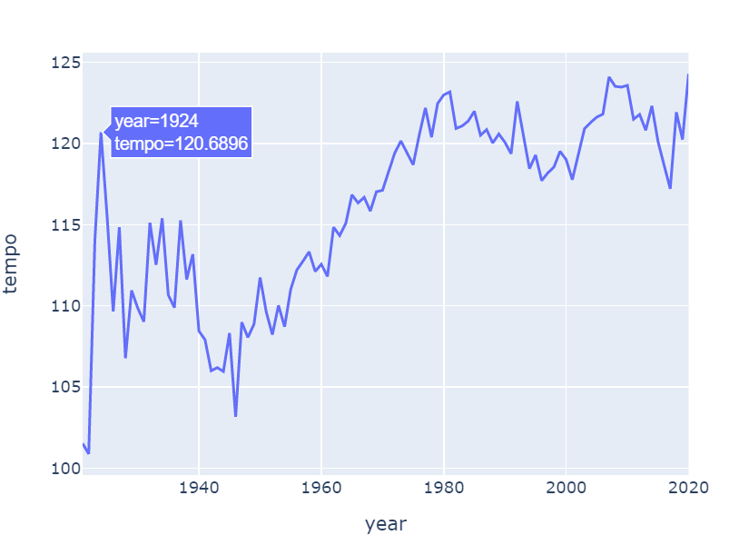
Music Over Time
Music has transitioned from the more acoustic and instrumental sound of the early 1900s to the more danceable and energetic sound of the 2000s mainly due to the advent of computers in music industry.
The tempo graph states that music has got significantly faster over the last century.

Slide 6
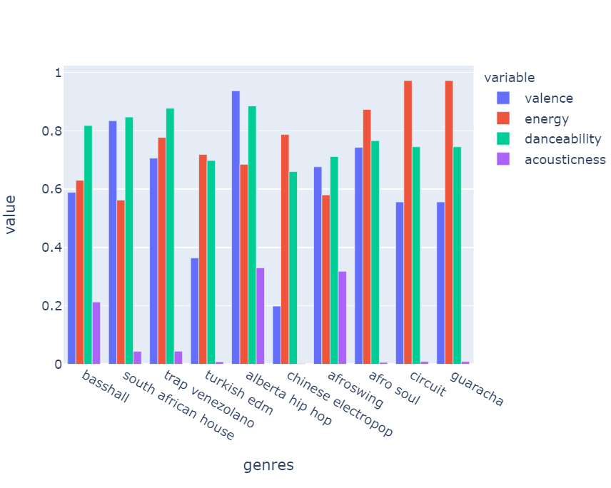
Characteristics of Genres

Slide 7
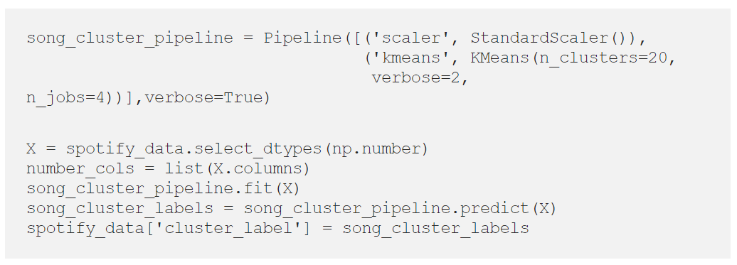
Clustering with K -Means

Slide 8

Dimensionality Reduction Technique
T-SNE VS PCA which is better?.....

Slide 9
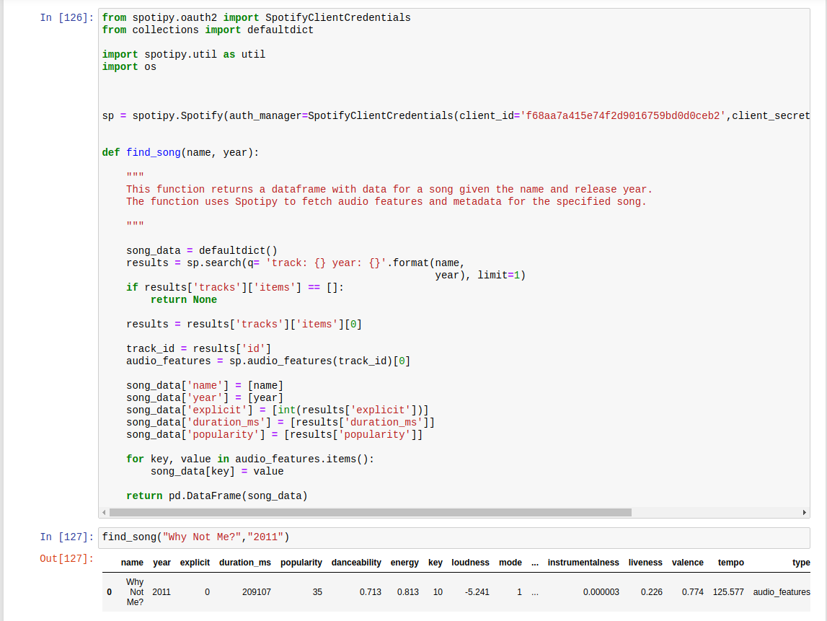
find_song function
The find_song function is defined to fetch the data for any song from Spotify’s catalog given the song’s name and release year. The results are returned as a Pandas Dataframe and the data fields are same as that in the original dataset.
The “client_id” and “client_secret_id” can be obtained from Spotify Developer’s page

Slide 10
The recommendation algorithm used follows three steps:
Compute the average vector of the audio and metadata features for each song the user has listened to.
Find the n-closest data points in the dataset (excluding the points from the songs in the user’s listening history) to this average vector.
Take these n points and recommend the songs corresponding to them

