Slide 2
MINOR PROJECT – 2 Sorting Visualizer Using Animation Under the guidance of MS. NIHARIKA SINGH
(AP-SS)
Submitted by-
Yash Nabh Rana Shashank Panthri Chahat Bansal

Slide 3
INTRODUCTION
Sorting is an important and widely studied issue, where the time complexity, execution time and the required resources for computation are of extreme importance, especially while dealing with real-time data processing.
Sorting algorithms can sort various data points with different methods that provide varying efficiency and complexity.
Unfortunately, this task cannot be described by a static drawing; it requires a dynamic sequence.
Thus, we have animation sequences portraying the behaviour of programs constructed automatically as a by-product of their execution, and therefore guaranteed to portray this execution faithfully.

Slide 4
Objectives
Main objective is to develop a sorting visualizer application using animation.
Designing and creating a user friendly interface.
Taking input for algorithm, size, and the speed of animation user chose.
Processing each input and saving information.
Displaying animation as per options picked by the user.

Slide 5
Literature Review
We were taught sorting algorithms and its importance in our ongoing course of Bachelor in Technology in Computer Science and we took this chance to study, analyse and animate the same.
The paper ‘Algorithm Animation’ by A. Kerren and J. Stasko [A. Kerren and J. T. Stasko. (2002) Chapter 1 Algorithm Animation. In: Diehl S.(eds) Software Visualization. Lecture Notes in Computer Science, vol 2269. Springer, Berlin, Heidelberg] has been very helpful and provided a clear understanding for our project.
Few already completed projects on the similar topic have been implemented using other software and tools like WebGL, available at https://www.cs.usfca.edu/~galles/visualization/Com parisonSort.html has helped us grasp the picture of project.

Slide 6
METHODOLOGY
Creating Interface:
We use pygame inbuilt function to create the interface and use basic shapes and colors to design
the interface.
Taking input:
Input is to be taken in form of x, y – coordinates and checked for collisions.
Saving Information:
Information is saved in various variables for each valid input and is then used to set the parameters
for the animation.
Displaying Animation:
A set of code will run in a loop with different arrangement of array every time, visualizing the internal
working of the sorting algorithm.

Slide 7
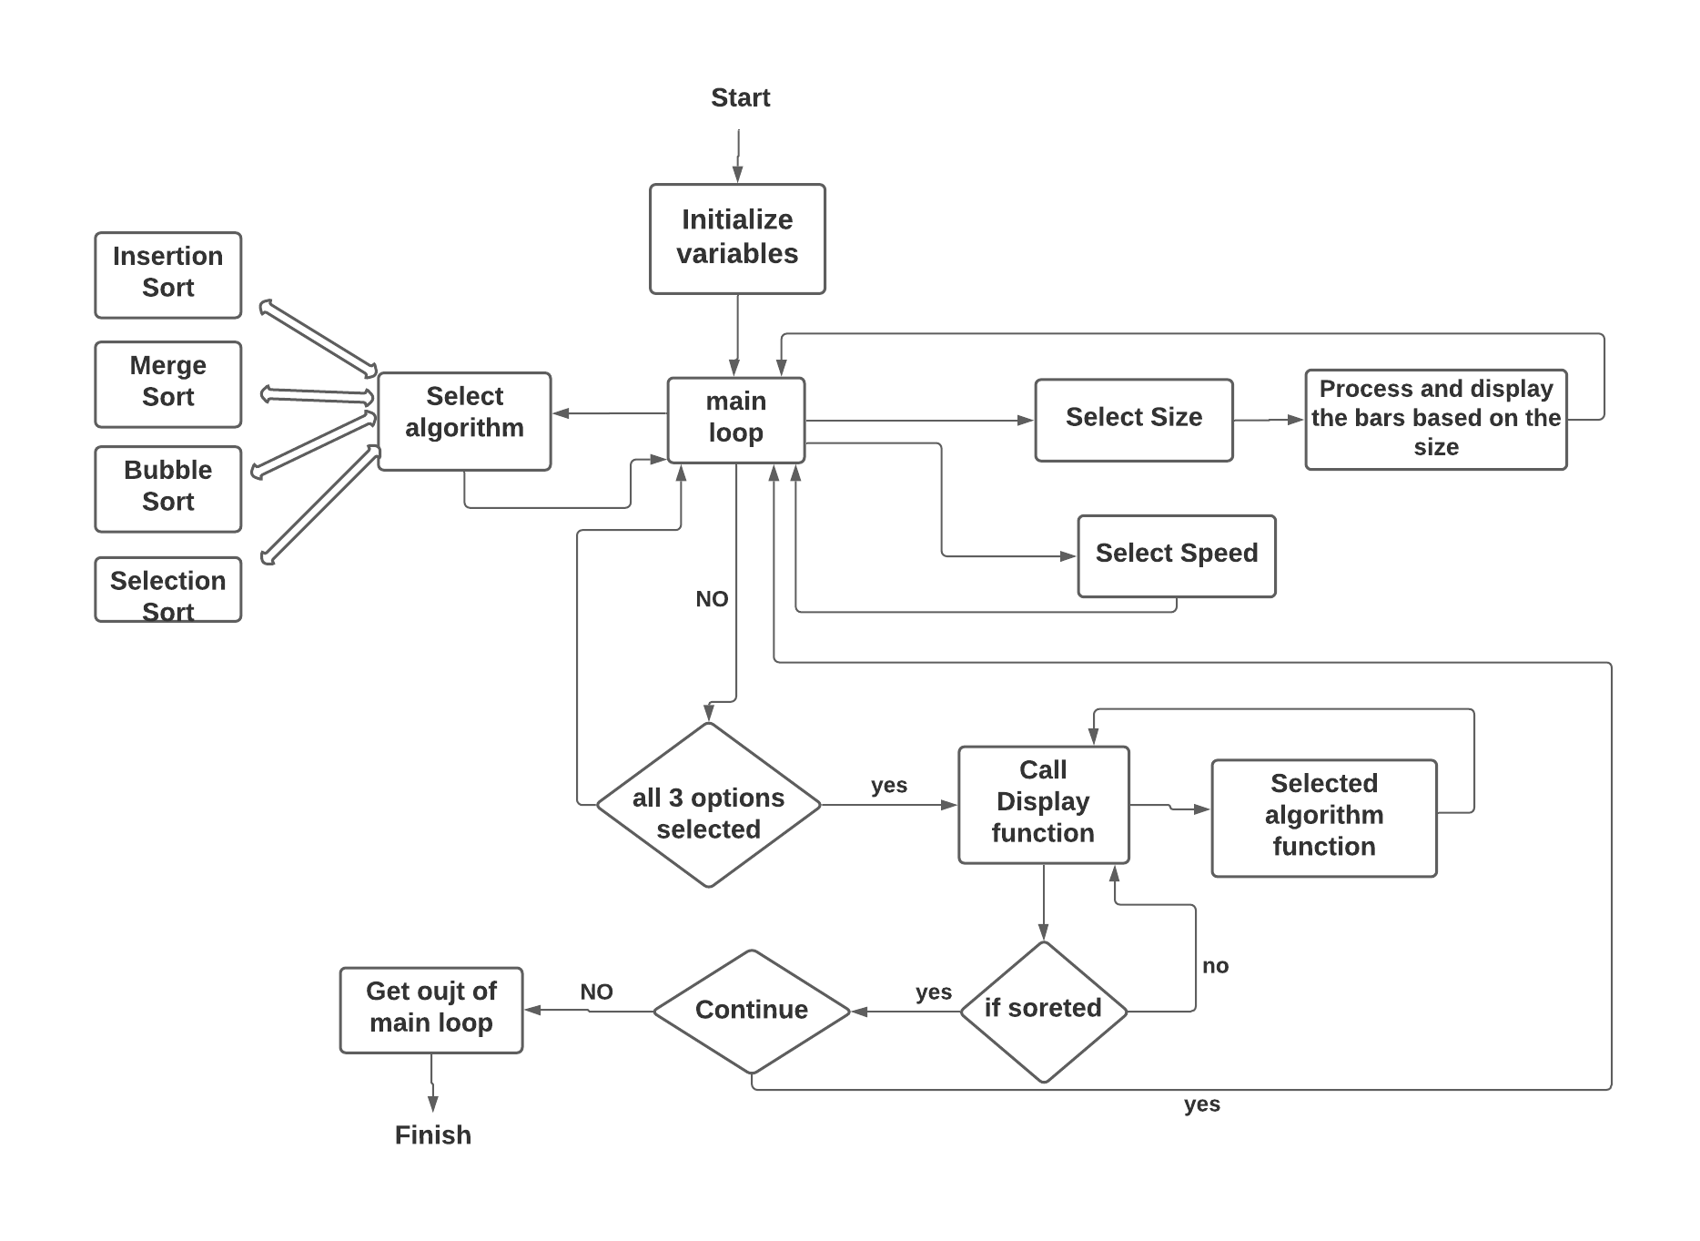
Algorithm Workflow

Slide 8
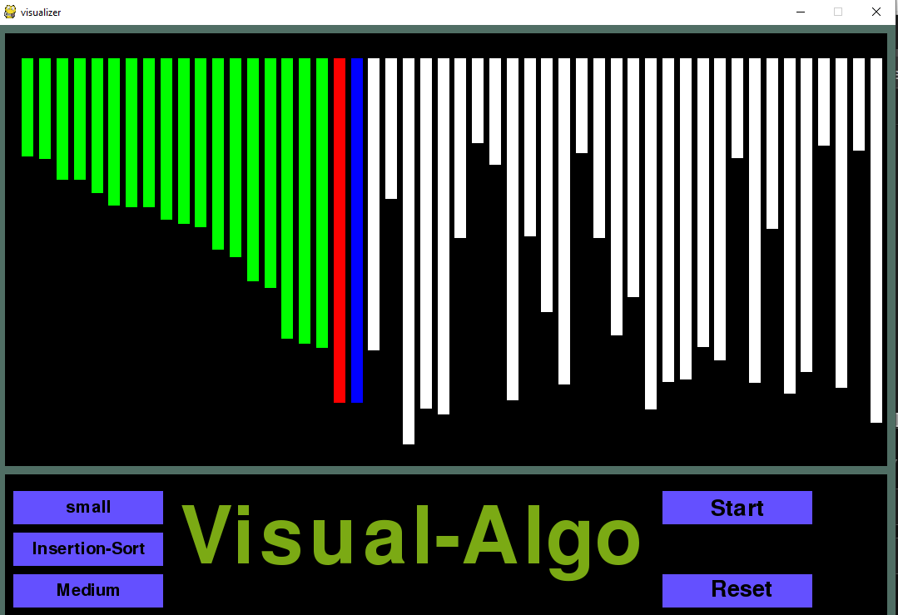
Example: Insertion Algorithm
def insertion_sort(height, colorOfLines):
for i in range(1, len(height)):
pygame.event.pump()
display()
# temp key
key = height[i]
# main line
colorOfLines[i] = colors[3]
j = i - 1
# if any line before main line is smaller then swap it
while j >= 0 and key < height[j]:
colorOfLines[j] = colors[1]
height[j + 1] = height[j]
display()
colorOfLines[j] = colors[2]
j = j - 1
# next line to be set as key
height[j + 1] = key
display()
# make the original main line again white
colorOfLines[i] = colors[2]

Slide 9
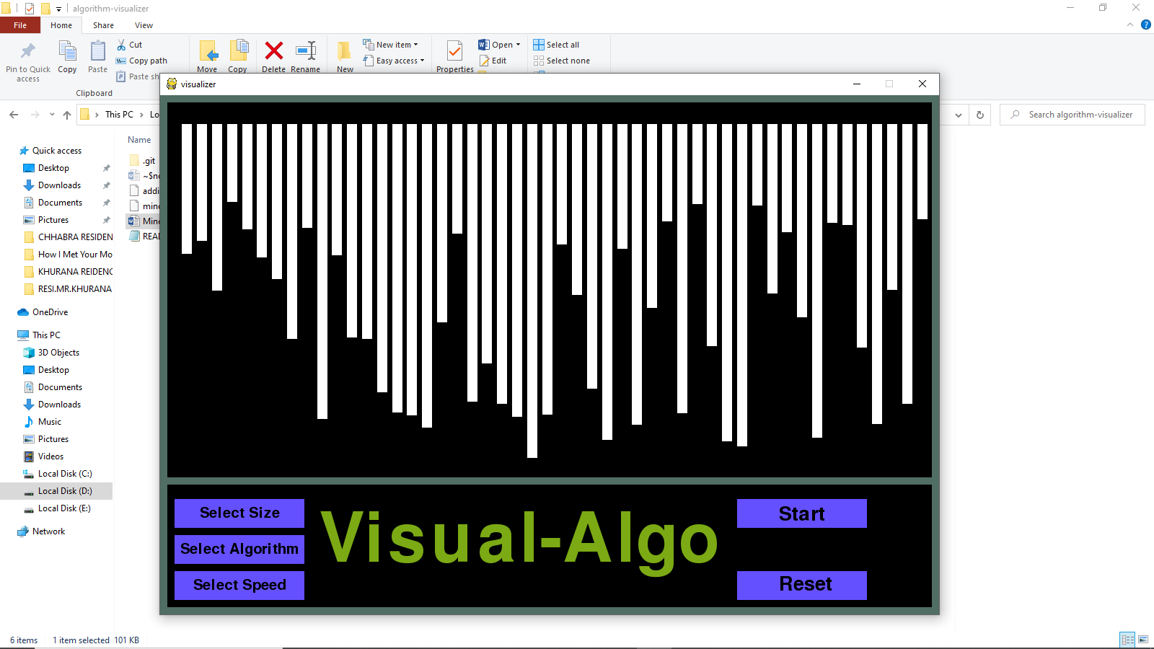
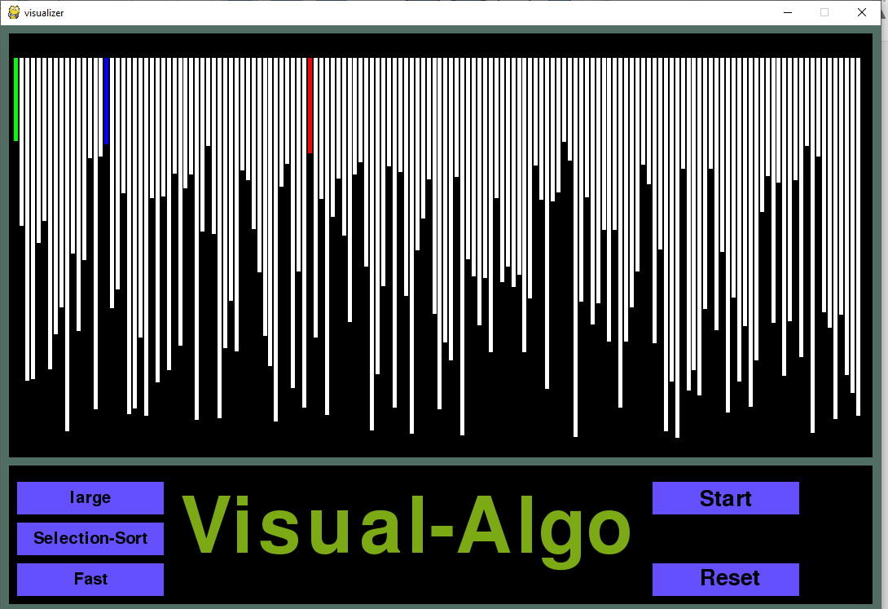
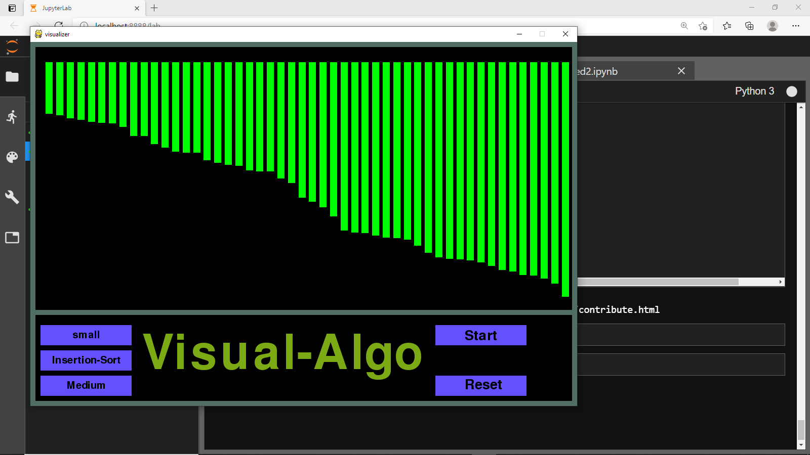
Output
Fig a.
Fig b.
Fig c.
Fig d.

Slide 10
REFERENCES:
A.Kerren and J. T. Stasko. (2002) Chapter 1 Algorithm Animation. In: Diehl S.(eds) Software Visualization.
Lecture Notes in Computer Science, vol 2269. Springer, Berlin, Heidelberg.
https://www.cs.usfca.edu/~galles/visualization/ComparisonSort.html
https://dev.to/kgprajwal/build-a-sorting-visualizer-in-python-2oej
T. Bingmann. “The Sound of Sorting - ‘Audibilization’ and Visualization of Sorting Algorithms.”
Panthemanet Weblog. Impressum, 22 May 2013. Web. 29 Mar. 2017.
A. Moreno, E. Sutinen, R. Bednarik, and N. Myller. Conflictive animations as engaging learning tools.
Proceedings of the Koli Calling ‘07 Proceedings of the Seventh Baltic Sea Conference on Computing Education
Research - Volume 88, Koli ‘07 (Koli National Park, Finland), pages 203-206.

