Slide 1
Application of Integration in Medicine
Amishi Desai C044
Chahel Gupta C049
Aneri Patel C056

Slide 2
Introduction
Many medicines which flow through the bloodstream can be modeled with a differential equation.
To solve a differential equation like this we could use integration to learn how it travels through the body (not just a rate, but now perhaps a distance as a function of time).

Slide 3
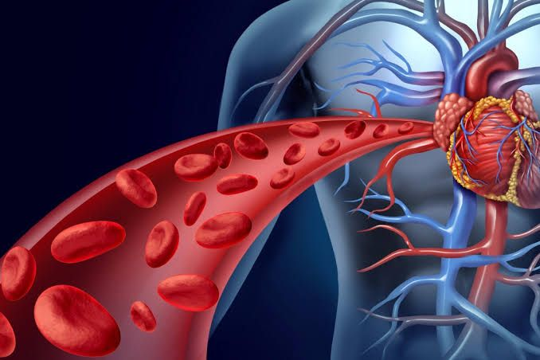
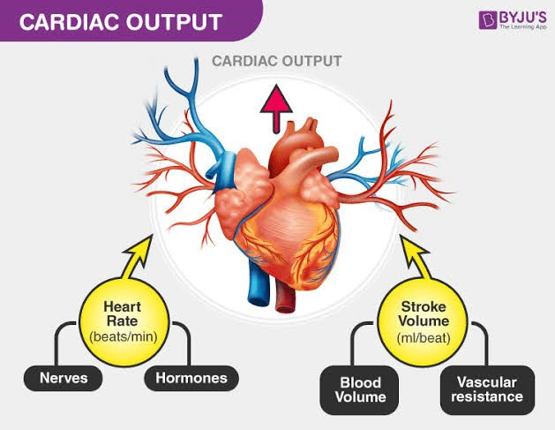
Real-Life Applications
Blood Flow
Cardiac Output
Calculus can be used to determine the blood flow in an artery or a vein at a given point in time.
Calculus can be used to find the amount of blood pumped through the heart per unit time.

Slide 4
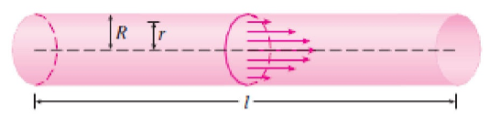

Blood Flow
Cylindrical Tube
The relationship between ‘v’ (velocity) and ‘r’ (radius) is given by the law of Laminar Flow which is:

Slide 5

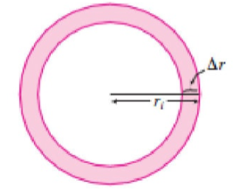
To find the rate of the blood flow, or flux, we use smaller, equally spaced radi so that the ring has an inner radius ‘ri-1’ and outer radius ‘ri’ and the area of the ring is:
If ∆r is small, the velocity is basically constant throughout the ring and is approximated by v*(ri). The volume of blood per unit time is:

Slide 6


Therefore, the total volume of the blood flowing through the blood vessel is:

Slide 7
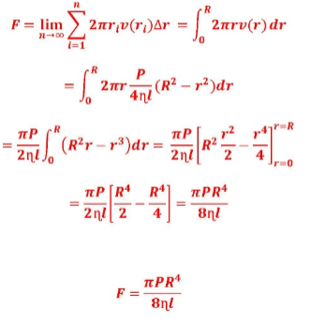
The velocity of blood increases in the centre of the blood vessel. The limit gives the exact value of the flux ( volume of blood that passes through the blood vessel ) per unit time.
This is the final equation

Slide 8
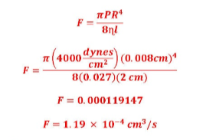
Example:
Use Poiseuille’s Law to calculate the rate of flow in a small human artery where we can take
n=0.027, R=0.008 cm, l=2 cm and P=4000 dynes/cm^2.
Solution:

Slide 9
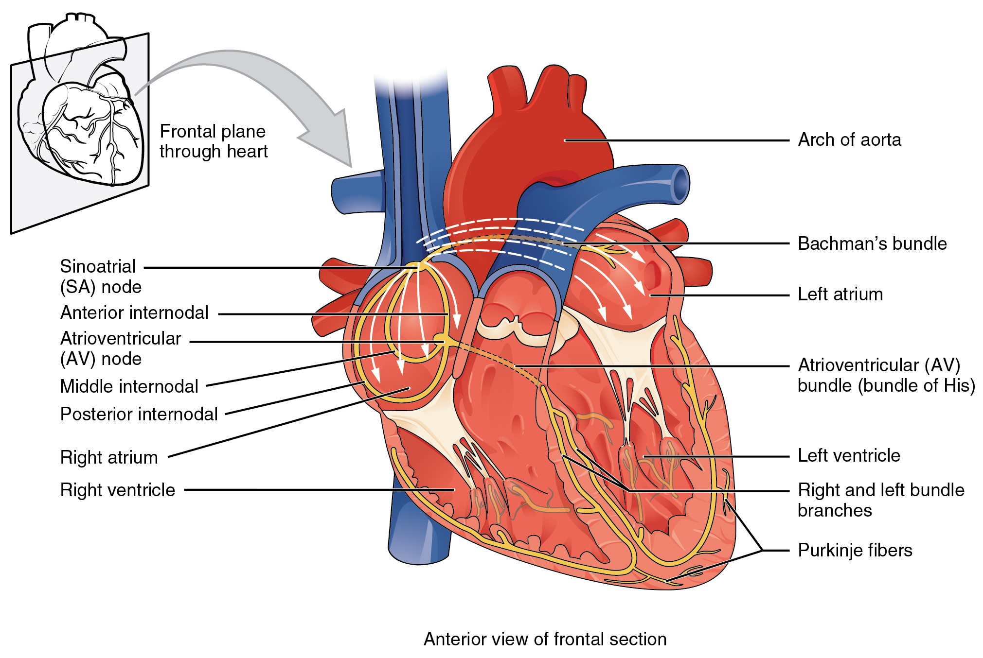
Cardiac Output
Volume of blood that is pumped out per unit time.
Cardiac output is the product of heart rate (HR) and stroke volume (SV) and is measured in liters per minute.

Slide 10
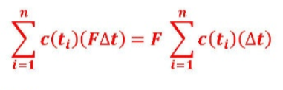
Let c(t) be the concentration of the dye at time t. By dividing the time intervals from (0,T) into equal sub-intervals ∆t, the amount of dye that flows past the measuring point during the subinterval from t=ti-1 to t-t1 is
Where f is the rate of flow which we are attempting to calculate. The total amount of dye is:

Slide 11
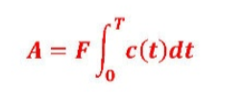

If we let n=∞, the amount of dye is:
So, the equation to find the cardiac output is:
Where A, the amount of dye, must be known and the integral can be calculated using the readings.

Slide 12
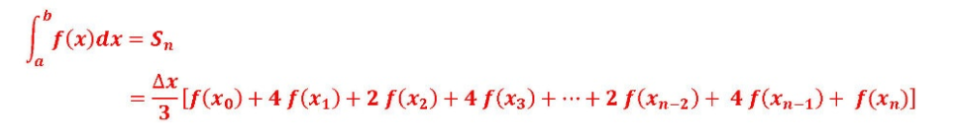

The Simpson’s Rule may also be required to solve certain questions. The Simpsons rule is:
Where n is even and :

Slide 13
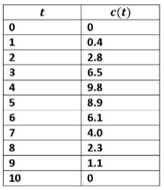
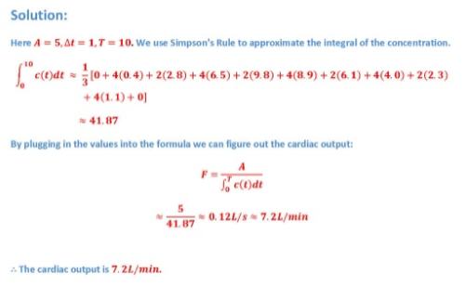
Example:
A 5mg bolus of dye is injected into right atrium. The concentration of the dye is measured in the aorta in one second intervals as shown in the chart. Estimate the cardiac output.

Slide 14
Thank you!

