Slide 1
Application of Graph Theory in Air-Transportation Network

Slide 2
Introduction
Graph Theory is the study of relationships.
Given a set of airports and connections, which can abstract anything from city layouts to
computer data, graph theory provides a helpful tool to quantify and simplify the many
moving parts of dynamic systems.
Graph theory plays a crucial role in the analysis and modeling of various real-world
systems, and the air transportation network is no exception.
The air transportation network can be effectively represented and studied using graph
theory concepts.

Slide 3
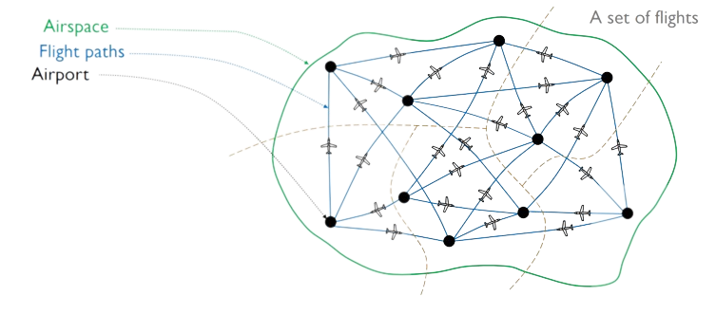
Air Traffic Control
Air traffic control is an essential element of the communication structure which supports air transportation.
Two basic for air traffic control (ATC) are safely and efficiency of air traffic movement.
ATC organizes the air space to achieve the objective of a safe, expeditious and orderly flow of air traffic.
The problem is future compounded by the fact that busy airports sustain excessive lending and departure rates and airports themselves are invariably situated within busy terminal areas and in close proximity to other airports.
To avoid collisions between moving aircrafts and maintain an orderly flow of traffic graph theory can be used.

Slide 4
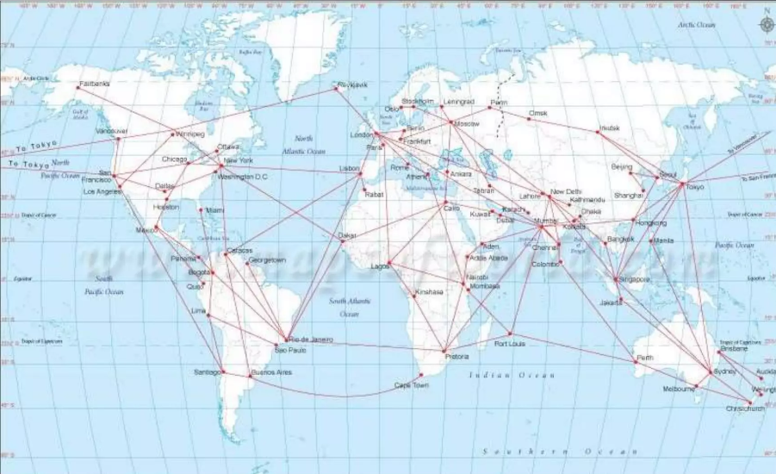
Terminal Approach Control
The purpose of air route traffic control centers is to protect the flight path of aircraft leaving the airways system to land at the airport in the terminal or alternatively the flight path of aircraft departing the terminal for and en-route airway.
When these are several airports in and urban area. One facility may control traffic to all these airports.

Slide 5
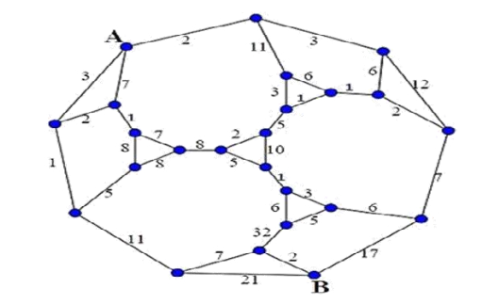
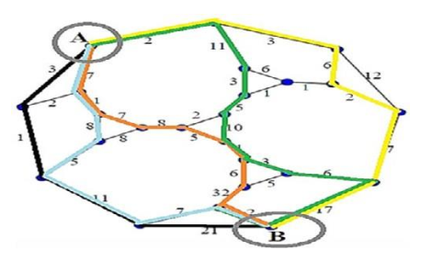
Graph Theory in Air Traffic Control Network
A graph is defined as a finite number of points (known as airports or vertices) connected by lines (known as edges or arcs).
This graph is a weighted graph, for which the weights represent the distance between each airport.
There are multiple path options to reach from airport A to airport B, but our aim is to find the shortest path with a minimum transportation cost.
To find the shortest path we use Kruskal’s Algorithm which will give us the minimum spanning tree.

Slide 6
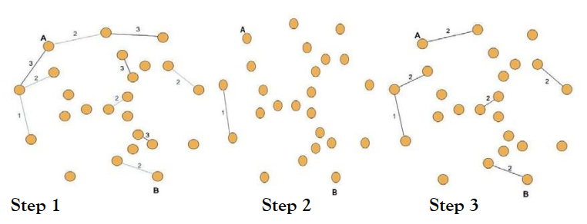
Step Wise Approach
Step 1:
We begin by placing all the airports of the given graph without edges, then we will start to put edges in their place starting from the lowest cost (edge weight 1) to one with higher costs but having in mind not to create cycles.
Step 2:
This process continues by placing the second edge of weight 2.
Step 3:
Edge of lower cost that comes after it with units 1 and 2 is the edge of length 3, keeping in mind to not form cycles.

Slide 7
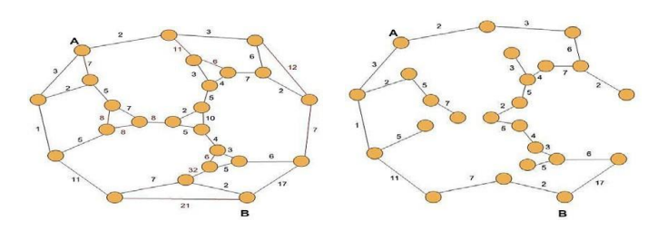
Step Wise Approach
After applying this rule to all edges of the given Graph given, we have gained a Minimum Spanning Tree (n-1 edges have been formed).
The spanning tree will give us multiple routes between all the connected nodes, but let us look at how to calculate the minimum distance between node A and B.

Slide 8
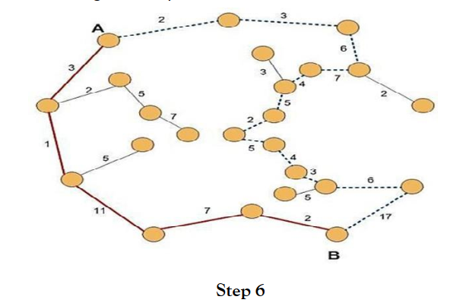
Minimum Cost Path
After obtaining the minimum spanning tree we are able to find the minimum cost path (trajectory) from airport A to airport B.
There are two alternative ways to reach from airport A to airport B, which are distinguished by dash line.
Option 1(dash line): 2+3+6+7+4+5+2+5+4+3+6+17 = 64 units
Option 2(full line): 3+1+11+7+2 = 24 units
This means that the second option represents the minimum cost path from airport A to airport B.
Option 2 will give us the most efficient flight route as it takes lesser time and uses lesser amount of fuel to reach the same destination.

Slide 9
Why are we using Krushkal’s Algorithm and not Prim’s Algorithm?
Kruskal’s algorithm traverses one node (airport) only once but Prim’s Algorithm traverses one node more than once to get the minimum distance, which in air transportation is pointless unless there is an emergency, and the aircraft has to return back to a certain airport before going to its destination.
Kruskal’s algorithm works well for disconnect graphs meaning airports of secluded areas can easily be covered in the air transportation network, but Prim’s algorithm will work only for connected graphs meaning it is more difficult to include airports of secluded areas.

Slide 10
Thank You
Discrete Mathematics
Application of Graph Theory in Air Transportation Network
B.Tech Integrated (Computers)
Batch B2
C048 – Pratham Vasa
C049 – Chahel Gupta
C050 – Vivean Arya
Carlson, S. C. (2023, September 1). Graph theory | Problems & Applications. Encyclopedia Britannica. https://www.britannica.com/topic/graph-theory
A. Farrahi, A. Goldberg, L. Bagasol, and J. Jung, "Applying graph theory to Problems in air traffic Management" [Online]. Available: https://core.ac.uk/download/pdf/84913826.pdf.
S. R. P. (Solai Rani P.), "Application of Graph Theory In Air-Transportation Network," J. Pur Appl Math, vol. 5, no. 1, pp. 1-4, 2021. Available: https://www.pulsus.com/scholarly-articles/application-of-graph-theory-in-airtransportation-network.pdf.

