Slide 1


(Ezekiel 47:14)
Envy-Free Matchings in Bipartite Graphs and their Applications to Fair Division
Erel Segal-Halevi
joint work wITH
Elad Aigner-Horev

Slide 2
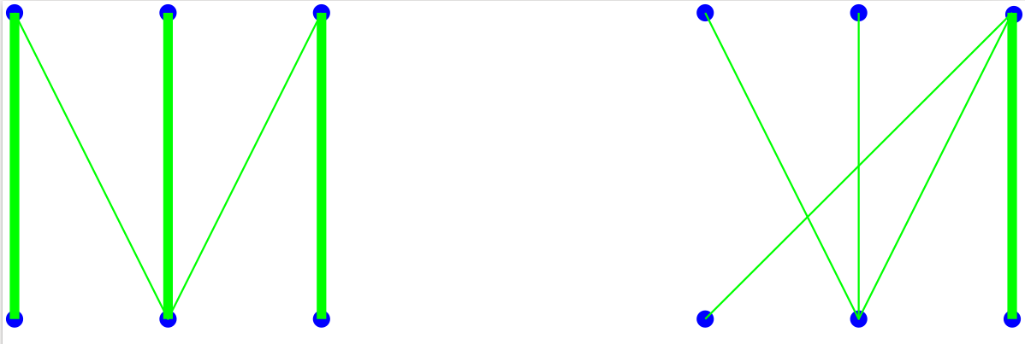
Perfect vs. Envy-Free Matching
X
Y
X-saturating matching: Every vertex of X is matched.
Envy-free matching: Every unmatched vertex of X is dis- connected from any matched vertex of Y.

Slide 3



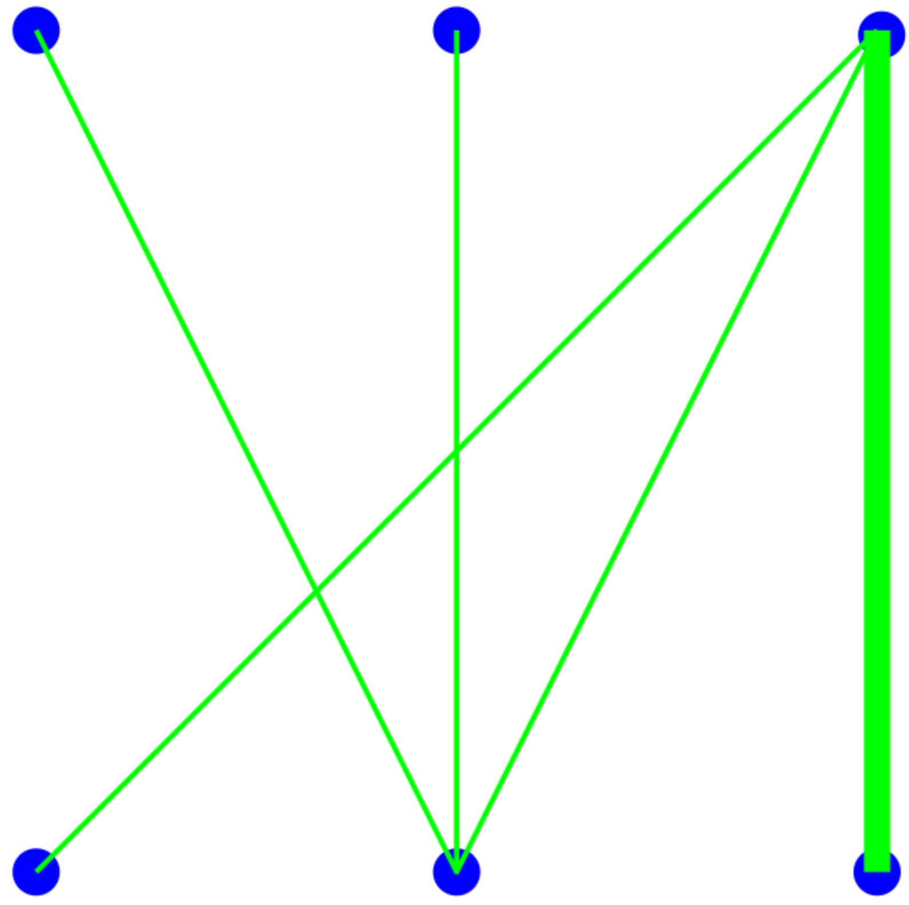



Envy-Free Matching: Metaphor
X
Y

Slide 4
Envy-Free Matching: Existence
Question. Does an EFM always exist?

Slide 5
Envy-Free Matching: Existence
Question. Does an EFM always exist?
Answer. Yes – the empty-matching is EF.

Slide 6
Envy-Free Matching: Existence
Question. Does an EFM always exist?
Answer. Yes – the empty-matching is EF.
Question 2. Does a non-empty EFM always exist?

Slide 7
Envy-Free Matching: Existence
Question. Does an EFM always exist?
Answer. Yes – the empty-matching is EF.
Question 2. Does a non-empty EFM always exist?
Answer 2. No →

Slide 8
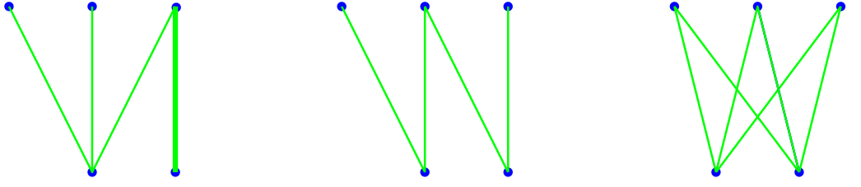
Non-empty vs. empty EFM
X
Y
Non-empty EFM
Only empty EFM

Slide 9
Questions
Graph theory questions: * When does a non-empty envy-free matching exists? * How to find an envy-free matching of maximum size?
Fair division questions: * What can we do with the unmatched vertices?

Slide 10
PART 1: EFM and graph-theory
Graph theory questions: * When does a non-empty envy-free matching exists? * How to find an envy-free matching of maximum size?

Slide 11
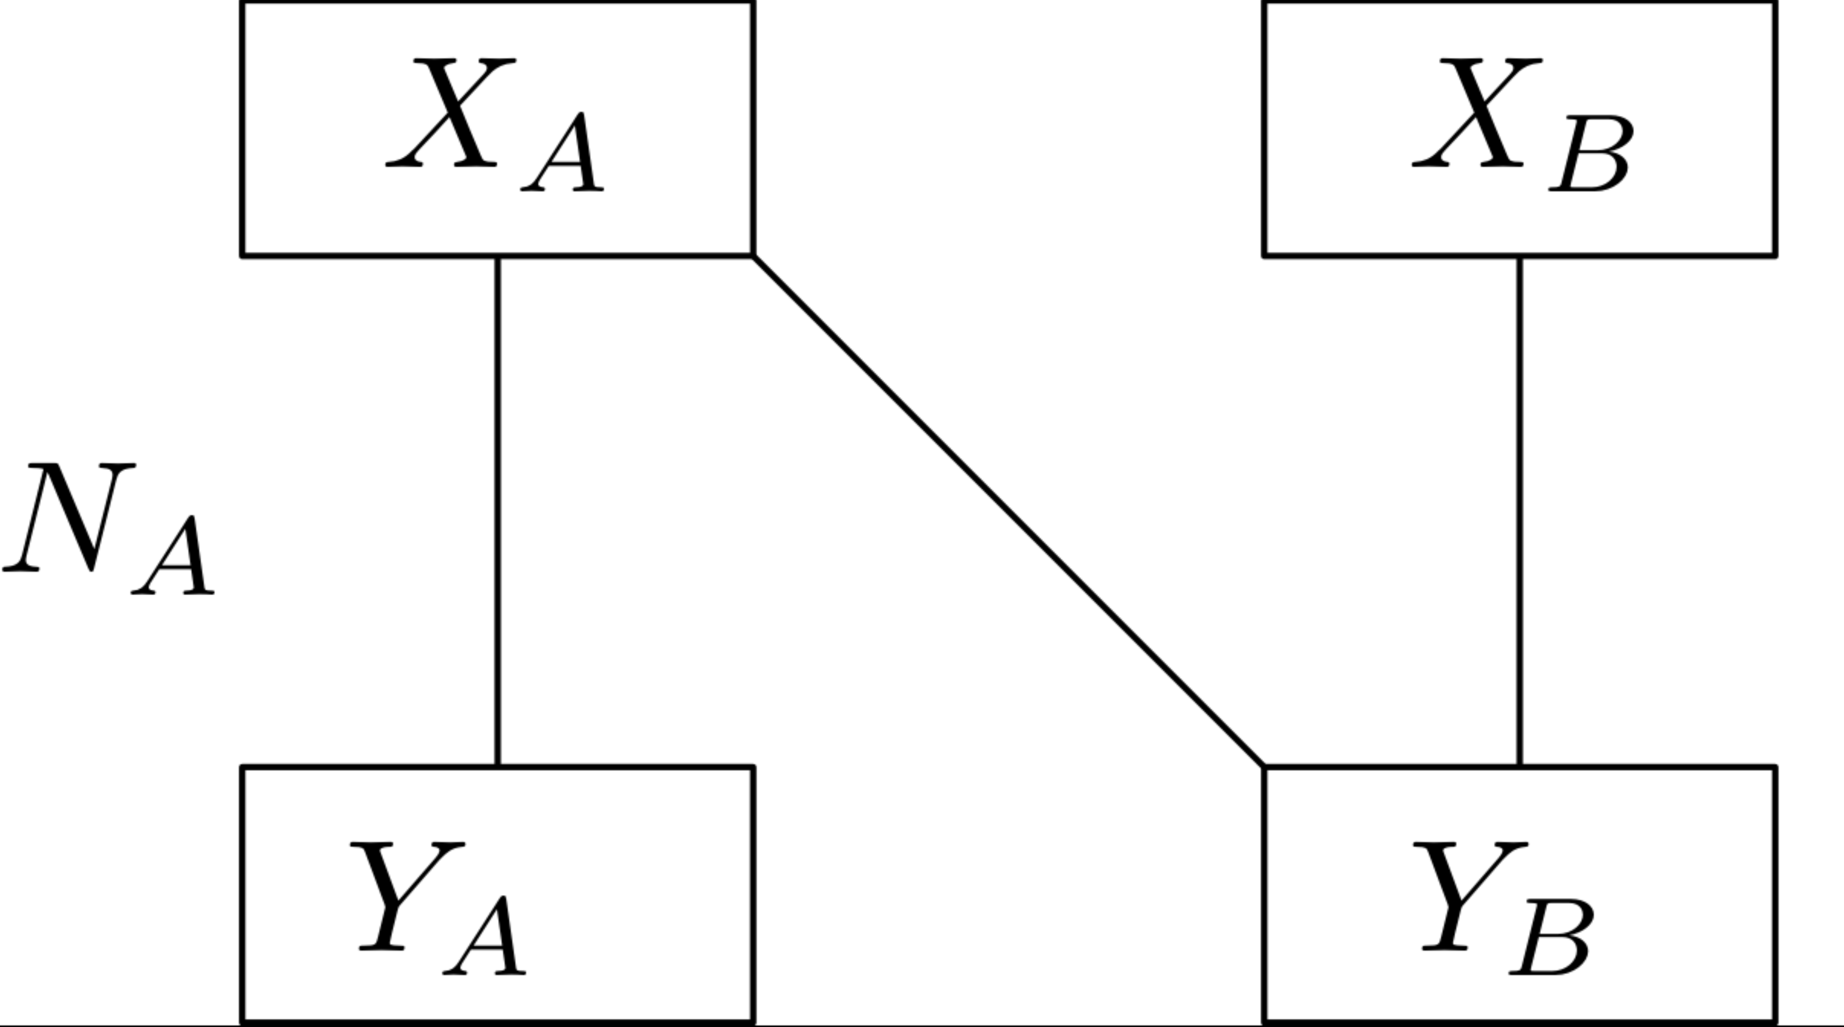
1 a. Decomposition Lemma
In any decomposition
G[X,Y] = G[X_{A},Y_{A}] ∪ G[X_{B},Y_{B}]
with no edges between X_{B} and Y_{A} :
X
Y
If N_{A} is an EFM in G[X_{A},Y_{A}], Then N_{A} is an EFM in G[X,Y].

Slide 12
1 b. Alternating Sequences
Given a matching M and a subset X₀ ⊂ X of unmatched vertices, an M-alternating sequence is a sequence of subsets:
X₀ – Y₁ – X₁ – Y₂ – X₂ – … – where:
Y_{i} = N_{G \ M} (X_{i-1}) \ ∪_{j<i} Y_{j};
X_{i} = N_{M}(Y_{i})
S(M,X₀) := maximal M-alternating sequence in which all subsets are non-empty.

Slide 13
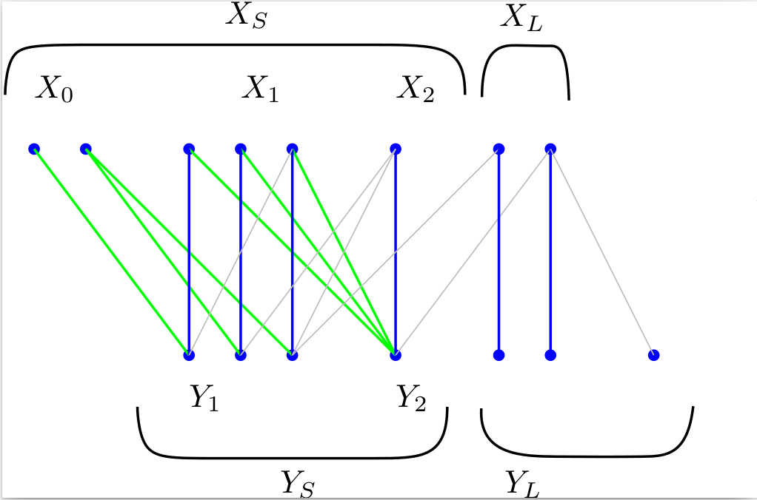
1 b. Alternating Sequences
M = blue vertical lines

Slide 14
1 b. Alternating Sequences
Decomposition:
X_{S} , Y_{S} = in sequence;
X_{L} , Y_{L} = the leftovers.
Properties:
No edges between X_{S} and Y_{L};
M[X_{L} , Y_{L} ] saturates X_{L};
If M is a maximum-size matching: M[X_{S} , Y_{S} ] saturates Y_{S} .

Slide 15

1 c. Alternating Sequences and EFM
Lemma. If:
M is max-size;
N is envy-free in G,
Then no vertex of X_{S} is saturated by N.
Proof sketch.
Suppose by contradiction that, for some i, some vertex x in X_{i} is saturated by N.
Use the properties of alternating sequences to show that some other vertex of X_{S} envies.

Slide 16
1 c. Alternating Sequences and EFM
Lemma. If:
M is max-size;
N is envy-free in G,
Then no vertex of X_{S} is matched by N.
Proof sketch. Suppose otherwise, and let i by the smallest index such that a vertex x in X_{i} is matched by N to some vertex y in Y . Consider several cases: →

Slide 17

1 c. Alternating Sequences and EFM
Case #1: The edge x-y is in M.
→ The neighbor of y from X_{i-1} is envious.

Slide 18
1 c. Alternating Sequences and EFM
Case #2: The edge x-y is in N \ M.
Let P := the maximal N-M alternating path starting at x.

Slide 19



1 c. Alternating Sequences and EFM
Case #2a: P is cyclic.
Last vertex before x is matched by N, and it is in Y_{i} .
Its neighbor from X_{i-1} is envious.

Slide 20

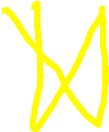
1 c. Alternating Sequences and EFM
Case #2b: P is acyclic
The last vertex s unmatched by N.
It is adjacent by M to a vertex in Y matched by N.
It is envious.
All cases lead to a contradiction.
Hence, no vertex of X_{S} is matched by N. ***

Slide 21
1 d. Algorithm for max-size EFM
Find a max-size matching M.
Construct the max M-alternating sequence.
Calculate X_{L} , Y_{L} .
Return N = M[X_{L} , Y_{L} ].
Correctness proof:
By alternating-sequence properties, N saturates X_{L.}
By decomposition lemma, N is EFM in G[X,Y] .
By previous lemma, no other EFM can saturate more vertices of X. So N is a max-size EFM. ***

Slide 22
1 e. Existence of non-empty EFM
Find a max-size matching M.
Construct the M-alternating sequence.
Calculate X_{L} , Y_{L} .
Return N = M[X_{L} , Y_{L} ].
Corollary. |N_{G}(X)| ≥ |X| ≥ 1 → G has nonempty EFM.
Proof. N saturates X_{L}; it is enough to prove: | X_{L} | ≥ 1.
Case 1: | X₀ |=0. Then X_{L} = X so | X_{L} | ≥ 1.
Case 2: | X₀ |>0. Then |X_{S} |> |Y_{S} |= |N_{G}(X_{S} )| → X_{S} ≠ X → | X_{L} | ≥ 1. ***

Slide 23
PART 2: EFM and Fair Division
EFM can be used as a subroutine in various fair division problems:
Fair cake-cutting – dividing a heterogeneous continuous resource;
Fair object allocation – allocating discrete objects.

Slide 24
2 a. EFM in cake-cutting (warm-up)
INPUT:
“Cake” – a heterogeneous divisible resource (e.g. land, time);
Some n agents with different value-measures over the cake.
OUTPUT:
Each agent gets a piece worth for him at least 1/n of the entire cake.
For 2 agents: cut-and-choose.

Slide 25
2 a. EFM in cake-cutting (warm-up)
ALGORITHM (“Lone Divider”, Kuhn 1967):
Normalize cake value to n.
A (remaining) agent cuts n pieces worth 1.
Construct a bipartite graph G[X,Y] with: * X = agents; * Y = pieces; * edge iff agent values piece as at least 1.
Find in G[X,Y] a max-size EFM.
Give each matched piece to its match.
If agents remain, go back to step 2.

Slide 26
2 a. EFM in cake-cutting (warm-up)
Proof of correctness.
4. |N_{G}(X)| ≥ |X| ≥ 1 → G has nonempty EFM.
5. Matched agents value their piece at ≥1.
Unmatched agents value given pieces at <1.
6. Unmatched n-k agents value remaining cake at > n-k. ***

Slide 27
2 b. EFM in object-allocation
INPUT:
Some discrete objects (e.g. house, car);
Some n agents with different value-measures (= additive utilities) over the objects.
OUTPUT:
Each agent gets a bundle worth for him at least his “1-out-of-n maximin-share” (= highest value he could get by dividing all objects into n piles and getting the worst).

Slide 28
2 b. EFM in object-allocation
INPUT: Discrete objects and n additive agents.
OUTPUT: 1-out-of-n MMS division.
For 2 agents – cut-and-choose.
For 3 or more agents – may not exist (Procaccia & Wang 2014).
1-out-of-(n+1) MMS division – open problem.
1-out-of-(2n-2) MMS division – next slide →

Slide 29
2 b. EFM in object-allocation
ALGORITHM (Aigner-Horev & Segal-Halevi 2019):
Normalize 1-out-of-(2n-2) MMS to 1.
A remaining agent makes n bundles worth ≥1.
Construct a bipartite graph G[X,Y] with: * X = agents; * Y = bundles; * edge = agent values bundle at least 1.
Find in G[X,Y] a max-size EFM.
Give each matched bundle to its match.
Go back to step 2.

Slide 30
2 b. EFM in object-allocation
Proof of correctness.
4. |N_{G}(X)| ≥ |X| ≥ 1 → G has nonempty EFM.
5. Matched agents value their bundle at ≥1.
Unmatched agents value given bundles at <1.
6. Technical lemma: Each of the unmatched n-k agents can divide the remaining objects into n-k bundles worth at least 1. ***

Slide 31
2 b. EFM in object-allocation
A similar algorithm can find an algorithm for:
2-out-of-(3n-2) MMS allocation;
(l-1)-out-of-(ln-2) MMS allocation, for any l;
2/3-fraction 1-out-of-n MMS allocation;
An individual criterion for each agent.

Slide 32
Future Work Ideas
Graph theory questions: * EFM in weighted graphs; * EFM in non-bipartite graphs; * Envy-free 1-to-many matchings; * “Envy-free except 1” matchings.
Fair division questions: * What else can be solved with EFM?

Slide 33
Acknowledgments
Zur Luria
Yuval Filmus
Thomas Klimpel
Thank you for coming ☺

