Slide 1


(Ezekiel 47:14)
Fair Division with Minimal Sharing
Erel Segal-Halevi (Ariel University)
with
Fedor Sandomirskiy (Technion / HSE ST. Petersburg)

Slide 2







Setting
Input: m objects, n agents, additive valuations:
Object:
v_{A}: 3 2 3 1 2
v_{B}: 1 1 1 5 4
Goal: Envy-Free and Pareto-Optimal division.
No monetary transfers.

Slide 3
Main problem
The objects are indivisible:
Object:
v_{A}: 3 2 3 1 2
v_{B}: 1 1 1 5 4
→ An envy-free Pareto-optimal allocation
might not exist.

Slide 4
Handling indivisible objects
Common approach in computer science:
Approximate fairness, e.g.:
Envy-free except one object (EF1)
– Unacceptable with high-value objects.

Slide 5

Handling indivisible objects
Common approach in economics:
Randomization:
Envy-free in expectation.
– Unacceptable with high-value objects.

Slide 6
Handling indivisible objects
Our approach:
Minimal Sharing: Find the smallest number of objects that must be shared to attain PO+EF.

Slide 7
Problem statement
INPUT: valuation matrix v : n x m.
v_{i,o} = value of object o to agent i.
[Initially we assume: v_{i,o} > 0]
OUTPUT: allocation matrix z : n x m.
z_{i,o} = fraction of object o given to agent i.
[Everything is allocated: ∑_{i} z_{i,o} = 1 for all o]
[Additive utilities: u_{i} (z) := ∑_{o} z_{i,o} v_{i,o}]
GOAL: minimize #sharings(z) s.t. z is PO+EF.
#sharings(z) := # { (i,o) | z_{i,o} > 0 } – m
[#sharings(z) = 0 iff no objects are shared]

Slide 8
Solution outline
Step 1. Upper Bound:
A PO+EF allocation with at most n-1 sharings always exists and can be found efficiently.
Step 2. Minimization Algorithm:
A PO+EF allocation with a minimum number of sharings can be found in time polynomial in m, if n is fixed.

Slide 9
Step 1: Upper Bound
Preliminary Theorem.
A PO+EF allocation with ≤ n-1 sharings exists and can be found in time O(poly(m,n)).

Slide 10
Step 1: Upper Bound
Preliminary Theorem.
A PO+EF allocation with ≤ n-1 sharings exists and can be found in time O(m²n²(m+n)).
Proof Sketch.
(a) Ignoring the number of sharings, find an allocation maximizing the product of utilities.
(b) Modify the allocation to have ≤ n-1 sharings, without changing utilities.
(c) The allocation still maximizes the product. Any such allocation is PO+EF.

Slide 11
Step 1: Upper Bound
1(a): Find an allocation z maximizing the product of utilities, ignoring #sharings:
– Can be done in time O((n+m)⁴ log(n+m)).
James B Orlin. "Improved algorithms for computing Fisher’s market clearing prices" (STOC 2010).
– Any such allocation is PO+EF.
E Eisenberg and D Gale, "Consensus of subjective probabilities" (Annals of Math. Statistics, 1959‏).

Slide 12
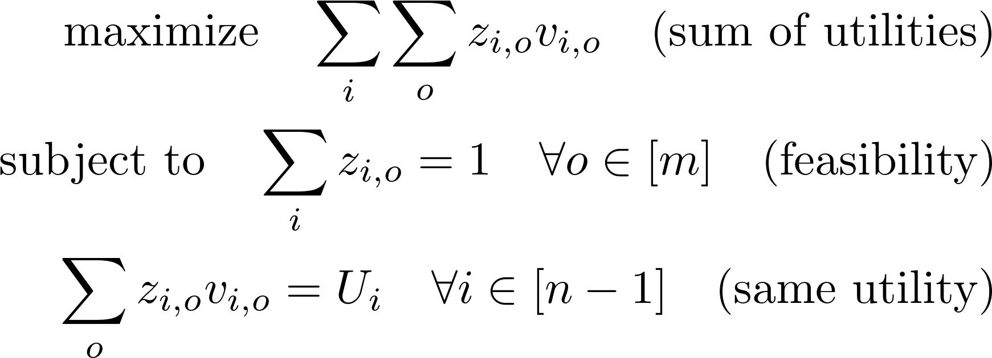
Step 1: Upper Bound
1(b): Find a new allocation z* with same utilities (U₁,…,U_{n}) and ≤ n-1 sharings.
LP-based proof (extends Stephen Wilson, "Fair division using linear programming", preprint, Iowa State University, 1998):
m+n-1 constraints → Basic sol. has ≤ m+n-1 nonzeros.
→ Allocation has ≤ n-1
sharings.
Utility of n-th agent must be U_{n} too.

Slide 13
Step 1: Upper Bound
1(b): Find a new allocation z* with same utilities (U₁,…,U_{n}) and ≤ n-1 sharings.
Polytime proof (extends "Dividing goods or bads under additive utilities", Bogomolnaia&Moulin&Sandomirskiy&Yanovskaya, 2016).
Construct the directed consumption graph of z.
z is PO → no cycles with weight-product < 1.
Remove each cycle with weight-product = 1 by trading along the cycle without changing the utilities.
Claim: in the resulting z*, the undirected consumption graph is acyclic (since each such cycle corresponds to two opposite directed cycles with product=1).
Acyclic graph→ ≤ m+n-1 edges→ ≤ n-1 sharings.

Slide 14
Step 1: Upper Bound
1(c): The new allocation z* has:
At most n-1 sharings;
Product-maximizing utilities U₁,…,U_{n}. → It is still PO+EF.
Conclusion:
n-1 is an upper bound on #sharings.
In worst case, n-1 sharings are necessary.
In some cases, less sharings are sufficient.
Next goal: minimize #sharings.

Slide 15
Step 2: Minimization – 2 agents
Discouraging result: n=2 agents with identical valuations:
n–1 = 1, so either 0 or 1 sharings.
Any allocation is PO.
An allocation is EF iff both agents get exactly the same utility.
→ Equivalent to NP-hard problem Partition!
Conclusion: Minimizing the number of sharings is computationally-hard even for 2 agents with identical valuations.

Slide 16
Step 2: Minimization – 2 agents
Encouraging result. n=2 agents with generic valuations, i.e.:
the m ratios v_{a,o} / v_{b,o} are all different.
Order the objects by decreasing ratio: v_{a,1}/v_{b,1} > v_{a,2} / v_{b,2} > ... > v_{a,o} / v_{b,o} > … > v_{a,m} / v_{b,m}
Order Lemma. In a PO allocation, If Alice gets a positive amount of some object o, then Alice gets all objects o' < o. Proof. Otherwise Alice could trade o for o'.

Slide 17
Step 2: Minimization – 2 agents
Encouraging result (cont.). Any PO allocation must have the form: A: 1 1 … x … 0 B: 0 0 … 1-x … 1
for some object o and x in [0,1].
Only m+1 PO allocations with 0 sharings.
It is easy to check each of them for EF.
→ Minimization can be solved in O(m log m). Conclusion: For 2 agents, minimizing the number of sharings is computationally-hard even only with non-generic preferences.

Slide 18
Step 2: Minimization – 2 agents
Partially-generic valuations.
Degree of degeneracy := smallest d such that for any ratio r > 0 there are at most d objects o with v_{a,o} / v_{b,o}= r (generic: d=1; identical: d=m).
At most 2^{d} * m allocations with no sharing.
If d = O(log(m)), the minimization can still be solved in time O(poly(m)).
If d = Ω(mª) for some a>0, the minimization is NP-hard (reduction from Partition).

Slide 19
Step 2: Minimization – n agents
Generic valuations:= for every two agents i,j:
the m ratios v_{i,o} / v_{j,o} are all different.
Main Theorem. When n is fixed and the valuations are generic, a PO+EF allocation minimizing the number of sharings can be found in time O(poly(m)).

Slide 20
Step 2: Minimal Sharing
Main Theorem. When n is fixed and the valuations are generic, a PO+EF allocation minimizing the number of sharings can be found in time O(poly(m)).
Proof Sketch.
(a) Define consumption-graph of an allocation.
(b) At most O(m^{n(n-1)/2}) consumption-graphs correspond to PO allocations, and they can be enumerated with breadth-first search.
(c) Given a consumption-graph, PO+EF can be decided in time O(m²).

Slide 21
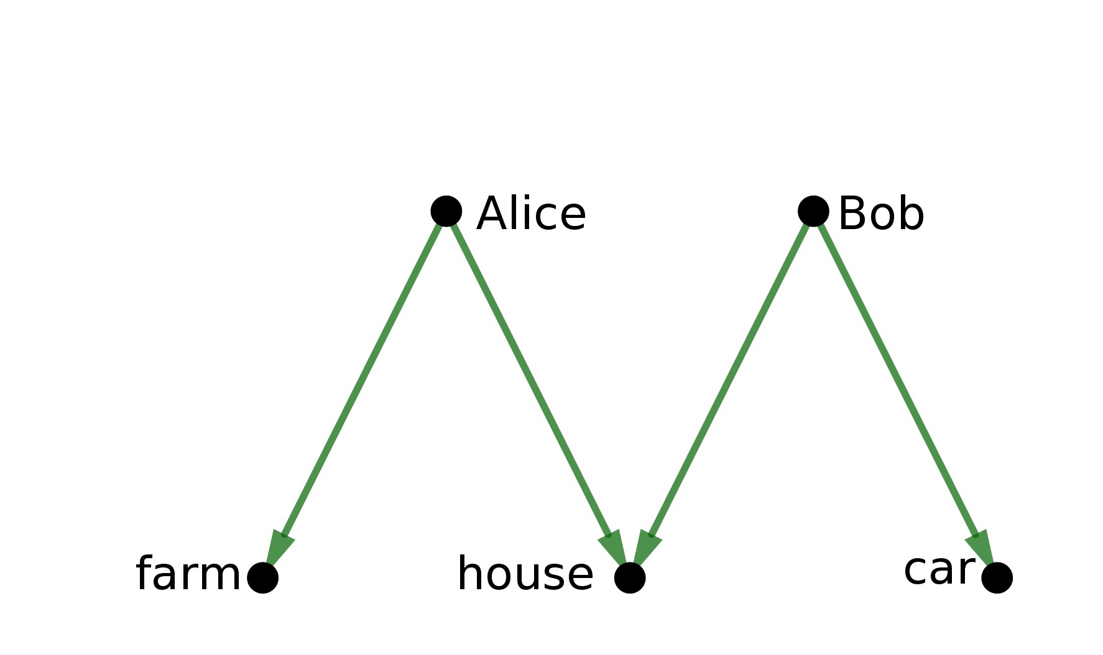
Step 2(a): Consumption graph
Consumption graph of allocation z :=
Bipartite graph: agents vs. objects.
Edge between i and o iff z_{i,o} > 0.
Example:
Alice takes farm; Bob takes car; shared house.

Slide 22
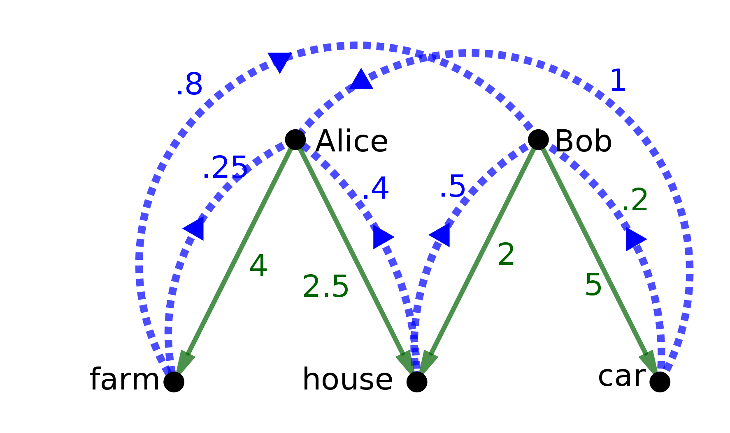
Step 2(a): Consumption graph
Directed consumption graph of z :=
Edge from i to o iff z_{i,o} > 0; weight v_{i,o}.
Edge from o to i ; weight 1/v_{i,o}.
v_{a} = [4, 2.5, 1]; v_{b} = [1.25, 2, 5].

Slide 23
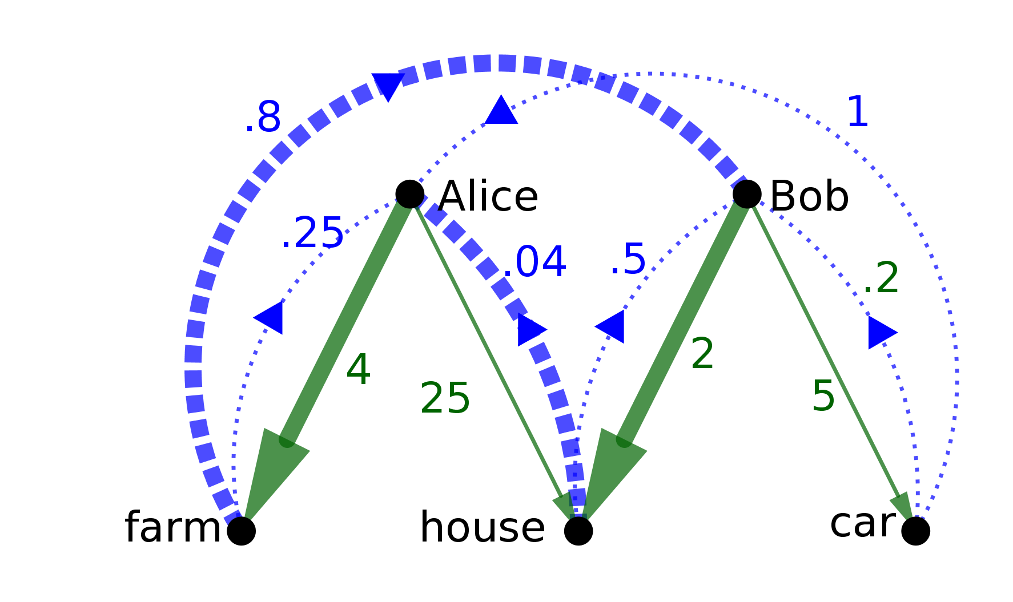
Step 2(a): Consumption graph
Cycle Lemma. An allocation is PO iff its directed consumption graph contains no cycles whose product of weights is < 1 (like this: )
v_{a} = [4, 25., 1]; v_{b} = [1.25, 2, 5].

Slide 24
Step 2(a): Consumption graph
Cycle Lemma - Proof Sketch.
→ Given a cycle with weight-product < 1, we can trade goods among agents in the cycle such that all participants strictly gain.
← Suppose there are no such cycles. Pick an arbitrary agent i with nonempty bundle. Find a minimum-product path from i to every other agent j. Define the weight of j as the product of this path. We can prove that the allocation maximizes the weighted-sum of the agents' utilities. Hence it is PO.

Slide 25
Step 2(a): Consumption graph
Corollary. It is possible to check whether a consumption-graph corresponds to a PO allocation in time O(m n (m+n)).
Proof.
Convert weights to their logarithms;
Use algorithms for negative cycle detection (e.g. Bellman-Ford algorithm).

Slide 26
Step 2(b): Tree of PO graphs
2(b). Enumerating PO consumption graphs
We construct a tree of consumption graphs.
For all k in 1,…,n, level k will contain the consumption graphs of all PO allocations among agents 1,…,k.

Slide 27
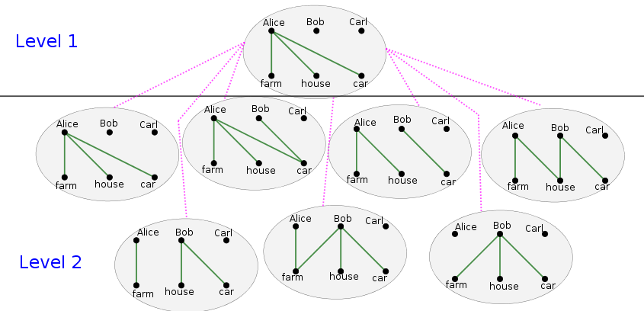
Step 2(b): Tree of PO graphs
All objects are given to agent 1.
All objects are given to agents 1,2. 2m+1 options (by Order Lemma).

Slide 28
Step 2(b): Tree of PO graphs
2(b). Enumerating PO consumption graphs
… In level 3, all objects are given to 1,2,3.
For each node in level 2:
All objects of 1 are divided between 1 and 3;
2m₁+1 options (m₁ = #objects given to 1).
All objects of 2 are divided between 2 and 3.
2m₂+1 options (m₂= #objects given to 2).
(2m₁+1)(2m₂+1) = O(m²) children per node.
All in all: O(m³) nodes in level 3.

Slide 29
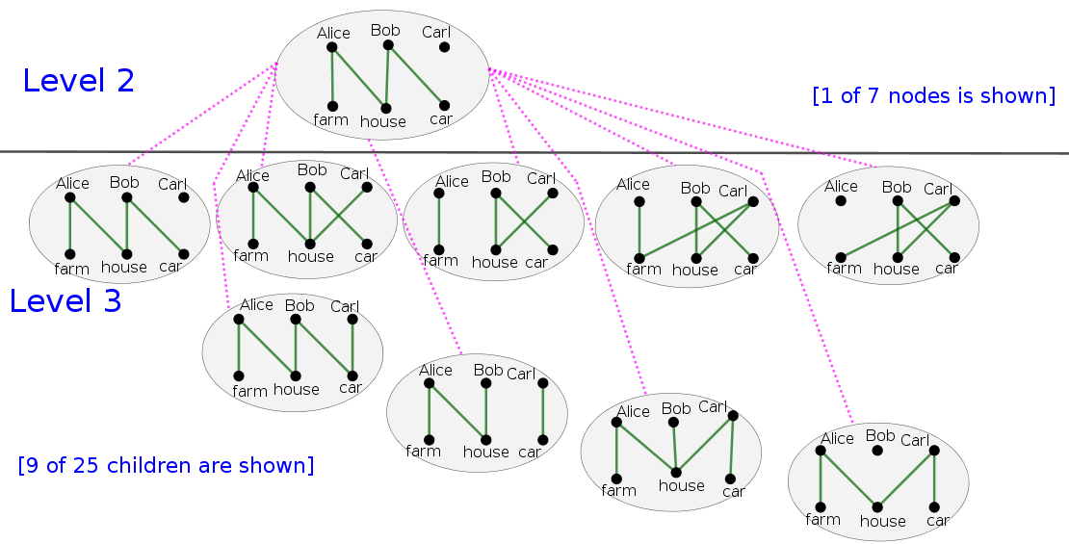
Step 2(b): Tree of PO graphs

Slide 30
Step 2(b): Tree of PO graphs
2(b). Enumerating PO consumption graphs
… In level k, all objects are given to 1,…,k.:
O(m^{k-1}) children per node in level k-1.
O(m^{k(k-1)/2}) nodes in level k.
All in all: O(m^{n(n-1)/2}) leaves (in level n).
Apply the Cycle Lemma to the leaves.
Only graphs of PO allocations remain.
By the Generation Lemma (next slide):
All graphs of PO allocations are in the tree→

Slide 31
Step 2(b): Tree of PO graphs
Generation Lemma. Every PO allocation z⁺ among agents 1,…,k+1 can be generated by:
Taking some PO allocation z among 1,…,k;
Having each agent i in 1,…,k share zero or more objects with agent k+1.
Proof sketch.
(I) Initialize z := z⁺ without the (k+1)-th bundle.
(II) Take an object o from the (k+1)-th bundle. For each agent i in 1,…,k, let z'(i) := z with o given to agent i. One of these z'(i) must be PO.*
(III) Let z := z'(i) [z remains PO] and return to (II).

Slide 32
Step 2(b): Tree of PO graphs
Generation Lemma – elaboration of part II*:
Suppose each z'(i) is not PO ≡ has a PI trade.
z is PO → this PI trade is not in z → it must involve agent i giving o to some agent, j(i).
Create a graph on 1,…,k with edges i→j(i).
This graph has a cycle. Concatenate all the PI trades along the cycle and get a long PI trade.
In the long PI, each agent both receives o (from the agent before it) and gives o (to the agent after it).
Hence, the PI trade can be done without o.
Hence, the PI exists in z too – contradiction.

Slide 33
Step 2(c): PO+EF allocations
For each consumption graph in leaf of tree:
If it has cycle with product < 1 – discard leaf.
If #sharings (= #edges – m) > n-1 – discard leaf.
Otherwise, create a linear program with:
One variable for each sharing (at most n-1).
Feasibility constraint for each shared good.
EF constraint for each pair of agents (n²-n).
Size of LP does not depend on m.
Can be solved in constant time (for fixed n).
All in all: O(m²) time for each leaf.
→ Minimal-sharing is solved in O(poly(m)). □

Slide 34
Conclusion
The minimal sharing algorithm is useful when:
There are few agents and many objects.
The objects are too valuable for approximate-fairness or fairness-in-expectation.
Objects can be shared, but it is undesired.

Slide 35
Variants (in paper)
Minimize the number of shared goods instead of the number of sharings.
Use other fairness definitions instead of envy-freeness:
Proportionality := each agent's value is at least 1/n of the total value.
Weighted proportionality := proportionality with different entitlements.
Equitability := all agents have the same subjective value.

Slide 36
Variants (in paper)
If we want fairness but do not care about PO:
Finding an allocation with ≤ n-1 sharings becomes computationally easier.
Minimizing the number of sharings becomes NP-hard even when agents have generic valuations (reduction from Partition).

Slide 37
Ongoing and Future Work
Negative and mixed values.
Consensus division: each agent values each bundle as exactly 1/n.
Useful for truthful allocation mechanisms.
Upper bound: n*(n-1) sharings.
Non-linear sharing, e.g.: a fraction x of an object gives only a fraction x² of its utility.
Minimize the utility of shared goods, instead of just their number.
Thank you for coming ☺

