Slide 1



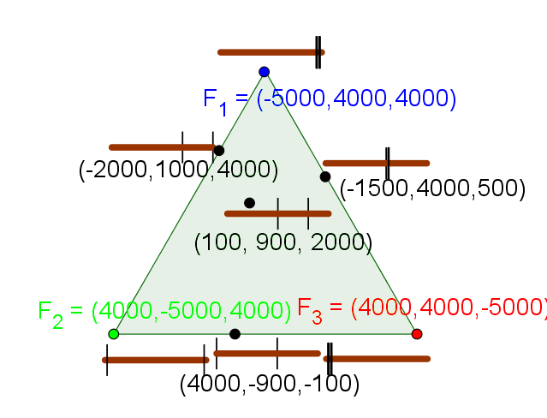
(Ezekiel 47:14)
Generalized Rental Harmony
Erel Segal-Halevi
American Mathematical Monthly, 2022
arXiv 1912.13249
The Rental Harmony Problem
Input: n rooms, fixed total rent R, n tenants with different preferences.
Preferences = function: price-vector → set of “best rooms” given prices.
Output: A matching of tenants to rooms, and a price-vector with sum = R.
Envy-free (EF) = each tenant gets a room from his “best rooms” set.
Two Incompatible Preference Models
Model 1: Quasilinear Tenants
The “best rooms” of agent i are
arg max_{j=1..n} value_{i} (j) – price(j)
EF exists by LP duality (Gale, 1960).
Example:
val (1)=70, val(2)=val(3)=val(4)=10
p=(50,40,10,0) → best room = 1
Incompatible with miserly tenants
Model 2: Miserly Tenants
If there is a room with price ≤ 0, then every tenant has a “best room” with price ≤ 0.
EF exists by Sperner’s Lemma (Su, 1999).
Example:
p=(10,20,20,50) → best room = 1
p=(10,20,40,30) → best room = 2 (externality)
Incompatible with quasilinear tenants
Extensions:
Minimum discount (Haake&Raith&Su, 2002).
Non-negative prices (Sung&Vlach, 2004).
Max-min utility (Gal&Mash&Procaccia&Zick, 2017).
Limited budget (Procaccia&Velez&Yu, 2018).
Extensions:
Roommates (Azrieli&Shmaya, 2014).
Secretive agent (Frick&Houston&Meunier, 2019).
Extra agent (Meunier&Su, 2019).
Multiple houses (Nyman&Su&Zerbib, 2020).
The New Model: Compensable Tenants
For some T, if there is a room with price ≤ 0 and a room with price ≥ T, then every tenant has a best room with price < T.
Strictly generalizes both models.
Envy-free matching always exists. Proof idea:
Consider the standard simplex { (x₁,...,x_{n}) | x₁ + ... + x_{n} = 1 }.
To each point, associate prices (p₁,...,p_{n}): p_{j} = T – (Tn – R)*x_{j .}
Triangulate simplex; apply Sperner’s lemma; find colorful simplex.
Using continuity, shrink the colorful simplex to a single point p.
Example with R=3000, T=4000
Corollary: Model 2 extensions are valid for compensable & quasilinear tenants.
Open question: can we generalize the preference model even further?
What is a necessary condition for the existence of Rental Harmony?

