Slide 1


(Ezekiel 47:14)
Envy-Free Matchings in Bipartite Graphs and their Applications to Fair Division
Erel Segal-Halevi
joint work wITH
Elad Aigner-Horev

Slide 2
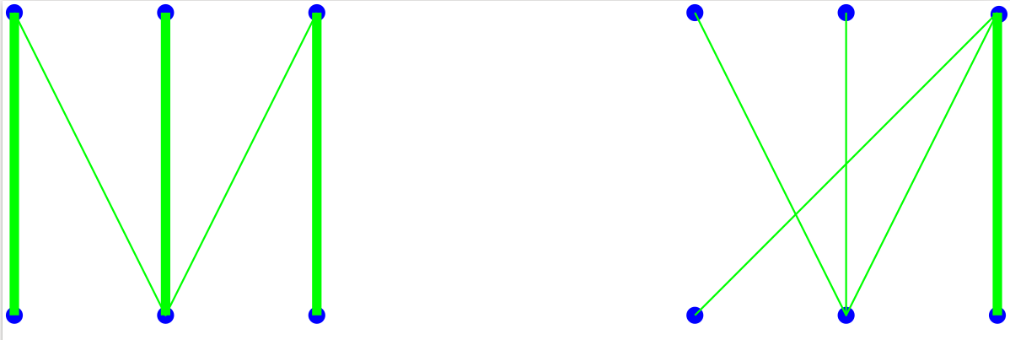
Perfect vs. Envy-Free Matching
X
Y
X-saturating matching: Every vertex of X is matched.
Envy-free matching: Every unmatched vertex of X is dis- connected from any matched vertex of Y.

Slide 3



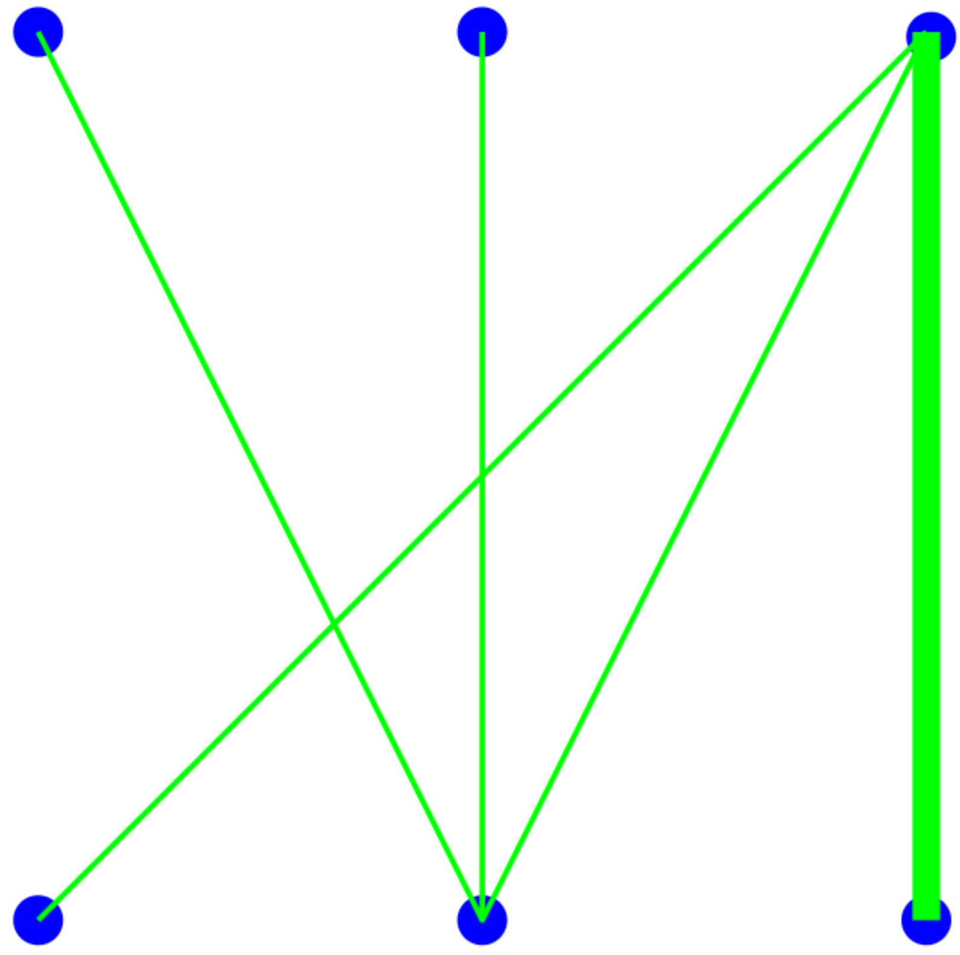

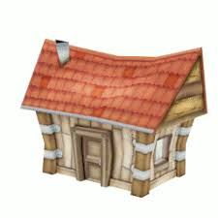

Envy-Free Matching: Metaphor
X
Y

Slide 4
Envy-Free Matching: Existence
Question. Does an EFM always exist?

Slide 5
Envy-Free Matching: Existence
Question. Does an EFM always exist?
Answer. Yes – the empty-matching is EF.

Slide 6
Envy-Free Matching: Existence
Question. Does an EFM always exist?
Answer. Yes – the empty-matching is EF.
Question 2. Does a non-empty EFM always exist?

Slide 7
Envy-Free Matching: Existence
Question. Does an EFM always exist?
Answer. Yes – the empty-matching is EF.
Question 2. Does a non-empty EFM always exist?
Answer 2. No →

Slide 8
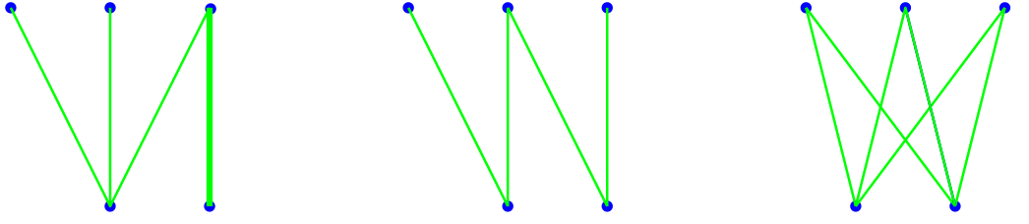
Non-empty vs. empty EFM
X
Y
Non-empty EFM
Only empty EFM

Slide 9
Questions
Theory: What characterizes the graphs that admit a non-empty EFM?
Computation: How can we find an EFM of maximum size?
Application: What can we do with the unmatched vertices?

Slide 10
1. EFM and graph structure
Two extreme types of bipartite graphs:
X-saturated: largest possible EFM.
Odd path: only an empty EFM.
Theorem 1 (informal).
Every G has a unique decomposition:
G := X-saturated + “Odd-path-like”.
Every EFM in G is contained in the X-saturated part.

Slide 11
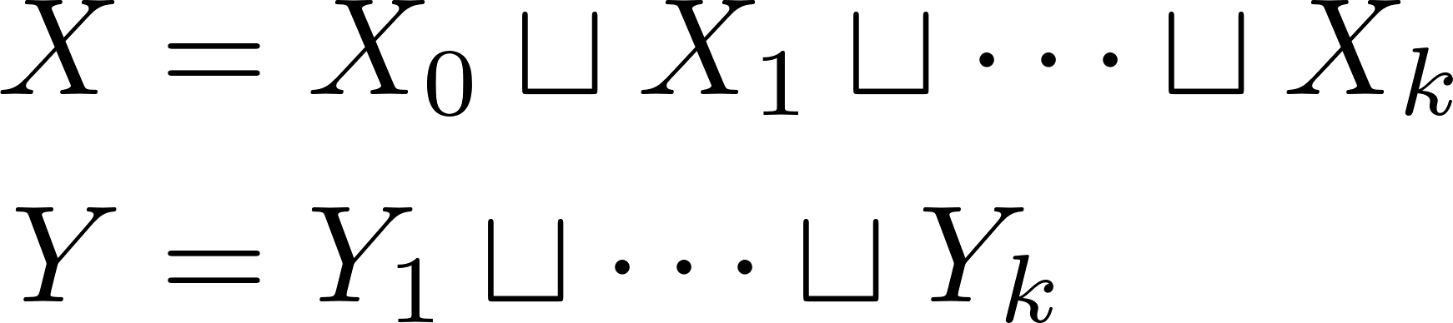
1. EFM and graph structure
Definition. G =(X ∪ Y, E) is odd-path-like if, for some k ≥ 1, there exist partitions
such that for all i ≥ 1
X_{i} is perfectly matchable to Y_{i};
Every vertex in Y_{i} is adjacent to a vertex in X_{i-1}.

Slide 12
1. EFM and graph structure
Theorem 1. Every bipartite G = (X∪Y, E) admits unique partitions X = X_{S} ∪ X_{L} Y = Y_{S} ∪ Y_{L}
With the following properties:
No edges between X_{S} and Y_{L};
G[X_{S} , Y_{S} ] is odd-path-like;
G[X_{L} , Y_{L} ] is X-saturated. Moreover:
Every X-sat. matching in G[X_{L} , Y_{L}] is EFM.
Every EFM in G is contained in G[X_{L} , Y_{L} ].

Slide 13
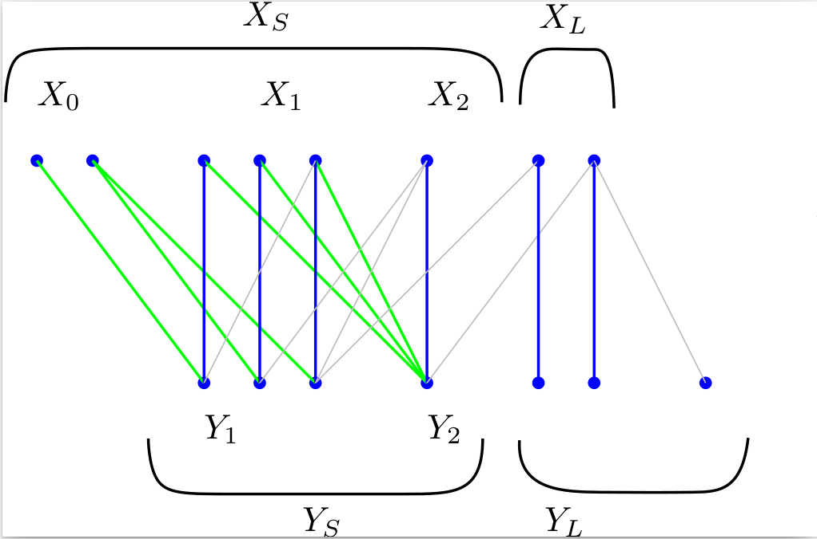
Theorem 1: Example

Slide 14
Theorem 1: Construction
Take a maximum-size matching M.
Let X₀ be the unmatched vertices in X.
Construct a sequence of vertex subsets:
X₀ – Y₁ – X₁ – Y₂ – X₂ – … – where:
Y_{i} = N_{G \ M} (X_{i-1}) \ ∪_{j<i} Y_{j};
X_{i} = N_{M}(Y_{i})
Let X_{S} = Union of X_{i} , Y_{S} = Union of Y_{i},
X_{L} = X - X_{S} , Y_{L} = Y - Y_{S}

Slide 15
Theorem 1: Construction
M = blue vertical lines

Slide 16
1 (proof): Decomposition
Decomposition:
X_{S} , Y_{S} = in sequence;
X_{L} , Y_{L} = the leftovers.
Properties:
No edges between X_{S} and Y_{L};
G[X_{S} , Y_{S} ] is odd-path-like (construction ends at X side);
G[X_{L} , Y_{L} ] is X-saturated (by edges of M).

Slide 17
1 (proof): Decomposition
Lemma. For any decomposition G[X_{S} , Y_{S} ] + G[X_{L} , Y_{L} ]
that satisfies properties (a),(b),(c):
(d) Every X-saturating matching in G[X_{L} , Y_{L}] is envy-free in G.
(e) Every envy-free matching in G is contained in G[X_{L} , Y_{L} ].

Slide 18
1 (proof): Decomposition
Proof of (d).
Given an X-saturating matching in G[X_{L} , Y_{L}]:
Vertices of X_{L} do not envy since they are saturated.
Vertices of X_{S} do not envy since by (a) they are not connected to Y_{L}.
→ The matching is envy-free in G.

Slide 19

1 (proof): Decomposition
Proof of (e).
Given an envy-free matching W in G:
i := smallest index s.t. a vertex in Y_{i} is matched by W.
By (b), vertices of Y_{≥i} are perfectly matched. Their matches in X_{≥i} must be matched by W.
At least one more vertex in X_{i-1} must be matched by W. → Contradiction.

Slide 20
1 (proof): Uniqueness
[Theorem 1] there is a unique decomposition G[X_{S} , Y_{S} ] + G[X_{L} , Y_{L} ]
satisfying the properties:
No edges X_{S} -- Y_{L};
G[X_{S} , Y_{S} ] is odd-path-like;
G[X_{L} , Y_{L} ] is X-saturated.
Proof. Take any G[X‘_{S} , Y‘_{S} ] + G[X‘_{L} , Y‘_{L} ].
There is an EFM saturating X’_{L}, so X’_{L} ⊆ X_{L}.
There is an EFM saturating X_{L}, so X_{L} ⊆ X’_{L}.

Slide 21
2. Algorithm for max-size EFM
Find a max-size matching M.
Construct the decomposition X_{L} , Y_{L} , X_{S} , Y_{S} .
Return M[X_{L} , Y_{L} ].
Correctness proof.
By property (d), M[X_{L} , Y_{L} ] is an EFM.
By property (e), there is no larger EFM.

Slide 22
2. Algorithm for max-size EFM
Find a max-size matching M.
Construct the decomposition X_{L} , Y_{L} , X_{S} , Y_{S} .
Return M[X_{L} , Y_{L} ].
Extension.
If each edge is endowed with a cost:
We can find a max-size min-cost EFM.

Slide 23
2. Algorithm for max-size EFM
Find a max-size matching M.
Construct the decomposition X_{L} , Y_{L} , X_{S} , Y_{S} .
Return M[X_{L} , Y_{L} ].
Corollary. |N_{G}(X)| ≥ |X| ≥ 1 → G has nonempty EFM.
Proof. It is sufficient to prove: | X_{L} | ≥ 1.
Case 1: | X₀ |=0. Then X_{S} = ∅ so X_{L} = X so | X_{L} | ≥ 1.
Case 2: | X₀ |>0. Then |X_{S} |> |Y_{S} |= |N_{G}(X_{S} )| → X_{S} ≠ X → | X_{L} | ≥ 1. ***

Slide 24
3. Applications for fair division
EFM can be used as a subroutine in various fair division problems:
Fair cake-cutting – dividing a heterogeneous continuous resource;
Fair object allocation – allocating discrete objects.

Slide 25
3 a. EFM in cake-cutting
INPUT:
“Cake” – a heterogeneous divisible resource (e.g. land, time);
Some n agents with different valuations (non-atomic measures) over the cake.
OUTPUT:
Each agent gets a piece that he values as at least 1/n of the entire cake.
For 2 agents: cut-and-choose.

Slide 26
3 a. EFM in cake-cutting
ALGORITHM (“Lone Divider”, Kuhn 1967):
Normalize cake value to n.
A (remaining) agent cuts n pieces worth 1.
Construct a bipartite graph G[X,Y] with: * X = agents; * Y = pieces; * edge iff agent values piece at least 1.
Find in G[X,Y] a maximum-size EFM.
Give each matched piece to its agent.
Update n; if n ≥ 1 go back to step 2.

Slide 27
3 a. EFM in cake-cutting
Proof of correctness.
4. |N_{G}(X)| ≥ |X| ≥ 1 → G has nonempty EFM.
5. Matched agents value their piece at ≥1.
Unmatched agents value given pieces at <1.
6. The unmatched n-k agents value the remaining cake at > n-k. ***

Slide 28
3 b. EFM in object-allocation
INPUT:
Some discrete objects (e.g. house, car);
Some n agents with different valuations (additive set functions) over the objects.
OUTPUT:
Each agent gets a bundle worth for him at least his “1-out-of-n maximin-share” →

Slide 29
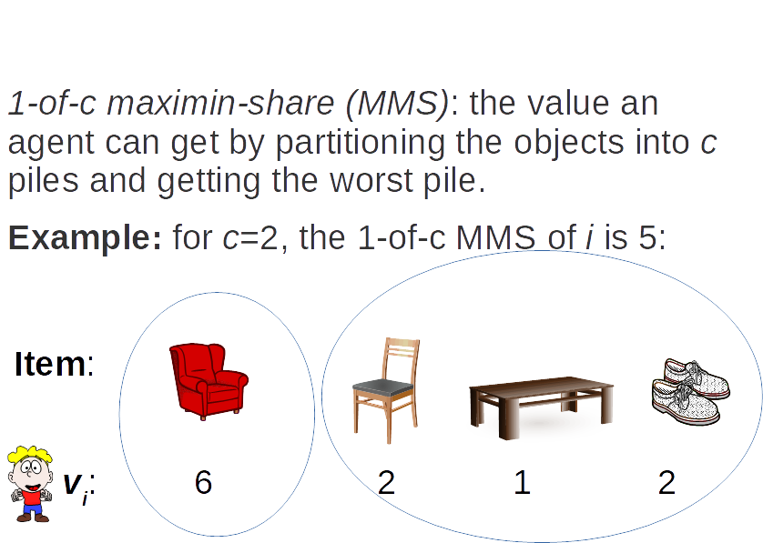

Slide 30
3 b. EFM in object-allocation
INPUT: Discrete objects and n additive agents.
OUTPUT: 1-out-of-n MMS division.
For 2 agents – cut-and-choose.
For 3 or more agents – may not exist (Procaccia & Wang 2014).
1-out-of-(n+1) MMS division – open problem.
1-out-of-(2n-2) MMS division – next slide →

Slide 31
3 b. EFM in object-allocation
ALGORITHM:
Normalize 1-out-of-(2n-2) MMS to 1.
A remaining agent makes n bundles worth ≥1.
Construct a bipartite graph G[X,Y] with: * X = agents; * Y = bundles; * edge iff agent values bundle at least 1.
Find in G[X,Y] a maximum-size EFM.
Give each matched bundle to its agent.
Update n; if n ≥ 1 go back to step 2.

Slide 32
3 b. EFM in object-allocation
Proof of correctness.
4. |N_{G}(X)| ≥ |X| ≥ 1 → G has nonempty EFM.
5. Matched agents value their bundle at ≥1.
Unmatched agents value given bundles at <1.
6. Technical lemma: Each of the unmatched n-k agents can divide the remaining objects into n-k bundles worth at least 1. ***

Slide 33
3 b. EFM in object-allocation
A similar algorithm can find an algorithm for:
2-out-of-(3n-2) MMS allocation;
(l-1)-out-of-(ln-2) MMS allocation, for any l;
2/3-fraction 1-out-of-n MMS allocation;
An individual criterion for each agent.

Slide 34
Future Work
1. Envy-free one-to-many matchings:
A vertex x in X is „envious“ iff another vertex in X is matched to more vertices in Y that are adjacent to x.
2. Approximately-envy-free matchings:
A vertex x in X is „envious“ iff at least k of his neighbors in Y are matched.
3. 1-out-of-(n+1) MMS allocation ?

Slide 35
Acknowledgments
Zur Luria
Yuval Filmus
Thomas Klimpel
Thank you for coming ☺

