Slide 1


TUTORIAL 1
R BASICS

Slide 2
What is a dataframe in R?
Table of rows and columns
1 | 2 | 3 | 4
Column indices
gene | log2FoldChange | padj | baseMean
gene1 | -1 | 0.001 | 62
gene2 | +3 | 0.89 | 12
gene3 | 0.1 | 0.04 | 8
gene4 | +2.3 | 0.008 | 157
Column names
1
2
3
4
This is a 4x4 dataframe
Row names
Row indices

Slide 3
1 | 2 | 3 | 4
Column indices
gene | log2FoldChange | padj | baseMean
gene1 | -1 | 0.001 | 62
gene2 | +3 | 0.89 | 12
gene3 | 0.1 | 0.04 | 8
gene4 | +2.3 | 0.008 | 157
Column names
1
2
3
4
This is a 4x4 dataframe
Row names
Row indices
When do we use dataframes?
Almost every time we read in files in a table format (tab delimited text files, csv files, excel files, etc).
df <- read.table(file="pseudobulk_allcells_kovswt.txt", header = TRUE, sep = "\t")
Name the dataframe “df”
Inbuilt R function
Name of the tab delimited text file
The columns in this file are separated by tabs
assignment
QUESTION- What would you change if you have a csv file?

Slide 4
1 | 2 | 3 | 4
Column indices
gene | log2FoldChange | padj | baseMean
gene1 | -1 | 0.001 | 62
gene2 | +3 | 0.89 | 12
gene3 | 0.1 | 0.04 | 8
gene4 | +2.3 | 0.008 | 157
Column names
1
2
3
4
This is a 4x4 dataframe
Row names
Row indices
How to reference items in the dataframe?
Row names : rownames(df)
Column names : colnames(df)
Columns : df$columnname Example- df$gene. This is also a way to CREATE a new column. Example- df$score will create an empty column “score”.
Any particular item : remember df[R,C] where R and C are the row indices and column indices respectively.
df[1,1]
0.008
df[1:2,1:2]
df[1,]
df[,3] OR df$padj
gene1
df[4,3]

Slide 5
1 | 2 | 3 | 4
Column indices
gene | log2FoldChange | padj | baseMean
gene1 | -1 | 0.001 | 62
gene2 | +3 | 0.89 | 12
gene3 | 0.1 | 0.04 | 8
gene4 | +2.3 | 0.008 | 157
Column names
1
2
3
4
This is a 4x4 dataframe
Row names
Row indices
How to subset dataframes?
STEP 1- Conditional/Logical operators
> : greater than
< : lesser than
=/== : equal to when you check numbers/ equal to when you check words
! : NOT
& : AND
| : OR
QUESTION- What do these operators mean >= , <= , !=

Slide 6
1 | 2 | 3 | 4
Column indices
gene | log2FoldChange | padj | baseMean
gene1 | -1 | 0.001 | 62
gene2 | +3 | 0.89 | 12
gene3 | 0.1 | 0.04 | 8
gene4 | +2.3 | 0.008 | 157
Column names
1
2
3
4
This is a 4x4 dataframe
Row names
Row indices
STEP 2- We want to subset this dataframe to retain all items with log2FoldChange greater than 0 and p value lesser than 0.5.
dfsub<-df[df$log2FoldChange >0 & df$padj <0.5,]
Gives all rows that satisfy this condition
Gives all columns
gene | log2FoldChange | padj | baseMean
gene3 | 0.1 | 0.04 | 8
gene4 | +2.3 | 0.008 | 157

Slide 7
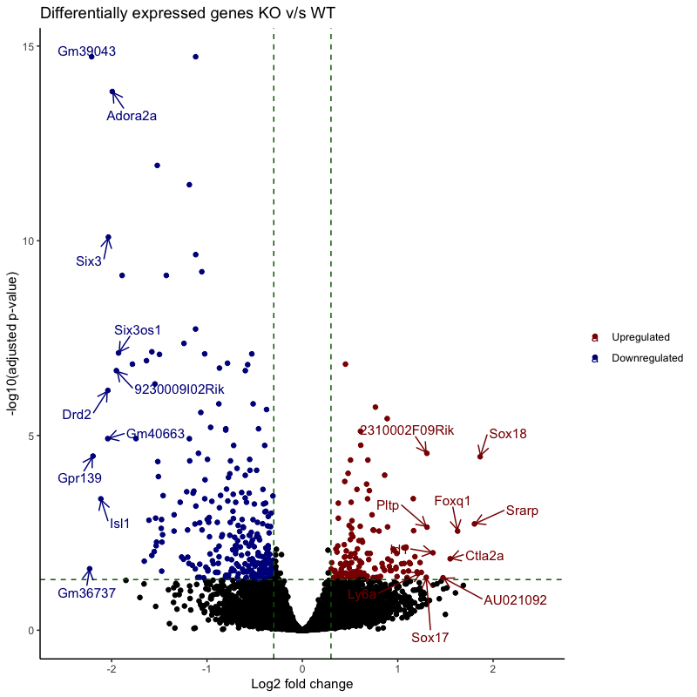
LET US MAKE A VOLCANO PLOT!

