Slide 1
ASSIGNMENT
Wanchai Nupinit
Wanchai.23.chai@gmail.com

Slide 2
API (Back-end)
X, 5, 9, 15, 23, Y, Z - Please create a new function for finding X, Y, Z value
Please use “Place search|Place API(by Google)” for finding all restaurants in Bangsue area and show result by JSON
Please create one small project for Line messaging API(Up to you), contain a flow diagram, your code, and database.

Slide 3
WEB (front-end)
Create a new router called “SCG”
X, 5, 9, 15, 23, Y, Z - Please create a new function for finding X, Y, Z value
Please use Bootstrap V4 for CSS
Please create Top bar, body, and footer for every page components
Please create a new page for showing results from your API(1.3)
One simple static page for your CV

Slide 4
X, 5, 9, 15, 23, Y, Z - Please create a new function for finding X, Y, Z value
5
2+3
N=2
(4-2)+3
N²-N+3
9
2+3+4
N=3
(9-3)+3
15
2+3+4+6
N=4
(16-4)+3
23
2+3+4+6+8
N=5
(25-5)+3
N term = N²-N+3

Slide 5
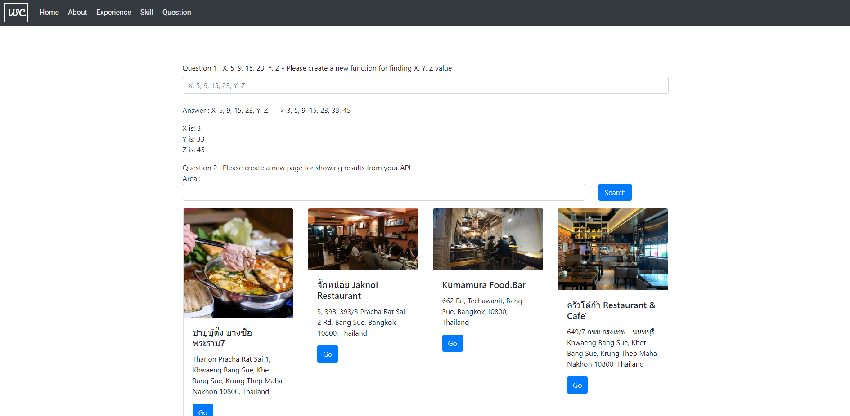
X, 5, 9, 15, 23, Y, Z - Please create a new function for finding X, Y, Z value

Slide 6
Please use “Place search|Place API(by Google)” for finding all restaurants in Bangsue area and show result by JSON
GET https://floating-waters-42919.herokuapp.com/api/nearby
Query String
radius : Number (Optional)
The distance (in meters) within which to return place results
Default: 1500
placeType : String (Optional)
Restricts the results to places matching the specified type such as restaurant, café, bus_station etc.
Default : restaurant
placeSearch : String (Optional)
field and passed as part of the same search string
Default : Bangsue

Slide 7
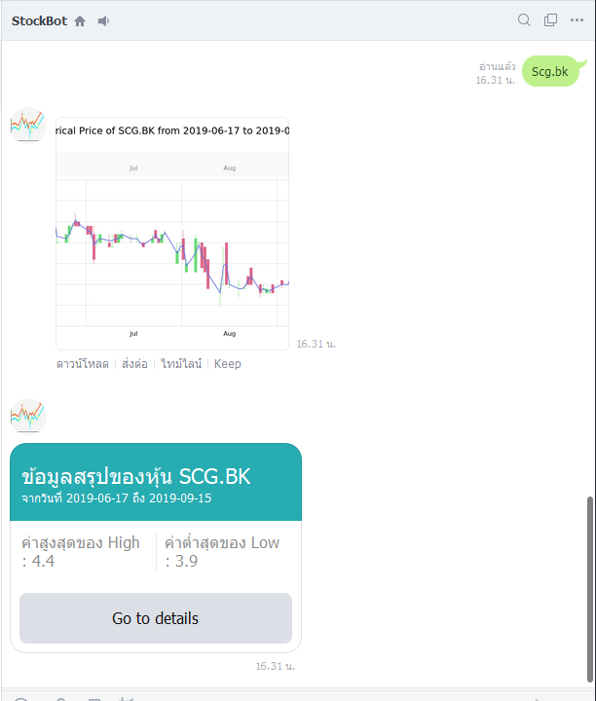
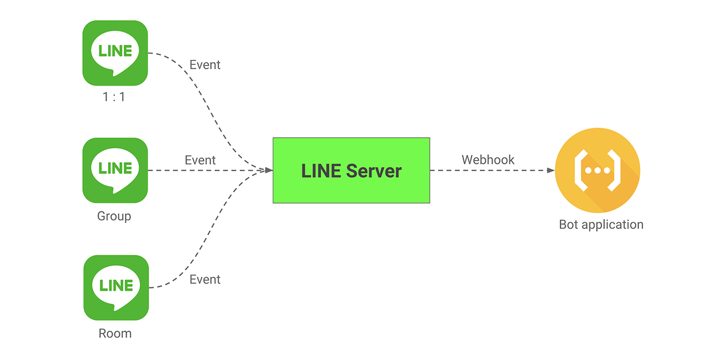
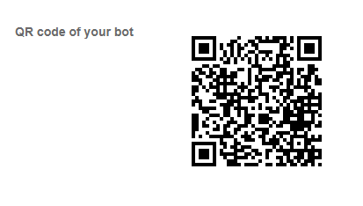
Please create one small project for Line messaging API(Up to you), contain a flow diagram, your code, and database.
My bot is provided stock data summary when user input symbol of stock , the bot will generate graph and summary maximum, minimum of price in 3 month ago.
The technology is line messaging api , my server will handle event from line server (web hook) , and the server will processing symbol by get stock data from yahoo finance api and will reply to user with graph picture and summary data.

Slide 8
Create a new router called “SCG”
https://www.wanchai.wcsoft.xyz/scg

Slide 9
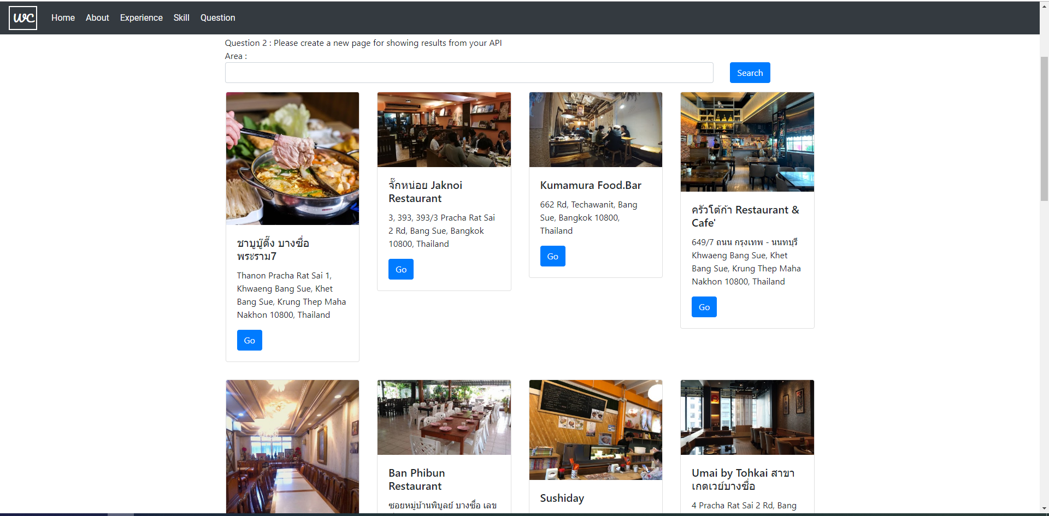
Please create a new page for showing results from your API(1.3)

Slide 10
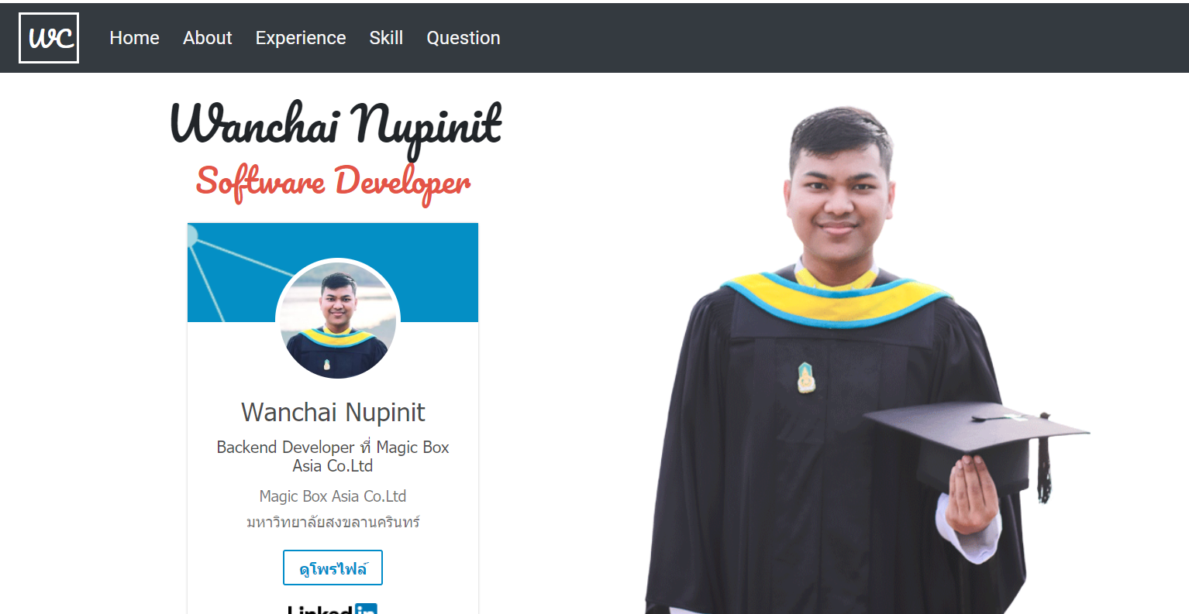
One simple static page for your CV
https://www.wanchai.wcsoft.xyz/

Slide 11
Tech Stack
Backend
Frontend
Nodejs
express
Reactjs
Bootstarp
Css
Deploy Application
- Firebase hosting
- keroku

Slide 12
Resource
GitHub
https://github.com/wanchai23chai/SCG
Front-end
https://www.wanchai.wcsoft.xyz/
Back-end
https://floating-waters-42919.herokuapp.com

