Slide 1
Git
Prepared by: Chai Ying Hua
Date: 26th June 2018

Slide 2
Outlines
Introduction
Window Installation
Mac Installation
Git commands
Synchronization with repositories.
Inspect a repository.
Undoing a change in repositories.
Branches with Git.
Git Flow Workflow.
Summary

Slide 3
Introduction
1.1 What is version control (VCS)?
Help software team manage changes of source code over time.
Keeps track of every modification to the code.

Slide 4
Introduction
1.2 Benefits of Version Control.
A complete long-term change history of every file.​
Branching and merging.
Traceability

Slide 5
Introduction
1.3 Why do we need Git?
Continuous Integration (CI/CD)
Code reviews.
Sustainability
Adopting sustainable development practices
Promote collaborations and communication between teams.
Avoid Integration Hell.

Slide 6
2. Window Installation
Download the latest Git for Windows installer via the link: ​https://gitforwindows.org
When you've successfully started the installer, you should see the Git Setup wizard screen. Follow the Next and Finish prompts to complete the installation.
Open a Command Prompt (or Git Bash if during installation you elected not to use Git from the Windows Command Prompt).
Configure your Git username and email using the following commands.
$ git config --global user.name “yinghua”
$ git config --global user.email “yinghua@smartblock.pro”

Slide 7
3. Mac Installation
3.1 Git for Mac Installer
Down the installer from : ​https://sourceforge.net/projects/git-osx-installer/files/
Follow the prompt to install Git.
$ git config --global user.name “yinghua”
$ git config --global user.email “yinghua@smartblock.pro”

Slide 8
3. Mac Installation
3.2 Installation with homebrew
If you have Homebrew package in OSX, follow these instruction to install Git.
Verify the installation was successful by typing which git --version:
Configure your Git username and email using the following commands.
$ brew install git
$ brew install git
$ git --version
Git version 2.18.0
$ git config --global user.name “yinghua”
$ git config --global user.email “yinghua@smartblock.pro”

Slide 9
4. Git Commands
4.1 git clone
Target an existing repository and create a clone
or ​copy of the target repository and download into your local computer.
$ mkdir calculator-apps
$ cd calculator-apps/
$ git clone https://github.com/CodesAreHonest/tdd-calculator.git
Cloning into 'tdd-calculator'...
remote: Counting objects: 90, done.
remote: Total 90 (delta 0), reused 0 (delta 0), pack-reused 90
Unpacking objects: 100% (90/90), done.

Slide 10
4. Git Commands
4.2 git init
Creates a new Git repository.
​convert an existing, unversioned project to a Git repository or initialize a new, empty repository​
First command you will run in new project.
$ mkdir calculator-apps
$ cd calculator-apps/
$ git clone https://github.com/CodesAreHonest/tdd-calculator.git
Cloning into 'tdd-calculator'...
remote: Counting objects: 90, done.
remote: Total 90 (delta 0), reused 0 (delta 0), pack-reused 90
Unpacking objects: 100% (90/90), done.

Slide 11
4.3 git status
Displays paths :-
that have differences between the index file and the current HEAD commit
​differences between the working tree and the index file
paths in the working tree that are not tracked by Git.
$ git status
On branch master
No commits yet
Untracked files:
(use "git add <file>..." to include in what will be committed)
.bowerrc
.gitignore
.jshintrc
.travis.yml
LICENSE
README.md
app/
bower.json
doc/
img/
karma.conf.js
package.json
nothing added to commit but untracked files present (use "git add" to track)

Slide 12
4.4 git add
adds a change in the working directory to the staging area
​It tells Git that you want to include updates to a particular file in the next commit
c​hanges are not actually recorded until you run git commit.
$ git add .
// the ‘dots’ means everything that contains in your file.
$ git add
Nothing specified, nothing added.
// without the ‘dots’ nothing will be added onto the staging area.

Slide 13
4.5 git commit
Commits are the core building block units of a Git project timeline.
​thought of as snapshots or milestones along the timeline of a Git project​
Git Snapshots are always committed to the local repository.
$ git commit -m "add calculator apps for initial commit to show how git works."
[master (root-commit) 14087a7] add calculator apps for initial commit to show how git works.
36 files changed, 1237 insertions(+)
create mode 100644 README.md
create mode 100644 app/calculator-app/calculator.css
create mode 100644 app/calculator-app/calculator.html
create mode 100644 app/calculator-app/calculator.js
create mode 100644 app/calculator-app/calculatorKey.js
create mode 100644 app/calculator-app/calculatorSpec.js
create mode 100644 app/calculator-app/image/background.jpg
create mode 100644 app/calculator-app/image/wallpaper.jpg
... Other files are not specified

Slide 14
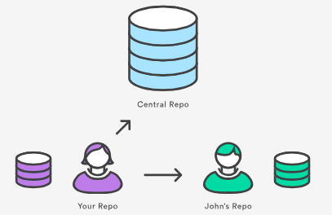
4.6 git remote add
establish connection to other repositories in Github
​Remote connections are more like bookmarks rather than direct links into other repositories.
$ git remote -v
$ git remote add origin https://github.com/chai-yinghua/git-workshop-iscity.git
// list out all the available remote
$ git remote -v
origin https://github.com/chai-yinghua/git-workshop-iscity.git (fetch)
origin https://github.com/chai-yinghua/git-workshop-iscity.git (push)

Slide 15
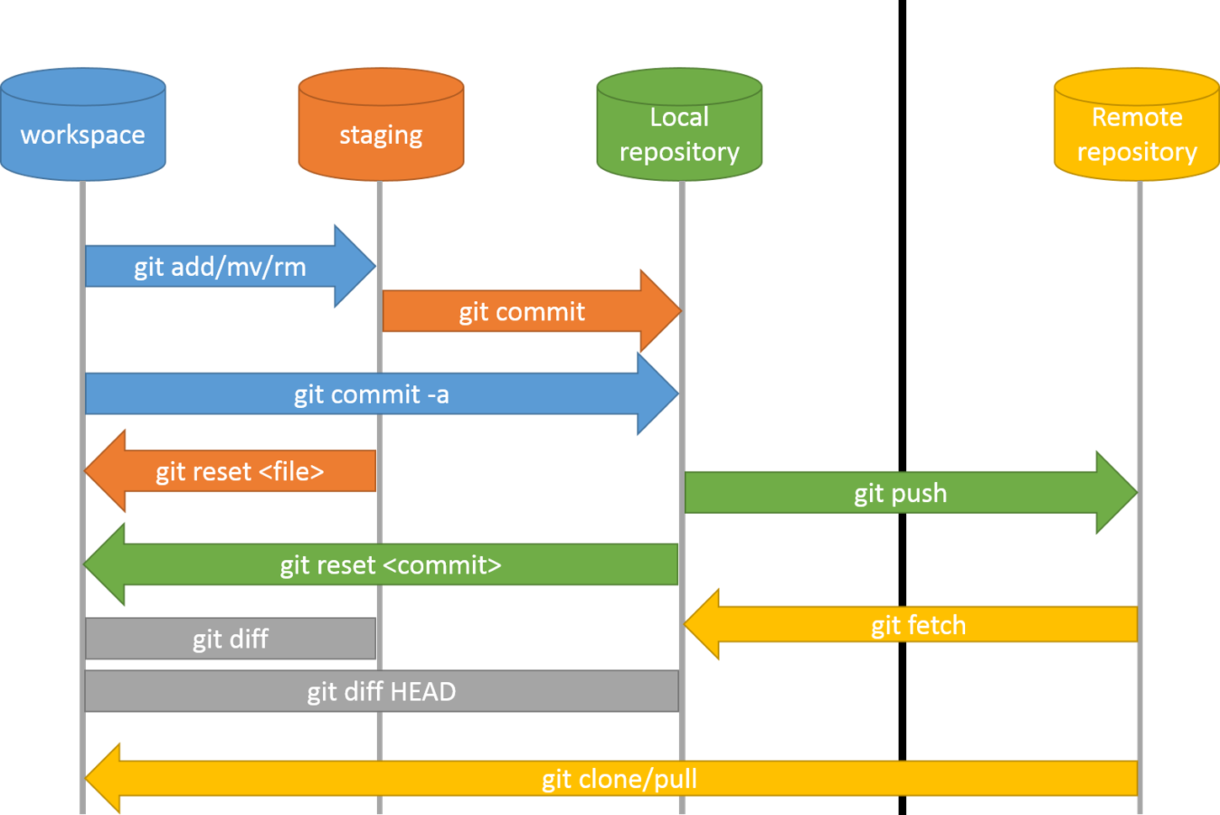
4.7 Overview of Git commands

Slide 16
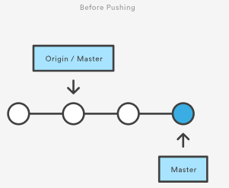
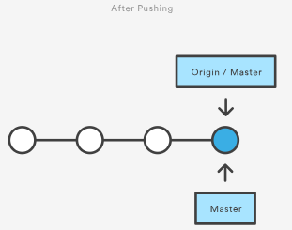
5. Synchronization with Repositories
5.1 git push
upload local repository content to a remote repository​
​publish an upload local changes to a central repository​
share the modifications with remote team members.

Slide 17
5.1 git push (conts.. )
$ git push
fatal: The current branch master has no upstream branch.
To push the current branch and set the remote as upstream, use
git push --set-upstream origin master
$ git push -u origin master
Counting objects: 48, done.
Delta compression using up to 4 threads.
Compressing objects: 100% (44/44), done.
Writing objects: 100% (48/48), 770.14 KiB | 10.41 MiB/s, done.
Total 48 (delta 2), reused 0 (delta 0)
remote: Resolving deltas: 100% (2/2), done.
To https://github.com/chai-yinghua/git-workshop-iscity.git
* [new branch] master -> master
Branch 'master' set up to track remote branch 'master' from 'origin'.

Slide 18
5.2 git pull
fetch and download content from a remote repository​.
​immediately update the local repository to match that content.
$ git pull
remote: Counting objects: 3, done.
remote: Compressing objects: 100% (3/3), done.
remote: Total 3 (delta 2), reused 0 (delta 0), pack-reused 0
Unpacking objects: 100% (3/3), done.
From https://github.com/chai-yinghua/git-workshop-iscity
09a0842..8eb8fbe master -> origin/master
Updating 09a0842..8eb8fbe
Fast-forward
README.md | 4 +---
1 file changed, 1 insertion(+), 3 deletions(-)
$ git pull origin master
From https://github.com/chai-yinghua/git-workshop-iscity
* branch master -> FETCH_HEAD
Already up to date.

Slide 19
5.3 git fetch
Downloads commits. Files, and refs from a remote repository in local repo
​​Purpose: see what everybody else has been working on.
$ cd ~/Documents/gcox_exchange // Change directory to GCOX Exchange for example.
$ git fetch
remote: Counting objects: 48, done.
remote: Compressing objects: 100% (9/9), done.
remote: Total 48 (delta 34), reused 48 (delta 34), pack-reused 0
Unpacking objects: 100% (48/48), done.
From https://github.com/smartblock/gcox-acm
2f5934e..fb74ad8 implement_new_kyc -> origin/implement_new_kyc

Slide 20
6. Inspect a local repositories
$ git log
commit a2d795eb2c68ac5cfab4d6dde6e8ba433d542a82 (HEAD -> master, origin/master)
Author: yinghua <yinghua@smartblock.pro>
Date: Sun Jun 24 22:35:29 2018 +0800
Revert "Update README.md"
This reverts commit 8eb8fbeebb22773026a845396e33494e16b0cb2b.
commit f80e2d99cca2388ddaaeb8c148f09c038299ed43
Author: yinghua <yinghua@smartblock.pro>
Date: Sun Jun 24 22:33:58 2018 +0800
Revert "ignore package-lock.json to prevent angular's dependencies exposed"
This reverts commit 09a084290842d408d342a6e57976104f1e1f5fd3.
// pretty print the log in one line
$ git log --oneline
a2d795e (HEAD -> master, origin/master) Revert "Update README.md"
f80e2d9 Revert "ignore package-lock.json to prevent angular's dependencies exposed"
8eb8fbe (tag: v0.1.0) Update README.md
09a0842 ignore package-lock.json to prevent angular's dependencies exposed
14087a7 add calculator apps for initial commit to show how git works.
6.1 git log
​navigate all the history of changes in your codes.​
​​go back into your project history to see who contributed what, figure out where bugs were introduced, and revert problematic changes with git reset.

Slide 21
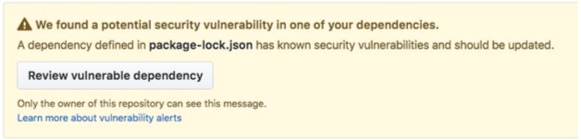
6. Inspect a local repositories
// Inside .gitignore files.
logs/*
!.gitkeep
node_modules/
e2e-tests/
bower_components/
Package-lock.json ← new lines is added to untrack the files.
$ git commit -m "iscity$ untrack package-lock.json in .gitignore to remove security
vulnerabilities."
[master 88ff5a4] iscity$ untrack package-lock.json in .gitignore to remove security
vulnerabilities.
1 file changed, 1 insertion(+)
$ git push origin master
Counting objects: 3, done.
Delta compression using up to 4 threads.
Compressing objects: 100% (3/3), done.
Writing objects: 100% (3/3), 349 bytes | 349.00 KiB/s, done.
Total 3 (delta 2), reused 0 (delta 0)
remote: Resolving deltas: 100% (2/2), completed with 2 local objects.
To https://github.com/chai-yinghua/git-workshop-iscity.git
7660727..88ff5a4 master -> master
// Removed the file in Github.
$ git rm --cached package-lock.json
rm 'package-lock.json'
6.2 git ignores
​Specifies the file and directory name in .gitignore files
​​prevent push onto the Github server.

Slide 22
7. Undoing change in a repository.
$ git log --oneline
b818da2 (HEAD -> master, origin/master) remove several information in README.md
5fa1dbe remove several information in README.md
88ff5a4 iscity$ untrack package-lock.json in .gitignore to remove security vulnerabilities.
$ git checkout 88ff5a4
Note: checking out '88ff5a4'.
You are in 'detached HEAD' state. You can look around, make experimental
changes and commit them, and you can discard any commits you make in this
state without impacting any branches by performing another checkout.
If you want to create a new branch to retain commits you create, you may
do so (now or later) by using -b with the checkout command again. Example:
git checkout -b <new-branch-name>
HEAD is now at 88ff5a4 iscity$ untrack package-lock.json in .gitignore to remove security
Vulnerabilities
$ git status
HEAD detached at 88ff5a4
nothing to commit, working tree clean
// return to original HEAD
$ git checkout master
Previous HEAD position was 88ff5a4 iscity$ untrack package-lock.json in .gitignore to remove
security vulnerabilities.
Switched to branch 'master'
Your branch is up to date with 'origin/master'.
7.1 git checkout
“load” any of these saved snapshots onto your development machine
​​the git checkout command operates upon three distinct entities: files, commits, and branches. (will be discussed in later section)

Slide 23
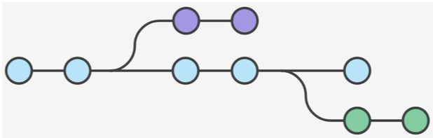
8. Branches with Git
Git branches are effectively a pointer to a snapshot of your changes.
When you want to add a new feature or fix a bug—you spawn a new branch to encapsulate your changes.
This makes it harder for unstable code to get merged into the main code base.

Slide 24
8.1 List all the branch
$ git branch
8.2. Create a new branch
$ git branch new-branch
$ git branch
* master
new-branch
8.3 Rename a branch
$ git branch -m new-branch old-branch
$ git branch
* master
old-branch

Slide 25
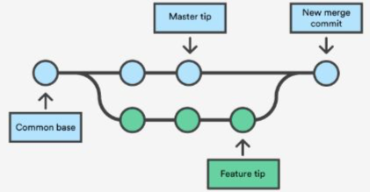
8.4 Switch to a branch
$ git checkout old-branch
Switched to branch 'old-branch'
8.5 Merge a branch
In the most frequent use cases, git merge is used to combine two branches.
// Step 1 - Confirm the receiving branch
$ git branch
* master
Old-branch
$ git merge old-branch
Updating b818da2..6cd7f45
Fast-forward
README.md | 2 +-
1 file changed, 1 insertion(+), 1 deletion(-)

Slide 26
8.6 Delete a branch
$ git branch
master
* old-branch
$ git branch -d old-branch
error: Cannot delete branch 'old-branch' checked out at
'/Users/iscity/Documents/git-workshop-iscity'
$ git checkout master
Switched to branch 'master'
Your branch is up to date with 'origin/master'.
$ git branch
* master
Old-branch
$ git branch -d old-branch
Deleted branch old-branch (was b818da2).
$ git branch
* master

