Slide 1

Automatic object control
BRACT’S
VISHWAKARMA INSTITUTE OF INFORMATION TECHNOLOGY
DEPARTMENT OF ENGINEERING AMD APPLIED SCIENCE
Academic year:2024
Semester : 2
Batch: B3
Sr.no. | Roll no. | PRN | Name
1.
2.
3. | 212067 | 22320022 | Chaitanya Mahamuni
4.

Slide 2
INTRODUCTION
In many industrial applications, the ability to detect and adjust for imbalance is crucial. Many sectors rely on stabilizing mechanisms these days. The technology is utilized in a wide range of items, from camera stabilizing equipment to surgical instruments. This is accomplished by using platforms that measure the tilt of the platform to correct for angular variability. The main motive of this project is to design and build a self-balancing platform that uses a PID controller, accelerometers and gyroscopes, and a Kalman filter to stabilize it. This device determines how far the present position of the platform is from the intended balanced position, and then the direction controller activates the appropriate motor to return the platform to its original stable position

Slide 3
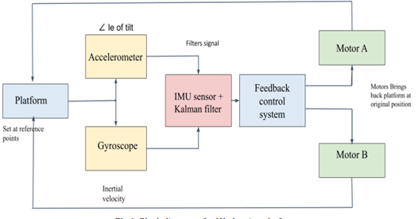
COMPONENTS

Slide 4
CIRCUIT DESCRIPTION
Concept Dimension: o Balancing Platform: 150*150*10mm o Base Platform: 200*200*10 mm o Motor Dimension: 40*19*42 mm o Holding plate: 50*25*10 mm o Height of the overall system (H): 220mm o Distance Between two plates: 200mm Design consideration: o Weight of floating platform (Wm): 150 gram o Weight of base platform (Wb) :250 gram o maximum weight to be applied (Wb): 150 gram o Maximum angle of tilt (θ): 50 degree o Weight of Entire system (M) : 800 gram o Maximum Torque requirement : H*g*M*sin(θ)[11][13][5]

Slide 5
Hardware
III. HARDWARE REQUIREMENT
Mega 2560:
The Arduino Mega 2560 is an ATmega2560-based microcontroller board. A 16 MHz crystal oscillator, 54 digital input/output pins, 16 analogue inputs, 4 UARTs (hardware serial ports), a USB connection, a power connector, an ICSP header, and a reset button are all included. Most shields designed for the Uno are compatible with the Mega 2560 board.
BNO055:
Sensor BNO055 is a system in package (SIP) solution that incorporates a triaxial 14 accelerometer, a tri -axial 16-bit gyroscope, and a tri-axial geomagnetic sensor. By combining sensors and sensor fusion in a single device, the BNO055 optimizes integration and eliminates the need for extensive multivendor solutions.
Servo Motor:
Motor selection for the balancing robot prioritizes torque output rather than velocity because it has to oppose the rotating moment that gravity exerts on the platform. To compensate for the platform's inclination, motors are employed. A servo motor is a rotary or linear actuator that provides for exact angular or linear position, velocity, and acceleration control. A servo is made comprised of a suitable motor and a position feedback sensor.[4]

Slide 6
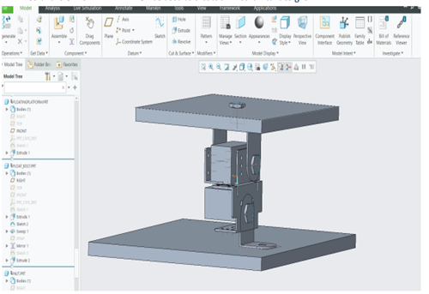
MODELING
The CAD-software CREO PARAMETRIC was used to create all mechanical designs

Slide 7
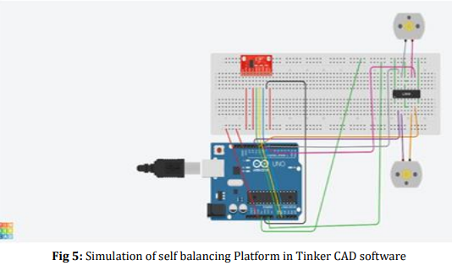
Simulation
Simulation: The simulation was performed in order to obtain the intended outcomes. The simulation results achieved using TinkerCAD software are described in considerable depth below.

Slide 8
. RESULTS AND DISCUSSION
To meet the project's goal, we conducted many tests in order to make the system more compatible. The findings acquired from the Arduino uno programmed after a PID is calibrated are detailed in this chapter. The results of the test cases are shown below, with the red line indicating the tilt angle detected by the IMU sensor and the yellow line indicating the displacement

Slide 9
conclusion
The project used the fundamental issue inverted pendulum challenge and expanded its application to create a self-balancing platform. Using this idea, the platform balances itself when pushed down or moved upward. The components' needs, functions, and connections have all been thoroughly described. The system, as well as the demonstration, might be upgraded significantly in the future. We may also go for the moving robot now that we have established a robust base. The same technology is also being utilized to produce self-balancing vehicles, self-balancing wheelchairs, and Segway. In order to increase the system's performance and reaction time, a different controller than PID might be used. One may utilize a dc motor instead of a servo motor to boost speed and efficiency. It is recommended that stepper motors should not be used since they increase system rise time.

