Slide 1
SaaS/E-Commerce Cohort Retention & CLTV Analysis
Customer retention, churn, lifetime value and business recommendations

Slide 2
Business Problem
Acquiring new customers is costly, but not every acquired user remains active.
The project measures customer retention month by month using cohort analysis.
CLTV analysis identifies high-value and low-value customers for better decision-making.

Slide 3
Objectives
Clean and prepare transaction-level customer data.
Generate acquisition cohorts and monthly retention rates.
Calculate historical CLTV and segment customers by value.
Build visual insights and a Streamlit dashboard.

Slide 4
Dataset Summary
Cleaned transactions: 3,682
Unique customers: 1,157
Unique orders: 3,682
Total revenue: Rs. 12,839,490.14

Slide 5
Methodology
Data cleaning: remove invalid IDs, duplicate records, cancelled orders and invalid dates.
Feature engineering: revenue, transaction month, cohort month and cohort index.
Cohort analysis: customer-count matrix and retention-rate matrix.
CLTV analysis: total revenue, AOV, purchase frequency and segmentation.

Slide 6
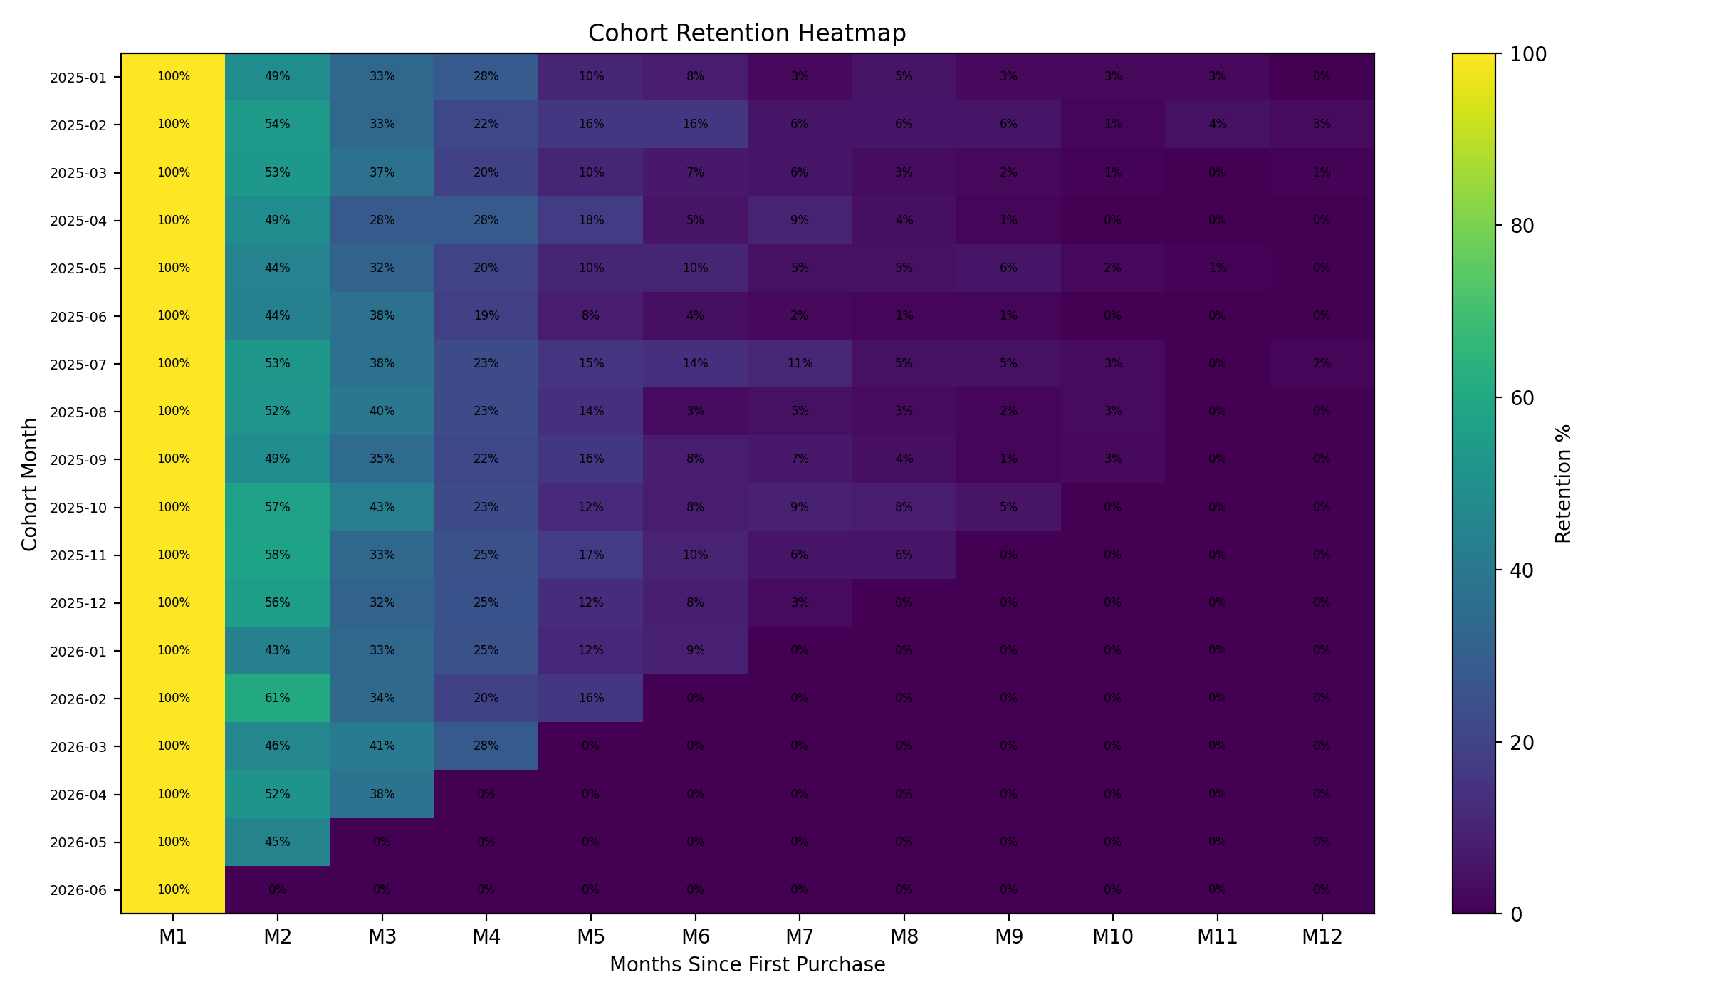
Retention Heatmap

Slide 7
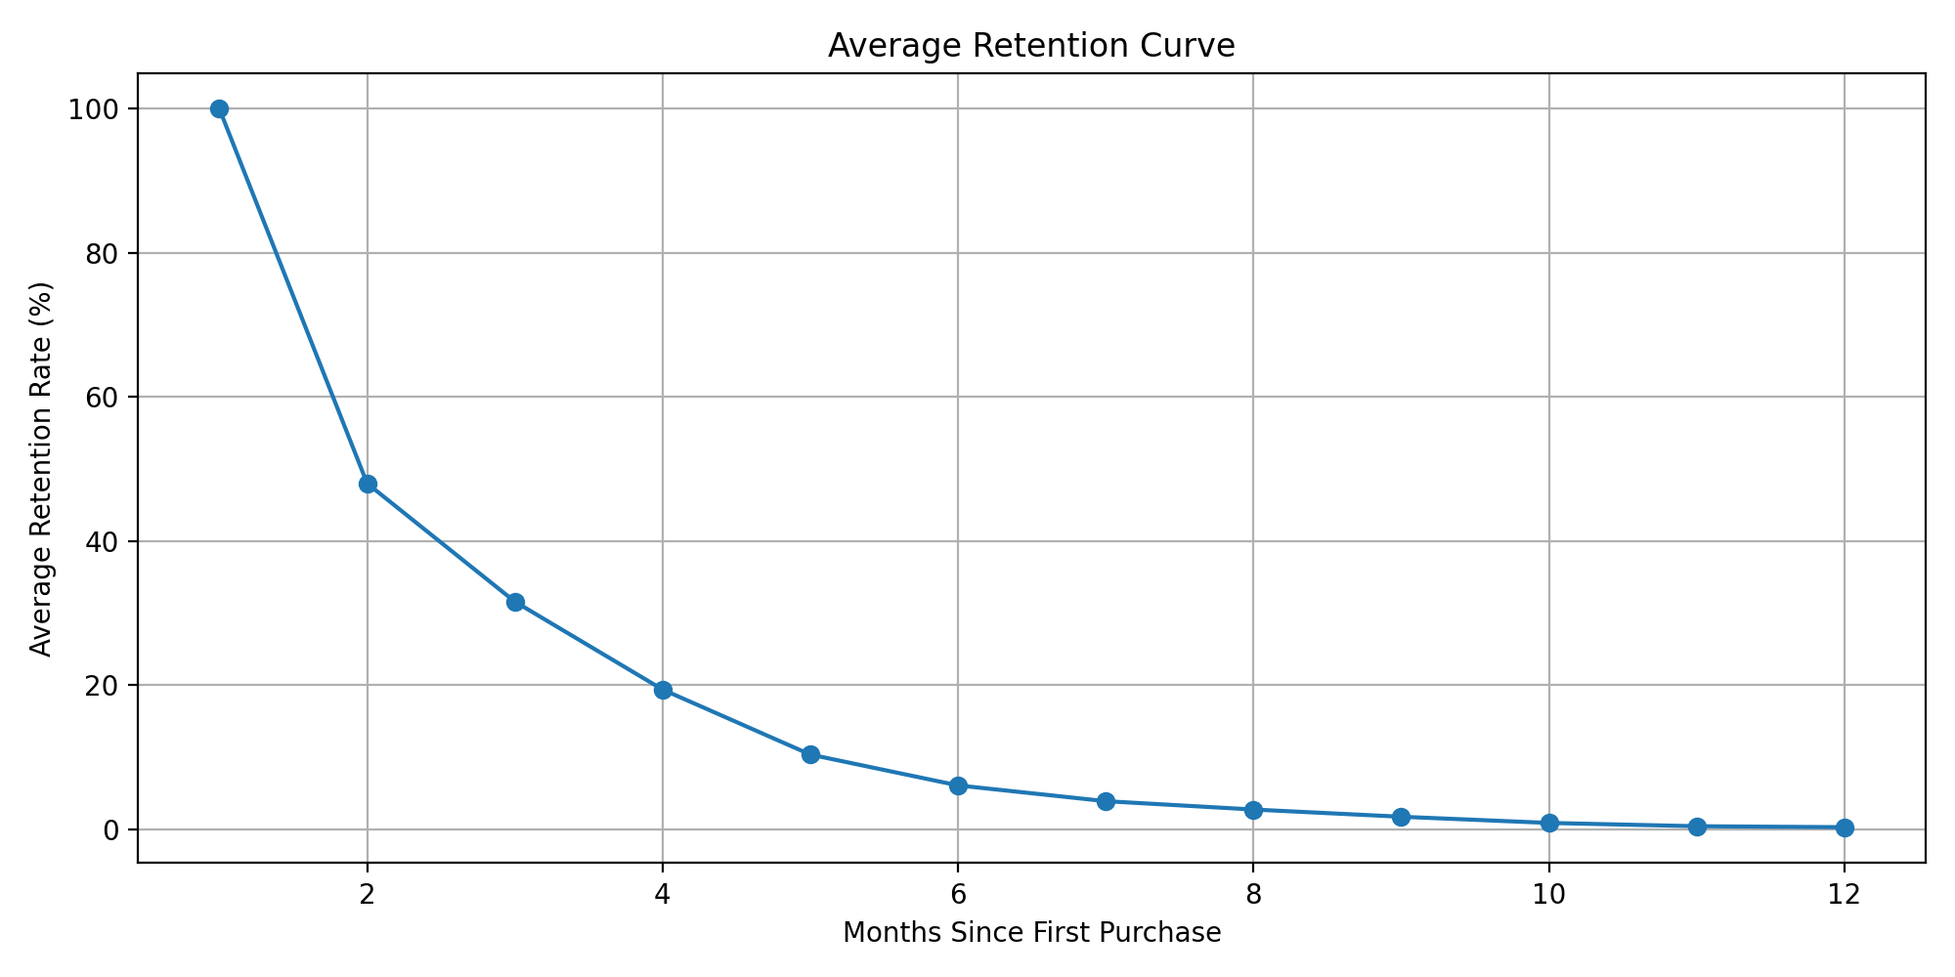
Average Retention Curve

Slide 8
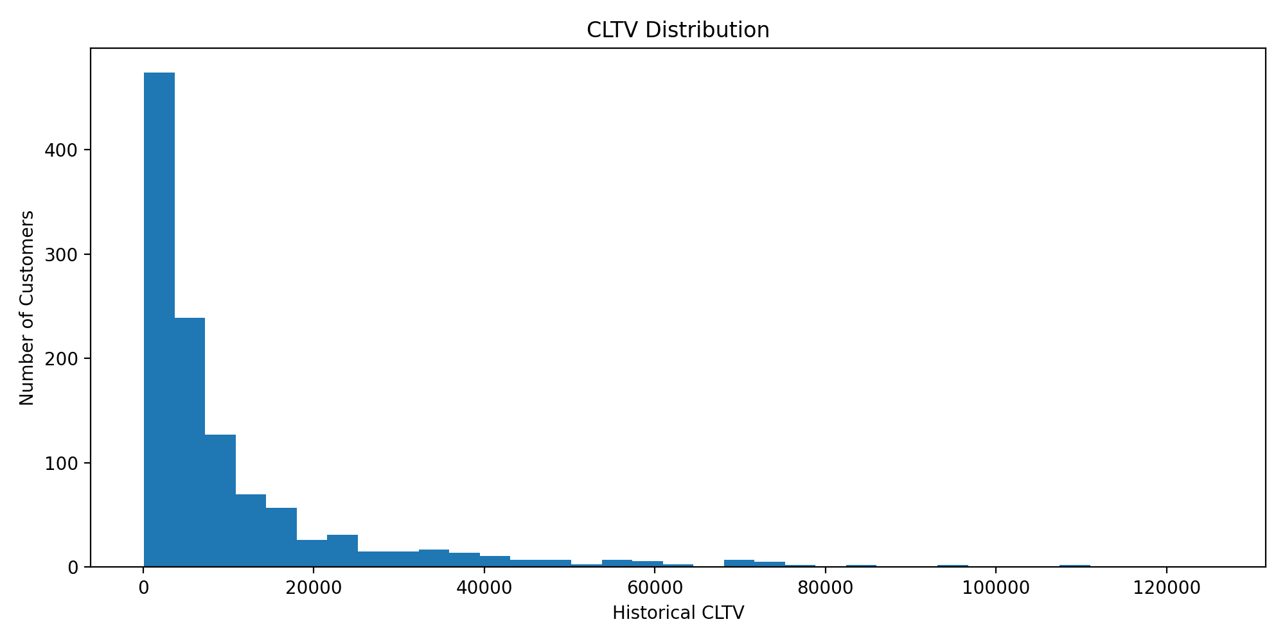
CLTV Distribution

Slide 9
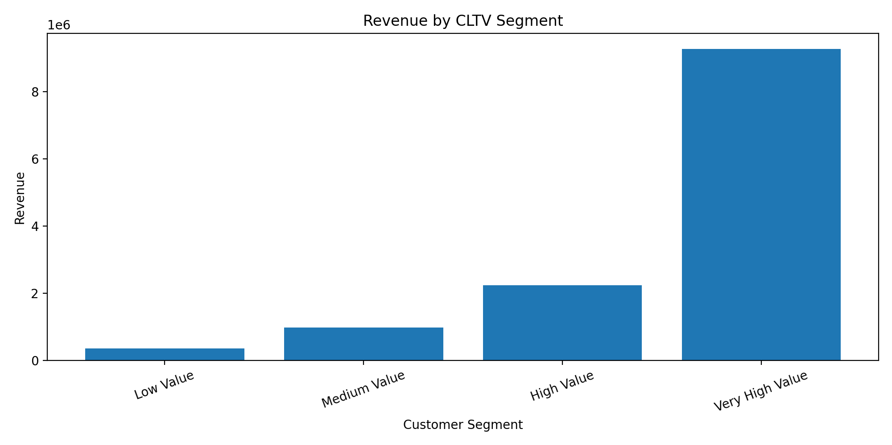
Segment Analysis

Slide 10
Business Insights
Repeat customer rate is 71.39%, showing scope for retention improvement.
High-value customers contribute strongly to revenue and should receive premium retention offers.
Early month drop-off should be reduced using re-engagement and second-purchase campaigns.

Slide 11
Recommendations
Launch automated campaigns 15-30 days after first purchase.
Prioritize acquisition channels with higher CLTV.
Create loyalty offers for high-value customers.
Monitor cohort retention monthly.

Slide 12
Conclusion
Cohort analysis identifies when customers churn.
CLTV analysis identifies which customers are most valuable.
Together, these insights support retention, revenue growth and profitable acquisition.

