Slide 1
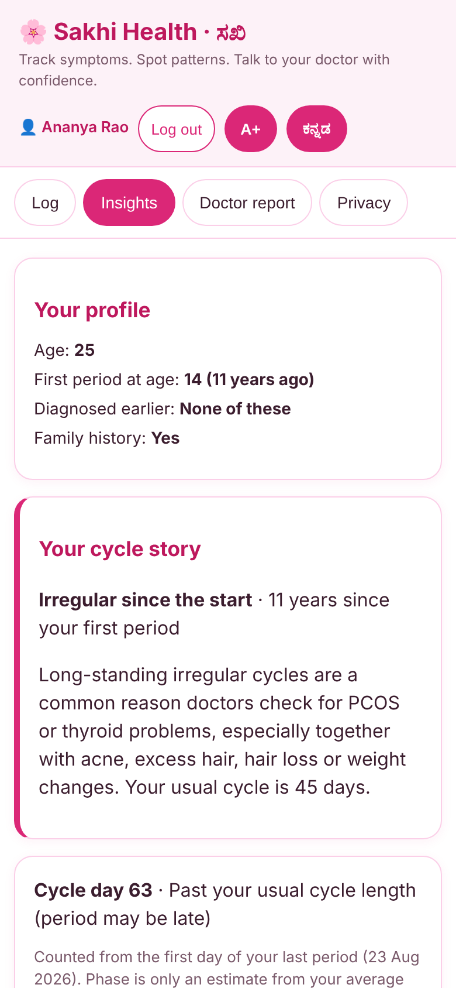
Sakhi Health · ಸಖಿ
Track symptoms. Spot patterns. Talk to your doctor with confidence.
recHERsion'26 · Problem Statement 1: Women's Healthcare
Team Leader: Chaitanya Pawar
Team Mate: Anusha Jidage
Notes:
Hello, we are presenting Sakhi Health, our answer to Problem Statement 1, Women's Healthcare. Sakhi means 'a trusted friend' - the app helps a woman notice what her body has been telling her, and walk into a doctor's office prepared.

Slide 2
The problem: answers come too late
10–13%
4–12 yrs
57%
of women of reproductive age have PCOS, and up to 70% of them are undiagnosed
average time to diagnose endometriosis, which affects about 1 in 10 women
of Indian women aged 15 to 49 are anaemic
(NFHS-5, 2019–21)
Doctors look for patterns over months. Patients remember the last few days.
Notes:
Three numbers frame the problem. WHO estimates that 10 to 13 percent of women of reproductive age have PCOS and up to 70 percent do not know it. For endometriosis, WHO says diagnosis takes 4 to 12 years on average. In India, NFHS-5 found 57 percent of women aged 15 to 49 are anaemic. The gap is simple: doctors look for patterns over months, but patients remember the last few days. Sources are on the references slide.

Slide 3




Proposed idea: Sakhi Health
A private, bilingual symptom tracker that turns daily logs into pattern insights and a doctor-ready report.
1 Know her
2 Log
3 Insights
4 Doctor report
Age, first-period age, past diagnoses, last period and missed months. Nothing is assumed.
Under 30 seconds a day. Tap symptoms or speak them in English or Kannada.
Counted from day 1 of her cycle and read for her age. Every matched sign is shown.
One page: cycle stats, tests to discuss and questions to ask.
Notes:
Sakhi means a trusted friend. The idea works in four steps. One: the app first asks the basics a doctor would ask - date of birth, when the last period started, and any missed periods in the last six months. If she does not remember, she can say so and nothing is guessed. Two: a daily log that takes under 30 seconds, with voice input in English and Kannada. Three: insights counted from day one of her cycle and read for her age. Four: a one-page doctor report.

Slide 4




What makes the idea different
Reads age and cycle
Speak your symptoms
Teen irregularity and the 40s transition are treated differently from PCOS.
English and Kannada voice input ticks matching symptoms for you.
Open, explainable rules
Private by design
No black box. Every matched sign is visible and checkable.
Data stays on the device. Passwords are stored only as salted hashes.
Notes:
Four things set Sakhi Health apart. It reads age and cycle, so a teenager or a woman in her forties is not wrongly told she may have PCOS. It has voice input in Kannada and English. The rules can be inspected by anyone. And it is private by design - no server, no tracking.

Slide 5
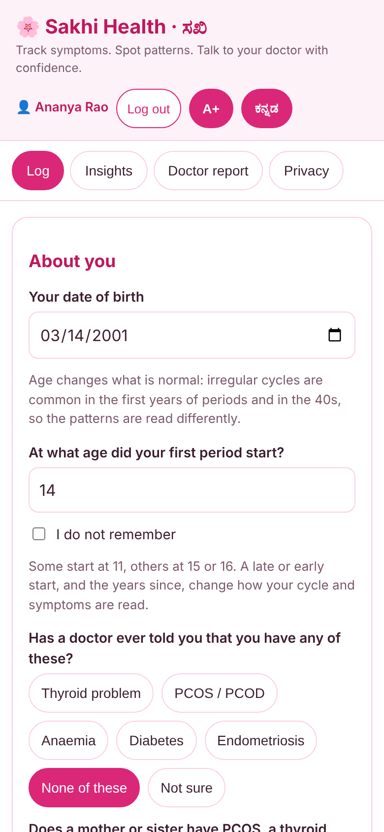
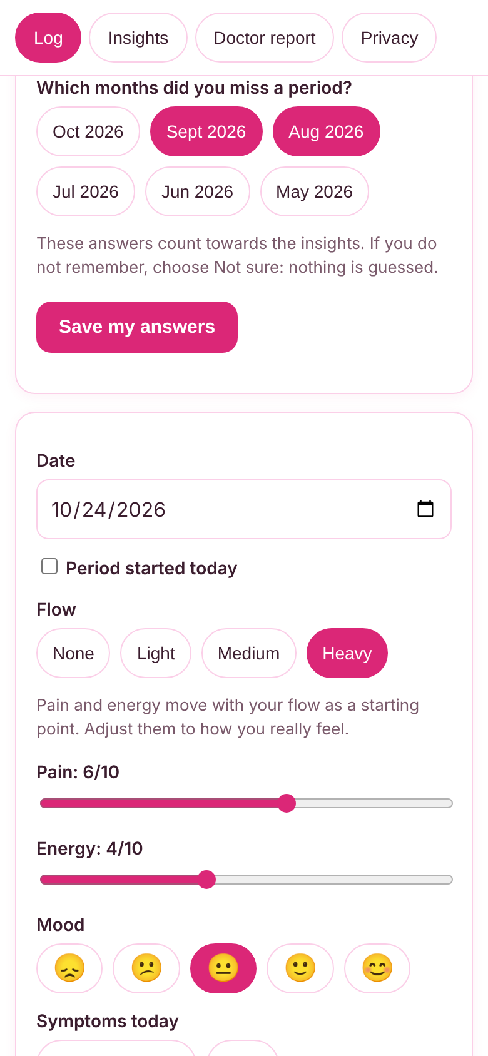
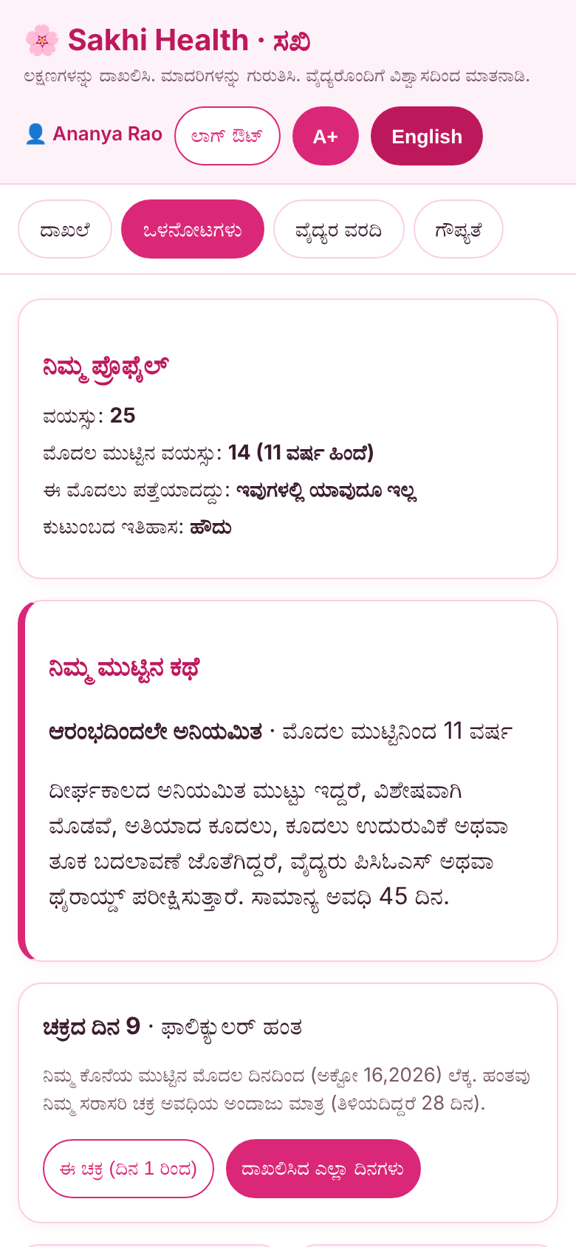
A working product, end to end
About you, no assumptions
Flow guides pain, energy
Insights from day one
Full Kannada support
Notes:
These are real screenshots from the working app, not mock-ups. Insights appear from day one using the About you and last-three-months answers; a clearly labelled sample-data button fills 90 days for demos.

Slide 6
Technical approach: cycle- and age-aware
Inputs
Cycle engine
Age rules
Outputs
Age, first period age
Past diagnoses, family
Last period, missed
Daily log + voice
Cycle day and phase
Cycle lengths from
all period starts
Gaps over 45 days
First 2 yrs of periods:
no PCOS from cycles
40+: perimenopause
45+: no PCOS flag
Pattern cards with
matched signs
Early-read note
Doctor report
Insights default to the current cycle (from day 1); a toggle shows all logged days.
"Not sure" answers are never guessed. Under 7 logged days shows an early-read note.
Plain JavaScript, rule-based and explainable. No ML model, because no labelled medical dataset exists and a black box would be unsafe.
Notes:
The technical approach is personalised and rule-based. Inputs are date of birth, the age at the first period, conditions a doctor has already diagnosed, family history, last period start date, missed months, and the daily log. A late or early first period and a prior diagnosis appear as extra signs on the relevant cards, and every flagged card has a plain-words summary. The cycle engine works out the cycle day and phase, cycle lengths from every logged period start, and flags long gaps. Age rules stop teenagers and women over 45 from being flagged for PCOS on irregular cycles alone, and add a perimenopause check from 40. Outputs are pattern cards that show every matched sign, an early-read note when little data exists, and the doctor report. We chose rules over machine learning on purpose: there is no labelled medical dataset, and an opaque model guessing at health conditions would be unsafe.

Slide 7
Insights you can verify
Pattern | Flagged when
PCOS / hormonal | Under 45, after the first 2 years of periods: irregular cycles, missed months or a long gap, plus acne, excess hair, hair loss or weight gain
Anaemia | Frequent fatigue, plus heavy flow, dizziness, pale skin or low energy
Severe pain | Pain 7/10 or more on 2+ days, plus painful periods or pelvic pain
Thyroid | 4 or more related symptoms occur often
Early-cycle years | First 2 years of periods: cycles under 21 or over 45 days, 3+ missed months, severe pain or heavy bleeding
Perimenopause (40+) | Changing cycles or 12 months without a period, plus hot flushes, poor sleep or mood changes
Not a diagnosis
Shows which signs matched
Lists tests doctors commonly consider
Warns about red-flag symptoms
Thresholds are heuristics from published guidelines, not clinically validated
Notes:
Here are the rules. For each pattern the app shows which signs matched, so a woman and her doctor can check the logic. They are informed by the Rotterdam criteria and the international PCOS guideline, NICE guidance on heavy menstrual bleeding, the ESHRE endometriosis guideline, ACOG guidance on adolescent cycles and the STRAW plus 10 staging for the menopause transition. We are honest that these thresholds are heuristics and not clinically validated - the next step is clinician review. The app never diagnoses.

Slide 8
System architecture
User (phone or laptop browser, no install)
84
automated tests, run in CI
Presentation: Log · Insights · Doctor report · Privacy
(English + Kannada, 3 text sizes, accessible)
0
accessibility violations (axe-core, 7 screens, English + Kannada)
Logic: analyze() rules · cycleInfo() · Voice.match()
Auth (Web Crypto PBKDF2) · i18n dictionaries
localStorage per account:
entries · profile · last period
Browser APIs: Web Crypto,
Web Speech, Print to PDF
0
runtime dependencies
No backend. No runtime dependencies. Hosted free on Streamlit Cloud (static front end).
Notes:
Architecturally it is a static web app. The user opens it in any browser. The presentation layer has four screens in two languages. The logic layer holds the rule engine, the cycle calculations, voice keyword matching and the local accounts, which use the Web Crypto API with salted PBKDF2 hashing. Data is stored per account in the browser, and nothing is sent to a server. Voice uses the browser Web Speech API. There are 84 automated tests running in continuous integration, and an axe-core audit found zero accessibility violations across seven screens in both languages. Honest limit: accounts are device-local, and the next step is Firebase or Supabase for sync.

Slide 9



Feasibility
Built and working
Risk | Mitigation
Rules not clinically validated | Never diagnoses; open rules; clinician review is the next step
Accounts are device-local | Swap auth.js for Firebase or Supabase, same functions
Speech accuracy, Kannada | Chips remain; users can correct what was heard
Sensitive health data | Stays on the device; one tap deletes everything
Complete MVP in the hackathon window, tested and live on Streamlit Cloud.
Near-zero cost
Static hosting and no servers. Nothing to run or pay for at demo scale.
Works on any phone
Runs in a browser, no install. Voice needs Chrome or Edge; chips work everywhere.
Notes:
Feasibility has three parts. It is already built and working. It costs almost nothing to run because it is a static site. And it works on any phone browser. We have also listed the real risks and how we would handle each: the rules need clinical validation, accounts are device-local today, speech accuracy in Kannada will vary so users can always correct the chips, and health data stays on the device.

Slide 10



Impact and benefits
For women
For doctors
For public health
Notice patterns sooner, arrive prepared, and use the app in Kannada or English without sharing data.
A structured history: cycle lengths, missed months, symptom frequency and questions to discuss.
Earlier check-ups for common, under-diagnosed conditions such as PCOS, anaemia and endometriosis.
Her symptoms, understood. Her doctor, prepared.
Notes:
The benefits reach three groups. Women notice patterns sooner and arrive at the clinic prepared, in their own language and without giving up their data. Doctors get a structured history instead of a vague recollection. And for public health, it nudges earlier check-ups for common conditions that are often found late. We make no claim of clinical outcomes yet; that needs validation.

Slide 11
Future scope
Today
Next
Then
Later
Profile questions, cycle-aware insights, voice, Kannada, report
Lab report explainer, offline app, specialist finder
Health-worker mode for community screening, more conditions
Clinician-validated rules, secure sync
Notes:
Today everything on the left is built and working. Next we would add a lab-report explainer, an installable offline app and a specialist finder. Then a health-worker mode so ASHA workers can support community screening, and more conditions. Finally clinician-validated rules and secure sync across devices.

Slide 12
References
WHO. Polycystic ovary syndrome (fact sheet). who.int/news-room/fact-sheets/detail/polycystic-ovary-syndrome
WHO. Endometriosis (fact sheet). who.int/news-room/fact-sheets/detail/endometriosis
NFHS-5 (2019–21), via Press Information Bureau, Govt. of India. pib.gov.in (PRID 1795421)
Teede HJ et al. International evidence-based guideline for PCOS, 2023
Rotterdam ESHRE/ASRM-sponsored PCOS Consensus Workshop Group. Fertil Steril, 2004
NICE NG88. Heavy menstrual bleeding: assessment and management, 2018
ESHRE guideline: Endometriosis, 2022
ACOG Committee Opinion 651. Menstruation in girls and adolescents, 2015
Harlow SD et al. STRAW+10: staging reproductive aging, 2012
Notes:
These are the sources behind the statistics and the rules. We also acknowledge that Claude helped with code and drafting, and that the team chose the problem, scope and design.

Slide 13
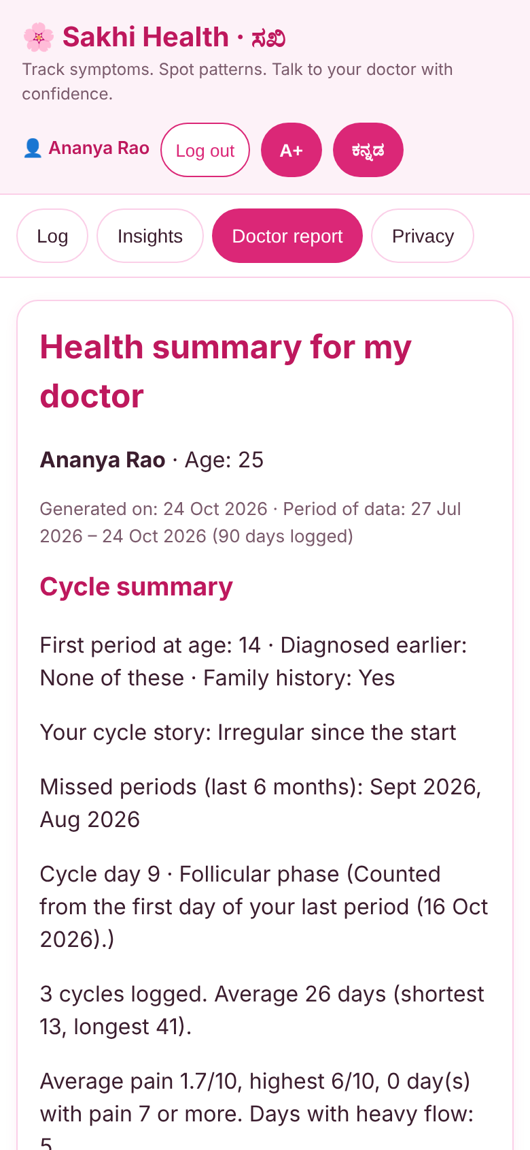
Her symptoms, understood.
Her doctor, prepared.
Code: https://github.com/chai0405-hub/recHERsion---Women-s-Healthcare
Live demo: https://rechersion-womens-healthcare-0405.streamlit.app/
Team: Chaitanya Pawar (Team Leader), Anusha Jidage
Notes:
Sakhi Health: her symptoms, understood, and her doctor, prepared. Thank you. The code, live demo and demo video are linked in our submission.

