Slide 1
Immersive reading
Alison Chaiken, alchaiken@gmail.com
Goal: increase concentration and retention using (surprise!) software hack.

Slide 2
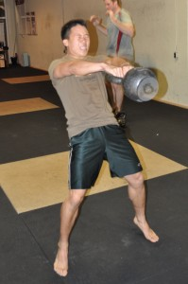
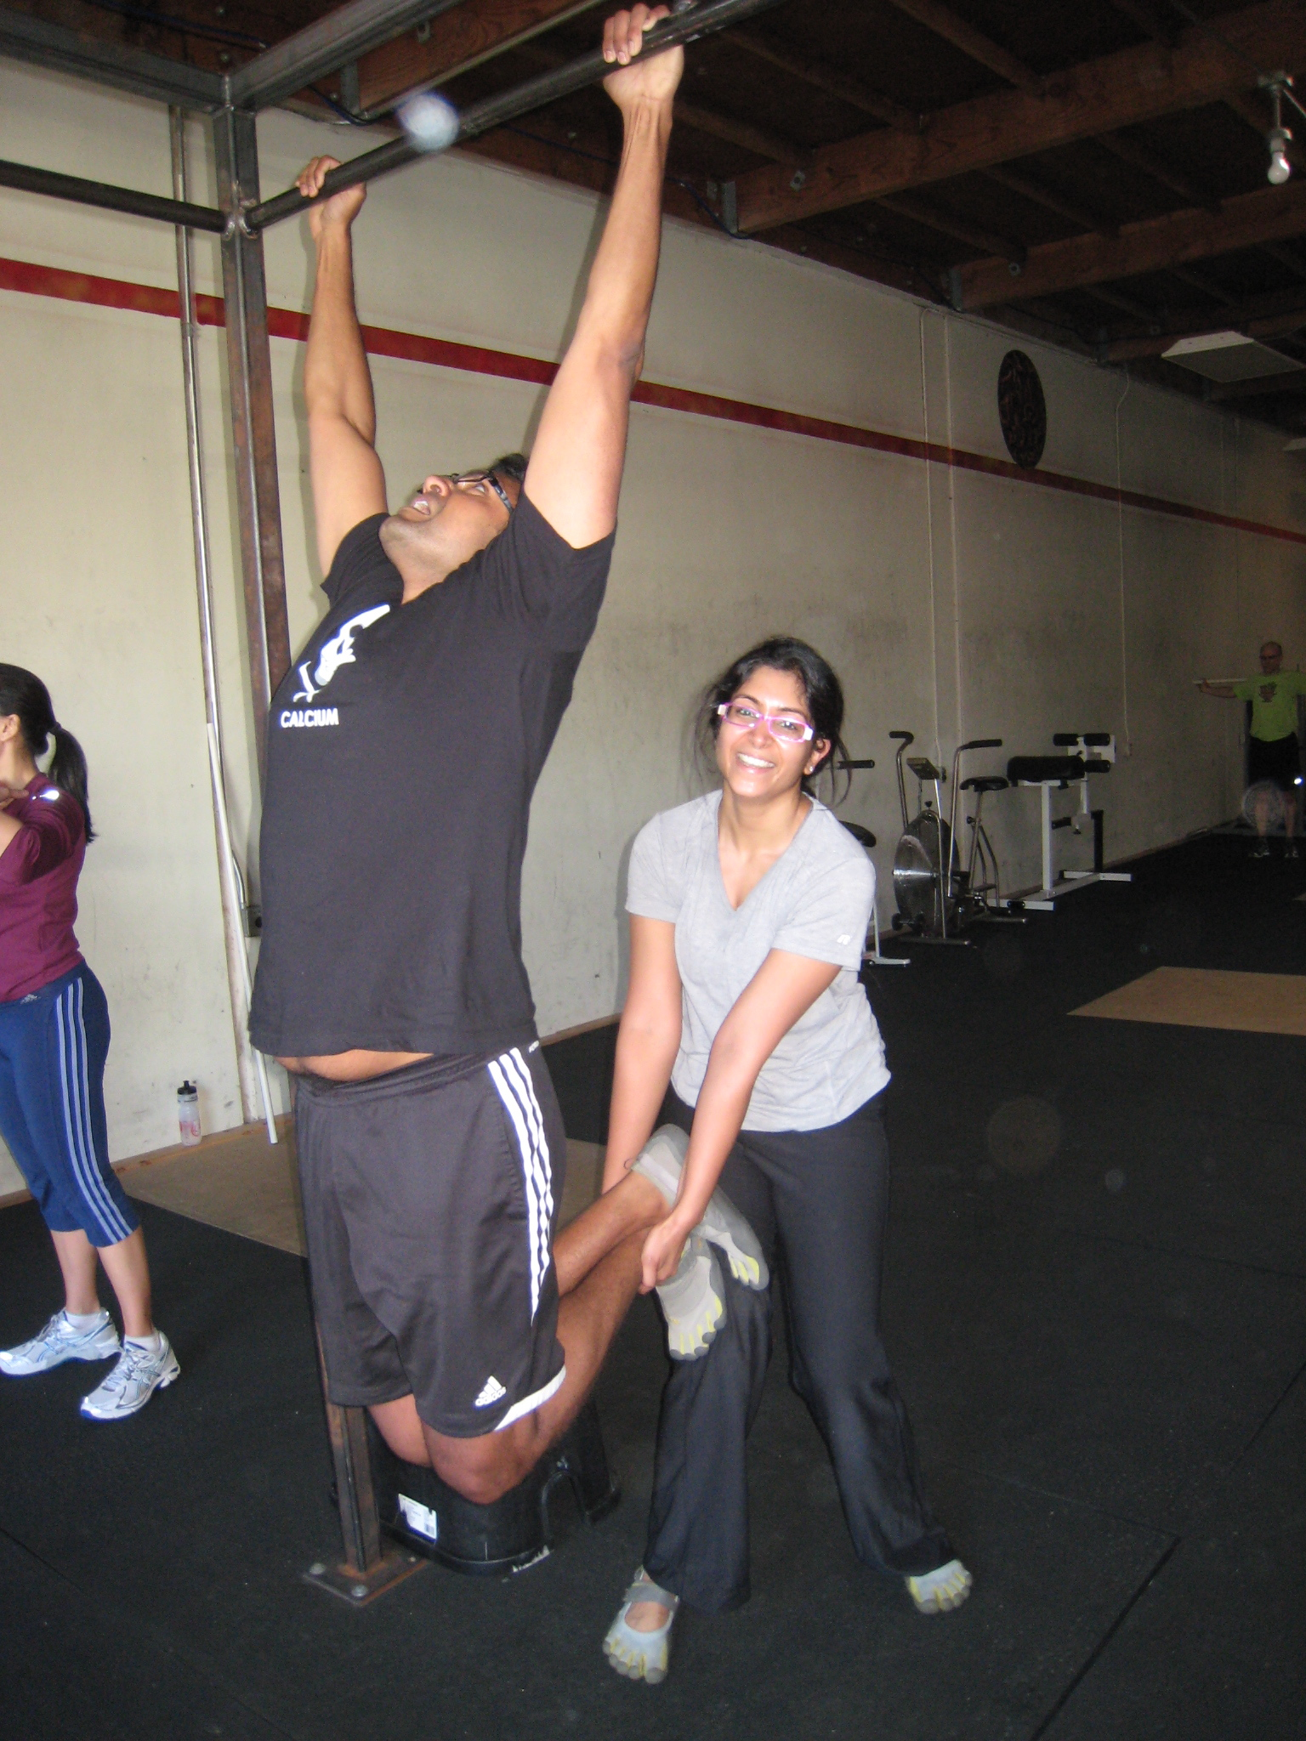
Inspiration: LKHC and CrossFit
(Shout-out to Palantir)
How to bring this intensity to thinking?

Slide 3
Problem: Noisy environment
* Now talking on #glofs
gaak99: RT @CJRoberts_DMM: Correct me if I'm wrong and they'll never find your body.
Identica Dan Lynch (@methoddan) sent a notice to your attention
Buzz: Can We Have a Free Press without Net Neutrality? I …
Inbox (2495)
Buzz: Qt Meetup In Mountain View
[pandaboard] Digest for pandaboard@googlegroups.com - 8 Messages in 5 Topics
katylevinson: "You're so fragile" "I am not! I can kick your ass!" "I'd like to see that" "Fine! Some time when my tummy doesn't hurt..."
Identica Jono Bacon (@jonobacon) sent a notice to your attention
natosaichek: Hackers / programmers of the world: Unite! Help our friends overseas! http://www.tokyohackerspace.org/en/japan-in-crisis
* ChanServ gives channel operator status to bkuhn
[hackerdojo] Digest for hackerdojo@googlegroups.com - 10 Messages in 5 Topics
* Now talking on #faif
Identica Scott Evans (@vk7hse) sent a notice to your attention

Slide 4
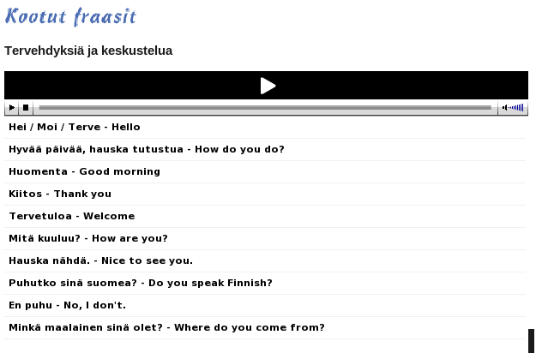
Inspiration: language study

Slide 5
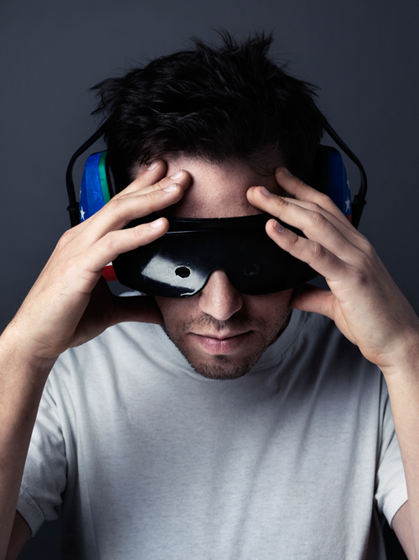
Inspiration: (dis?)abilities
Secrets of a Mind Gamer

Slide 6

He ain't got no distractions, can't hear no buzzes and bells
Don't see lights a-flashing, he plays by sense of smell

Slide 7
Idea!
Have a synthesized voice read documentation out loud.
But ¼
most documentation is in PDF format.

Slide 8

Gnome Pre-installed Solution: FAIL
Orca Frequently Asked Questions
“My desktop has stopped responding. What do I do?”

Slide 9
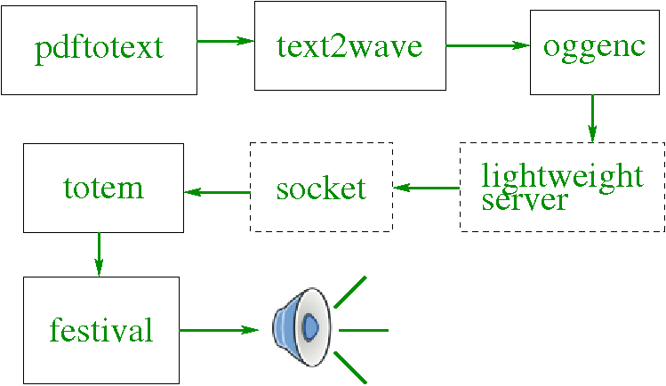
Duh! Approach
Wait, shouldn't that really be a socket?
Huh, I guess it's a Totem plugin …

Slide 10
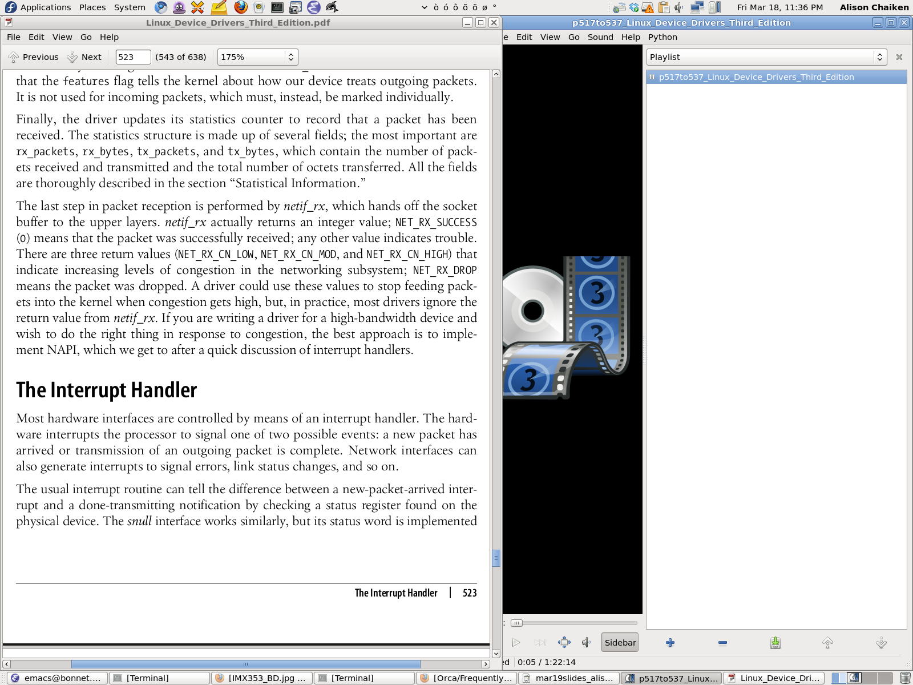
Works, at least mostly.
One of “Embedded Linux's Greatest Hits” playing.

Slide 11
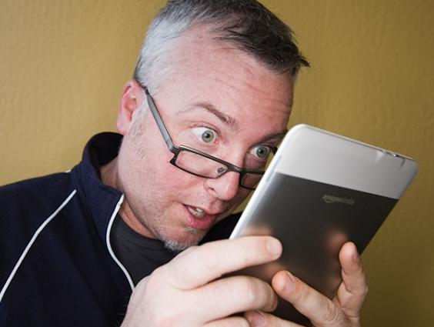
After 10 seconds, it doesn't matter that festival's voices are crap.

Slide 12

Observation:
Can only read docs at 70% of festival default speed.

Slide 13

Sidebars and hidden text present problems.

Slide 14
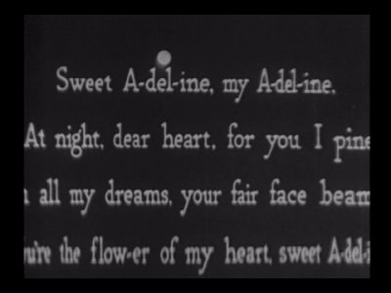
Text highlighting would be killer-app feature.
Implement with xournal? Use XSL-FO?

Slide 15
Moral of the Story
Have been told that KDE accessibility team is “discussing” this approach
How to get started in open source?
  Always scratch your own itch. Always.
  Release early, release often.
  Have fun.

