Slide 1

systemd, the modern Linux service and resource manager
Alison Chaiken
Sept. 8, 2015

Slide 2
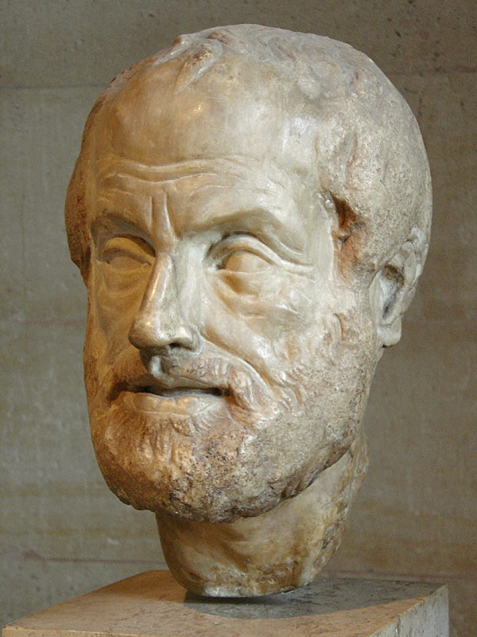
Philosophy of systemd
Extract duplicate functionality from daemons and move it to systemd core or kernel.
Replace /etc scripts with declarative config files.
Expose newer kernel APIs to userspace via a simple interface.

Slide 3
systemd is:
modular;
asynchronous and concurrent;
described by declarative sets of properties;
bundled with analysis tools and tests;
supplied with a fully language-agnostic API.

Slide 4
init.d scripts ⇒ systemd unit properties
Unit's action and parameters: ExecStart=
Dependencies: Before=, After=, Requires=, Conflicts= and Wants=.
Default dependencies:
  Requires= and After= on basic.target;
  Conflicts= and Before= on shutdown.target.
Types of unit files: service, socket, device, mount, scope, slice, automount, swap, target, path, timer, snapshot

Slide 5

Example: Automotive Message Broker
From /lib/systemd/system/ambd.service:
# ambd systemd service unit file
[Unit]
Description=Automotive Message Broker
After=syslog.target
[Service]
Type=dbus
BusName=org.automotive.message.broker
ExecStart=/usr/bin/ambd
[Install]
WantedBy=multi-user.target

Slide 6
Example: Make the gdp-hmi-controller only start when weston is ready
From: Jonathan Maw <jonathan.maw@codethink.co.uk>
[ . . . ]
--- /dev/null
+++ b/recipes-demo-hmi/genivi-demo-platform-hmi/gdp-hmi-launcher2/StartLauncher.path
+[Unit]
+Description=GENIVI Start Launcher when weston is ready
+Requires=weston.service
+After=weston.service
+[Path]
+PathExists=/var/run/user/0/wayland-0

Slide 7

sysVinit runlevels ≈ systemd targets
Targets are synchronization points.
Check /lib/systemd/system/runlevel?.target symlinks:
  multi-user.target (runlevel 3)
  graphical.target (runlevel 5)
Select boot-target :
  via /etc/systemd/system/default.target symlink;
  appending number or systemd.unit=<target> to bootargs.

Slide 8
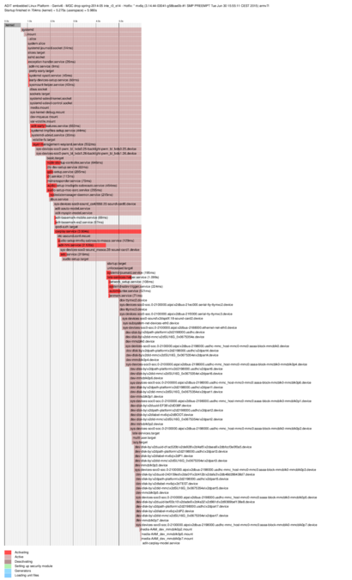
Illustration: systemd-bootchart and custom targets
Courtesy Marko Hoyer, ADIT.

Slide 9
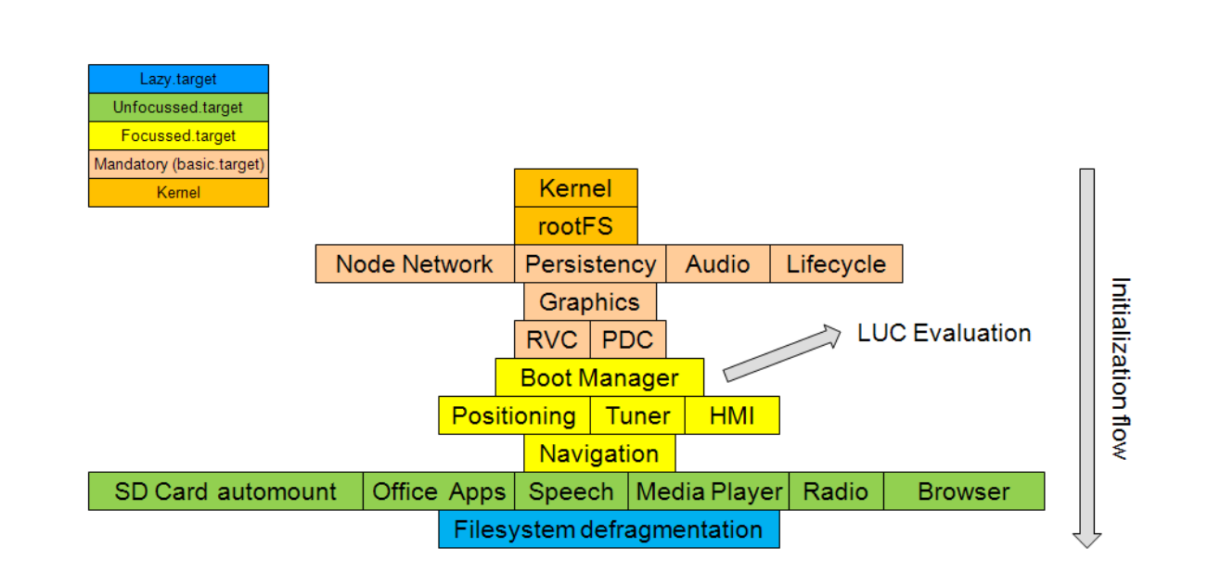
Custom Targets in GENIVI's Lifecycle Management
Node Startup Controller
LUC = Last User Context

Slide 10
Hierarchy of unit files for system and user sessions
Organized into system and user units
/lib/systemd/system: systemd upstream defaults for system-wide services
/etc/systemd/system: local customizations by override and extension
/lib/systemd/user: systemd's upstream defaults for per-user services
$HOME/.local/share/systemd/user for user-installed units
'drop-ins' are run-time extensions

Slide 11
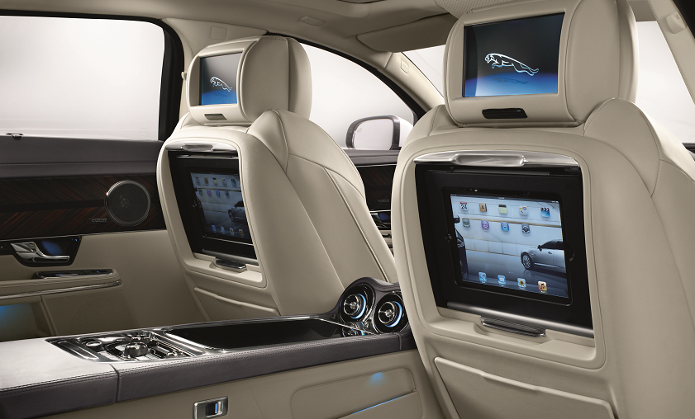
Illustration:Tizen Multi-user system
Source: Dominig ar Foll, “Tizen 3 IVI Architecture Multi User App FW”, FOSDEM 2014

Slide 12
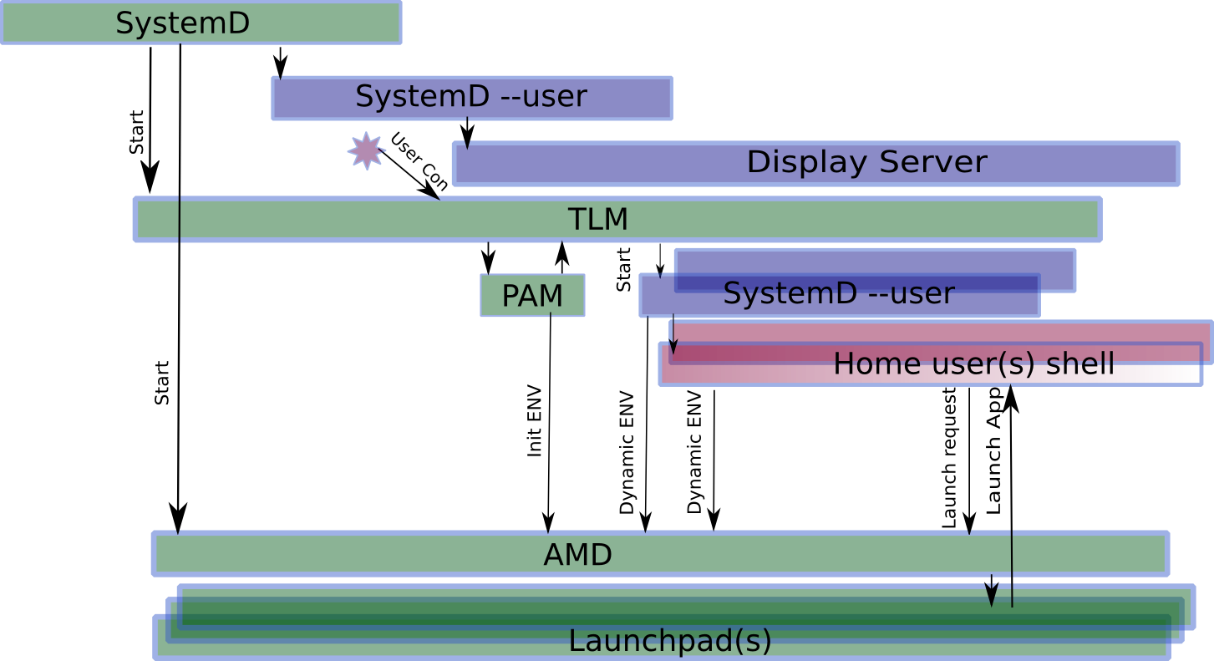
Tizen Login Manager and User Sessions
Source: Dominig ar Foll, “Tizen 3 IVI Architecture Multi User App FW”, FOSDEM 2014

Slide 13
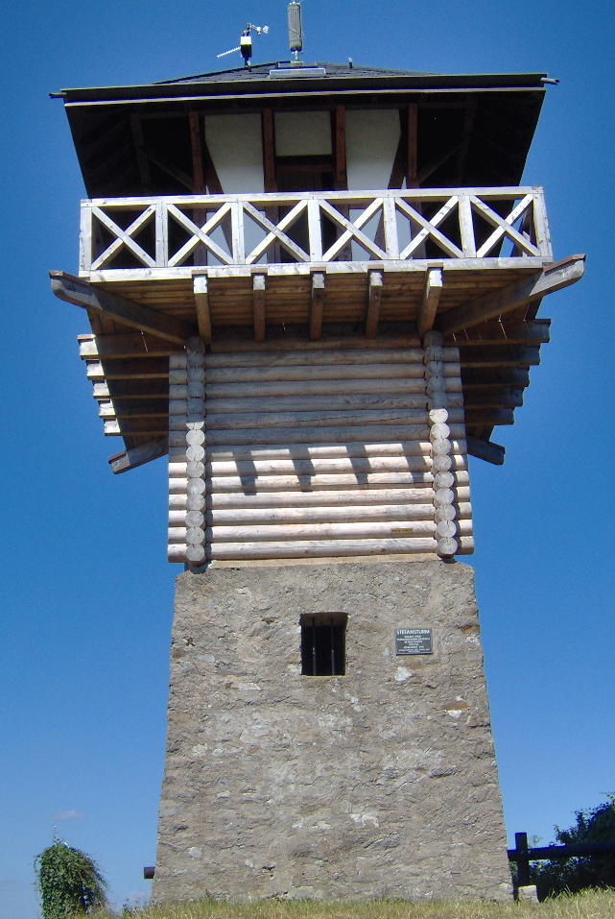
using the systemd journal
Easily pushed to a remote.
Can be cryptographically 'sealed'.
Configurable max size and rotation.
Simple log-reading tools are scriptable:
journalctl -xn
journalctl -p err
journalctl -u cron
journalctl -o json-pretty
systemctl status
systemctl is-failed bluetooth
systemctl --failed

Slide 14

Both systemd journal and DLT:
are modular and extensible.
support pushing data to AF_INET socket.
can share data with legacy syslog.
natively output binary formats.
→ Linking systemd and DLT involves:
  translating binary formats;
  handshaking;
  synchronization.
Performed by remote?

Slide 15
simplifies access to kernel's security, resource and watchdog controls
Including Capabilities, Watchdog, Cgroups and kdbus (still a 'coming attraction')
Kernel features configurable via simple ASCII options in unit files.
Encourages creation of system policies via unit templates.

Slide 16
granular resource control: systemd and cgroups
cgroups: a kernel-level mechanism for allocating storage, memory, CPU and network.
slices are groups of daemons whose resources are managed jointly.
systemd scopes are resultant groups of user processes.
Can set BlockIOWeight, IOSchedulingPriority, OOMScoreAdjust, CPUShares, MemoryLimit …
Tomorrow: “An introduction to Control Groups”

Slide 17
systemd and security: granular encapsulation via kernel's capabilities
CapabilityBoundingSet
PrivateTmp, PrivateDevices, PrivateNetwork
JoinNamespaces
ProtectSystem (/usr and /etc), ProtectHome
ReadOnlyDirectories, InaccessibleDirectories
systemd-nspawn: systemd's native containers

Slide 18

systemd's watchdog support
Provides simple configuration of soft or hard watchdogs.
RuntimeWatchdogSec sets a timer for petting the dog.
ShutdownWatchdogSec sets a timer to force reboot if shutdown hangs.

Slide 19
Summary
Adaptation to systemd requires considerable thought.
Uniform dependency language is attractive.
Managing resources, security and and watchdogs is potentially simplified.
Backwards compatibility eases transition, but project moves quickly.

Slide 20
Resources
Man pages are part of systemd git repo.
freedesktop.org: systemd mailing list archives and wiki
Poettering's 0pointer.de blog
➟At wayback machine: “Booting up” articles
Neil Brown series at LWN
➟Fedora's SysVinit to systemd cheatsheet
Poettering's 'What's new' talk from FOSDEM 2015
Josh Triplett's Debconf talk video
Linux Action Show interviews with Mark Shuttleworth and Lennart Poettering
A bunch of videos and slides linked at my website

Slide 21
resource utilization of systemd itself
systemd-211 in Poky includes 17 packages = 8 MB.
systemd-219 builds 90 MB of executables (not all needed).
minimal build = systemd, udevd and journald.
Memory (RSS) of fully featured build: ≈9 MB; minimum build ≈5 MB.
Features added/removed via './configure'.

