Slide 1
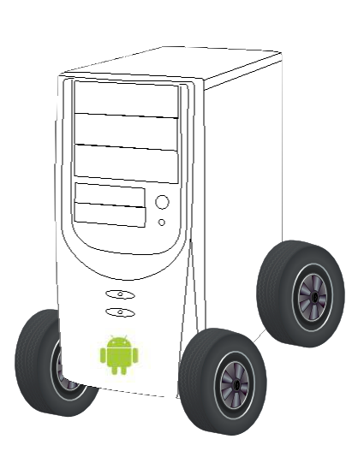
Tier X and the coming of the whitebox car
Alison Chaiken
member, technical staff
Embedded Software Division
Mentor Graphics
Fremont CA USA

Slide 2
Agenda
Motivation
Impact of new kinds of smaller players
Risks of the new ecosystem
Policy and legal developments
Implications for automotive industry

Slide 3
Linux makes the whitebox car inevitable
Cars are now consumer electronics.
CE devices are identical slabs differentiated only by SW.
Resisting SiliValley has not worked well for entertainment industry.
Nokia laughed when Apple announced a phone.
Google will sell a “Nexus”-branded autonomous vehicle.
GENIVI stems from OEM wish to change supplier relationships.
  Watch what you wish for.

Slide 4
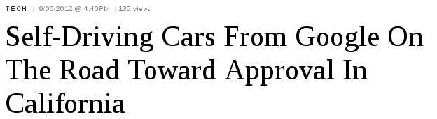
Autonomous Vehicle Legislation in U.S.
Enacted at some level in Nevada, Florida.
Introduced as a bill in Hawaii, New Jersey and Oklahoma.

Slide 5
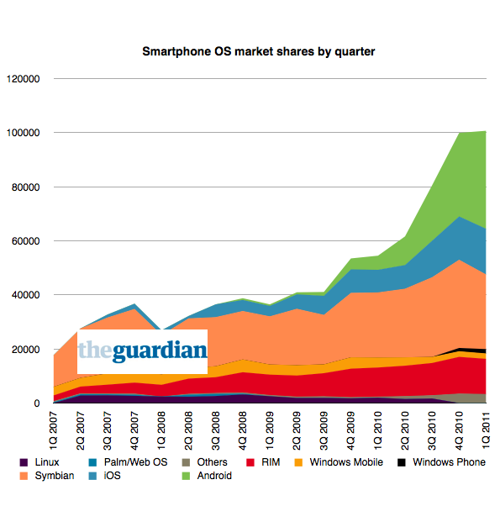
Disruption in mobile: a model for automotive?
4 kinds
of Unix!
guardian.co.uk/technology/blog/2011/may/19/smartphones-mobilephones

Slide 6
Tier X: “Start-ups” are different
Venture-funded ones look for “big score.”
Insurance companies are making big investments.
Telematics and data mining are hot.
Stanford and U.C. Berkeley innovation engines are onto IVI.
Ride- and car-sharing and EV startups are active.

Slide 7






















Bay Area IVI participants: players without logos matter!
Tier X: KleenSpeed, Savari, JustMiles, CloudCar,
JustShareIt, RideJoy, UnifyCar, Phil Sadow . . .

Slide 8
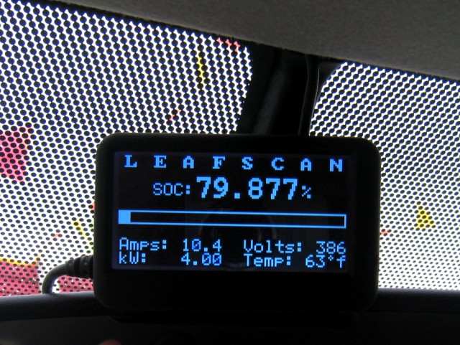
Case study: Nissan, Phil Sadow and the BayLeafs
A win for entrepreneur, owners and Nissan.

Slide 9
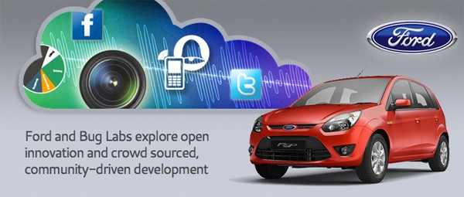
Tier X outreach: Ford's OpenXC
Indian launch; plans for further roll-out unclear.

Slide 10
Hot area: ride- and car-sharing start-ups
Well-established (Zimride, JustShareIt, carpooling.com) and new entrants (UnifyCars, Ridejoy, DriveNow . . . )
  Not just cars: trucks, boats . . . BMW-funded ParkAtMyHouse.
  Vehicles have CAN-bus driver monitors and/or lock overrides installed.
Car-disinterested urban youth with lower means find sharing appealing.
First augur of “Cars as a Service” – “whistle cars”.

Slide 11
Start-up to watch: CloudCar
$ whois openautomobilealliance.org
Domain Name:OPENAUTOMOBILEALLIANCE.ORG
Created On:16-Apr-2012 20:18:05 UTC
Registrant Name:Albert Jordan
Registrant Organization:CloudCar
Registrant City:Los Altos
Registrant State/Province:CA
Rumor: new project of Andy Rubin, serial entrepreneur.

Slide 12

meetup.com group
Silicon Valley way: free membership, free food, more active than local SAE and IEEE Vehicular Technology groups.
Huge interest: over 430 members joined since Oct. 2011.
Monthly technical presentations:
  Stanford (CARS), Tata Consultancy Services (ADAS), GM (MirrorLink), Mentor Graphics (GENIVI), Intel (Tizen), Nissan BayLeafs (entrepreneur-owners' group), Ford (OpenXC), start-up panel discussion, Savari Networks (V2V and V2I), GM (Android SDK) . . .
Sponsored by ICS, Intel and Mentor Graphics.

Slide 13
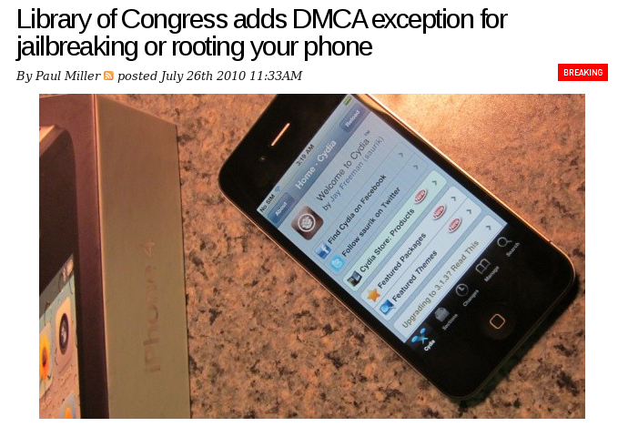
Watershed in Expectations about Electronic Devices

Slide 14
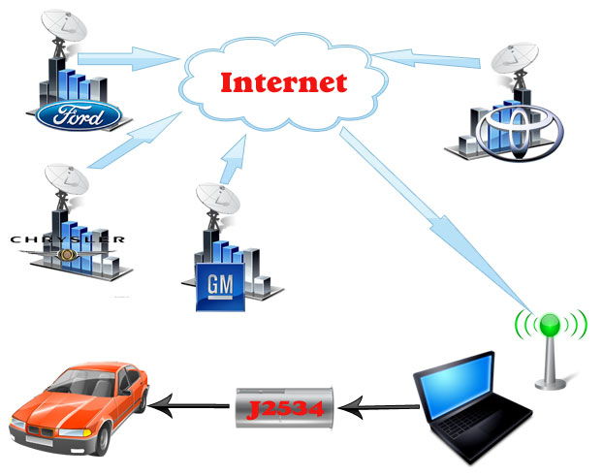
Massachusetts “Right to Repair” made law, 8/2012
“Each manufacturer of motor vehicles [ . . . ] shall make available for purchase by owners and independent repair facilities all diagnostic repair tools incorporating the same [ . . . ] capabilities that such manufacturer makes available to its dealers.”

Slide 15

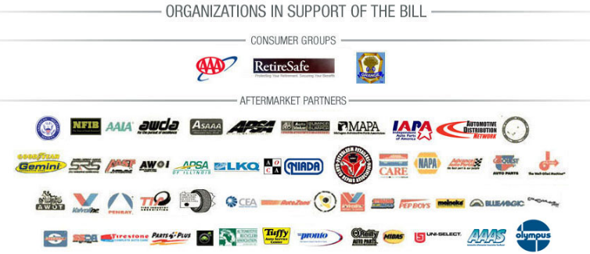
Federal U.S.
I'm once again a cosponsor of the Motor Vehicle Owners Right to Repair Act in the 112th Congress. . . . The Act has been referred to the House Committee on Energy and Commerce . . . Sincerely, Anna G. Eshoo

Slide 16
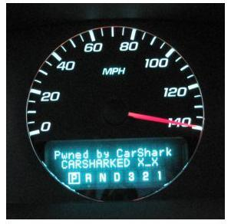
Linux best practices can help with security
UCSD, UWa, Rutgers: http://autosec.org/
but they can't modernize CAN bus design.

Slide 17
Downside: Malware and simply obnoxiousware
Traffic-law evasion software is an inevitability.
  “radar detection” made simple by siren indication within
  the J2735 emergency vehicle alert message?
Dangerous ideas: augmented reality games for drivers.
  Terrible idea in urban areas and for teens.
  What about convoys of long-haul truckers on lonely highways?

Slide 18
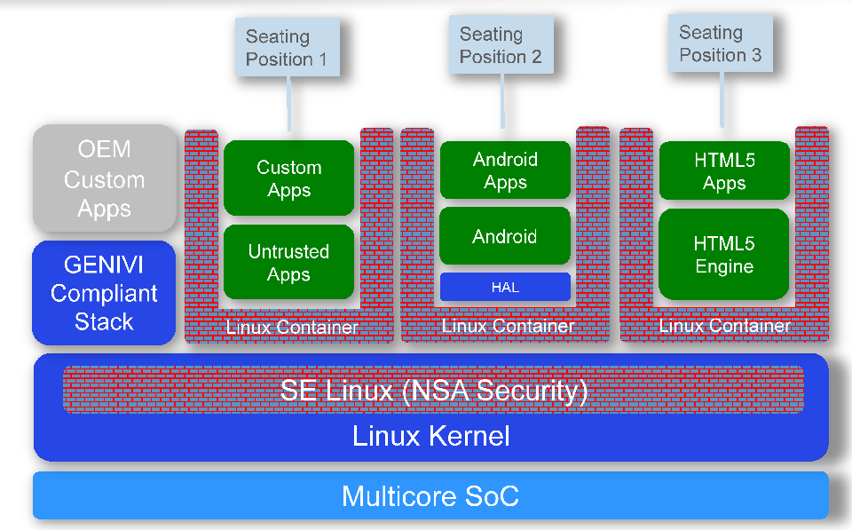
Allow arbitrary user-selected apps in containers?
Source: Iisko Lappalainen, MontaVista, ELC 2011
Help is on the way from GENIVI Alliance.

Slide 19
Trusted computing: a hot topic in Linux
Microsoft mandates a UEFI key-signing bootloader.
  Controversial due to new post-sale vendor lockdown.
  Different work-arounds by RedHat (pesign), Canonical and OpenSUSE.
Automotive modifications are traditionally lightly regulated, except:
  Emissions, anti-theft and safety systems.
  Wireless comm (DSRC V2V and V2I) standards are in USDoT RFC stage.
Principle: Systems that implement a standard API and pass a specified suite of safety tests are deemed safe.

Slide 20
Proposal: Extend Vehicle Safety Inspection to Software?
Any vehicle that passes a new safety and security inspection suite (to include at least black-box testing, static code analysis and coverage tools) is eligible for registration.
Principle: specify behavior of safety and security systems,
not underlying implementation details.

Slide 21
Influential Doctorow's “trusted platform modules”
Cory Doctorow is a renowned science fiction author and on-line rights advocate.
  Principal of well-read BoingBoing and Electronic Frontier Foundation Fellow.
Doctorow is a newly convinced advocate (Long Now Foundation, Aug 2012) of trusted computing for embedded.
Specifically cites automotive example.
[VIDEO CLIP]

Slide 22
Linux is the major force behind vehicle commodification
Open source ⇒ loss of control.
Start-up activity is unpredictable change agent.
Controversy over R2R, locked bootloaders is nascent.
Autonomous cars are harbingers of SW domination.
Globalization and push to lower costs cannot be curtailed.

Slide 23
Summary
Linux and globalization will drive commodification.
Tier X start-ups, consumer movements play major roles.
Legal and regulatory situations are evolving.
Identical hardware platforms differentiated by SW are inevitable.
“Cars as a Service” is the end-point.
Finally, a call to action . . .

Slide 24
Call to action
Raise awareness among OEMs' main customers: ask dealer salespeople, “What software does this car run?”

Slide 25
Why Automotive Linux needs start-ups: localization
Need goes beyond varying fonts, maps and comms standards.
  Use cases for cars vary hugely, even within one country.
Average Chinese new car buyer has been driving for 3 years.
  “Tutorial” driver mode for new drivers?
“Co-operative navigation” traffic routing (ETSI TR 102 638) naturally relies on a combination of local knowledge and real-time information

Slide 26
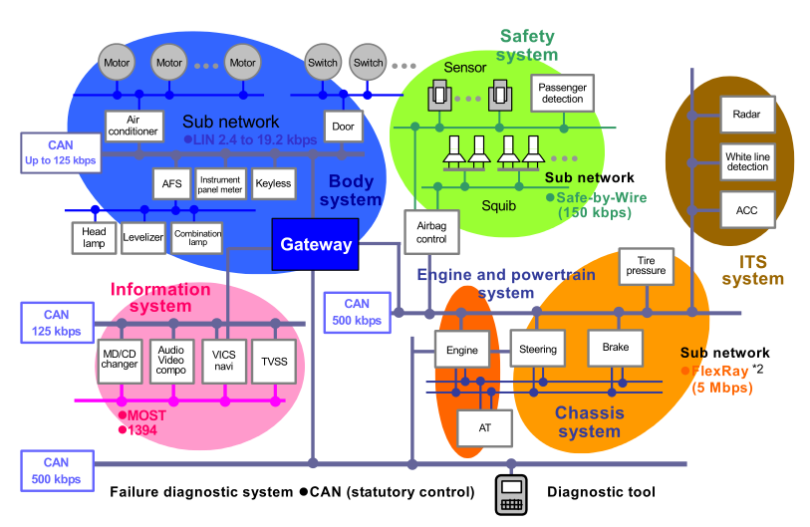
Gateways pass information freely among subnets
Wireless!
Source: Renesas' website

Slide 27
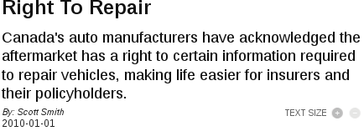
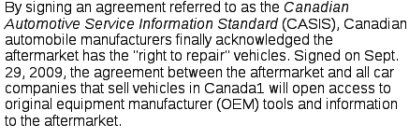
Canadian R2R since 2009

