Slide 1
Why Cars Need Free Software
Alison Chaiken, she-devel.com, March 24 2012
“no data are recorded by the EDR under normal driving conditions and no personal data . . . are recorded. However, other parties, such as law enforcement, could combine the EDR data with the type of personally identifying data routinely acquired during a crash investigation.”
Source: Insurance Institute for Highway Safety, http://www.iihs.org/research/qanda/edr.html

Slide 2
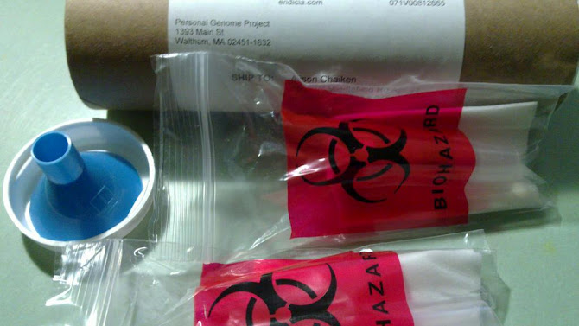
Publishing my own source with Personal Genome Project
Feel free to fork and improve me!

Slide 3
Same Old Topics
reappear on a new platform.
Security
Privacy
Personal empowerment

Slide 4
Our transportation system is
Dangerous
Hella annoying
Loud!!!
Time-wasting
Polluting
because until now individuals had little power to change it.
Goal: driver empowerment
Now: driver distraction
Goal: driver augmentation

Slide 5

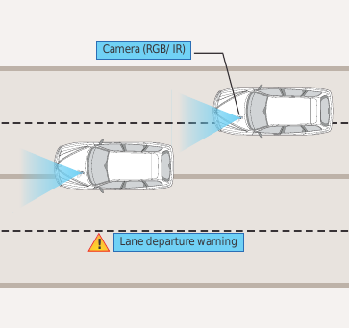
What is “in-vehicle infotainment”?
Courtesy Tata Consultancy Services
What “infotainment” calls to mind
What IVI could be

Slide 6
Status of Automotive Free Software
Manufacturer | Confirmed Operating system
Fiat-Chrysler Blue&Me (500, Delta), Kia Uvo, BYD | Microsoft Windows Embedded Automotive
Ford (all?) | MyTouch/Sync-Microsoft; OpenXC-Android
General Motors/Cadillac User Experience | MontaVista's GNU/Linux
Geely (China); Hawtai (China) | GNU/Linux: Moblin (MeeGo predecessor)
Renault R-Link | Android
Honda (Accord, Odyssey, Pilot), Audi, BMW (7-series and M models), Chrysler, Daewoo, GM (OnStar), Hyundai, Land Rover, Porsche, Saab (9-3) Renault (SM7) | QNX
Linux Foundation members: Toyota, Pelagicore, Symbio, Tieto
Automotive Linux Summit 2011 presenters: Toyota, Nissan, BMW
MeeGo Conference 2011 presenter: Nissan
Volkswagen has a pilot using Maemo (GNU/Linux).

Slide 7
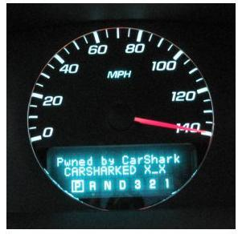
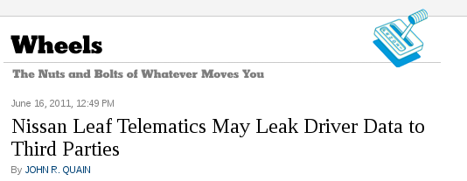
Current Automotive Security Situation is Shaky
Source: NY Times
Source: http://www.autosec.org/

Slide 8
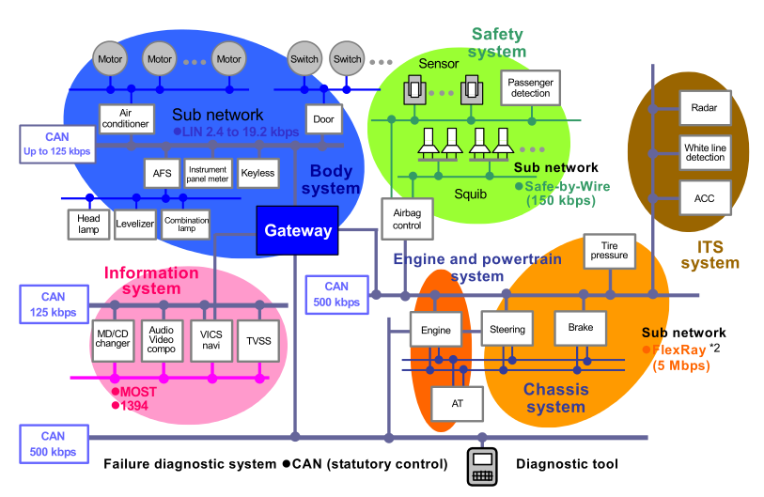
Gateways pass information freely among subnets
Wireless!

Slide 9
Published UWa/UCSD automotive exploit
http://www.autosec.org/
Use Gnu Radio to break in via wireless tire pressure sensors.
Discover all of 8-byte codes by “fuzzing” attack.
Or simply watch bus traffic to get many.
Brakes locked and driver controls disabled via use of codes or simple DOS attack.
But let's not make instrumenting our own vehicles illegal, too!

Slide 10
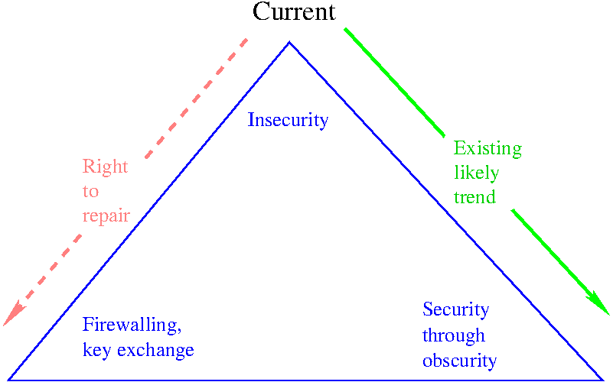
Free culture movement needs to get involved in automotive

Slide 11
How to fix automotive security
Automotive network protocols genuinely do need to be hardened.
Packet filtering, firewalls, cryptographic signing and Android “paranoid network” exist.
Any approach that posits the necessity to invent new technologies is wrong.
If NHTSA promulgates new rules, EFF, FSF, SFLC should participate!

Slide 12
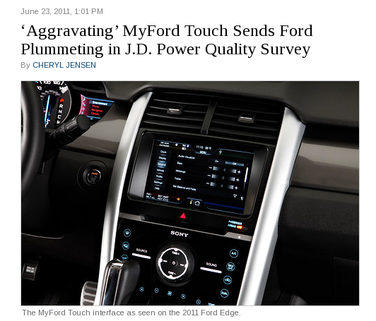
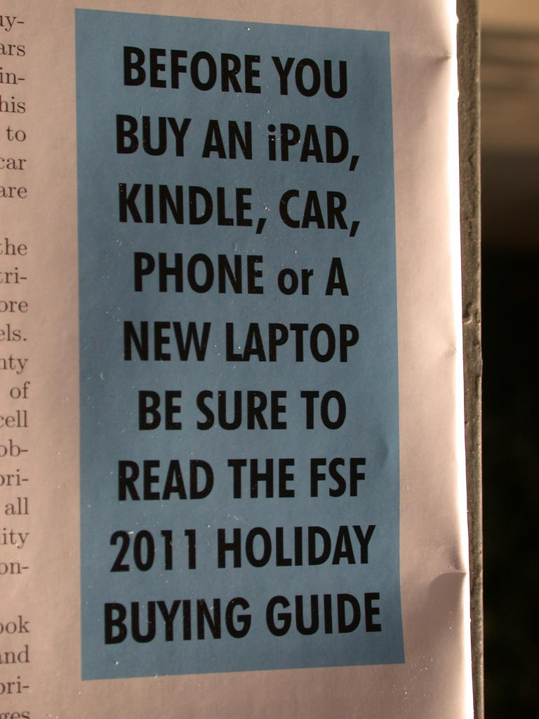
FSF is on the vanguard again
New York Times, June 23 2011

Slide 13
Ongoing mobile data privacy battle
“For crashes that don't involve litigation, especially when police or insurers are interested in assessing fault, insurers may be able to access the EDRs in their policyholders' vehicles based on provisions in the insurance contract requiring policyholders to cooperate with the insurer. However, some states prohibit insurance contracts from requiring policyholders to consent to access.”
Source: Insurance Institute for Highway Safety,
http://www.iihs.org/research/qanda/edr.html

Slide 14
Privacy Guarantees in Car Environment
JM1BK3437512345678
Vehicle Identifier Section: a particular car
Proposal: encrypt the Vehicle Identifier Section of the VIN so that it cannot be remotely transmitted.
Require “apps” to request access to VIS.

Slide 15
Motor Vehicle Owners Right to Repair Act
… requires vehicle manufacturers to provide the same service information to independent shops that they offer to their franchised dealers. Under current law, auto manufacturers protect their proprietary vehicle repair information, requiring consumers to bring their cars to the dealer for expensive repairs. The bill allows independent mechanics to compete fairly with dealerships in providing repair and maintenance services …
Source: Congresswoman Anna Eshoo

Slide 16
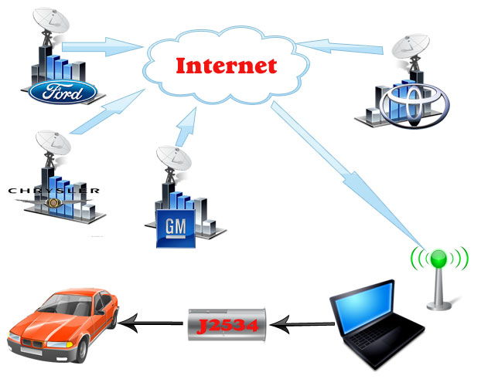
MA “Right to Repair” Initiative 2012

Slide 17
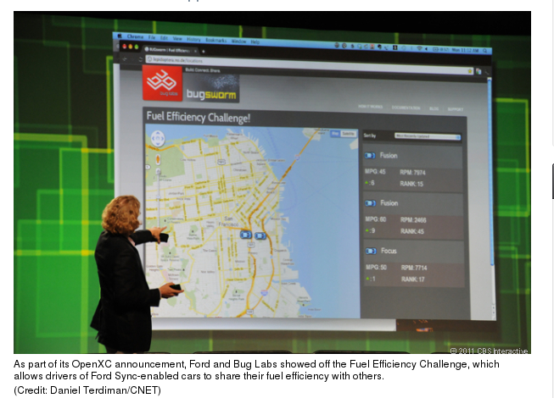
Vehicle data example: Ford's Fuel Efficiency Challenge
Some owner-empowering vehicle-data-mining ideas: http://tinyurl.com/7oegrj7

Slide 18
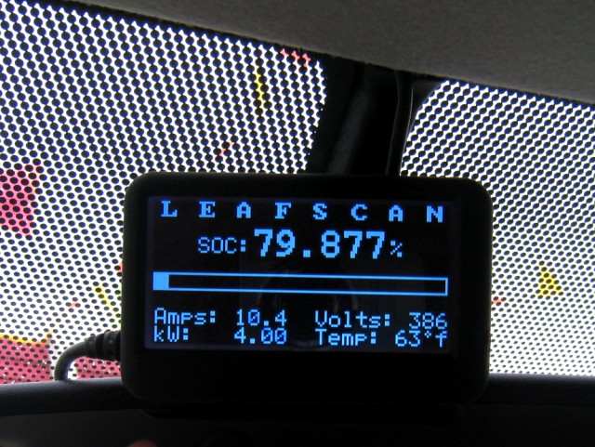
Quality community-sourced hardware and software already available
http://tinyurl.com/7wngdsj, http://tinyurl.com/7ttz24h

Slide 19
CFR PART 563—EVENT DATA RECORDERS
“Each manufacturer of a motor vehicle equipped with an EDR shall ensure by licensing agreement or other means that a tool(s) is commercially available that is capable of accessing and retrieving the data stored in the EDR that are required by this part. The tool(s) shall be commercially available not later than 90 days after the first sale of the motor vehicle for purposes other than resale.”
source: NHTSA website

Slide 20
What does it mean to “own” data?
The creator of the device that generates data that I own must provide, as a bare minimum
“any methods, procedures, authorization keys, or other information required” to read the data
and
“information provided [ . . . ] must be in a format that is publicly documented (and with an implementation available to the public in source code form), and must require no special password or key for unpacking, reading or copying.”

Slide 21




Free software community responds to embedded challenges

Slide 22
Summary
Old battles are renewed in new arena.
Proprietary interests will deny device owners access to their data with the excuse of protecting public safety.
Proprietary interests will claim that security by obscurity is better than proven network security standards.
Engineering implementers need the wise counsel of those who understand the Law.

