Slide 1


Automotive Free Software 2013:
“Right to Repair” and Privacy
Alison Chaiken
alison@she-devel.com
Art Kinsman
MA Right to Repair
March 23, 2013

Slide 2
Our transportation system is
Slow
Hella annoying
Dangerous
Noisy
Inefficient
Wasteful
because until now individuals had little power to change it.

Slide 3
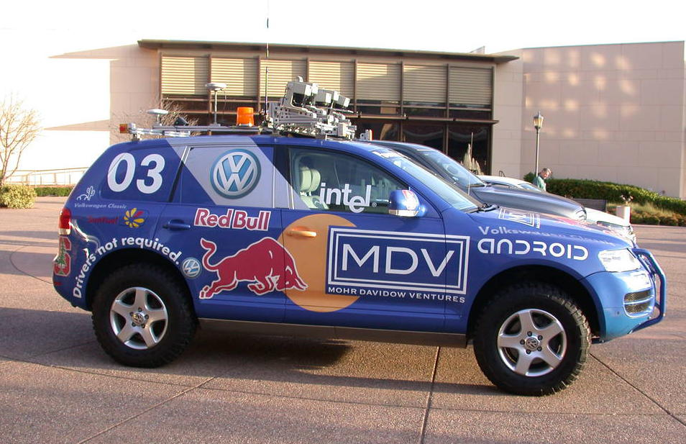
Inevitable end-point: fully autonomous operation
Stanford's Stanley, winner of Second DARPA Grand Challenge

Slide 4
Agenda
State of automotive free software 2013
Event data recorders (EDRs) update
802.11p and privacy
Right to Repair movement
Our community is growing!

Slide 5
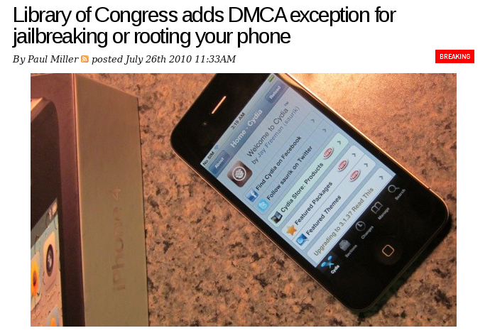
2010: Changing Consumer Expectations

Slide 6

Mar 2013: White House sides with Consumers
“The White House agrees with the 114,000+ of you who believe that
consumers should be able to unlock their cell phones without risking
criminal or other penalties.”

Slide 7
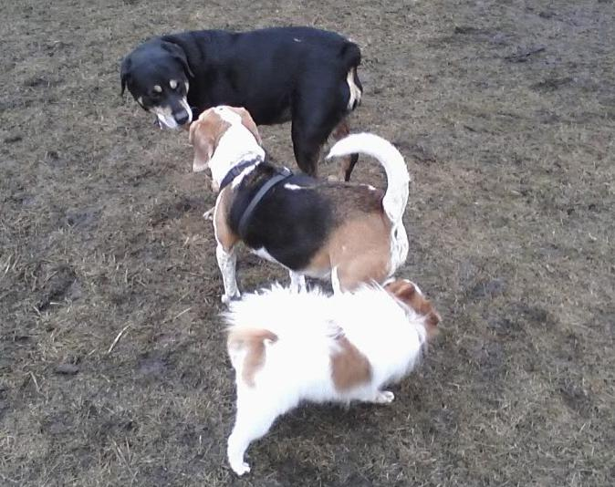
Automakers and Free Software get Acquainted

Slide 8
Current Public Status of Automotive Linux
Carmaker | Confirmed Operating system
Fiat-Chrysler Blue&Me, Kia Uvo | Microsoft Windows Embedded Automotive
Ford (all?) | Microsoft MyTouch/Sync (+ OpenXC Android dongle and SmartPhoneLink)
General Motors “Cadillac User Experience” | GNU/Linux
Geely (China); Hawtai (China) | GNU/Linux: Moblin (MeeGo-Tizen precursor)
Renault R-Link | native Android
Jaguar Land-Rover, Tata, Toyota | Tizen (GNU/Linux)
Honda (Accord, Odyssey, Pilot), Audi (A8L, Q5, A6), BMW (7-series and M models), Chrysler, Daewoo, GM (OnStar), Hyundai, Land Rover, Porsche, Saab (9-3), Renault (SM7), Mercedes (S- and C-class) | QNX
Linux Foundation members: Toyota, Pelagicore, Symbio, Tieto
GENIVI Alliance: 160+ members including 11 “OEMs”

Slide 9

GENIVI Auto Industry Alliance
Goals: reduce lock-in by SW suppliers; reduce cost and TTM.
Methods:
  Promote code reuse via standard interfaces.
  Grow the size of contributor community.
  Focus on middleware: not a distro.
10 Projects with released code; more in pipeline.
Public mailing lists and #genivi on FreeNode.

Slide 10
Features of GENIVI Alliance
Modeled on Apache Software Foundation.
Open development for released projects.
No CLA, but no GPLv3.
Familiar GNU/Linux (git, kernel, systemd, D-Bus, etc.).
Mostly permissively licensed.
Accepts outside patches.
Non-member projects may join (2 have so far).

Slide 11
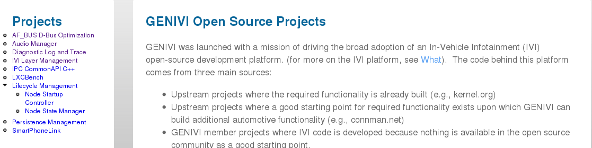
http://projects.genivi.org/

Slide 12
Agenda
State of automotive free software 2013
Event data recorders (EDRs)
802.11p and privacy
Right to Repair movement
Our community is growing!

Slide 13
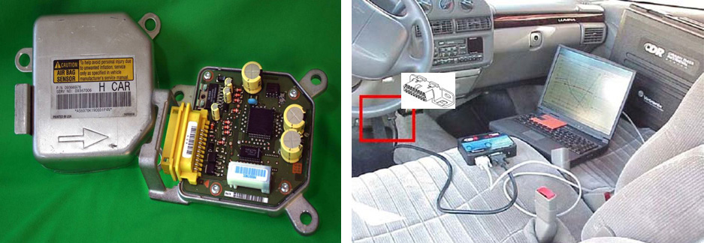
IEEE: EDRs already in 96% of cars
http://spectrum.ieee.org/computing/embedded-systems/the-automotive-black-box-data-dilemma/0#

Slide 14
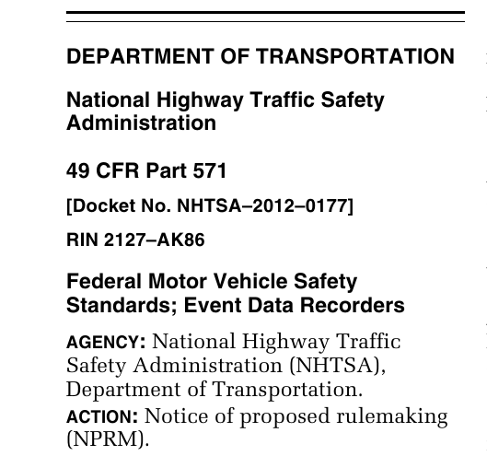
Public comment closed in February; takes force Sept. 2014.

Slide 15

(1) mandate clear statements . . . that EDR data is property of the owner . . .
(2) explicitly prohibit the collection of audio, video, and location data . . .
(3) place a maximum duration on EDR data recording,
(4) require that data . . . be accessible via a published, free,
and public standard . . .
(5) require the inclusion of a connector lockout apparatus . . .

Slide 16
Agenda
State of automotive free software 2013
Event data recorders (EDRs)
802.11p and privacy
Right to Repair movement
Our community is growing!

Slide 17
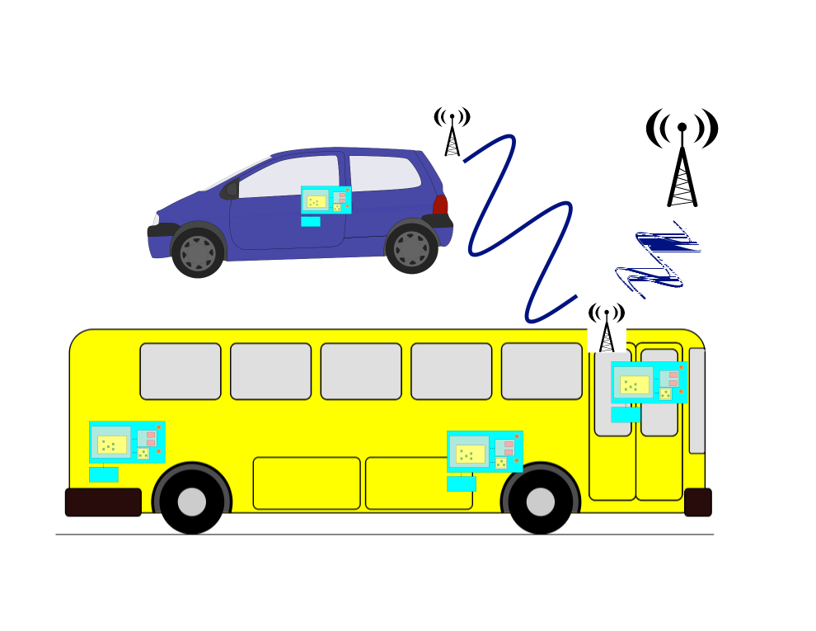
Vehicles are a “network of networks”
V2V
V2I

Slide 18
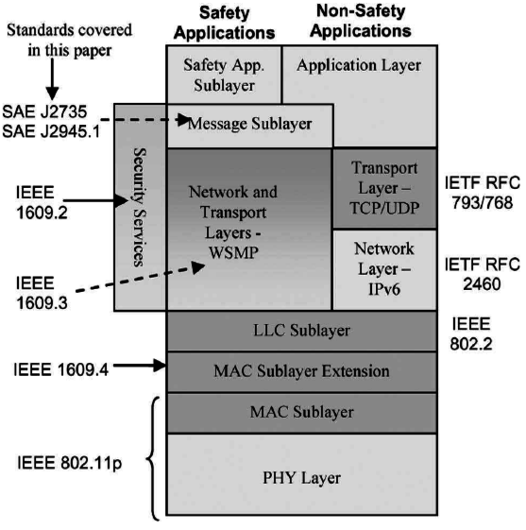
802.11p = Vehicular WiFi
Safety messages via dedicated short-range communication (DSRC) protocol (IEEE 1609)
Allocated spectrum at 5.9 GHz.
New protocols, e.g. DNS Geocasting.
New use cases, e.g. mobile routers
VIN == MAC? or is VIN private?
Field trials underway in Ann Arbor, MI and Germany (simTD)
J.B. Kenney,
Toyota ITC,
Proc. IEEE 99,
2011.

Slide 19
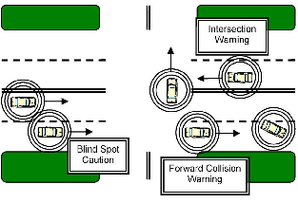
IEEE: DSRC and Basic Safety Message
Collision avoidance is primary motivation.
USDoT had RFC on PKE for V2X in 2012.
How to issue revocable keys w/o trackability?

Slide 20
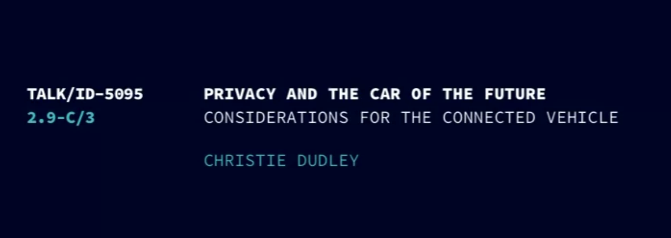
Must watch: Chaos Computer Club 2012 video
Christie Dudley, Santa Clara University Law School
http://tinyurl.com/crbazg9

Slide 21
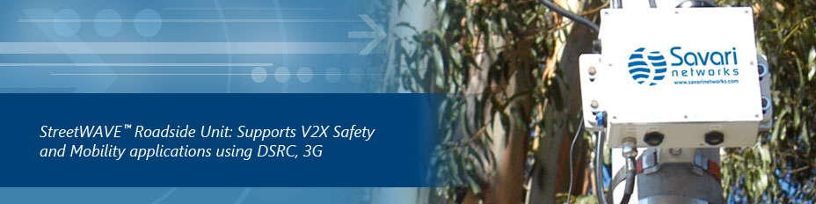
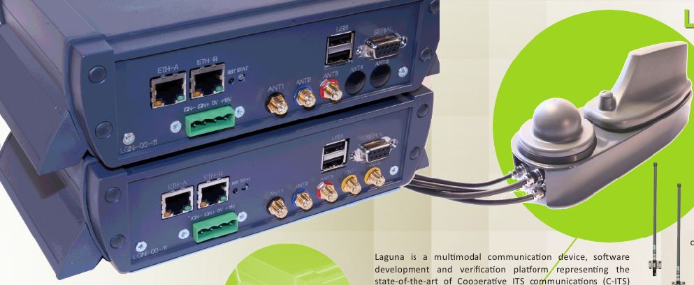
802.11p V2X routers in the wild
Linux-based
BSD-based?
Commsignia

Slide 22
Agenda
State of automotive free software 2013
Event data recorders (EDRs),
802.11p and privacy
Right to Repair movement (Brian Hickey)
Our community is growing!

Slide 23

MA “Right to Repair” is now Law
Key provisions of Massachusetts Right to Repair bill law include:
Immediately, car companies are required to make available to independents on “fair and reasonable terms,” the same tools, software, and repair information that they make available to dealers.
By model year 2018 (translates into 2017) manufacturers required to establish web sites or “clouds” that will contain the same information and software that dealers have access to as part of their proprietary tools.
Source: Aaron Lowe, Automotive Aftermarket Industry Association

Slide 24
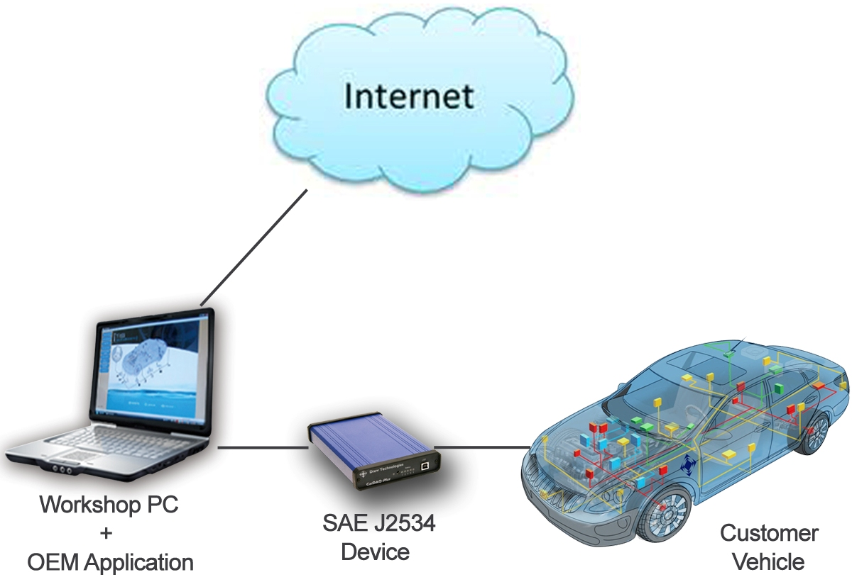
2018 Model Year System
Source: Aaron Lowe, Automotive Aftermarket Industry Association

Slide 25
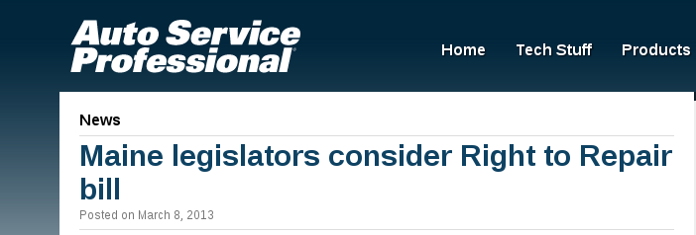
U.S. legislation still stuck in committee
but states, Canada are providing leadership.

Slide 26
Agenda
State of automotive free software 2013
Event data recorders (EDRs)
802.11p and privacy
Right to Repair movement
Our community is growing!

Slide 27
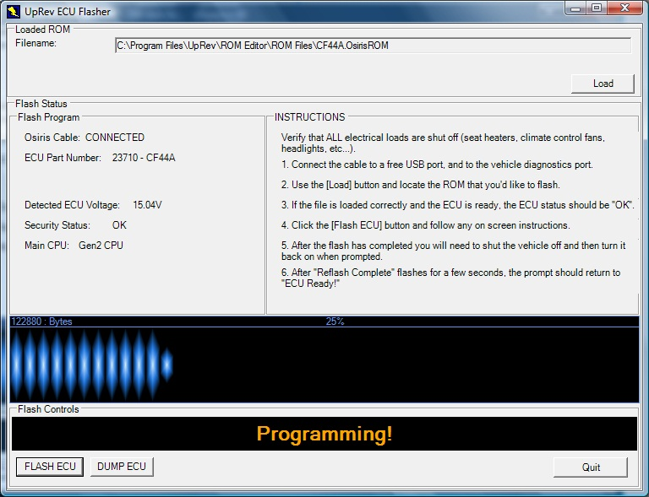
Car hackers vastly outnumber geeks
Many testers, bug reporters . . . if Free Software reaches out!

Slide 28






Free software has new allies
+

Slide 29
Summary
Increasing uptake of car SW with GPLv2 and permissive licenses.
  Linux Collaboration Summit panel discussion on GPLv3 (?)
New technologies can make us safer, but . . .
  EFF and Electronic Privacy Information Center are speaking up on EDRs.
  802.11p (V2V and V2I) and automotive LTE on horizon.
  Autonomous vehicles foreseeable.
Era of R2R is upon us.
Promise and peril continue for free car software.

Slide 30
Resources
Christie Dudley's Chaos Computer Club 802.11p and DSRC talk
Automotive Aftermarket Industry Association
Massachusetts Right to Repairand national organization
IEEE Spectrum on EDRs, EFF on EDRs,NHTSA EDR press release
GENIVI Alliance
IETF-ITS mailing list, Thinking Highways, Telematics News
Automotive Linux Summit 2013 Japan (May) and U.K. (October)
Silicon Valley Automotive Open Source group

Slide 31
Question: Proprietary Standards and Free Software
Many automotive standards (ISO, SAE, etc.) are available only on a fee basis.
May I freely distribute a library or device driver I write that implements a compatible interface to a standard I purchase?
Does Google-Oracle API-copyright case apply?
What does SMB-Samba precedent teach?

Slide 32

600+-member Silicon Valley Automotive Open Source Group
FAIF as well as FAIB
April speaker: Christie Dudley on PKE and privacy in cars
May speaker: Edward Durney on modularity and whole-system design methodologies for EVs
June speaker: Nate Cardozo of EFF on Event Data Recorders (tentative)

Slide 33

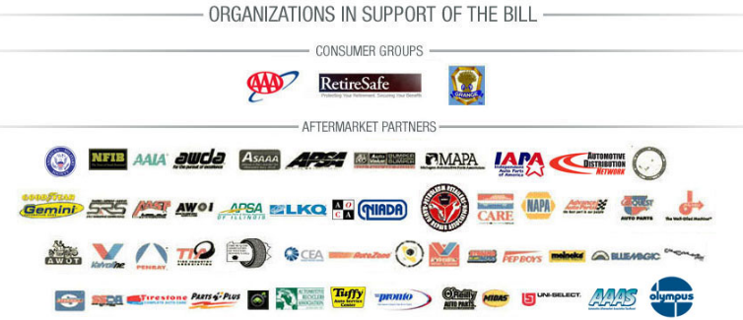
Federal U.S.
I'm once again a cosponsor of the Motor Vehicle Owners Right to Repair Act in the 112th Congress. . . . The Act has been referred to the House Committee on Energy and Commerce . . . Sincerely, Anna G. Eshoo

