Slide 1
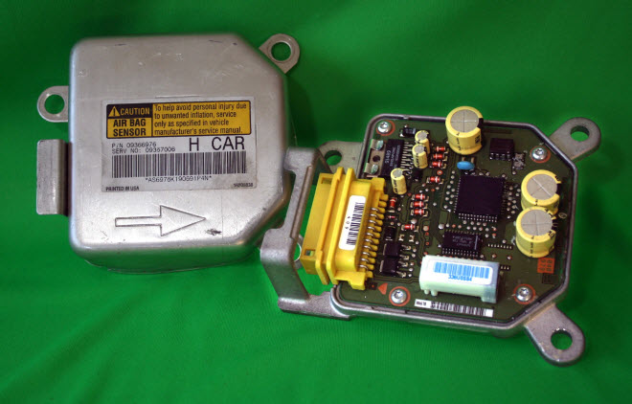

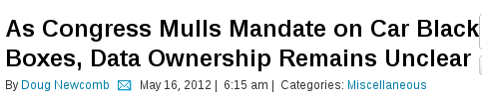
From Driver Distraction to Driver Augmentation:
Open Source in Cars
Alison Chaiken, she-devel.com

Slide 2
Our transportation system is
Dangerous
Hella annoying
Loud!!!
Time-wasting
Polluting
because until now individuals had little power to change it.
Goal: driver empowerment
Now: driver distraction
Goal: driver augmentation

Slide 3

Same old problems, new platform
Us!
Security
Privacy
Personal empowerment
Who will make the cool solutions?

Slide 4

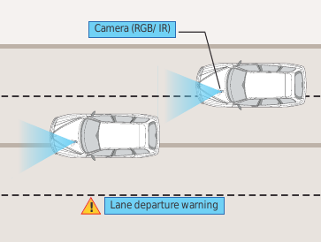
Do we need “in-vehicle infotainment”?
What Drivers Need
BigCo's “infotainment”
Courtesy Tata Consultancy Services

Slide 5
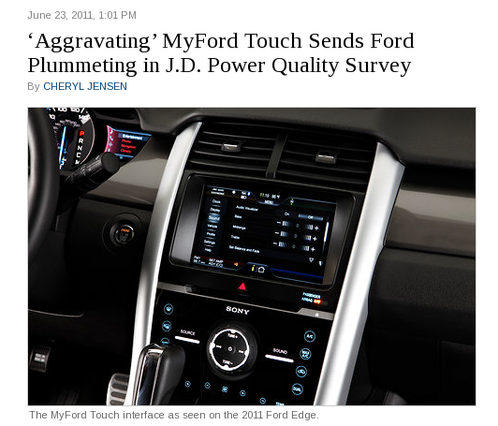
“Patch Tuesday” hits Cars?
New York Times, June 23 2011

Slide 6
Status of Automotive Software
Manufacturer | Confirmed Operating system
Fiat-Chrysler Blue&Me (500, Delta), Kia Uvo, BYD | Microsoft Windows Embedded Automotive
Ford (all?) | MyTouch/Sync-Microsoft; OpenXC-Android
General Motors/Cadillac User Experience | MontaVista's GNU/Linux
Geely (China); Hawtai (China) | GNU/Linux: Moblin (MeeGo predecessor)
Renault R-Link | Android
Honda (Accord, Odyssey, Pilot), Audi, BMW (7-series and M models), Chrysler, Daewoo, GM (OnStar), Hyundai, Land Rover, Porsche, Saab (9-3) Renault (SM7) | QNX
Linux Foundation members: Toyota, Pelagicore, Symbio, Tieto
Automotive Linux Summit 2011 presenters: Toyota, Nissan, BMW
MeeGo Conference 2011 presenter: Nissan
Volkswagen has a pilot using Maemo (GNU/Linux).

Slide 7
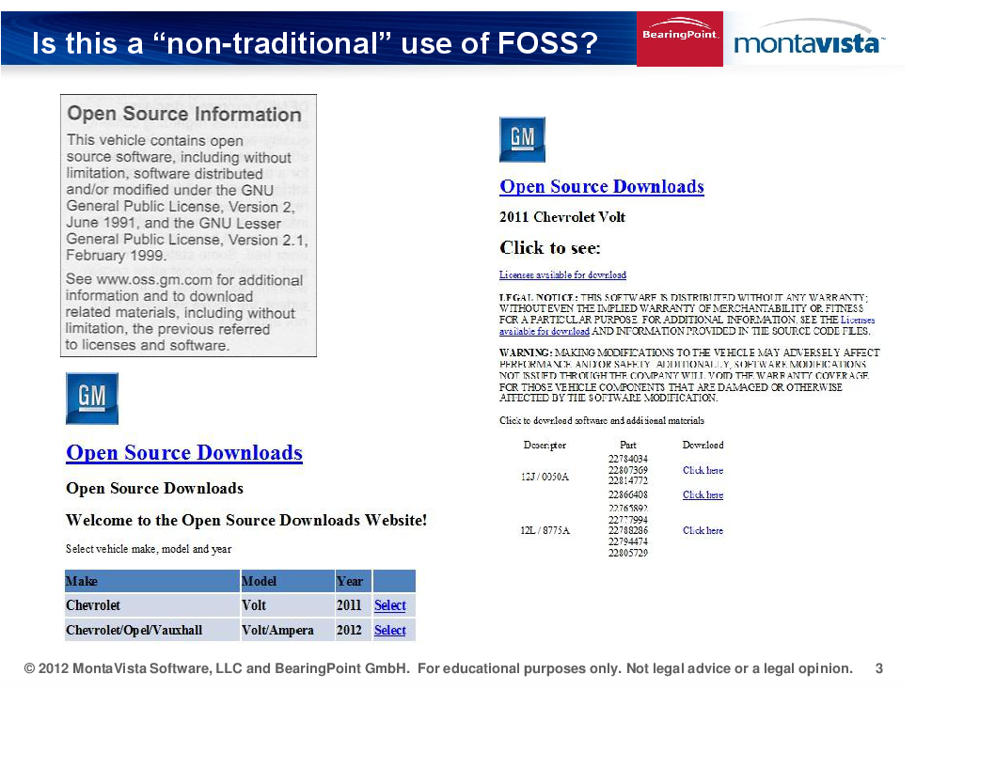

Slide 8
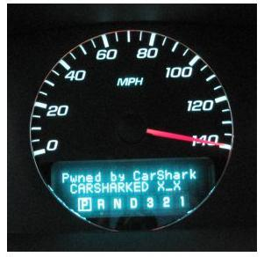
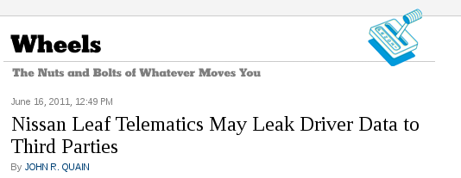
Current Automotive Security Situation is Shaky
Source: NY Times
Source: http://www.autosec.org/

Slide 9
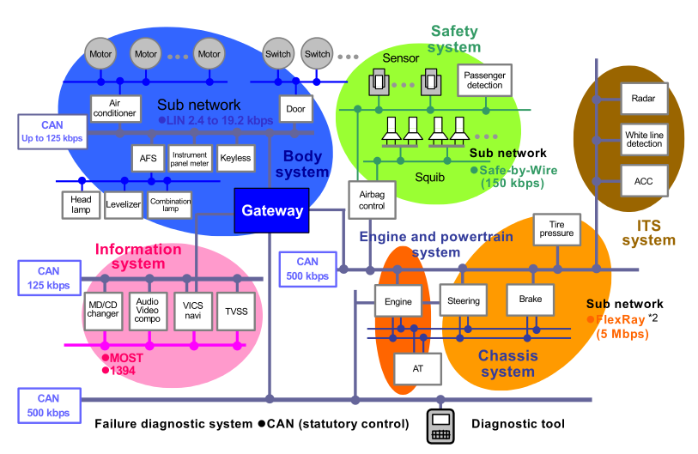
Wireless access to car allows penetration of its data network
Keyless entry
Wireless
tire pressure
FM radio

Slide 10
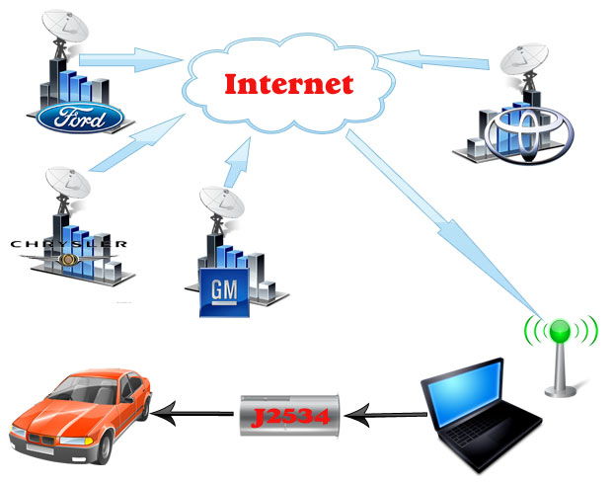
MA “Right to Repair” Initiative 2012

Slide 11
Who cares about vehicular data?
Car health report business: securely record mileage and “trouble codes” over entire history of a car, make available to used-car buyer
Personal environmental report card: integrate subscriber's automotive pollution data with their smart-meter data, credit card data, etc. to assess overall impact
Data-based vehicle routing: suggest route measured to be minimum-polluting or fastest at this time of day
Reality-based performance estimator: what range do other drivers see for this model E.V. on my route to Tahoe?

Slide 12
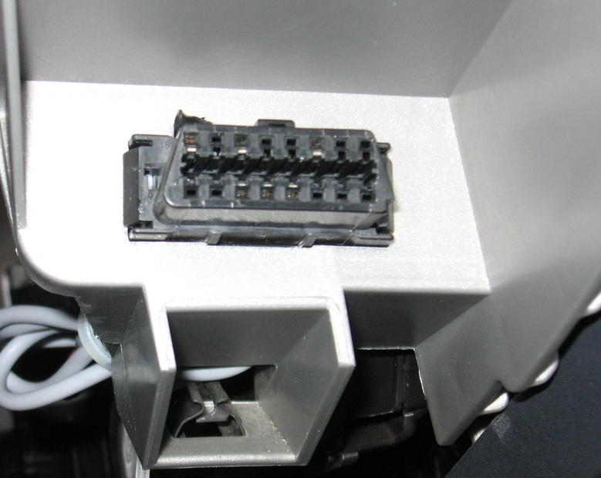
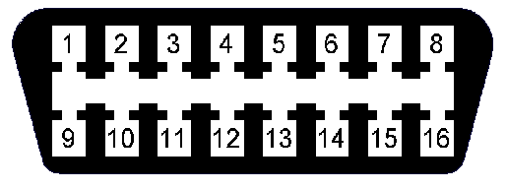
How to access a car's data
OBDII connector found in every
U.S. car since 1996.
COM
HS-CAN
LS-CAN
GND
Determine protocols in use
by examining populated pins.
2006 Mazda 3

Slide 13
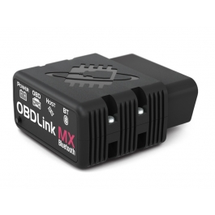
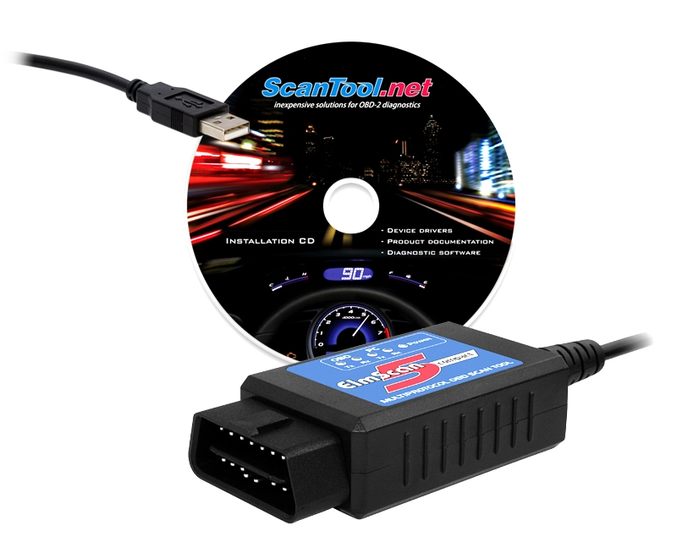
How to access a car's data: the scantool
Entry level: USB, limited protocol set,
read-only comms, $40
Experienced user: Bluetooth, expanded
protocols, some risk, $250
Scantool.net has great documentation and community support.

Slide 14
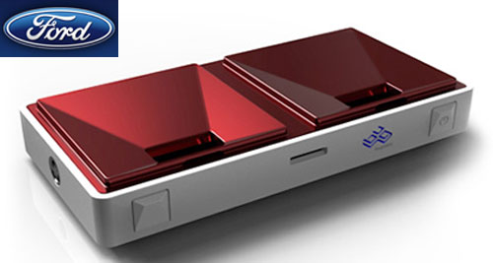
Ford and BugLabs' Android Dongle
32-bit ChipKit platform is Arduino-compatible at pin and API levels.

Slide 15
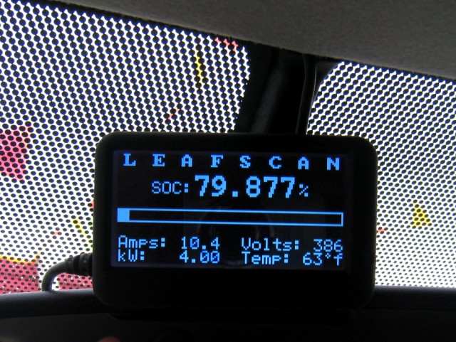
BayLeafs' State-of-Charge Display, Adopted by Nissan
http://tinyurl.com/7wngdsj, http://tinyurl.com/7ttz24h

Slide 16
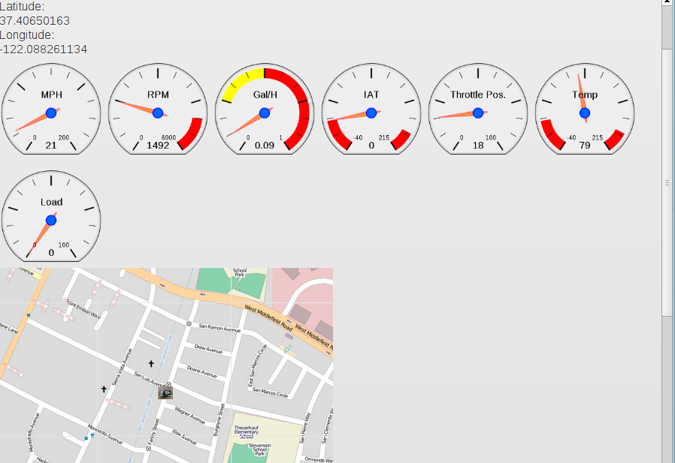
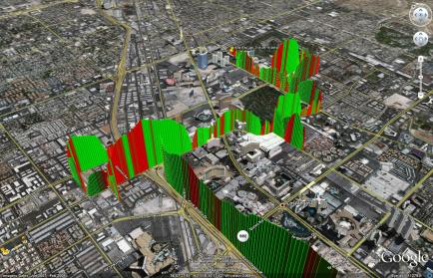
OpenICE cooperating projects
nOBDy
obdgpslogger
Simple installation: packaged for popular Linux distributions.

Slide 17
How can I get involved?
Ask an auto dealer, “What operating system does this car run?”
Support the Right to Repair movement.
Join one of many employers: engineer shortage!
Put cool open-source hardware or software in your car right now.
Roll your own HW or SW solution.
Join Silicon Valley Automotive Open Source or come by our booth #7658.

Slide 18
Summary
Smartphone and Internet privacy and security battles have come to cars.
We could lose our existing right to repair our own cars.
Or, cool stuff could be coming from developers and small businesses.
There are opportunities RIGHT NOW.
Come by Booth #? to learn more.

Slide 19
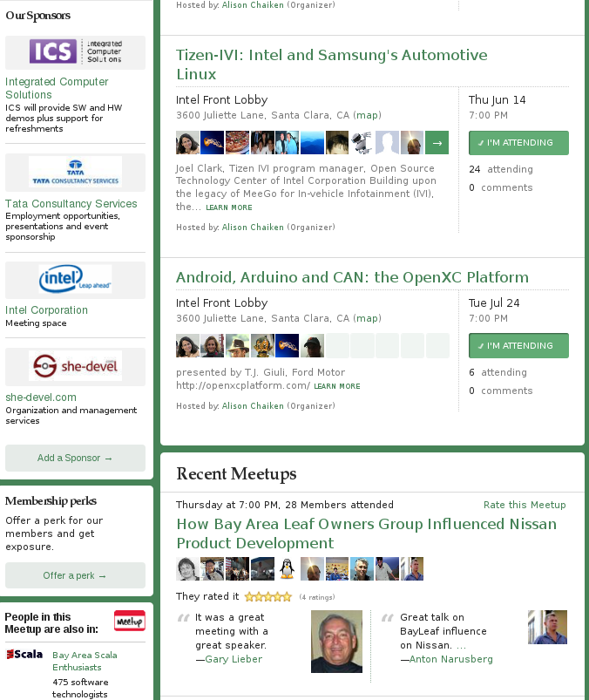
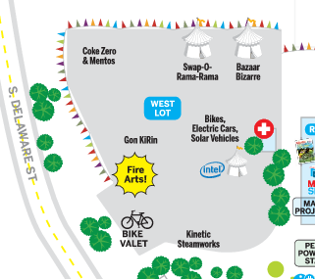
Silicon Valley Automotive Open Source Group
Free monthly meetings sponsored by ICS and Intel
Booth #7658

Slide 20
What does it mean to “own” data?
The creator of the device that generates data that I own must provide, as a bare minimum:
“any methods, procedures, authorization keys, or other information required” to read the data
and
“information provided [ . . . ] must be in a format that is publicly documented (and with an implementation available to the public in source code form), and must require no special password or key for unpacking, reading or copying.”

Slide 21
Privacy Guarantees in Car Environment
JM1BK3437512345678
Vehicle Identifier Section: a particular car
Proposal: encrypt the Vehicle Identifier Section of the VIN so that it cannot be remotely transmitted.
Require “apps” to request access to VIS.

Slide 22
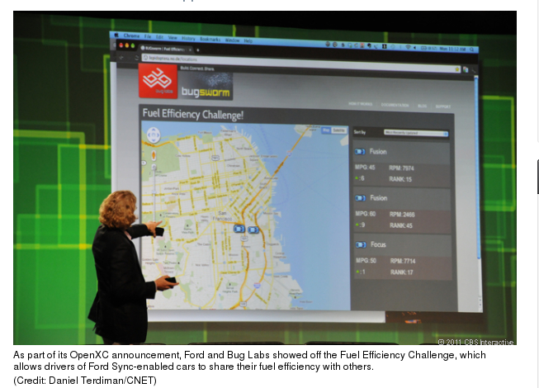
Vehicle data example: Ford's Fuel Efficiency Challenge
Owner-empowering vehicle-data-mining ideas: http://tinyurl.com/7oegrj7

Slide 23
Federal Motor Vehicle Owners Right to Repair Act
… requires vehicle manufacturers to provide the same service information to independent shops that they offer to their franchised dealers.… auto manufacturers protect their proprietary vehicle repair information, requiring consumers to bring their cars to the dealer for expensive repairs. … allows independent mechanics to compete fairly with dealerships …
Source: Congresswoman Anna Eshoo

Slide 24
Howto fix automotive security
Automotive network protocols genuinely do need to be hardened.
Virtualization-based security, packet filtering, firewalls, cryptographic signing and Android “paranoid network” already exist.
Any approach that posits the necessity to invent new technologies is wrong.
If NHTSA promulgates new rules, EFF, FSF, SFLC should participate!

Slide 25
Published UWa/UCSD automotive exploit
http://www.autosec.org/
Use Software-Defined Radio to break in via wireless tire pressure sensors (or FM radio, or keyless entry …).
http://www.ted.com/talks/avi_rubin_all_your_devices_can_be_hacked.html
Discover all of 8-byte codes by “fuzzing” attack or simply sniff bus traffic.
Brakes locked and driver controls disabled via use of codes or simple DOS attack.
But let's not make instrumenting our own vehicles illegal, too!

Slide 26
Ongoing mobile data privacy battle
“For crashes that don't involve litigation, especially when police or insurers are interested in assessing fault, insurers may be able to access the EDRs in their policyholders' vehicles based on provisions in the insurance contract requiring policyholders to cooperate with the insurer. However, some states prohibit insurance contracts from requiring policyholders to consent to access.”
Source: Insurance Institute for Highway Safety,
http://www.iihs.org/research/qanda/edr.html

Slide 27
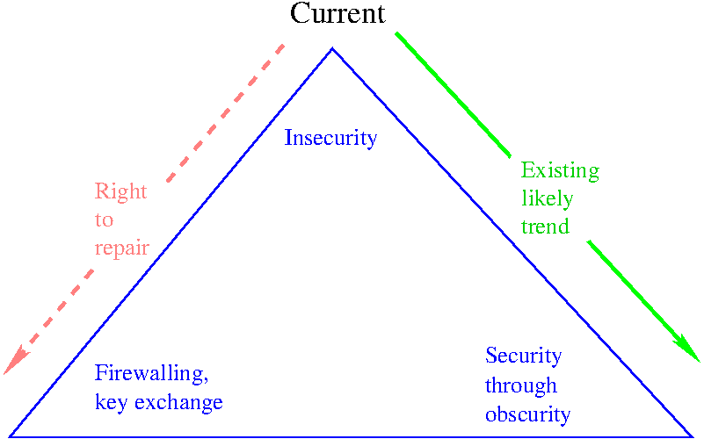
Free culture movement needs to get involved in automotive

Slide 28
CFR PART 563—EVENT DATA RECORDERS
“Each manufacturer of a motor vehicle equipped with an EDR shall ensure by licensing agreement or other means that a tool(s) is commercially available that is capable of accessing and retrieving the data stored in the EDR that are required by this part. The tool(s) shall be commercially available not later than 90 days after the first sale of the motor vehicle for purposes other than resale.”
source: NHTSA website

