Slide 1
Alison Chaiken
Nokia Mobility Solutions
Sunnyvale CA
alchaiken@gmail.com
BoF Session ELC 2011
MeeGo is a smallish Linux with extensive support for touch
whose UI is based on X11 and Qt.

Slide 2

Nokia
MeeGo
Community

Slide 3
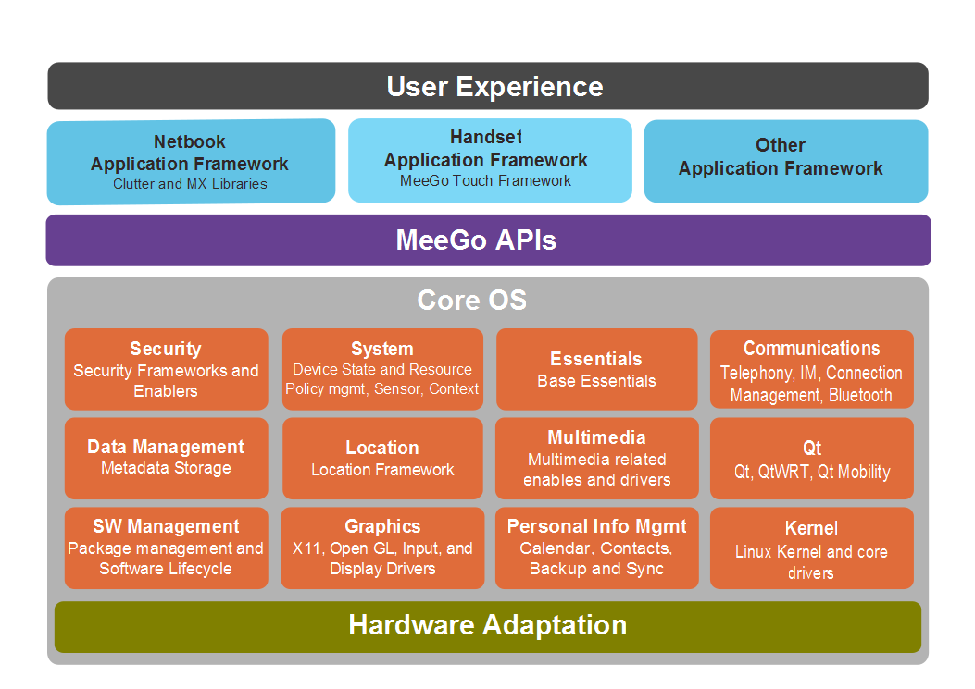

Slide 4
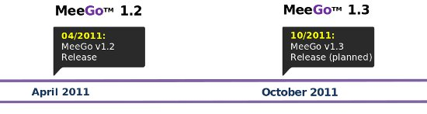
Core Roadmap for 2011
Still more or less on track . . .

Slide 5

Harmattan Handset Release in May
MeeGo 1.1
Maemo

Slide 6
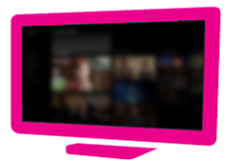




User Experiences
SmartTV
Tablet
IVI
Handset
?
Netbook
?
2009
2010
2011
2012

Slide 7
Arm | MeeGo | Linaro | Android
Organization | Linux Foundation auspices | UK non-profit | Industry consortium
Membership | No formal membership | Core, Club, Community | Unclear
Planning/gover-nance process | Open meetings on IRC + private | Board, TSGs meet in private | Private meetings of members
License | LGPL | “in line” with upstreams | Apache v2
Corporate participants | 16 (more or less) inc. Intel, TI, Nokia?, AMD, Fujitsu, Renesas | 6 “commercial”: ARM, Freescale, IBM, Samsung, ST Ericsson, TI | “over 80,” esp. Mentor in embedded
Supported architectures | Atom (x86) and ARMv7-A, MIPS in progress | ARMv7: Cortex A8, A9, & A15 | ARMv7-A, ARMv5, PowerPC, x86, MIPS
Shipping products | WeTab, IndaMixx, Amino STB | Not yet | legion

Slide 8
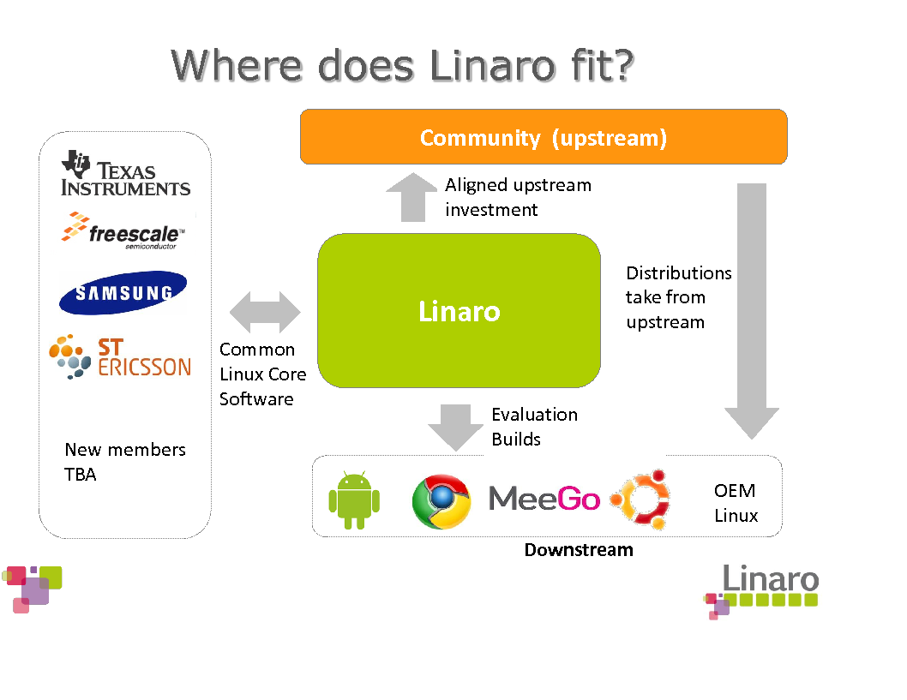

Slide 9


